Slide 1
Unit 11
Programming
ENHANCED EDITION

Slide 2
Unit Contents
Section A: Program Development
Section B: Programming Tools
Section C: Procedural Programming
Section D: Object-Oriented Code
Section E: Declarative Programming

Slide 3
Section A: Program Development
Programming Basics
Program Planning
Program Coding
Program Testing and Documentation

Slide 4
Programming Basics
Computer programming encompasses a broad set of activities that include planning, coding, testing, and documenting
A related activity, software engineering, is a development process that uses mathematical, engineering, and management techniques to reduce the cost and complexity of a computer program while increasing its reliability and modifiability
The instructions that make up a computer program are referred to as code because program instructions for first-generation computers were entered in binary codes

Slide 5
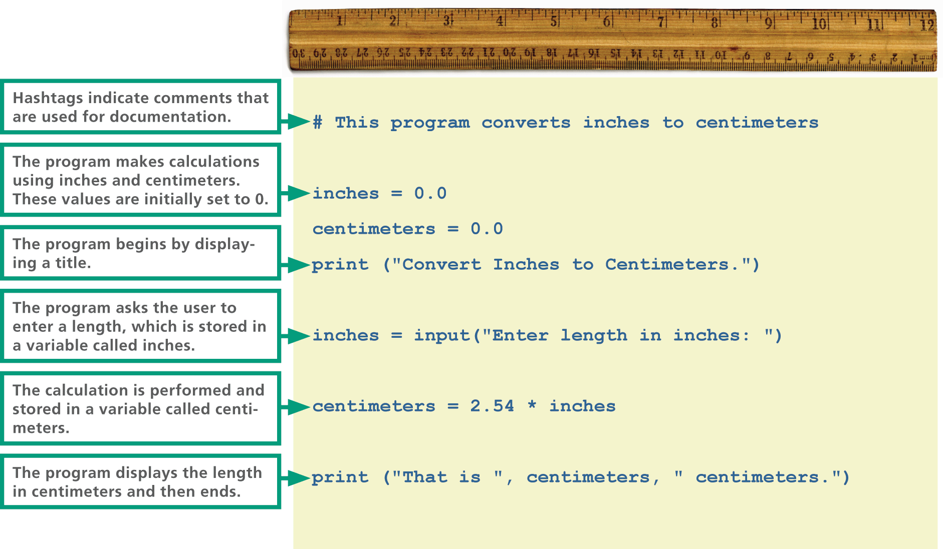
Programming Basics

Slide 6
Programming Basics
Programmers typically specialize in either application programming or system development
Application programmers create productivity applications such as Microsoft Office
Systems programmers specialize in developing system software such as operating systems, device drivers, security modules, and communications software

Slide 7
Program Planning
In the context of programming, a problem statement defines certain elements that must be manipulated to achieve a result or goal
A good problem statement for a computer program has three characteristics:
  It specifies any assumptions that define the scope of the problem
  It clearly specifies the known information
  It specifies when the problem has been solved

Slide 8
Program Planning
In a problem statement, an assumption is something you accept as true in order to proceed with program planning
The know information in a problem statement is the information that is supplied to the computer to help it solve a problem
After identifying the known information, a programmer must specify how to determine when the problem has been solved

Slide 9
Program Planning
Several software development methodologies exist to help program designers and coders plan, execute, and test software
Methodologies can be classified as predictive or agile
  A predictive methodology requires extensive planning and documentation up front; it’s used to construct buildings and assemble cars—tasks that are well defined and predictable
  An agile methodology focuses on flexible development and specifications that evolve as the project progresses

Slide 10
Program Coding
The core of a computer program is a sequence of instructions
A keyword, or command, is a word with a predefined meaning
Keywords differ depending on the programming language; there is a basic vocabulary that covers most necessary tasks

Slide 11
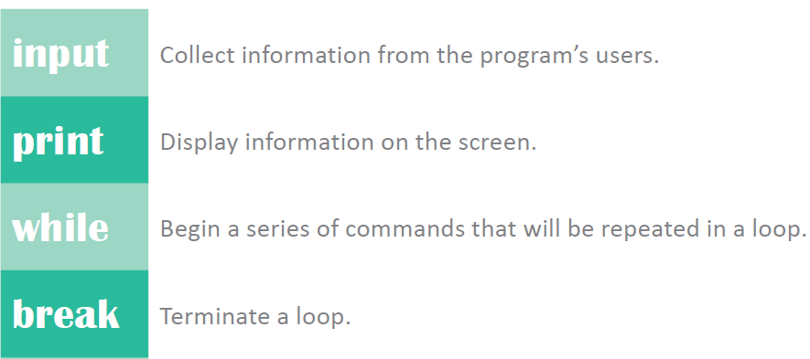
Program Coding
Cont…

Slide 12
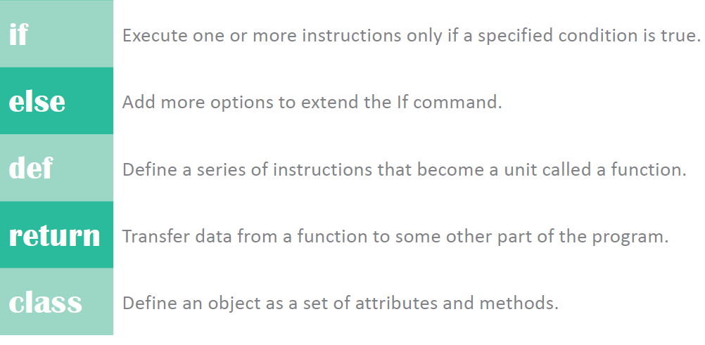
Program Coding

Slide 13
Program Coding
Keywords can be combined with specific parameters, which provide more detailed instructions for the computer to carry out
These parameters include variables and constants
  A variable represents a value that can change
  A constant is a factor that remains the same throughout a program

Slide 14
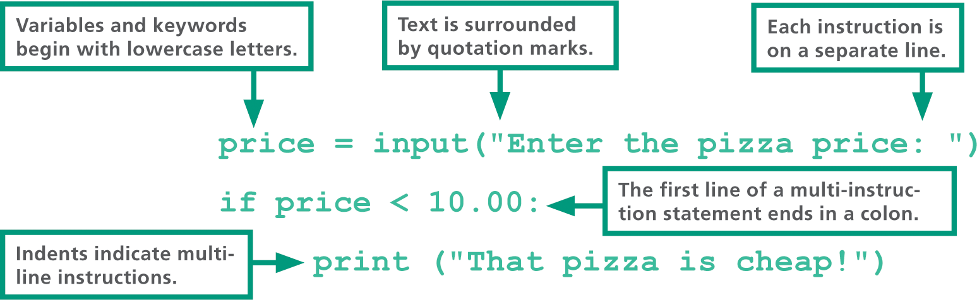
Program Coding
The set of rules that specify the sequence of keywords, parameters, and punctuation in a program instruction is referred to as syntax

Slide 15
Program Coding
You may be able to use a text editor, program editor, or graphical user interface to code computer programs
A text editor is any word processor that can be used for basic text editing tasks, such as writing email, creating documents, and coding computer programs
A program editor is a type of text editor specially designed for entering code for computer programs

Slide 16
Program Testing and Documentation
Programs that don’t work correctly might crash, run forever, or provide inaccurate results; when a program isn’t working, it’s usually the result of a runtime, logic, or syntax error
  A runtime error occurs when a program runs instructions that the computer can’t execute
  A logic error is a type of runtime error in the logic or design of the program
  A syntax error occurs when an instruction does not follow the syntax rules of the programming language

Slide 17
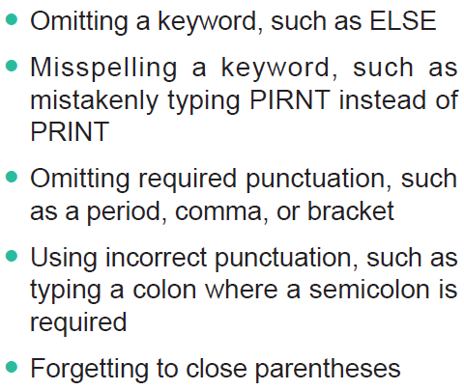

Program Testing and Documentation

Slide 18
Program Testing and Documentation
Programs need to meet performance, usability, and security standards
  Performance – programmers need to carry out real-world tests to ensure that programs don’t take too long to load
  Usability – programs should be easy to learn and use and be efficient
  Security – program specifications are formulated to so programmers remain aware of security throughout the software development life cycle

Slide 19
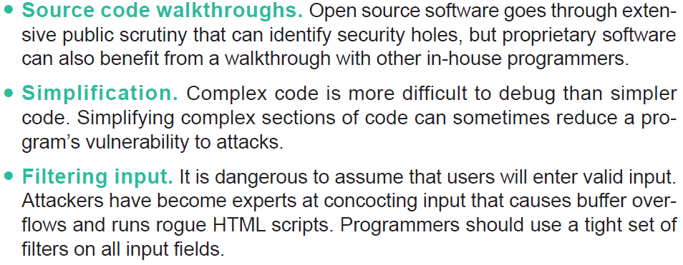
Program Testing and Documentation
Techniques associated with defensive programming include:

Slide 20
Section B: Programming Tools
Language Evolution
Compilers and Interpreters
Paradigms and Languages
Toolsets

Slide 21
Language Evolution
When applied to programming languages, abstraction inserts a buffer between programmers and the chip-level details of instruction sets and binary data representation
For programming languages, abstraction automates hardware-level details, such as how to move data from memory to the processor

Slide 22
Language Evolution
A low-level language has a low level of abstraction because it includes commands specific to a particular CPU or microprocessor family
A high-level language uses command words and grammar based on human languages to provide a level of abstraction that hides the underlying low-level language

Slide 23
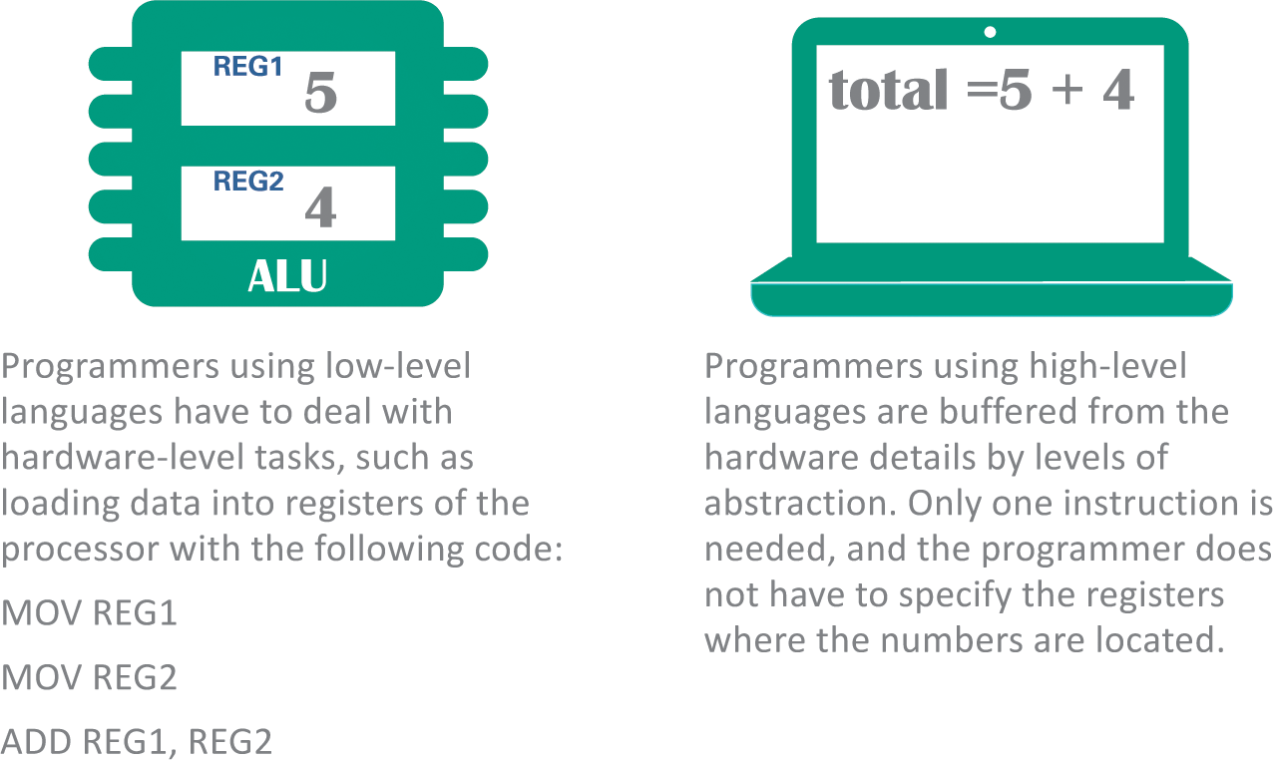
Language Evolution

Slide 24
Language Evolution
First-generation languages are the fist machine languages programmers used
Second-generation languages added a level of abstraction to machine languages by substituting abbreviated command words for binary numbers
Third-generation languages were conceived in the 1950s and used easy-to-remember command words, such as PRINT and INPUT

Slide 25
Language Evolution
An assembly language is classified as a low-level language because it is machine specific
An assembler typically reads a program written in an assembly language, which has two parts: the op code and the operand
  An op code, which is short for operation code, is a command word for an operation such as add, compare, or jump
  The operand for an instruction specifies the data for the operation

Slide 26
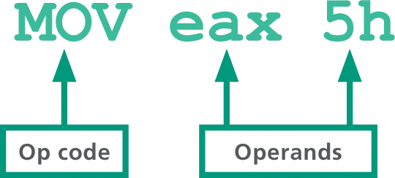
Language Evolution
Look at the parts of an assembly language shown in figure 11-15—consider how tedious it would be to write a program consisting of thousands of these concise, but cryptic, op codes:

Slide 27
Language Evolution
Fourth-generation languages are considered “high-level” languages, and more closely resemble human languages
The computer language Prolog, based on a declarative programming paradigm, is identified as a fifth-generation language—though some experts disagree with this classification

Slide 28
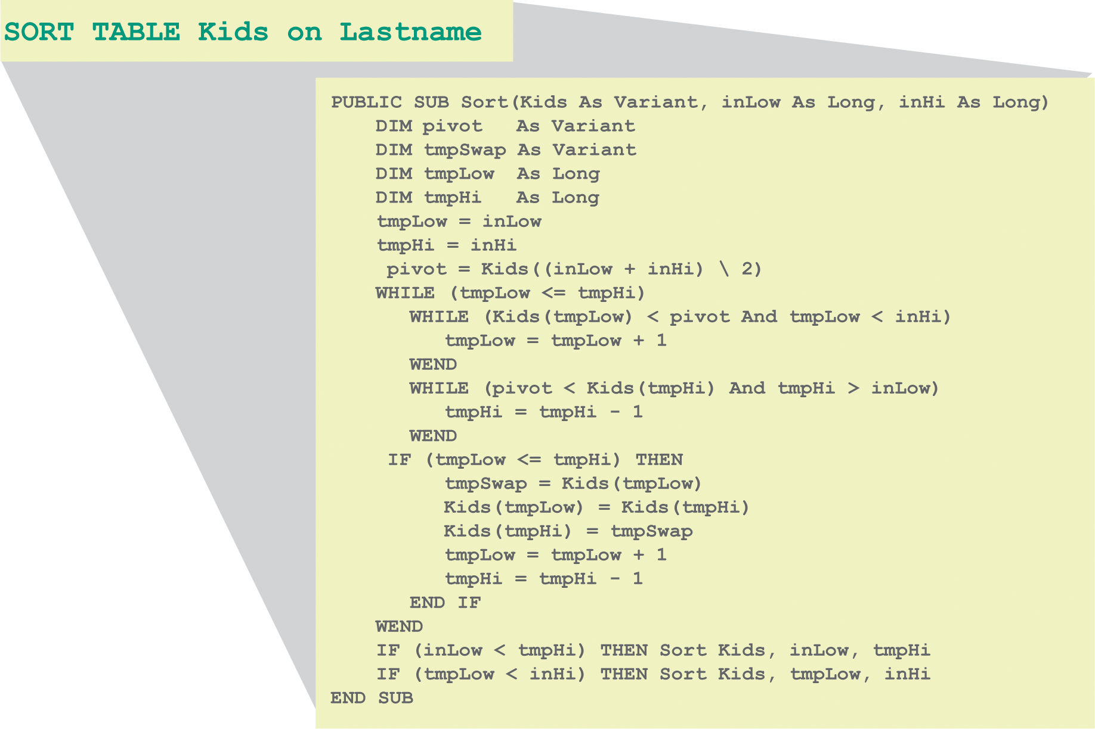
Language Evolution

Slide 29
Compilers and Interpreters
The human-readable version of a program created in a high-level language by a programmer is called source code
Source code must first be translated into machine language using a compiler or interpreter
  A compiler converts all the statements in a program in a single batch, and the resulting collection of instructions, called object code, is placed in a new file
  An interpreter converts and executes one statement at a time while the program is running; once executed, the interpreter converts and executes the next statement

Slide 30
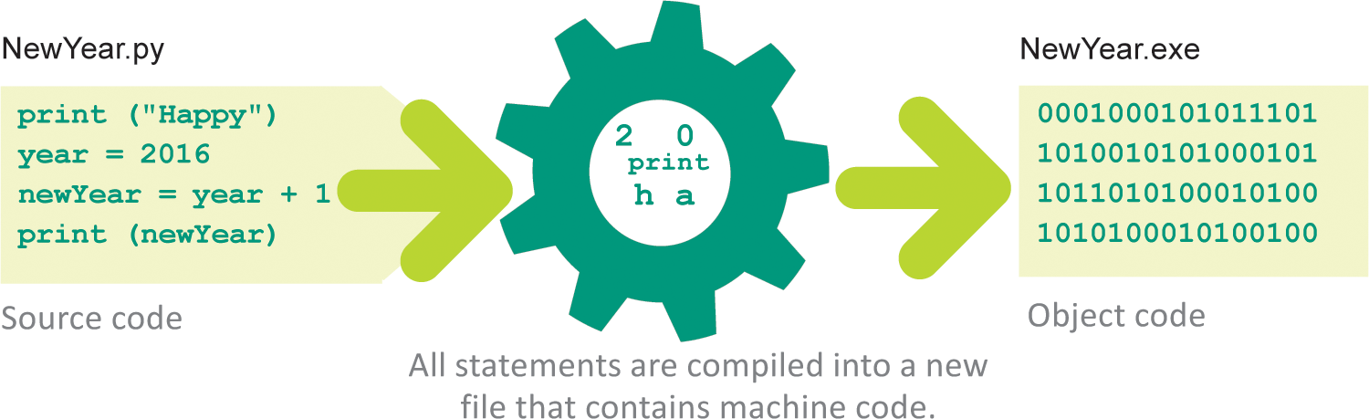
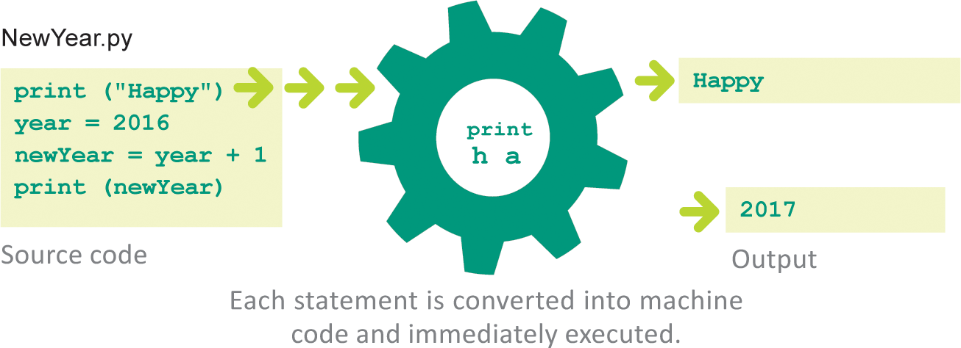
Compilers and Interpreters

Slide 31
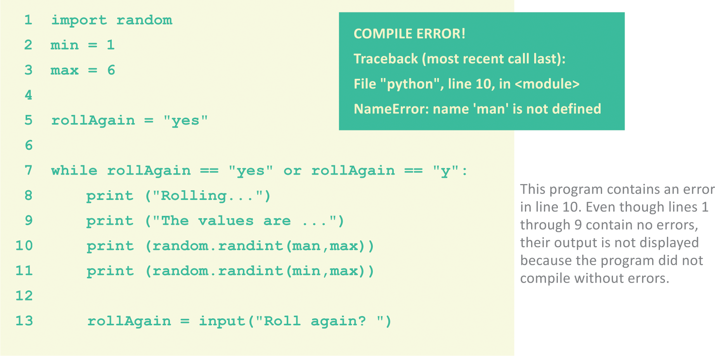
Compilers and Interpreters

Slide 32
Paradigms and Languages
The phrase programming paradigm refers to a way of conceptualizing and structuring the tasks a computer performs
A programmer uses a programming language that supports the paradigm
Other programming languages—referred to as mulitparadigm languages—support more than one paradigm

Slide 33
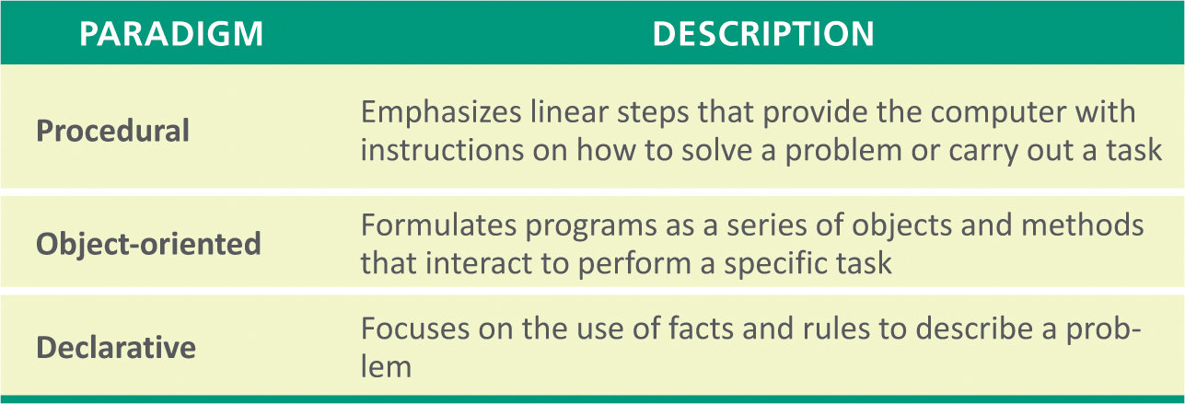
Paradigms and Languages

Slide 34
Paradigms and Languages
Programmers generally find it useful to classify languages based on the types of projects for which they are used
Some languages are used for Web programming; others for mobile apps, games, and enterprise applications
Some of the most commonly used programming languages include:
  Fortran
  LISP
  COBOL
  BASIC
  C
Ruby
Java
JavaScript
PHP
C#
Swift
Perl
Prolog
Ada
C++
Objective-C
Python
Visual Basic (VB)

Slide 35
Toolsets
Serious programmers typically download and install programming tools; their toolbox may include a compiler, a debugger, and an editor
Programmers often download an SDK or IDE that contains a collection of programming tools
  An SDK (software development kit) is a collection of language-specific programming tools that enables a programmer to develop applications for a specific computer platform
  An IDE (integrated development environment) is a type of SDK that packages a set of development tools into a sleek programming application

Slide 36
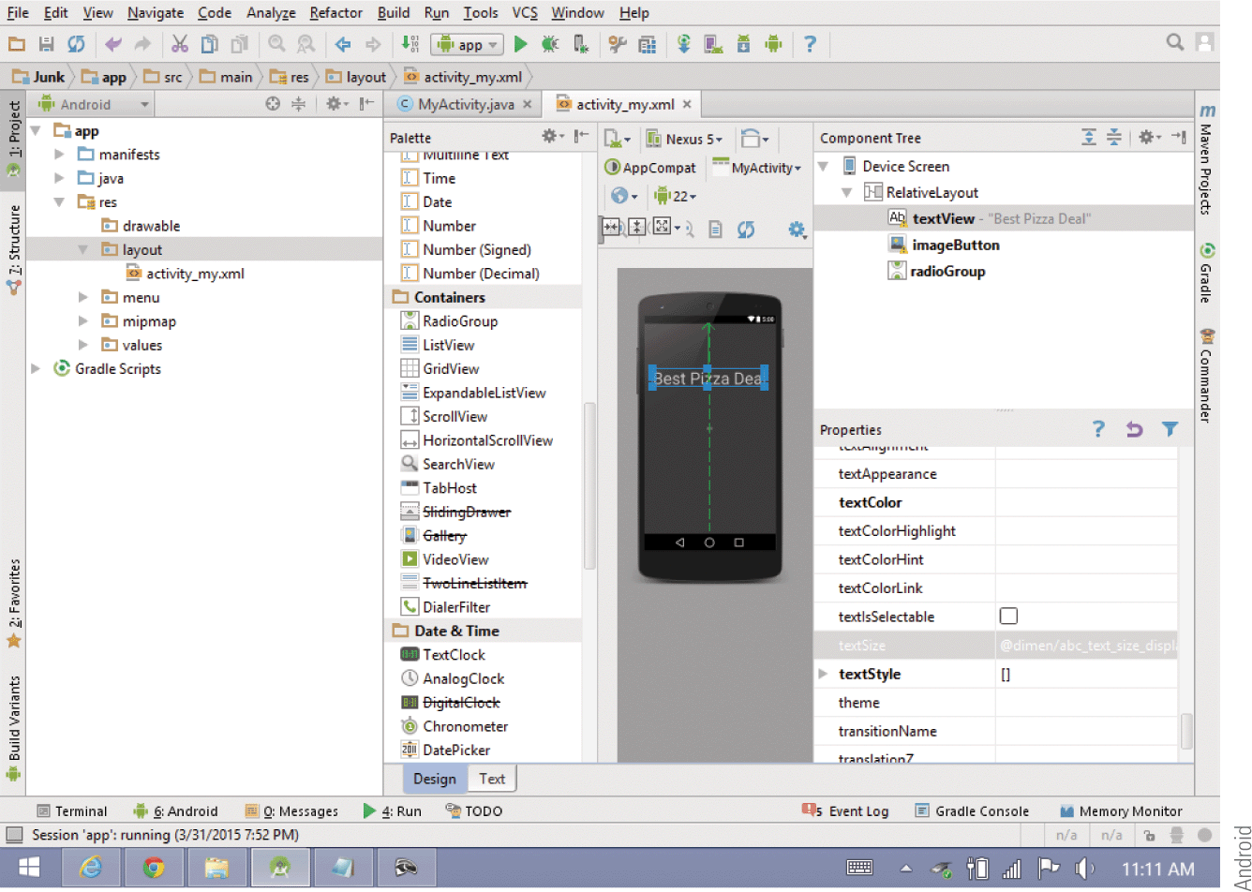
Toolsets

Slide 37
Section C: Procedural Programming
Algorithms
Pseudocode and Flowcharts
Flow Control
Procedural Applications

Slide 38
Algorithms
The traditional approach to programming uses a procedural paradigm (sometimes called an imperative paradigm) to conceptualize the solution to a problem as a sequence of steps
A programming language that supports the procedural paradigm is called a procedural language; these languages are well suited to problems that can easily be solved with a linear, step-by-step algorithm

Slide 39
Algorithms
An algorithm is a set of steps for carrying out a task that can be written down and implemented
For example, the algorithm for making macaroni and cheese is a set of steps that includes boiling water, cooking the macaroni in the water, and adding the cheese sauce
Algorithms are usually written in a format that is not specific to a particular programming language

Slide 40
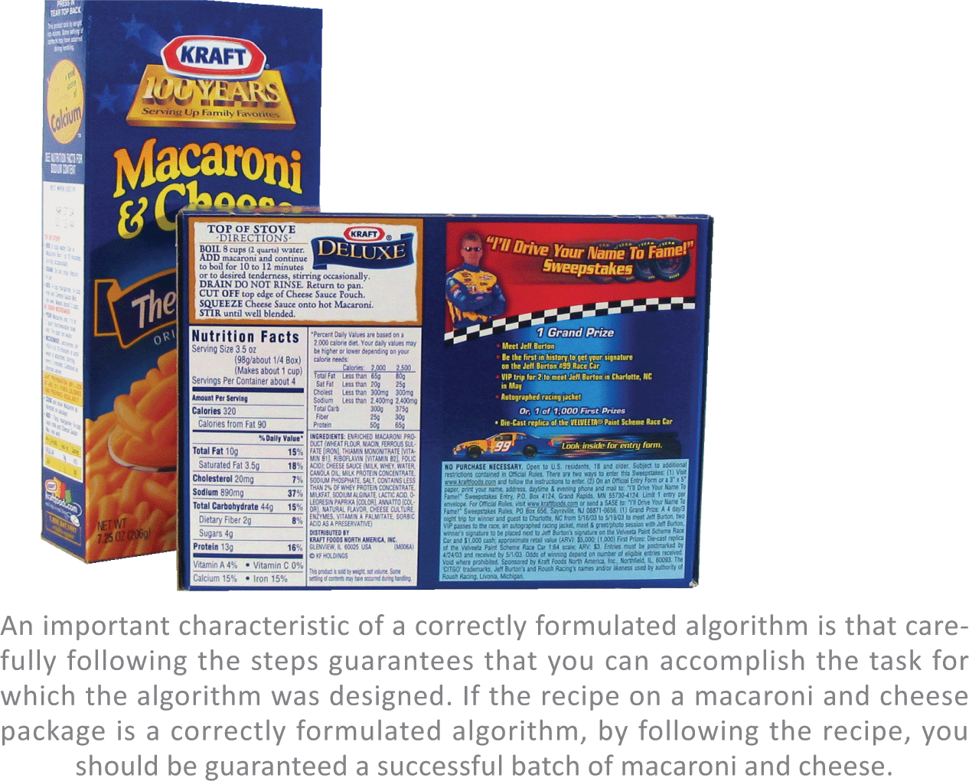
Algorithms

Slide 41
Algorithms
Steps for designing an algorithm:
  Record the steps required to solve the problem manually
  Specify how to manipulate the information needed to calculate and solve the problem
  Specify how the computer decides what to display as the solution

Slide 42
Pseudocode and Flowcharts
You can express an algorithm in several different ways, including structured English, pseudocode, and flowcharts
  Structured English is a subset of the English language with a limited selection of sentence structures that reflect processing activities
  Pseudocode is a notational system for algorithms that is less formal than a programming language
  A flowchart is a graphical representation of the way a computer should progress from one instruction to the next as it performs a task

Slide 43
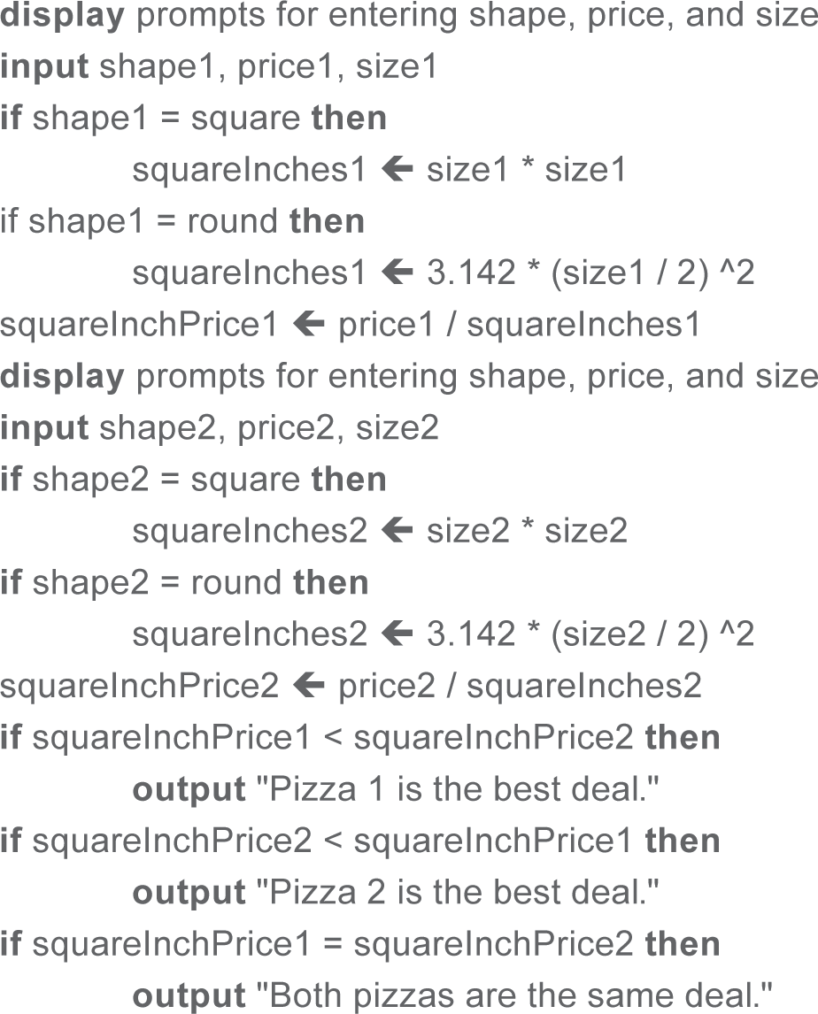
Pseudocode and Flowcharts

Slide 44
Flow Control
The key to a computer’s ability to adjust to so many situations is the programmer’s ability to control the flow of a program
Flow control refers to the sequence in which a computer executes program instructions
Programmers assign a sequential execution for computers to follow when performing program instructions

Slide 45
Flow Control
Here is a simple program written in the Python programming language that outputs This is the fist line. and then outputs This is the next line.:
  print (“This is the first line.”)
  print (“This is the next line.”)

Slide 46
Flow Control
A sequence control structure changes the order in which instructions are carried out by directing the computer to execute an instruction elsewhere in the program
In the following simple program, a goto command tells the computer to jump directly to the instruction labeled “Widget”:
  print (“This is the first line.”)
  goto Widget
  print (“This is the next line.”)
  Widget: print (“All done!”)

Slide 47
Flow Control
A function is a section of code that is part of a program but is not included in the main sequential execution path; a sequence control structure directs the computer to the statements contained in a function—when the statements have been executed, the computer returns to the main program

Slide 48
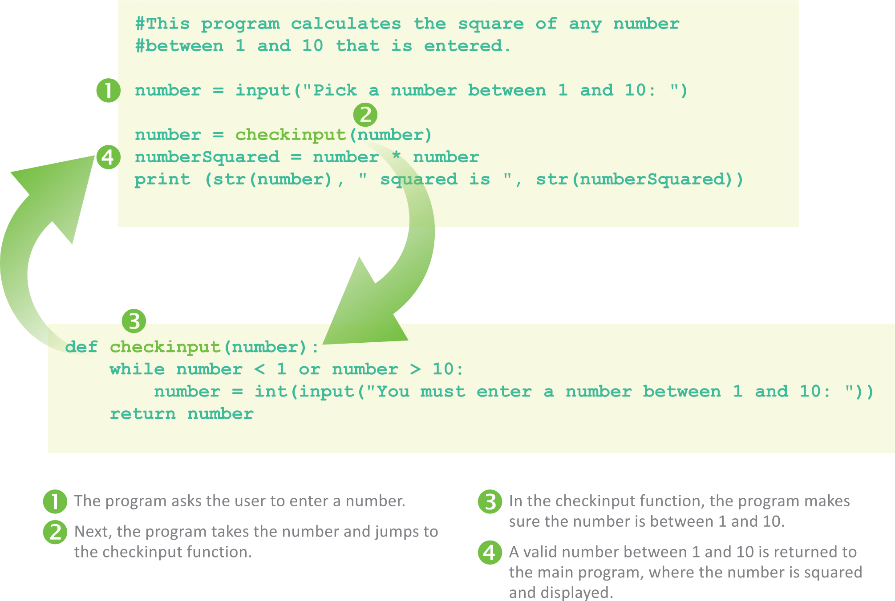
Flow Control

Slide 49
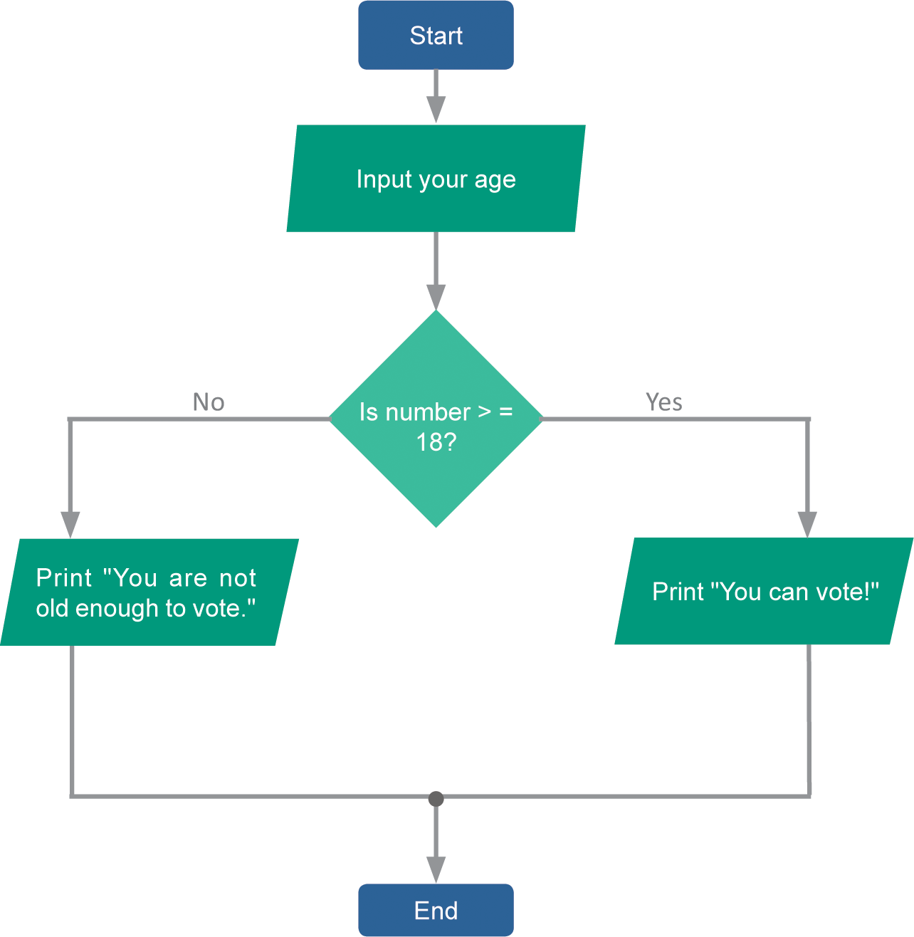
Flow Control
A selection control structure tells a computer what to do based on whether a condition is true or false; a simple example of a selection control structure is the if…else command

Slide 50
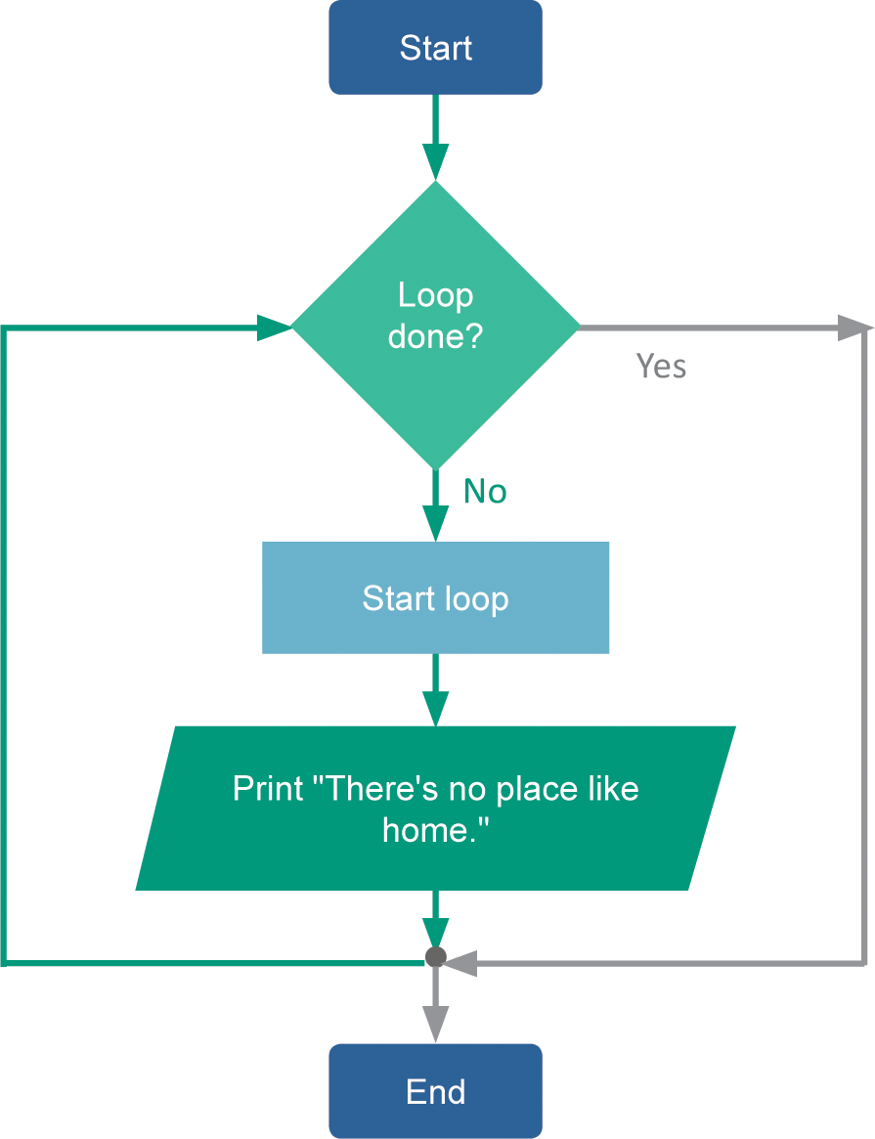
Flow Control
A repetition control structure directs the computer to repeat one or more instructions until a certain condition is met
The selection of code that repeats is usually referred to as a loop or an iteration

Slide 51
Procedural Applications
Procedural languages encourage programmers to approach problems by breaking the solution down into a series of steps; the earliest programming languages were procedural
The procedural approach is best used for problems that can be solved by following a step-by-step algorithm
Programs using the procedural approach tend to run quickly and use system resources efficiently
The procedural paradigm is quite flexible and powerful, which allows programmers to apply it to many types of problems

Slide 52
Section D: Object-Oriented Code
Objects and Classes
Inheritance
Methods and Messages
OO Program Structure
OO Applications

Slide 53
Objects and Classes
The object-oriented (OO) paradigm is based on objects and classes that can be defined and manipulated by program code
It is based on the idea that the solution for a problem can be visualized in terms of objects that interact with each other
Rather than envisioning a list of steps, programmers envision a program as data objects that essentially network with each other to exchange data

Slide 54
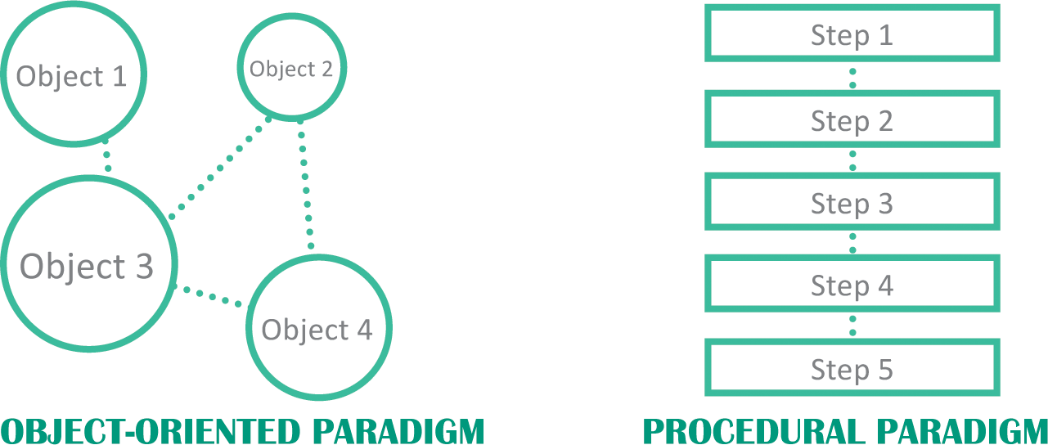
Objects and Classes

Slide 55
Objects and Classes
In the context of the OO paradigm, an object is a unit of data that represents an abstract or real-world entity, such as a person, place, or thing
Whereas an object is a single instance of an entity, a class is a template for a group of objects with similar characteristics

Slide 56
Objects and Classes
A class attribute defines the characteristics of a set of objects
Each class attribute generally has a name, scope, and data type; its scope can be defined as public or private
  A public attribute is available for use by any routine in the program
  A private attribute can be accessed only from the routine in which it is defined

Slide 57
Inheritance
In OO jargon, inheritance refers to passing certain characteristics from one class to other classes
The process of producing new classes with inherited attributes creates a class hierarchy that includes superclass and subclasses
  A superclass is any class from which attributes can be inherited
  A subclass (or derived class) is any class that inherits attributes from a superclass

Slide 58
Methods and Messages
In an OO program, the objects interact; programmers specify how they interact by creating methods
A method is a segment of code that defines an action; the names of methods end in a set of parenthesis, such as compare() or getArea()
The code that is contained in a method may be a series of steps similar to code segments in procedural programs

Slide 59
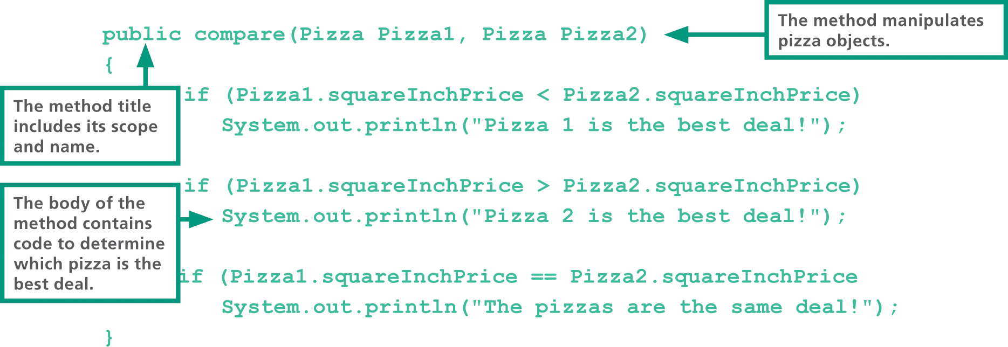
Methods and Messages

Slide 60
Methods and Messages
A method is activated by a message, which is included as a line of program code that is sometimes referred to as a call
In the OO world, objects often interact to solve a problem by sending and receiving messages
Polymorphism, sometimes called overloading, is the ability to redefine a method in a subclass; it provides OO programmers with easy extensibility and can help simplify program control structures

Slide 61
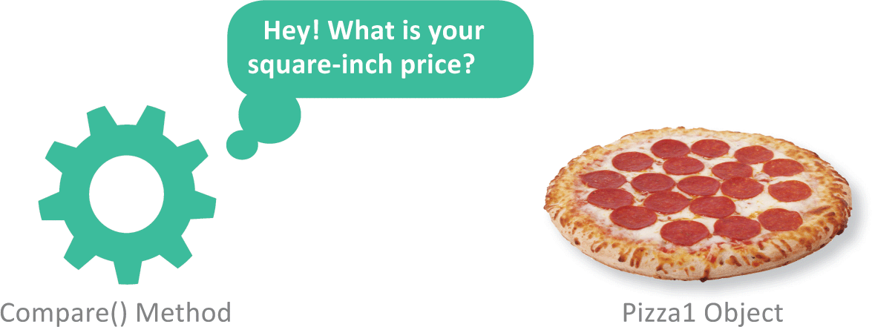
Methods and Messages

Slide 62
OO Program Structure
For classes and methods to fit together they must be placed within the structure of a Java program, which contains class definitions, defines methods, initiates the comparison, and outputs results
The computer begins executing a Java program by locating a standard method called main(), which contains code to send messages to objects by calling methods

Slide 63
OO Applications
In 1983, OO features were added to the C programming language, and C++ emerged as a popular tool for programming games and applications
Java was originally planned as a programming language for consumer electronics, but it evolved into an OO programming platform for developing Web applications
Most of today’s popular programming languages, such as Java, C++, Swift, Python, and C#, include OO features

Slide 64
Section E: Declarative Programming
The Declarative Paradigm
Prolog Facts
Prolog Rules
Interactive Input
Declarative Logic
Declarative Applications

Slide 65
The Declarative Paradigm
The declarative paradigm describes aspects of a problem that lead to a solution
Programmers using declarative languages write code that declares, or states, facts pertaining to a program

Slide 66
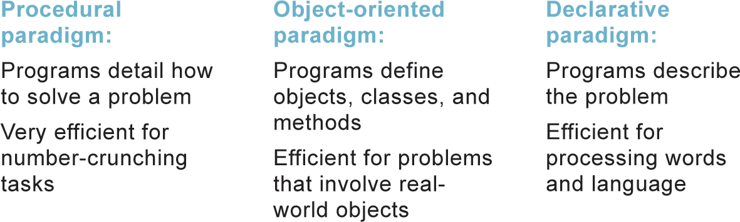
The Declarative Paradigm

Slide 67
The Declarative Paradigm
The programming language Prolog uses a collection of facts and rules to describe a problem
In the context of a Prolog program, a fact is a statement that provides the computer with basic information for solving a problem; a rule is a general statement about the relationship between facts

Slide 68
Prolog Facts
Prolog programming is easy to use; the punctuation mainly consists of periods, commas, and parentheses, so programmers don’t have to track levels and levels of curly brackets
The words in the parentheses are called arguments, which represent one of the main subjects that a fact describes

Slide 69
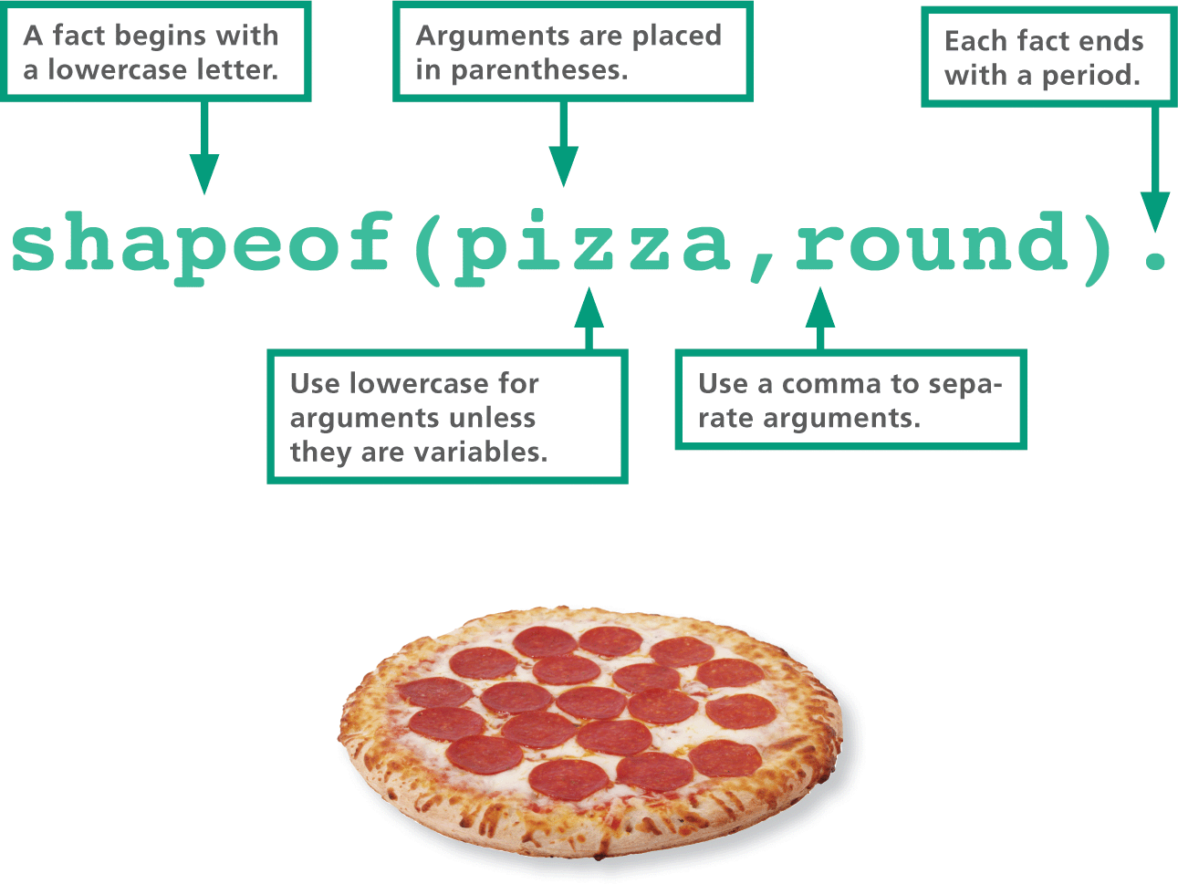
Prolog Facts

Slide 70
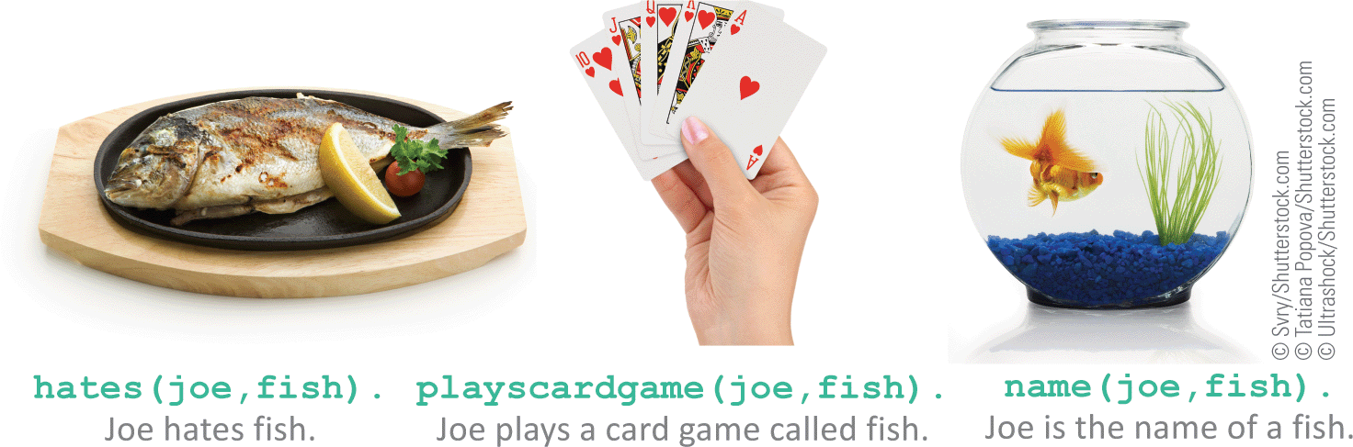
Prolog Facts
The word outside the parentheses is called a predicate and describes the relationship between the arguments

Slide 71
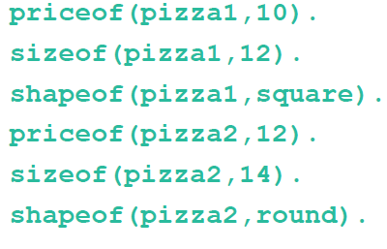
Prolog Facts
Each fact in a Prolog program is similar to a record in a database, but you can query a Prolog program’s database by asking a question, called a goal
As an example, the following facts can easily be queried by entering goals:

Slide 72
Prolog Rules
With just facts and goals, Prolog would be nothing more than a database
The addition of rules gives programmers a set of tools to manipulate the facts
Unlike other programming languages, the order or sequence of rules in a Prolog program is usually not critical to making sure the program works

Slide 73
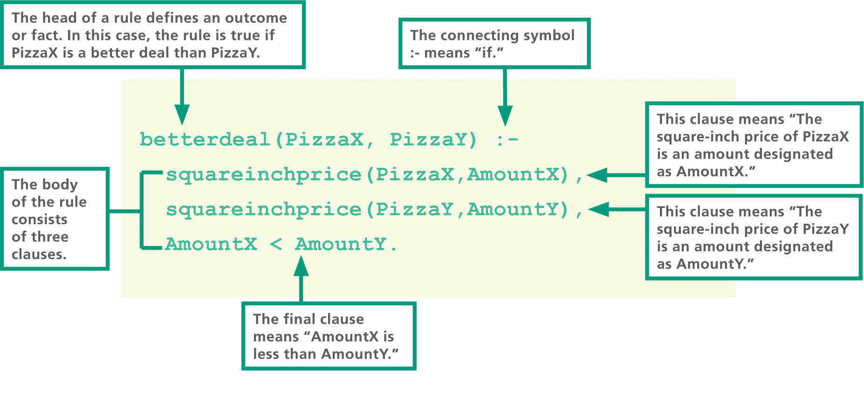
Prolog Rules

Slide 74
Interactive Input
In order for programmers to collect input from the user, they can use read and write statements
Read and write predicates collect user input
Prolog uses the write predicate to display a prompt for input
The read predicate gathers input entered by the user, and then creates a fact

Slide 75
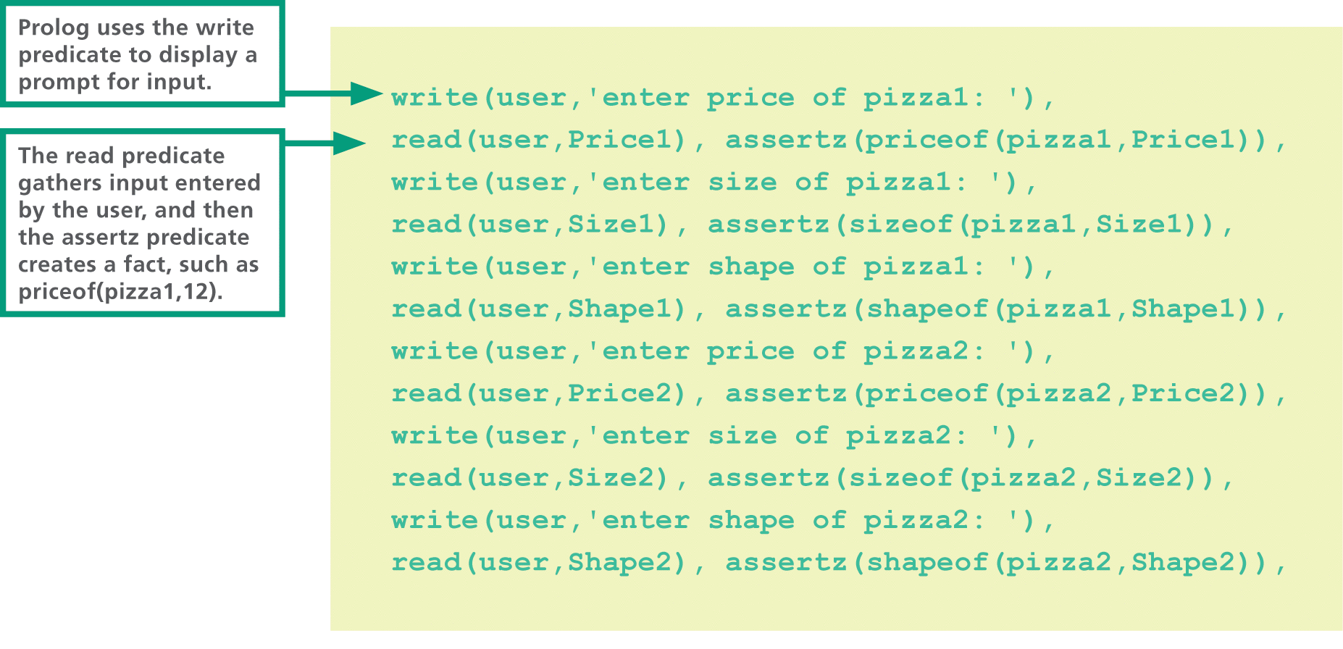
Interactive Input

Slide 76
Declarative Logic
Programmers need to determine how many conditions will apply to a program before starting to code facts and rules
A decision table is a tabular method for visualizing and specifying rules based on multiple factors
The decision table lays out the logic for the factors and actions and allows the programmer to see the possible outcomes

Slide 77
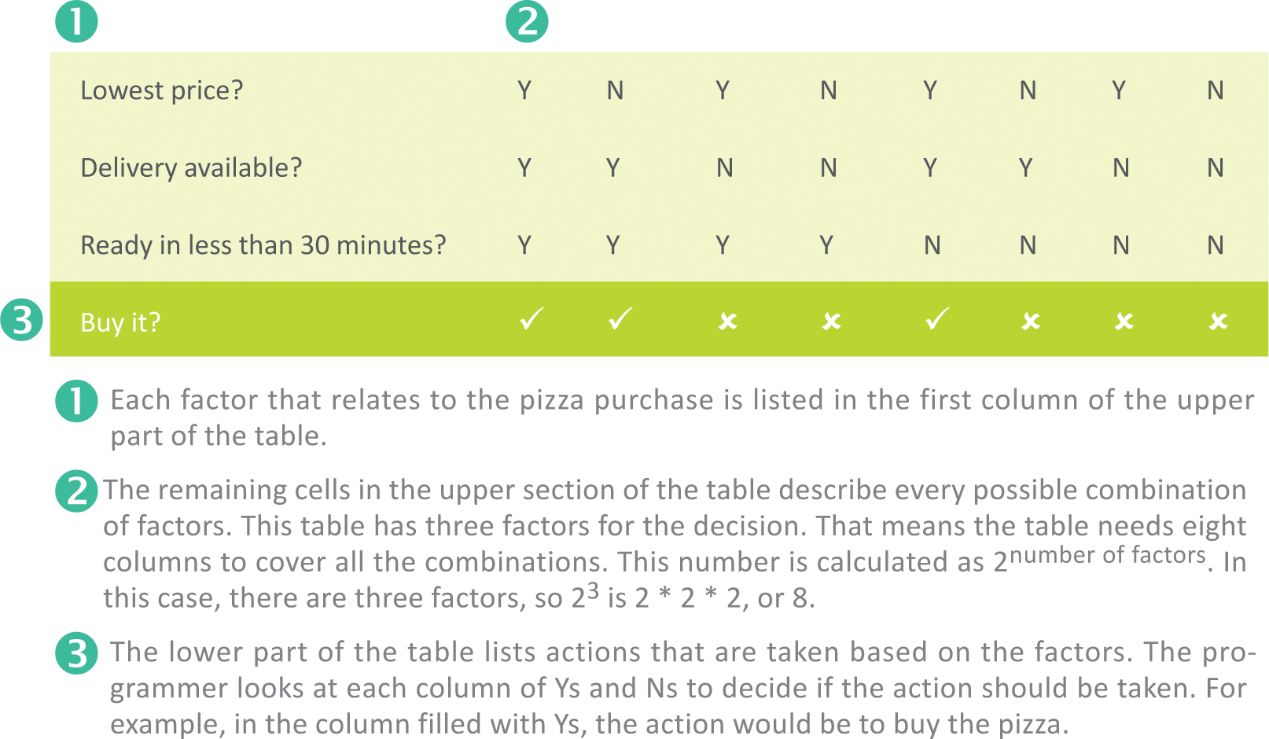
Declarative Logic

Slide 78
Declarative Applications
As a general rule, declarative programming languages are most suitable for problems that pertain to words and concepts rather than to numbers
Declarative languages offer a highly effective programming environment for problems that involve words, concepts, and complex logic
One of the disadvantages of declarative languages is that they are not commonly used for production applications—today’s emphasis on the OO paradigm has pushed declarative languages out of the mainstream, both in education and in the job market

Slide 79
Unit 11 Complete

