Slide 1
Unit 7
Digital Security
ENHANCED EDITION

Slide 2
Unit Contents
Section A: Unauthorized Use
Section B: Malware
Section C: Online Intrusions
Section D: Interception
Section E: Social Engineering

Slide 3
Section A: Unauthorized Use
Encryption
Authentication
Strong Password
Password Managers

Slide 4
Encryption
Encryption transforms a message or data file in such a way that its contents are hidden from unauthorized readers
An original message or file that has not yet been encrypted is referred to as plaintext or cleartext
An encrypted message or file is referred to as ciphertext
The process of converting plaintext into ciphertext is called encryption; the reverse process—converting ciphertext into plaintext—is called decryption

Slide 5
Encryption
Data is encrypted by using a cryptographic algorithm and a key
  A cryptographic algorithm is a procedure for encryption or decryption
  A cryptographic key (usually just called a key) is a word, number, or phrase that must be known to encrypt or decrypt data
  There are various encryption methods, and some are more secure than others; AES (Advanced Encryption Standard) is the encryption standard currently used worldwide

Slide 6
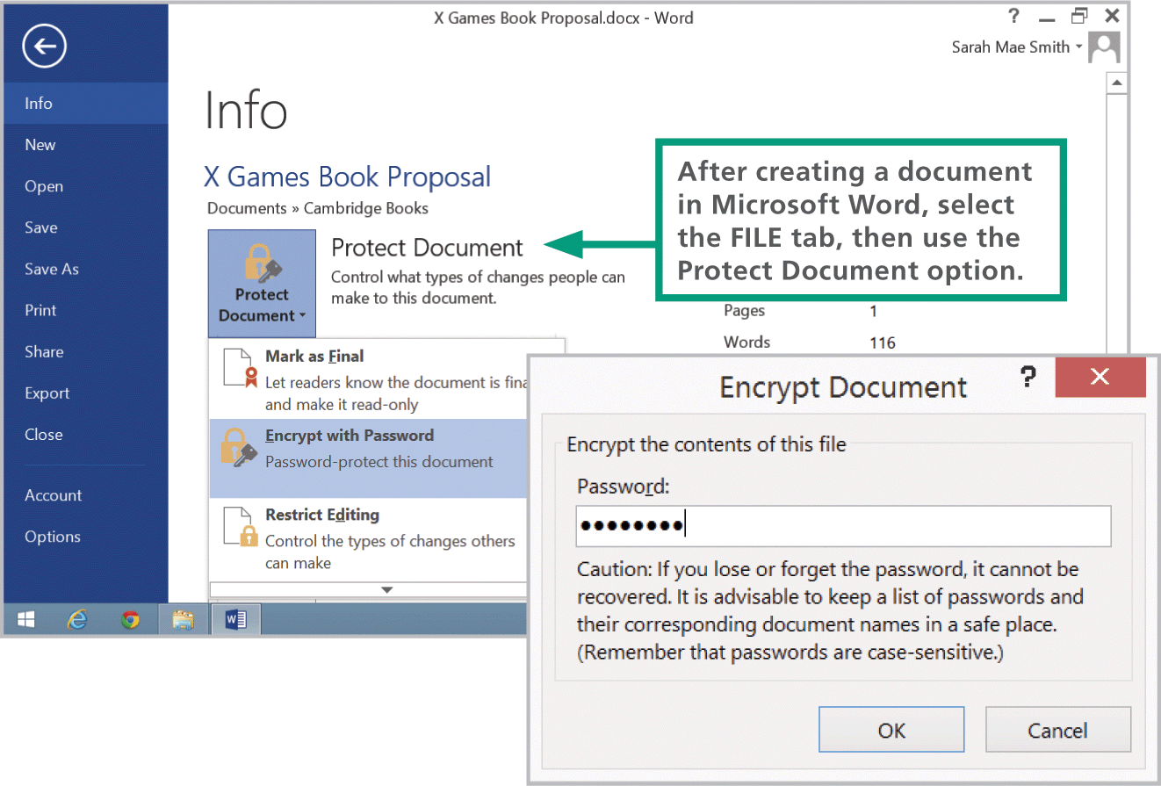
Encryption

Slide 7
Authentication
Authentication protocols, such as passwords, PINs, and fingerprint scanners, are the first line of defense against data thieves and snoopers
iPhones and iPads should be configured to require a login password, called a passcode, each time the device is used; the standard iOS security setting establishes a four-digit numeric passcode, similar to a PIN (personal identification number)
Android devices have an overwhelming number of security settings; Android devices do not automatically encrypt data stored on the device when a user activates the login password; configuring a password and activating encryption are two separate steps

Slide 8
Authentication
Windows offers several password options that can be configured using the Accounts utility, which is accessed from the Start menu or Control panel; Windows devices can be encrypted using Microsoft’s BitLocker or third party utilities
Macs offer several password settings, which are accessed from the Security & Privacy preferences; a feature called Automatic Login allows access to a device without a password

Slide 9
Strong Passwords
A strong password is difficult to hack; conventional wisdom tells us that strong passwords are at least eight characters in length and include one or more uppercase letters, numbers, and symbols

Slide 10
Strong Passwords
A brute force attack uses password-cracking sortware to generate every possible combination of letters, numerals, and symbols; because it exhausts all possible combinations to discover a pssword, it can run for days before a password is cracked
A dictionary attack helps hackers guess your password by stepping through a dictionary containing word lists in common languages such as English, Spanish, French, and German

Slide 11
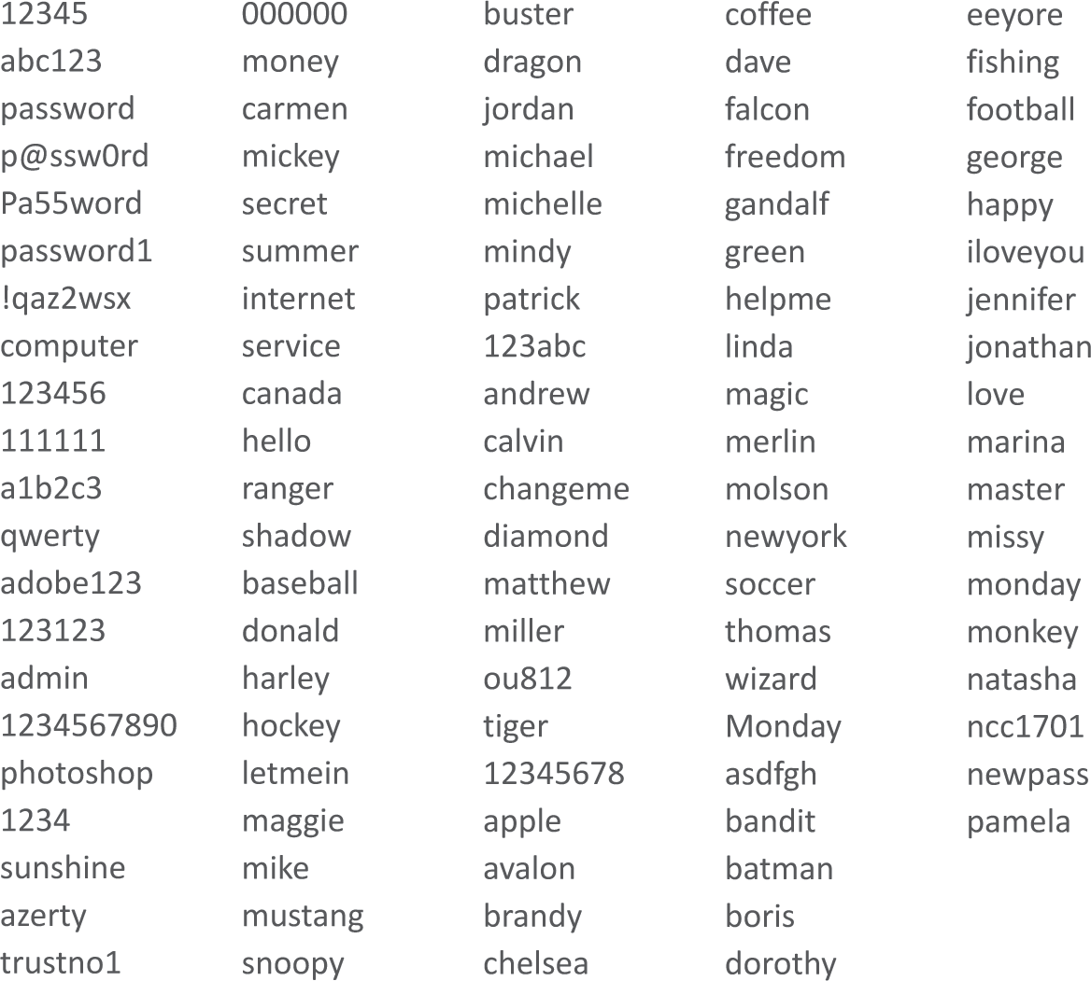
Strong Passwords
Dictionary attacks are effective because many users choose passwords that are easy to remember and likely to be in the most commonly used list

Slide 12
Strong Passwords
Many of the clever schemes users devise to create passwords are obvious to hackers and the programmers who create password cracking tools
Weak passwords include the following:

Slide 13
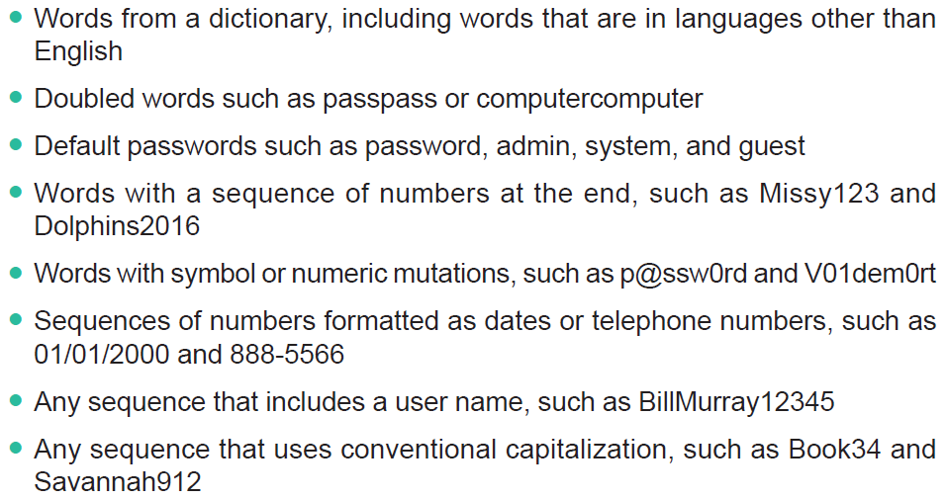
Strong Passwords

Slide 14
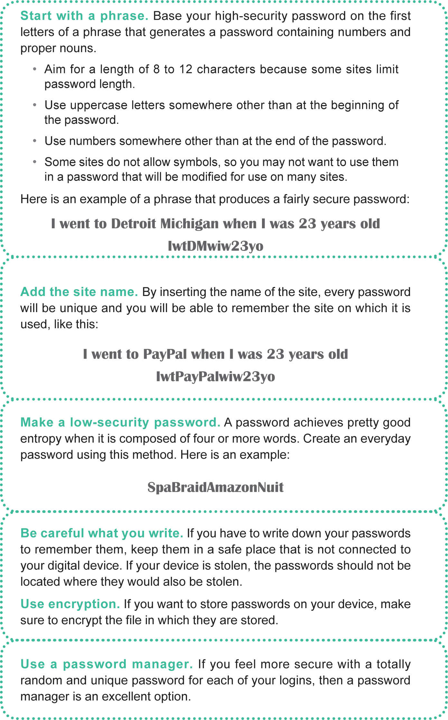
Strong Passwords

Slide 15
Strong Passwords

Slide 16
Password Managers
The core function of a password manager (sometimes called a keychain) is to store user IDs with their corresponding passwords
Password managers may also include a strength meter that indicates password security—a feature that is useful if you create a custom password rather than using one generated by the password manager

Slide 17
Section B: Malware
Malware Threats
Computer Viruses
Computer Worms
Trojans
Antivirus Software

Slide 18
Malware Threats
Malware refers to any computer program designed to surreptitiously enter a digital device
The action carried out by malware code is referred to as a payload
Common classifications of malware include:
  Viruses
  Worms
  Trojans

Slide 19
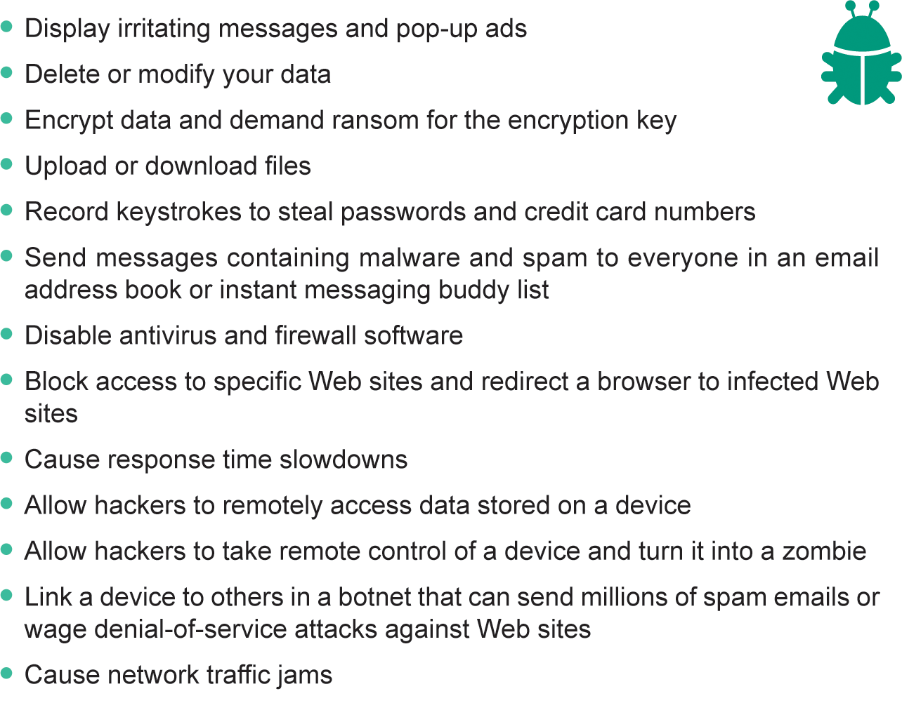
Malware Threats

Slide 20
Computer Viruses
A computer virus is a set of self-replicating program instructions that surreptitiously attaches itself to a legitimate executable file on a host device
Today, viruses are a mild threat; they do not spread rapidly, and they are easily filtered out by antivirus software
Viruses reveal the basic techniques that are still used to inject third-party code into legitimate data streams
Code injection is the process of modifying an executable file or data stream by adding additional commands

Slide 21
Computer Viruses
Viruses spread when people exchange infected files on disks and CDs, as email attachments, and on file sharing networks; they can also be inadvertently obtained from unauthorized app stores
Through a process called side-loading, an app from a source other than an official app store is installed on a device
Any code that is designed to hide the existence of processes and privileges is referred to as a rootkit; these were originally designed to allow “root” or administrative access to digital devices and computer systems

Slide 22
Computer Worms
A computer worm is a self-replicating, self-distributing program designed to carry out unauthorized activity on a victim's device
A mass-mailing worm spreads by sending itself to every address in the address book of an infected device
An internet worm looks for vulnerabilities in operating systems, open communication ports, and JavaScripts on Web pages
A file-sharing worm copies itself into a shared folder under an innocuous name

Slide 23
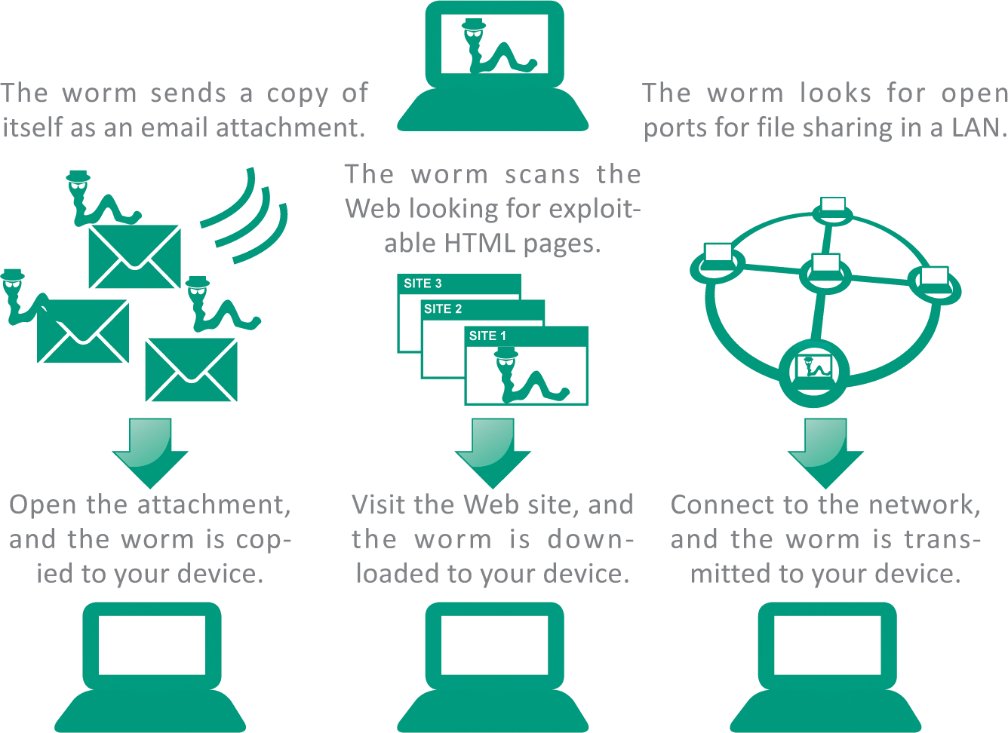
Computer Worms

Slide 24
Trojans
A trojan (sometimes called a “Trojan Horse”) is a computer program that seems to perform one function while actually doing something else; most trojans are not designed to replicate themselves
A dropper is designed to deliver or “drop” malicious code into a device; they are usually the first phase of a sophisticated malware attack

Slide 25
Antivirus Software
Antivirus software is a type of utility software that looks for and eliminates viruses, trojans, worms, and other malware
A virus signature is a section of program code that contains a unique series of instructions known to be part of a maleware exploit; they are discovered by security experts who examine the bit sequences contained in malware program code

Slide 26
Antivirus Software
Antivirus software can use techniques called heuristic analysis to detect malware by analyzing the characteristics and behavior of suspicious files
Heuristics may produce false positives that mistakenly identify a legitimate file as malware

Slide 27
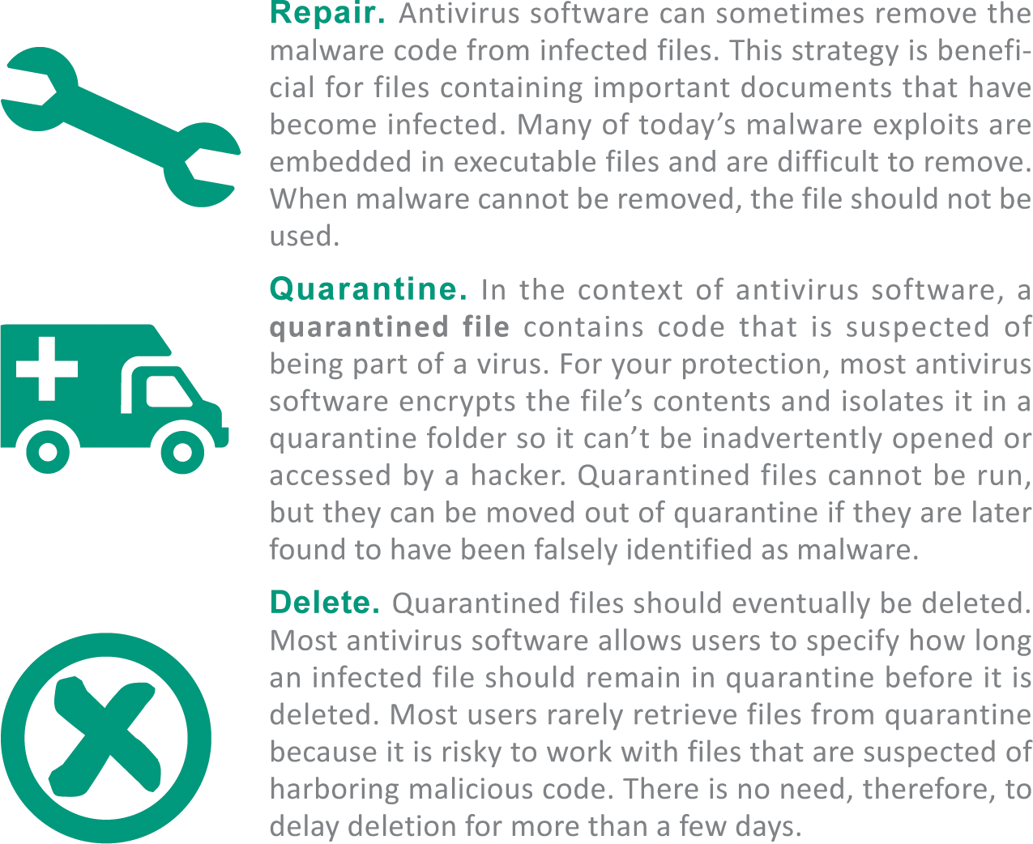
Antivirus Software

Slide 28
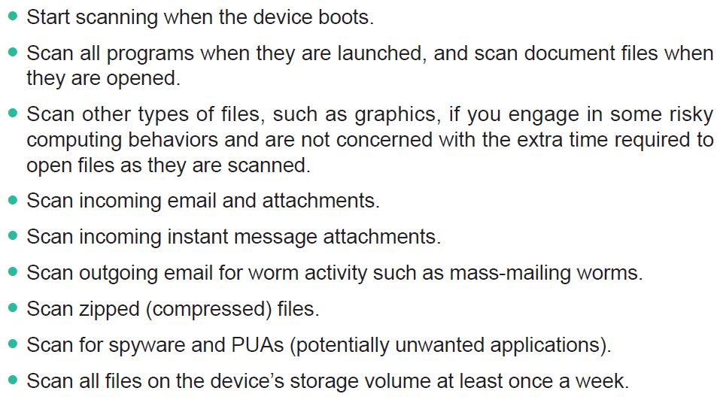
Antivirus Software
For the most extensive protection from malware, you should look for and enable the following features of your antivirus software:

Slide 29
Antivirus Software
Some virus threats are very real, but you’re also likely to get email messages about so-called viruses that don’t really exist
A virus hoax usually arrives as an email message containing dire warnings about a supposedly new virus on the loose
Never forward a viral email to others, even if you think it’s just a virus hoax

Slide 30

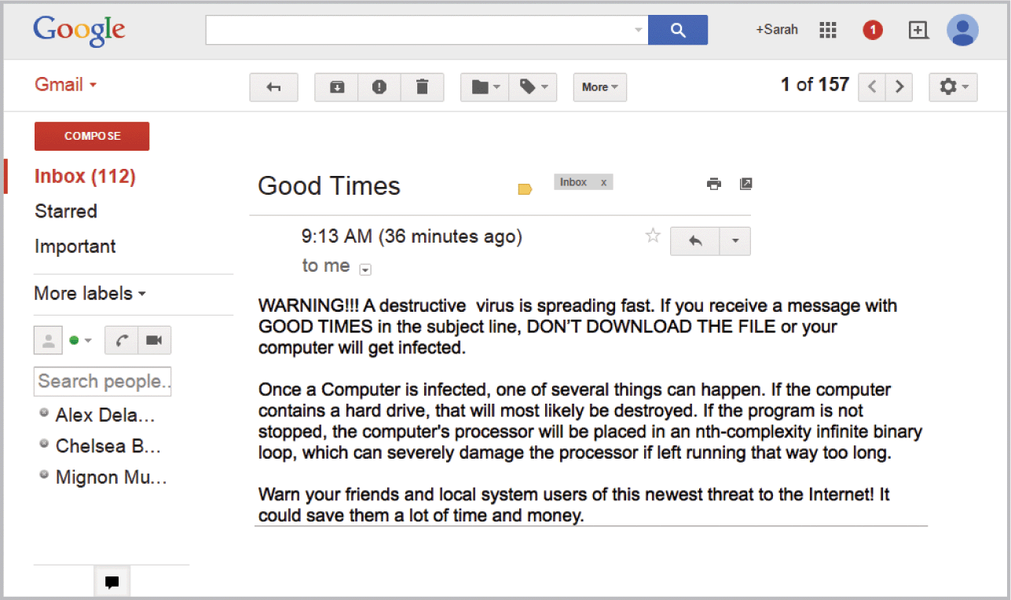
Antivirus Software

Slide 31
Section C: Online Intrusions
Intrusion Threats
Anti-exploit Software
Netstat
Firewalls

Slide 32
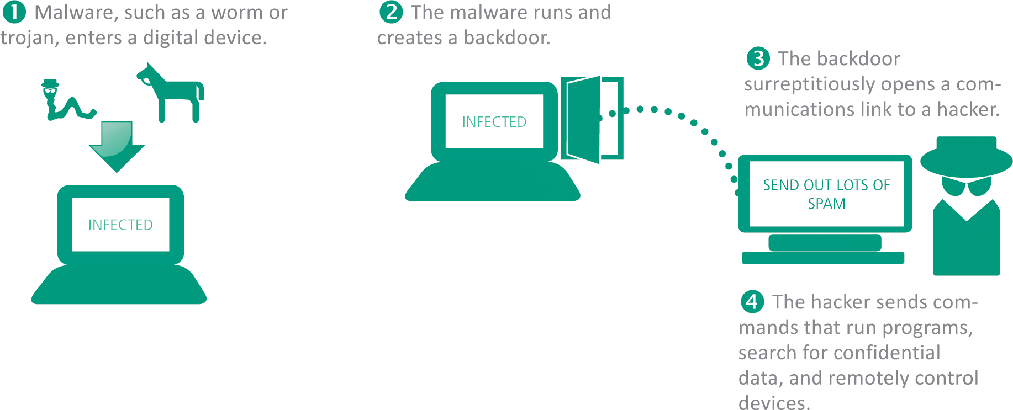
Intrusion Threats
An online intrusion takes place when an unauthorized person gains access to a digital device by using an Internet connection and exploiting vulnerabilities in hardware or software

Slide 33
Intrusion Threats
Different types of intrusions include:
  RATs (Remote Access Trojan) – malware that arrives in a trojan disguised as a legitimate software; sets up a secret communication link with the hacker
  Ransomware – locks a device and then requests payment for an unlocking code; commonly exploits the Find My iPhone feature
Cont…

Slide 34
Intrusion Threats
  Botnets – a client-server network created by hackers who gain control over several computers; this network is hidden from the victims, who continue to use their devices
  Backdoor – an undocumented method of accessing a digital device; RATs create a backdoor to a victim’s device that can be used by a hacker to obtain photos and videos
  DDoS (distributed denial of service) – attacks designed to flood a legitimate Web site or Internet router with so much traffic that it can no longer function

Slide 35
Anti-exploit Software
A zero-day attack exploits previously unknown vulnerabilities in software applications, hardware, and operating system program code
Anti-exploit security software offers an additional defense against zero-day attacks
Anti-exploit software shields certain applications against behaviors commonly exhibited by intrusions and other exploits

Slide 36
Netstat
Hackers use a technique called port scanning to discover which ports are open on a device
A port scan pings a packet of data to the port; if a reply is received, then the port is open
Open ports are used for communications between botnets and their masters
A network utility called Netstat produces a detailed list of open ports on a device; although it is not clear which open ports are being used by botnets

Slide 37
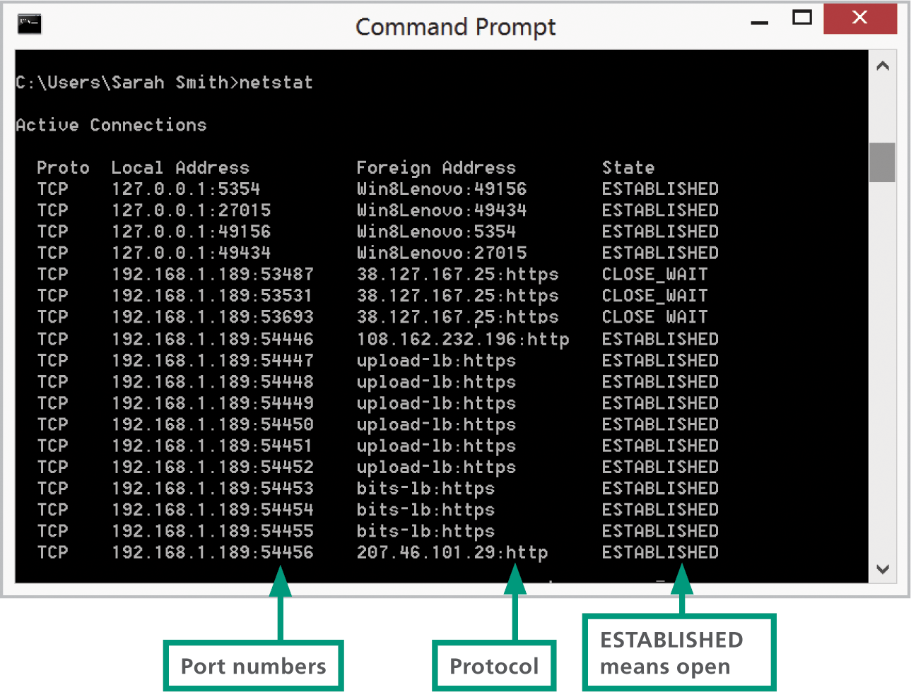
Netstat

Slide 38
Firewalls
A firewall is a device or software that is designed to block unauthorized access while allowing authorized communications
A personal firewall uses a set of rules to block data or allow it to enter a digital device
Most personal firewalls are configured to block all communication unless an app and its corresponding communication port are on a list of allowed exceptions

Slide 39
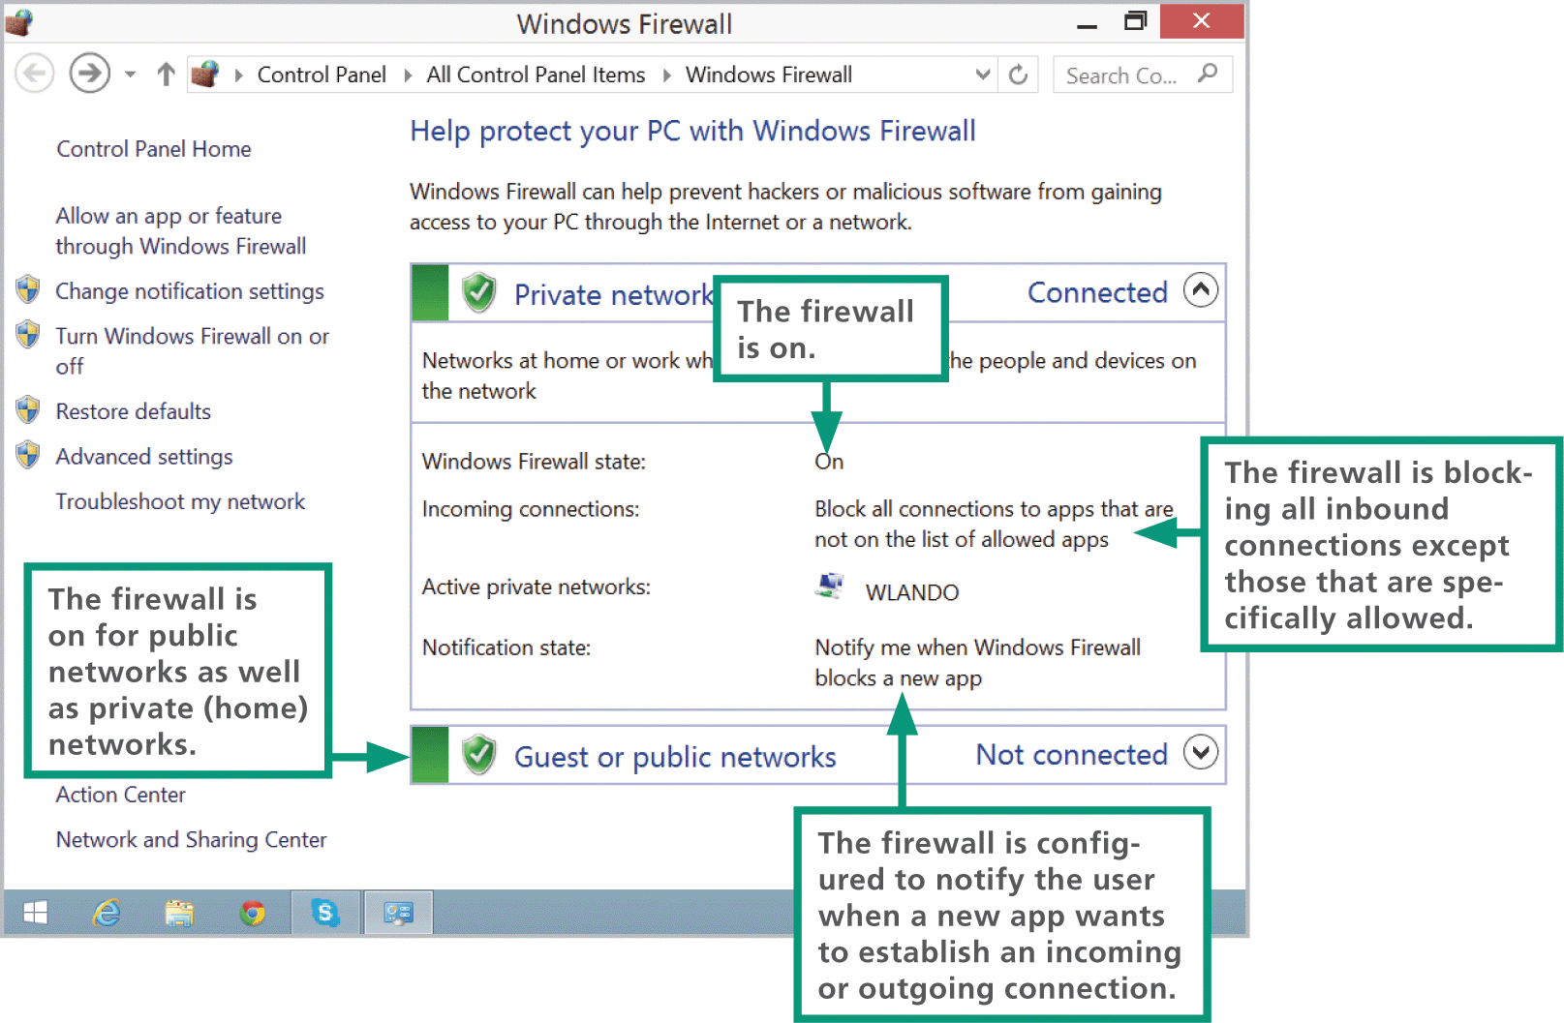
Firewalls

Slide 40
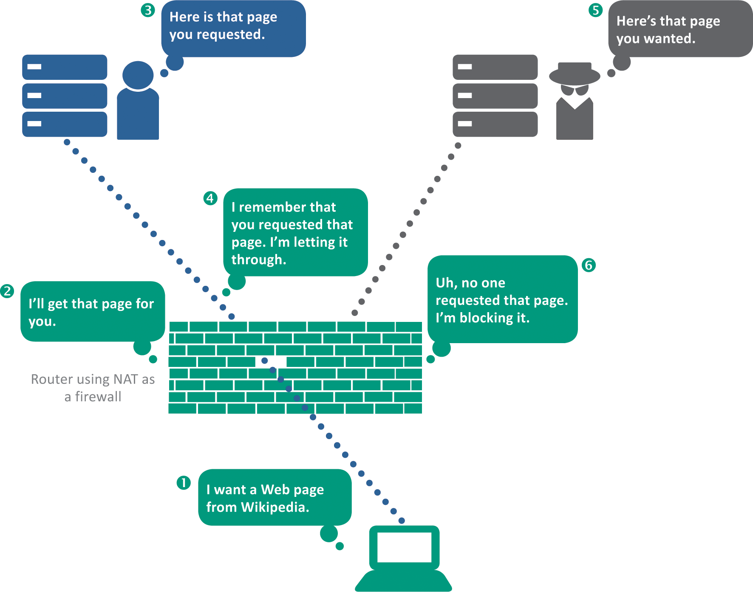
Firewalls

Slide 41
Section D: Interception
Interception Basics
Evil Twins
Address Spoofing
Digital Certificate Hacks
IMSI Catchers

Slide 42
Interception Basics
Interception exploits that are current threats to consumers include the following:
  Spyware – any software that secretly gathers personal information without the victim’s knowledge
  Adware – monitors Web browsing activity to supply ad-serving sites with data used to generate targeted ads
Cont…

Slide 43
Interception Basics
  Keyloggers – a common type of spyware, it records keystrokes and sends them to a hacker who sifts out user passwords to access the victim’s accounts; often used by identity thieves and industrial spies
  Man-in-the-Middle (MITM) – in the context of cyber security, it is an eavesdropping exploit; MITM attacks include Evil Twins, address spoofing, digital certificate hacks, and IMSI catchers

Slide 44
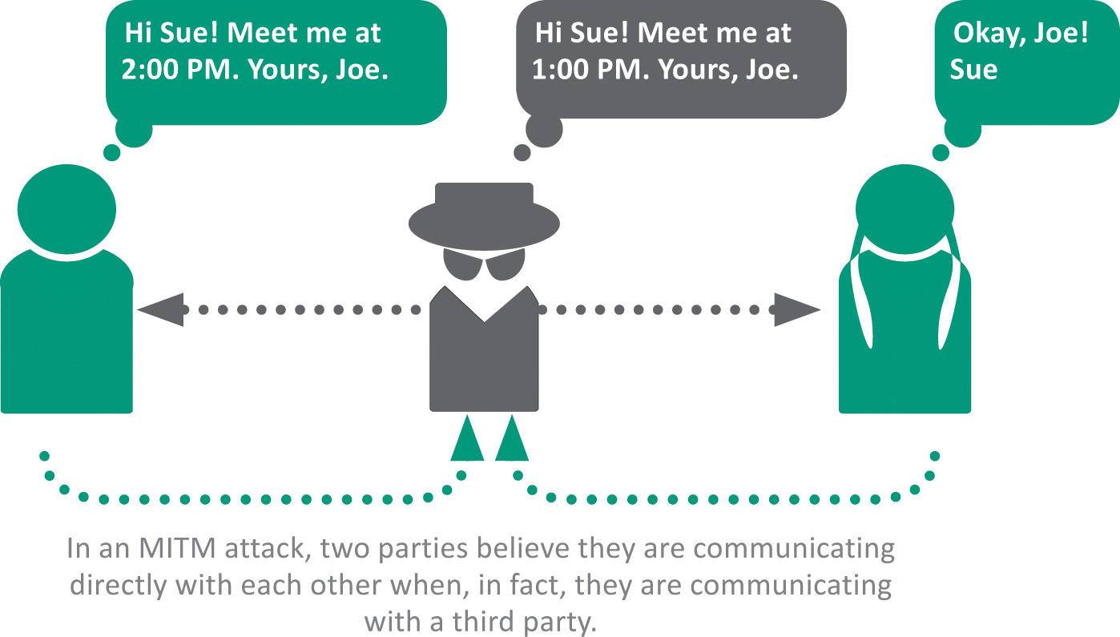
Interception Basics

Slide 45
Evil Twins
An Evil Twin is a LAN server that is designed to look like a legitimate Wi-Fi hotspot
Evil Twins are difficult to detect; to avoid this exploit, refrain from entering sensitive data while using any questionable network, and avoid using unsecured networks

Slide 46
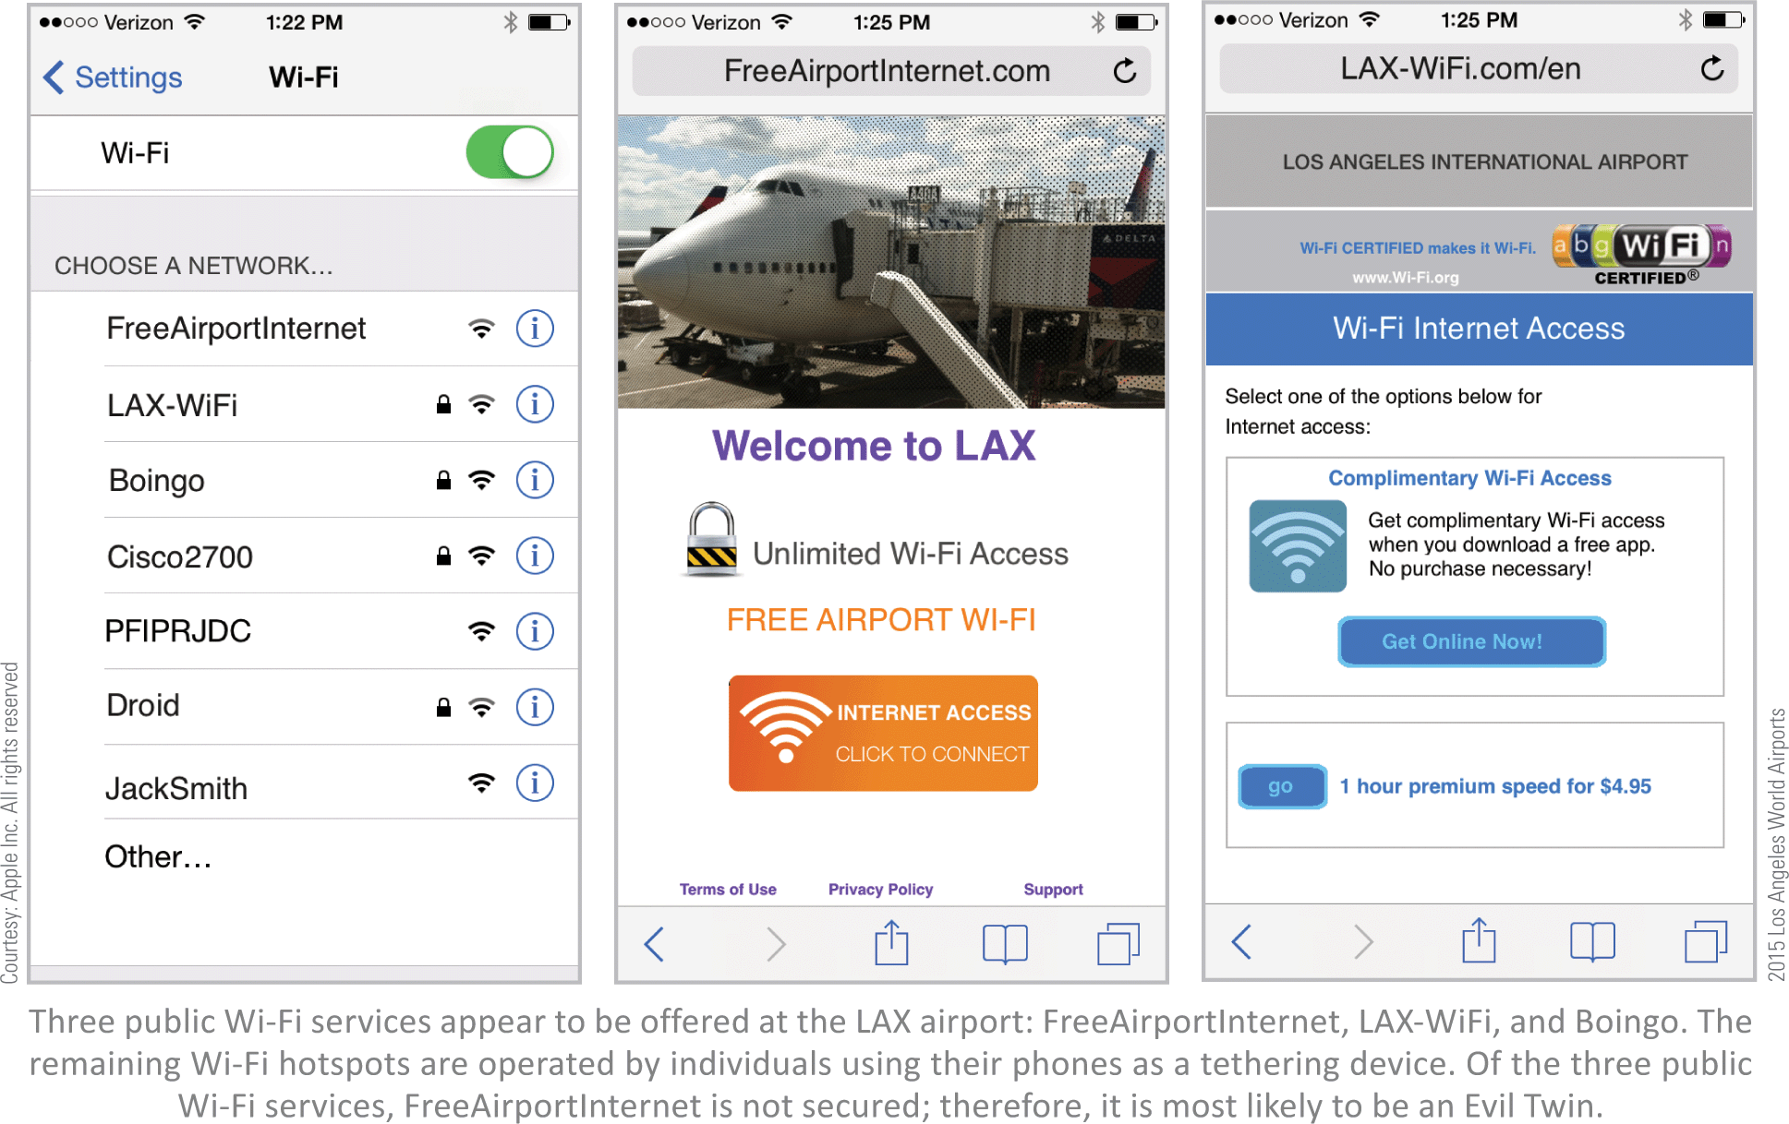
Evil Twins

Slide 47
Address Spoofing
Broadly speaking, address spoofing changes an originating address or a destination address to redirect the flow of data between two parties
In the context of security exploits, address spoofing can take place on various levels of communication

Slide 48
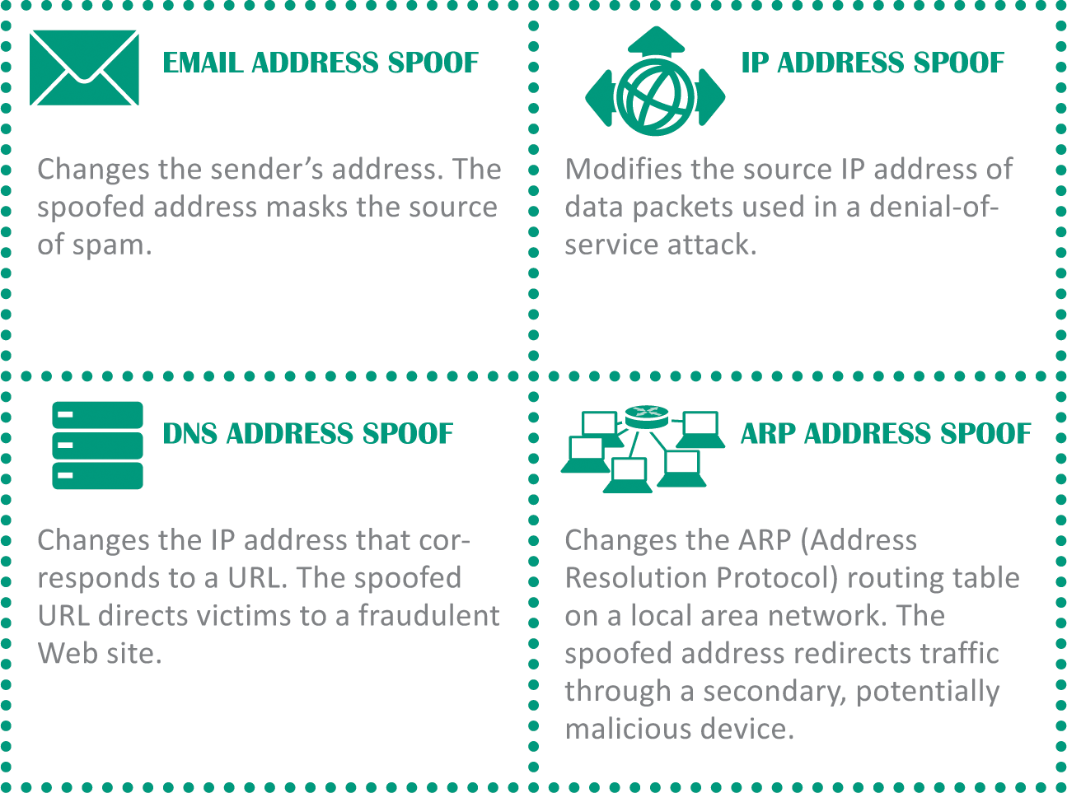
Address Spoofing

Slide 49
Digital Certificate Hacks
The current method of encrypting communication between a client and a server depends on a security protocol called TLS (Transport Layer Security)
TLS checks a digital certificate to verify a server’s identity and pass a public key to the client
The client then uses the public key to encrypt data that is sent to the server

Slide 50
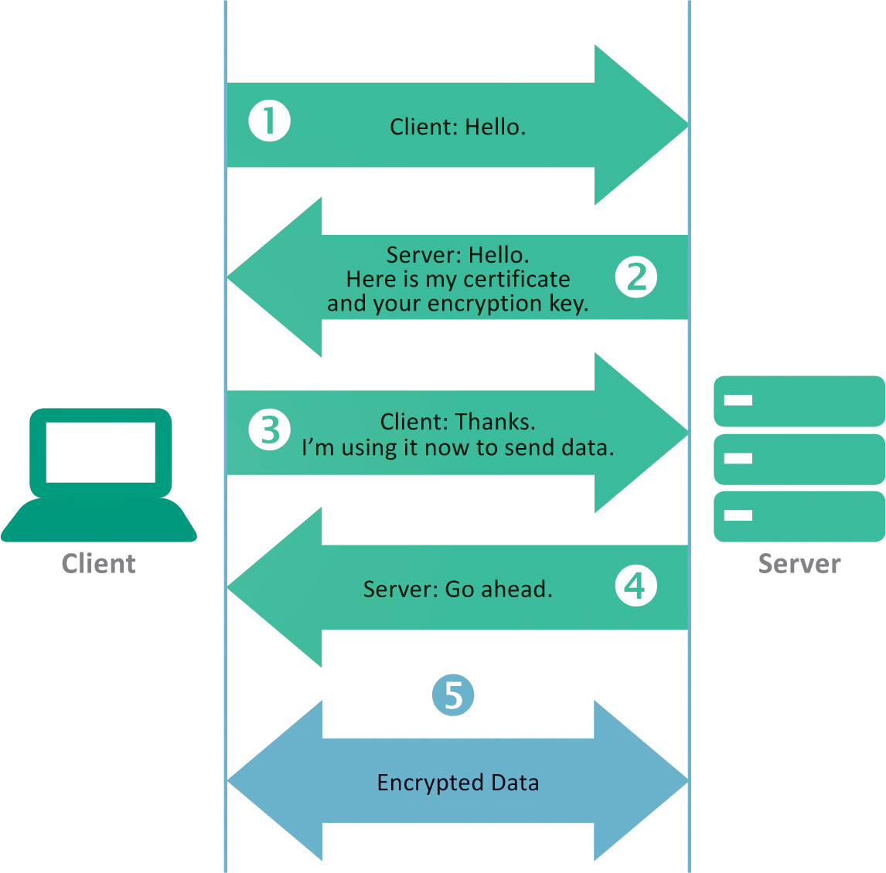
Digital Certificate Hacks

Slide 51
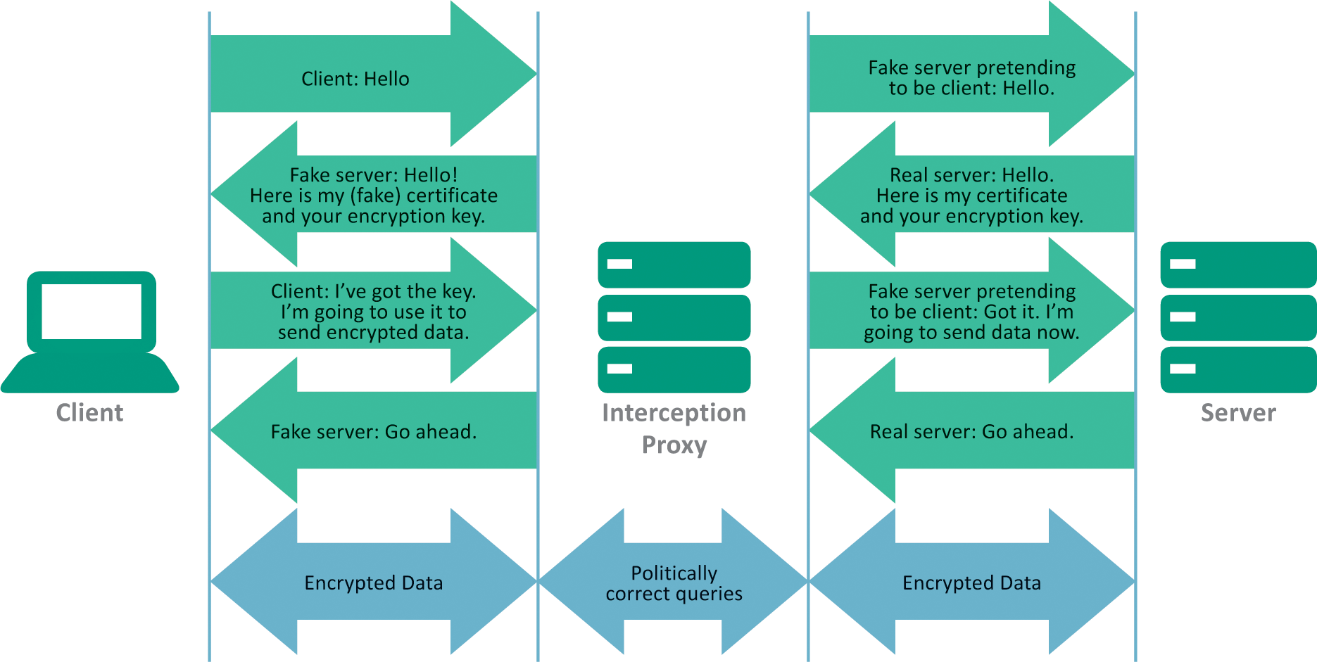
Digital Certificate Hacks

Slide 52
IMSI Catchers
IMSI is an acronym for International Mobile Subscriber Identity
It’s a 64-bit number that uniquely identifies a cellular device
An IMSI catcher is an eavesdropping device used for intercepting mobile phone signals and tracking the location of cellular devices
IMSI catchers are used for MITM attacks

Slide 53
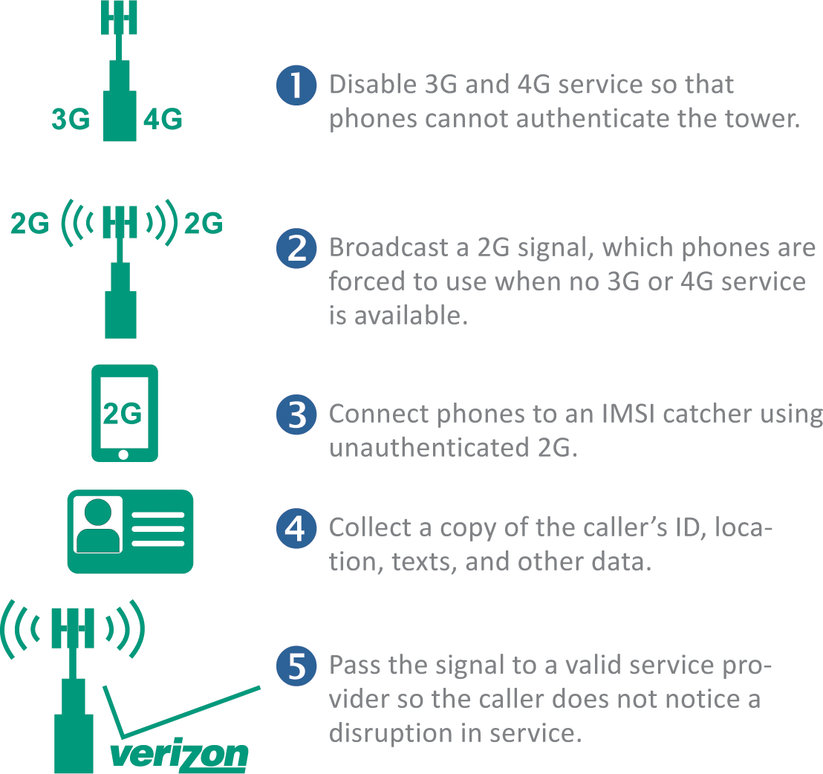
IMSI Catchers

Slide 54
Section E: Social Engineering
Social Engineering Basics
Spam
Phishing
Pharming
Rogue Antivirus
PUAs

Slide 55
Social Engineering Basics
In the context of cyber security, social engineering (SE) is a deceptive practice that exploits human psychology by inducing victims to interact with a digital device in a way that is not in their best interest
Social engineer is a judgment-neutral term for a person who devises and carries out a scam in order to accomplish a goal, such as financial gain or service disruption
The target of a social engineering exploit is an individual or organization that may be tricked into participating in the scam

Slide 56
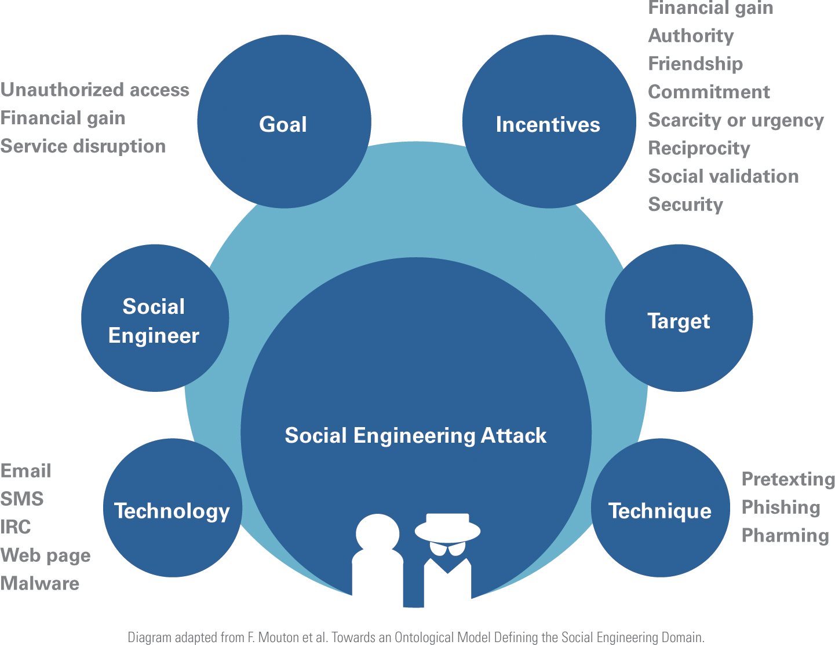
Social Engineering Basics

Slide 57
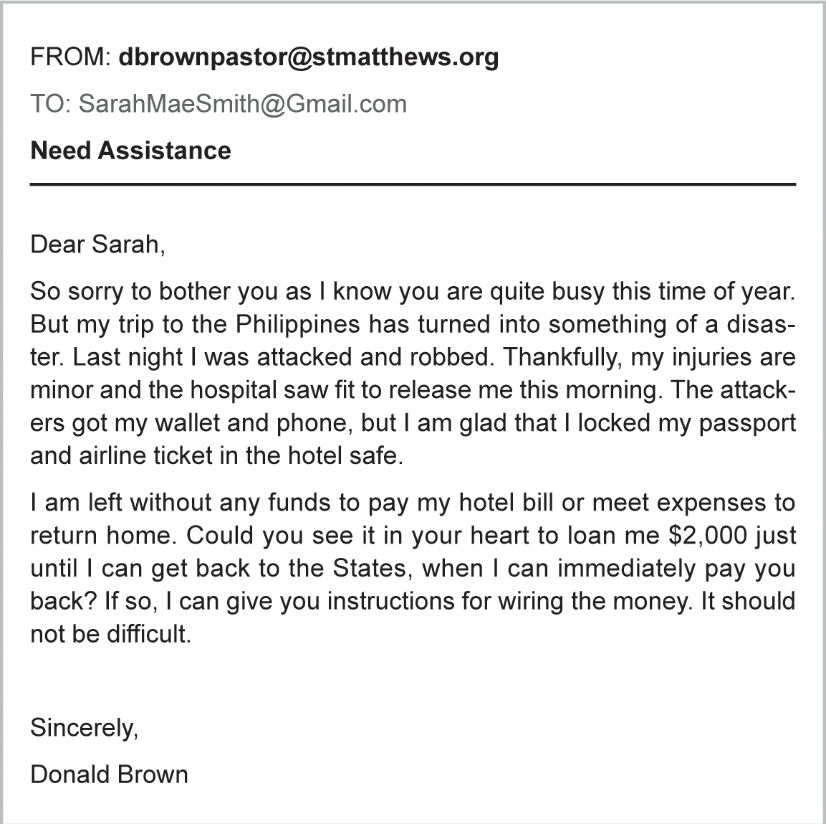
Social Engineering Basics
The poster child for social engineering scams is called advance fee fraud, in which the victim is promised a large sum of money in exchange for a bank account number from which a small advance fee is withdrawn

Slide 58
Spam
Spam is defined as unsolicited messages that are usually sent in massive numbers using electronic mail systems; it accounts for approximately 70% of all email
Everyone gets spam; mass-mailing databases obtain millions of email addresses at low costs
In 2003, the U.S. Congress passed a so-called anti-spam law, the CAN-SPAM Act (Controlling the Assault of Non-Solicited Pornography And Marketing Act of 2003)

Slide 59
Spam
Most ISPs and email services use filtering techniques to block spam coming from IP addresses and senders that are know to generate spam
Spammers have developed techniques to bypass these barriers, and spam continues to make its way into consumer mailboxes
Defending against spam requires careful Inbox management
To reduce the amount of spam you receive, consider the following recommendations:

Slide 60
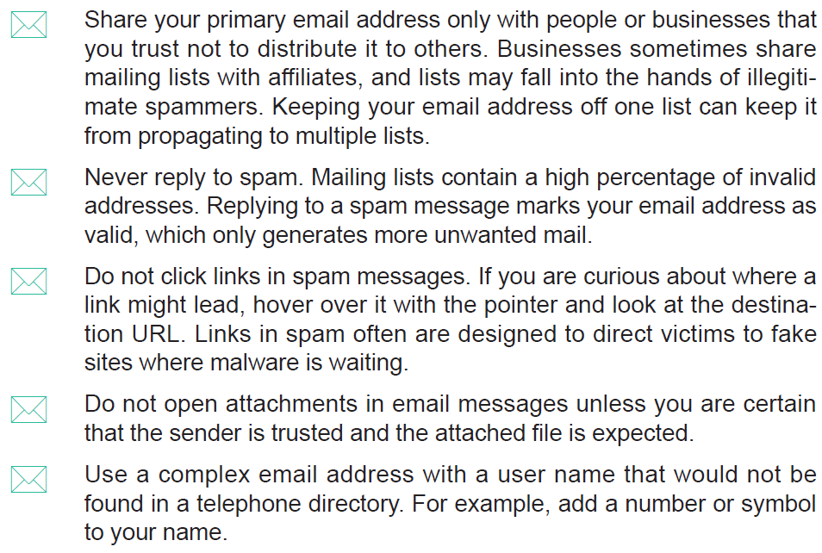
Spam

Slide 61
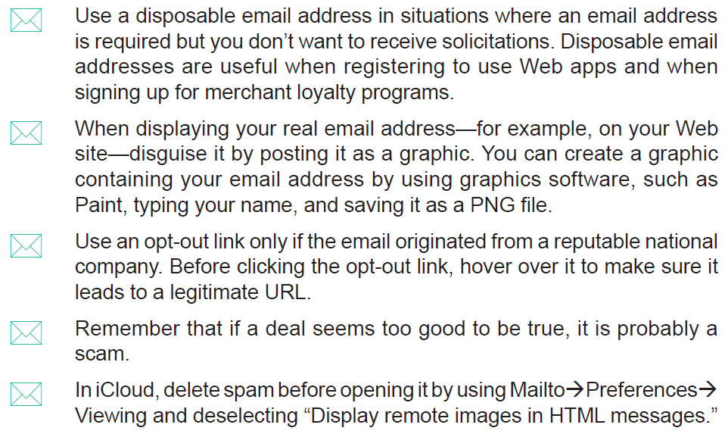
Spam

Slide 62
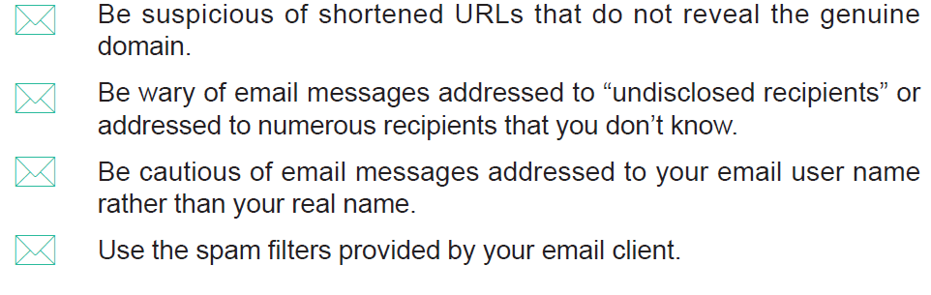
Spam

Slide 63
Phishing
Phishing is an email scam that masquerades as a message from a legitimate company or agency of authority, such as the IRS
The goal of a phishing scam is to obtain private information such as passwords and bankcard numbers
Some of the most common attacks appear to originate from FedEx, UPS, DHL, or the U.S. Postal service

Slide 64
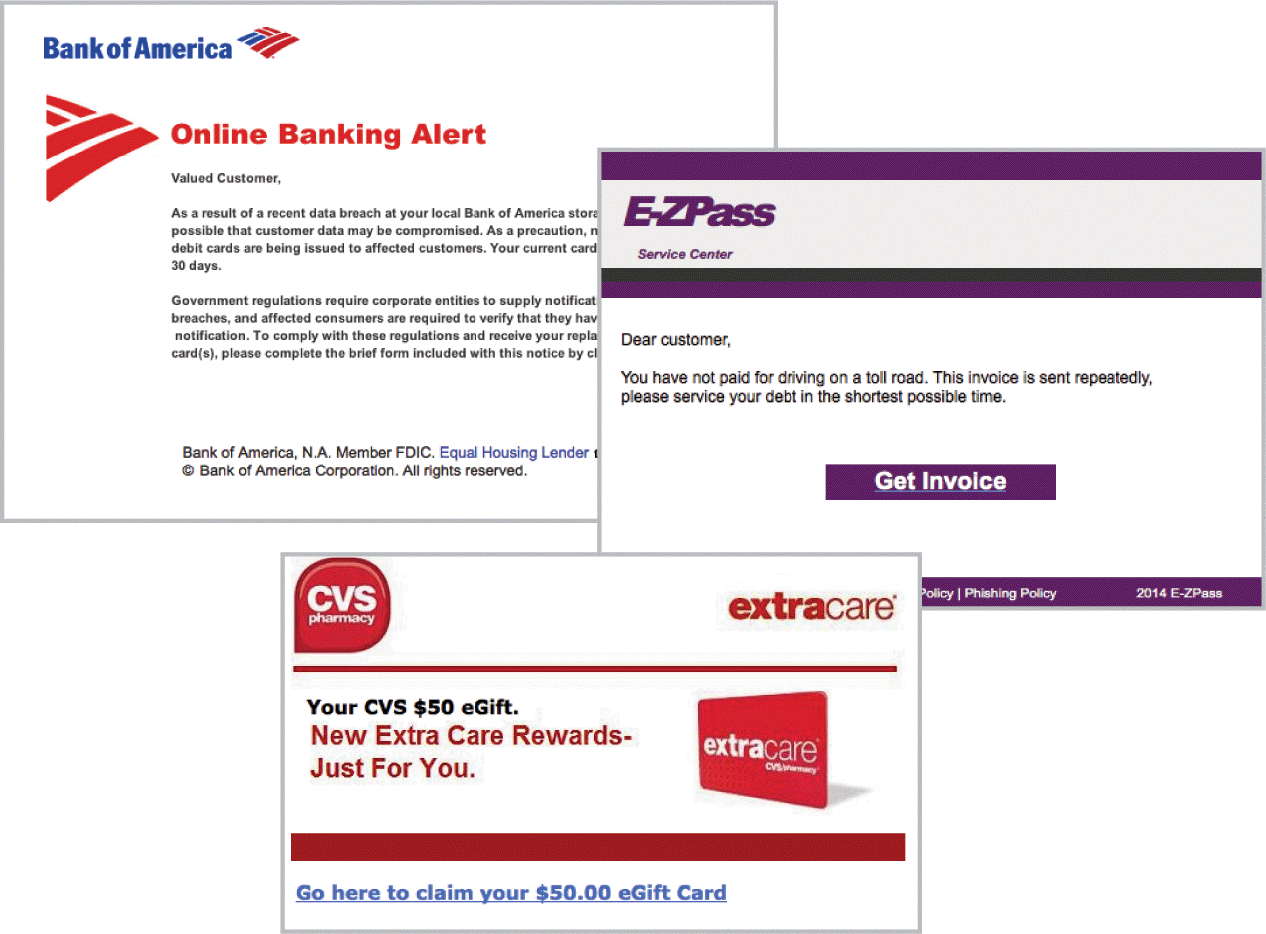
Phishing

Slide 65
Pharming
Pharming redirects Web site traffic to fraudulent Web sites that distribute malware, collect personal data, and perpetrate other scams
Safe Browsing is a service offered by Google that checks URLs against a list of suspicious Web site URLs
Chrome, Safari, and Firefox use Safe Browsing to alert users about sites to avoid; Microsoft offers a similar service called SmartScreen Filter

Slide 66
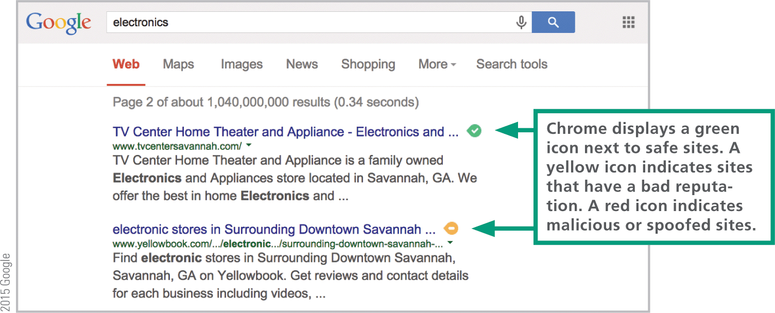
Pharming

Slide 67
Rogue Antivirus
A rogue antivirus exploit usually begins with a virus warning and an offer to disinfect the infected device
The goal of this exploit is to trick consumers into clicking a link that downloads malware
Fake virus alerts, which appear in pop-up windows, commonly appear when browsing the Web at slightly sketchy Web sites

Slide 68
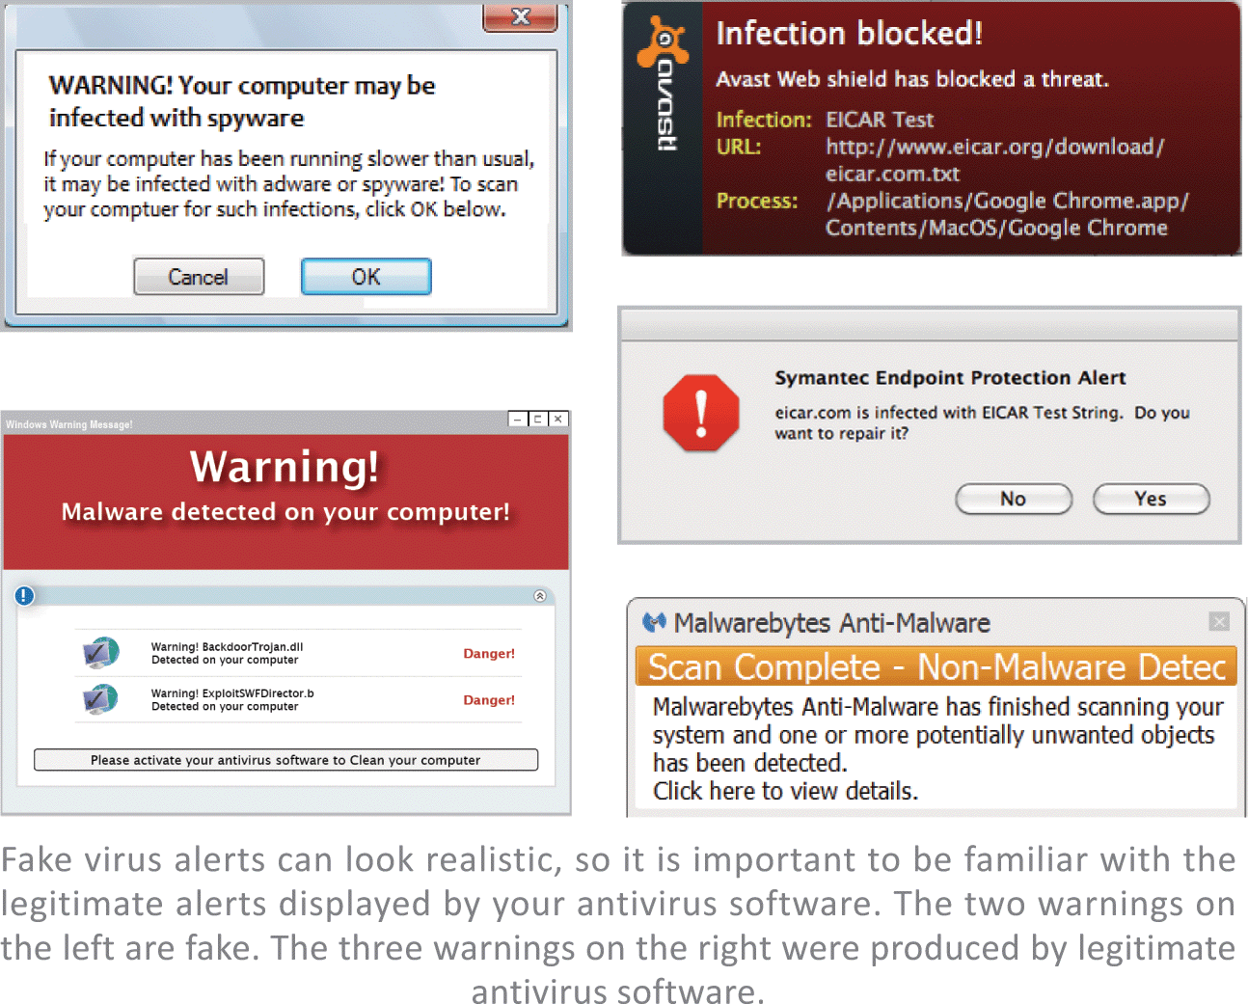
Rogue Antivirus

Slide 69
PUAs
The acronym PUP stands for potentially unwanted program
The acronym PUA stands for potentially unwanted application *(both PUP and PUA are used interchangeably)
If you suddenly notice that an odd browser has become the default on your device and your attempts to reset to Chrome, IE, or Safari fail, then your computer is likely to have a PUA
PUAs are installed using social engineering techniques, such as hoping consumers will mistakenly accept a PUA application during software installation

Slide 70
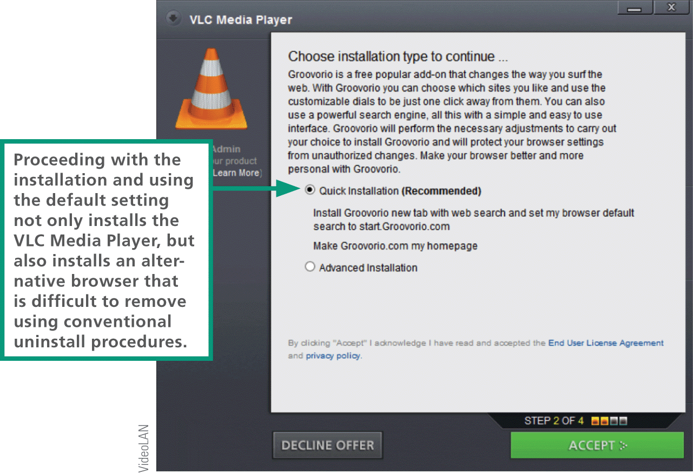
PUAs

Slide 71
Unit 7 Complete

