Slide 1
Unit 6
Software
ENHANCED EDITION

Slide 2
Unit Contents
Section A: Software Basics
Section B: Operating Systems
Section C: Apps and Applications
Section D: Productivity Software
Section E: File Management Utilities

Slide 3
Section A: Software Basics
Essentials
Distribution
Software Licenses
Pirated Software

Slide 4
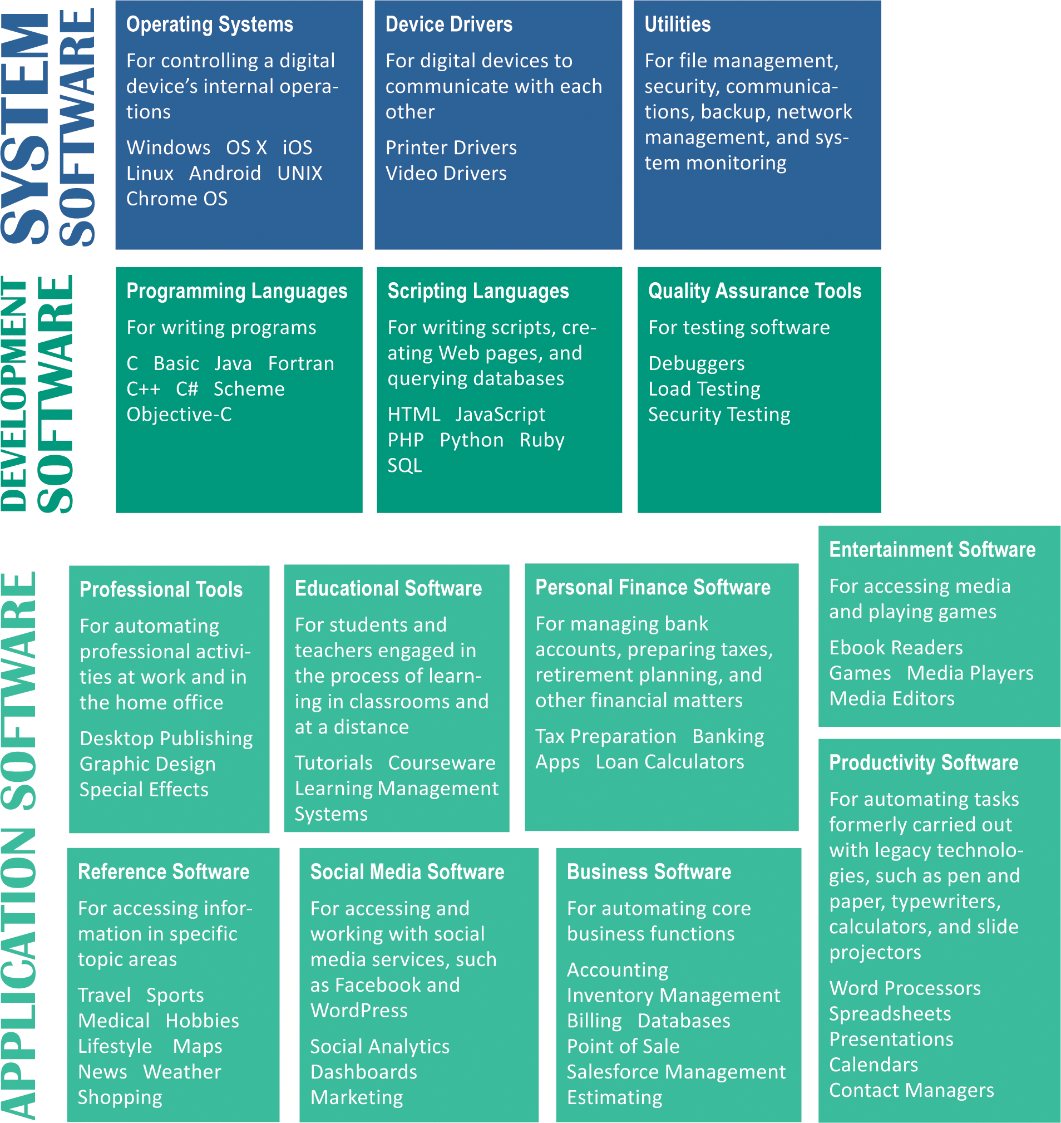
Essentials
When searching for new software, it helps to have a framework of categories

Slide 5
Essentials

Slide 6
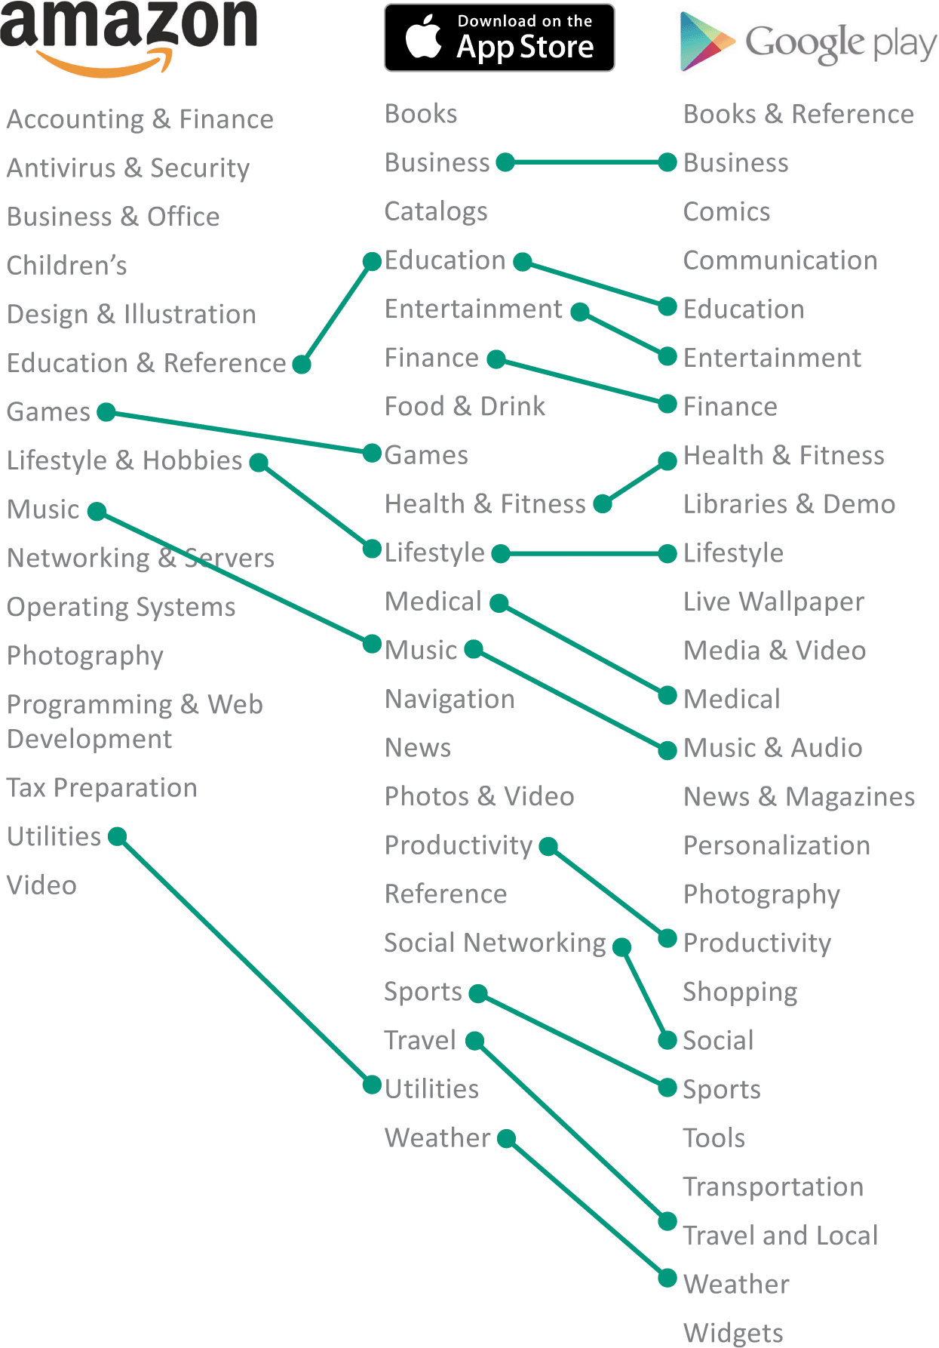
Essentials
There is no universal standard for categorizing software, but various categorization schemes have many similarities

Slide 7
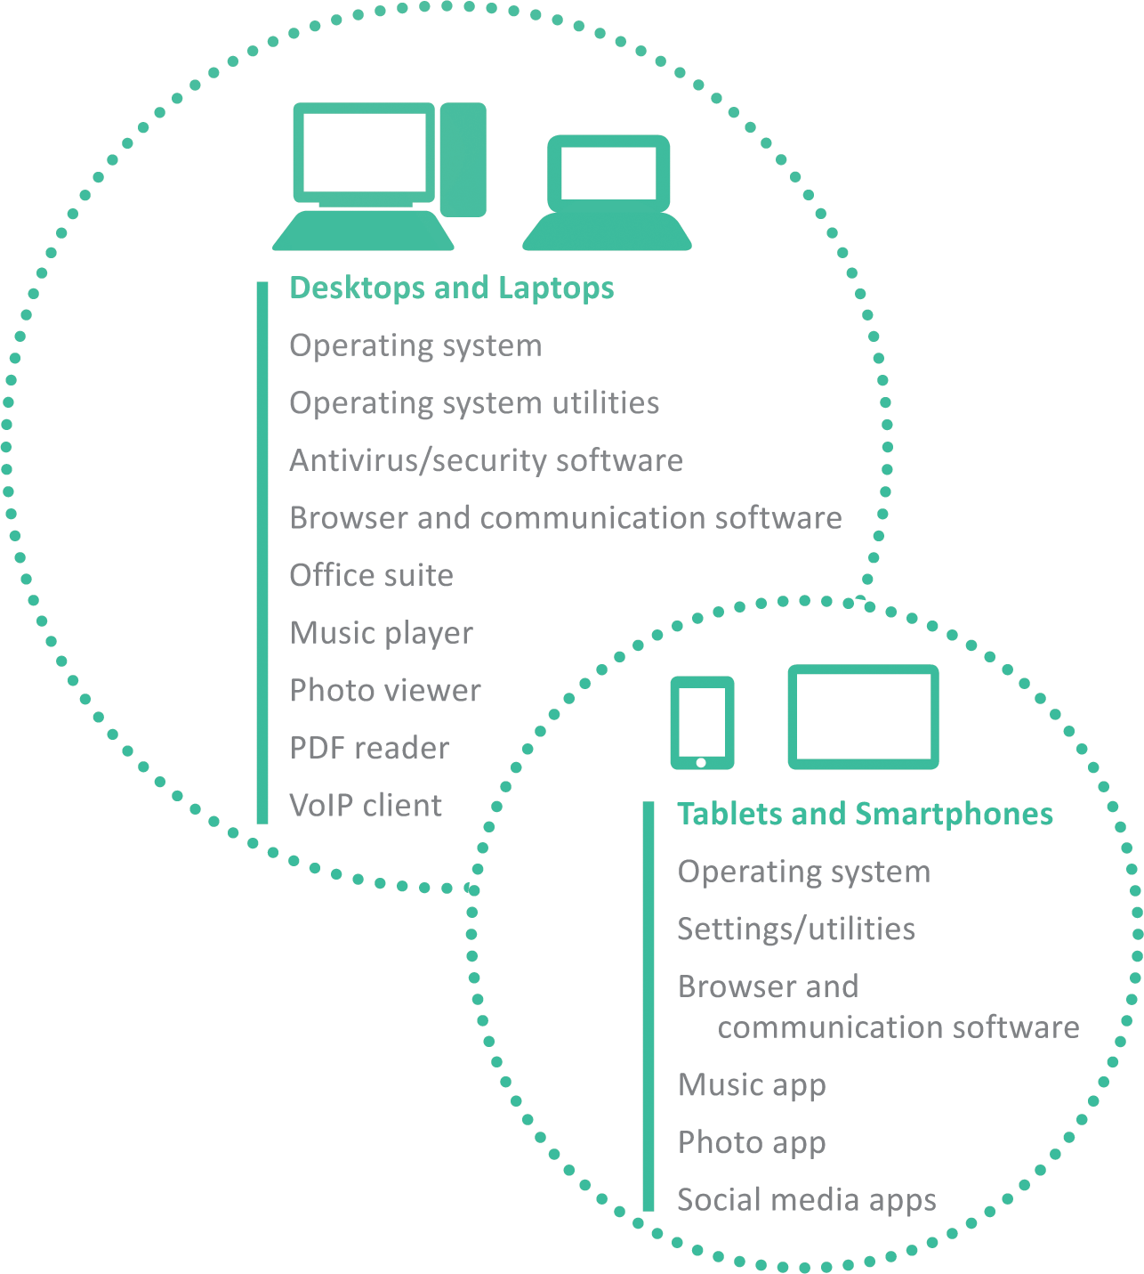
Essentials
Mobile devices are used differently from desktop and laptop computers, so the configuration of their software is slightly different
An OS is still required, but utilities are replaced by settings or preferences

Slide 8
Distribution
Most consumers obtain software online, where it can be downloaded directly from the developer or from a software aggregator
An executable file contains a computer program that is carried out step-by-step within the microprocessor
Software can contain viruses and other malware, so consumers should download new applications only from trusted sources
Software developers usually have a Web site for distributing software; well-established developers tend to offer trustworthy products

Slide 9
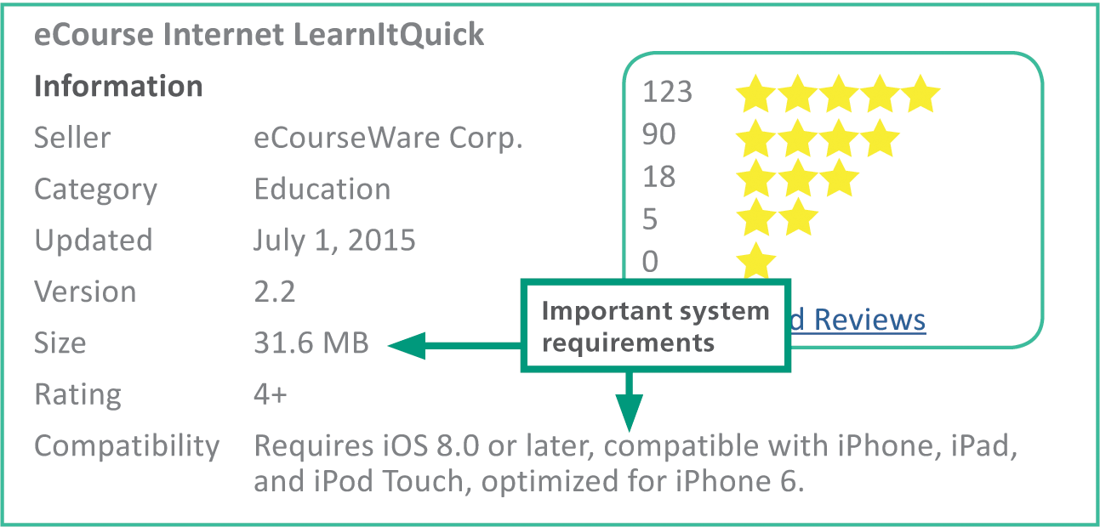
Distribution
System requirements specify the operating system and minimum hardware capacities necessary for a software product to work correctly

Slide 10
Distribution
When a new version or edition of a software product is released it is referred to as a software upgrade
A software update (sometimes called a software patch) is a small section of program code that replaces part of the software currently installed
The term service pack, which usually applies to operating system updates, refers to a set of updates
Updates and service packs are designed to correct problems and address security vulnerabilities

Slide 11
Distribution
Software can be obtained under a variety of pricing models
  One-time purchase – the software remains basically the same as when it was purchased
  Subscription – consumers pay an annual fee to use software; updates and upgrades are usually included in the pricing
  Trial – consumers use a software product during a free trial period
  Freemium – provides free use of a stripped-down or basic version of the product but requires payment for upgraded features

Slide 12
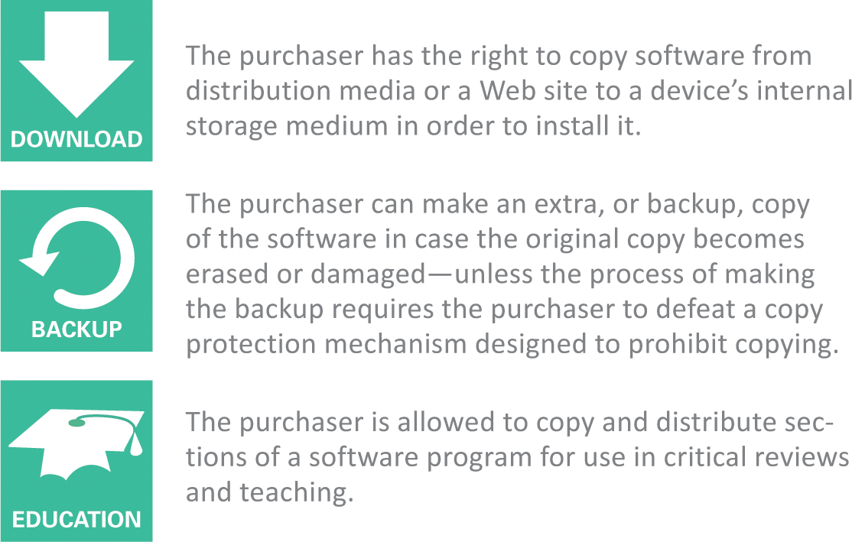
Software Licenses
A software license, or license agreement, is a legal contract that defines the ways in which a computer program may be used
These licenses are sometimes referred to as EULAs (End User License Agreements)

Slide 13
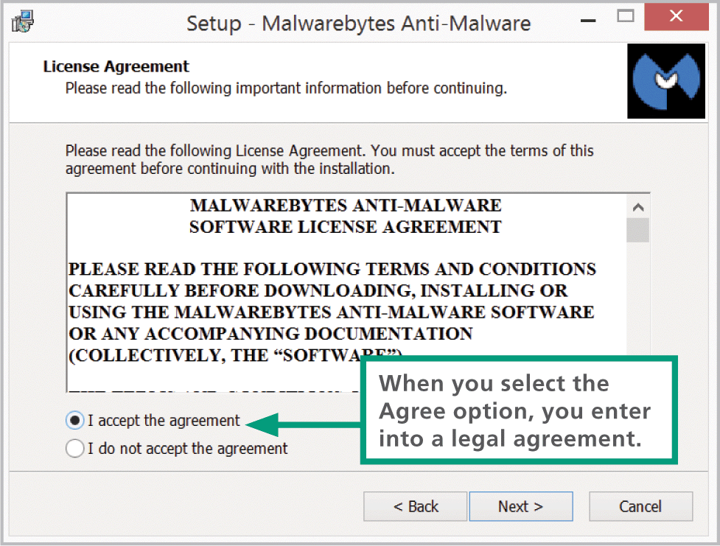
Software Licenses
License agreements are displayed during the installation process; by clicking the I Agree button, you consent to the terms of the license agreement

Slide 14
Software Licenses
Public domain software is not protected by copyright because the copyright has expired or the author has placed the program in the public domain, making it available without restriction
Proprietary software has restrictions on its use that are delineated by copyright, patents, or license agreements
Commercial software is usually sold in retail stores or on Web sites; most commercial software is distributed under a single-user license that limits use to one person at a time

Slide 15
Software Licenses
A site license is generally priced at a flat rate and allows software to be used on all computers at a specific location
A multiple-user license is priced per copy and allows the allocated number of copies to be used simultaneously

Slide 16
Software Licenses
Freeware is copyrighted software that—as you might expect—is available for free; it’s fully functional and requires no payment for its use
Demonware is proprietary software made available as a trial version; it’s distributed for free and often comes preinstalled on new devices
Product activation is a means of protecting software from illegal copying by requiring users to enter a product key or an activation code

Slide 17
Software Licenses
A hash value is a unique number derived from encoding one or more data sets, such as names, serial numbers, and validation codes
Shareware is copyrighted software marketed under a try-before-you-buy policy; it was conceived as a low-cost marketing and distribution channel for independent programmers

Slide 18
Software Licenses
Open source software makes uncompiled program instructions—the source code—available to programmers who want to modify and improve the software; Linux is an example of open source software
Two of the most common open source and free software licenses are BSD and GPL

Slide 19
Software Licenses
The BSD license originated as the Berkeley Software Distribution license for a server operating system
The GPL (General Public License) was developed for a free operating system called GNU; it’s slightly more restrictive than the BSD license because it requires derivative works to be licensed

Slide 20
Pirated Software
People who circumvent copyright law and illegally copy, distribute, or modify software are sometimes called software pirates, and their illegal copies are referred to as pirated software

Slide 21
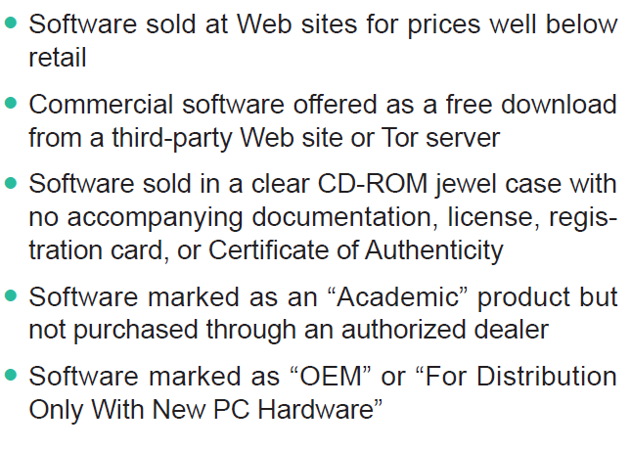
Pirated Software
According to the Software & Information Industry Association (SIIA), the following characteristics can help you spot pirated software:
Cont…

Slide 22
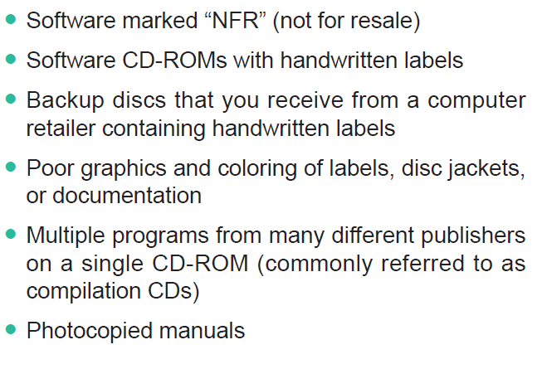
Pirated Software

Slide 23
Section B: Operating Systems
Operating System Basics
Microsoft Windows
OS X
iOS
Android
Chrome OS
Virtual Machines

Slide 24
Operating System Basics
An operating system gives your digital device a personality; it controls key elements of the user interface, which includes the visual experience as well as the keyboard, mouse, microphone, or touchscreen that collects user commands
Behind the scenes, the OS is busy supervising critical operations that take place within a device

Slide 25
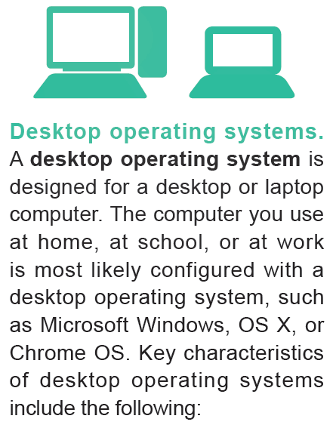
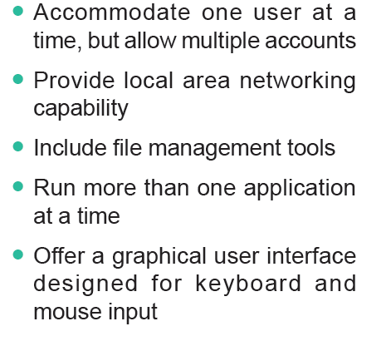
Operating System Basics

Slide 26
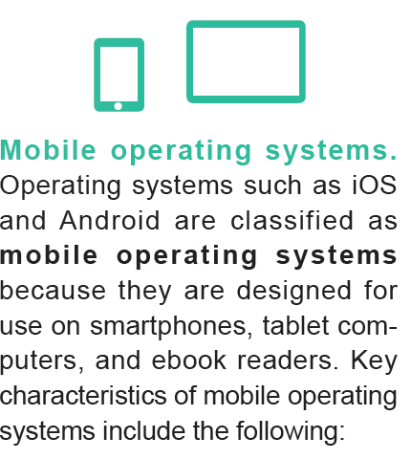
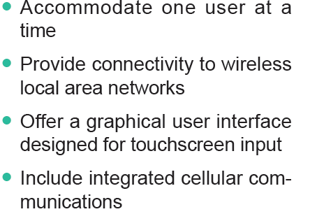
Operating System Basics

Slide 27
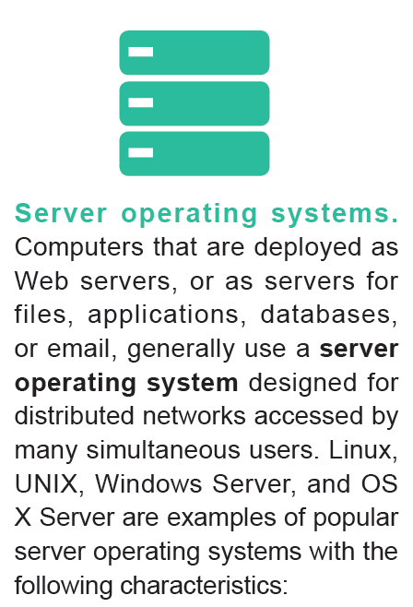
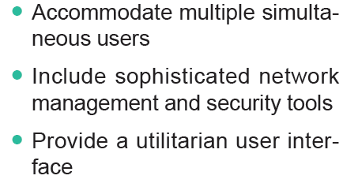
Operating System Basics

Slide 28
Operating System Basics
During the boot process, the OS kernel is loaded into RAM; a kernel provides essential operating system services, such as memory management and file access
In the context of digital devices, the term resource refers to any component that is required to perform work

Slide 29
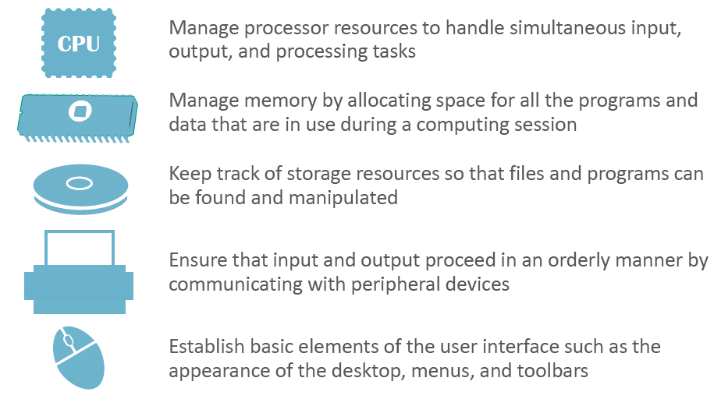
Operating System Basics

Slide 30
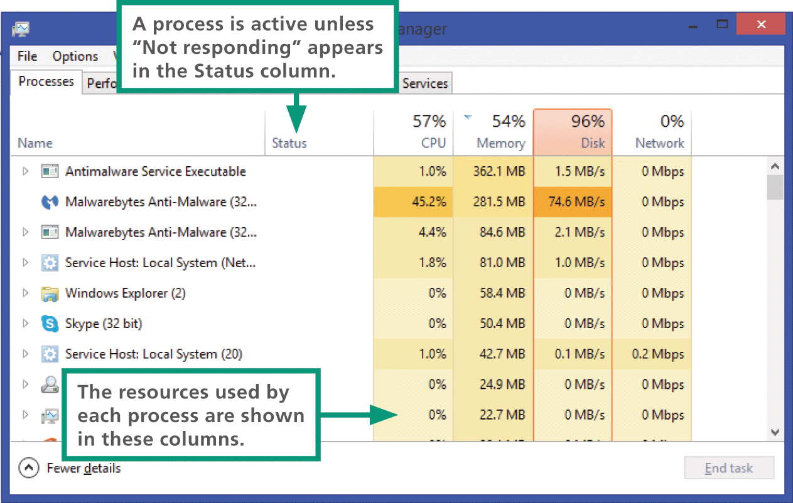
Operating System Basics
Many activities—called processes—compete for the attention of a device’s microprocessor
To manage all these competing processes, an operating system must ensure that each process receives its share of attention from the microprocessor

Slide 31
Operating System Basics
Depending on the capabilities of the operating system and computer hardware, processes can be managed by multitasking, multithreading, and multiprocessing
  Multitasking – provides process and memory management services that allow two or more tasks, jobs, or programs to run simultaneously
  Multithreading – allows multiple commands, or threads to run simultaneously
  Multiprocessing – a capability that supports a division of labor among all the processing units

Slide 32
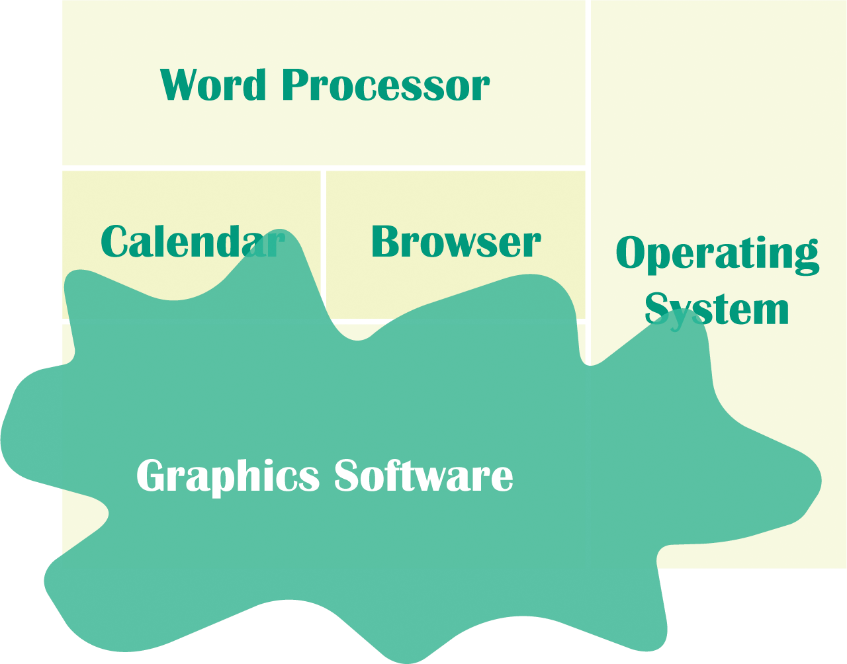
Operating System Basics
When you want to run more than one application at a time, the OS has to allocate specific areas of memory for each; sometimes application requests memory but never releases it—a condition called a memory leak
Memory “leaks” away into this application reserved area, eventually preventing other applications from accessing enough memory to function properly

Slide 33
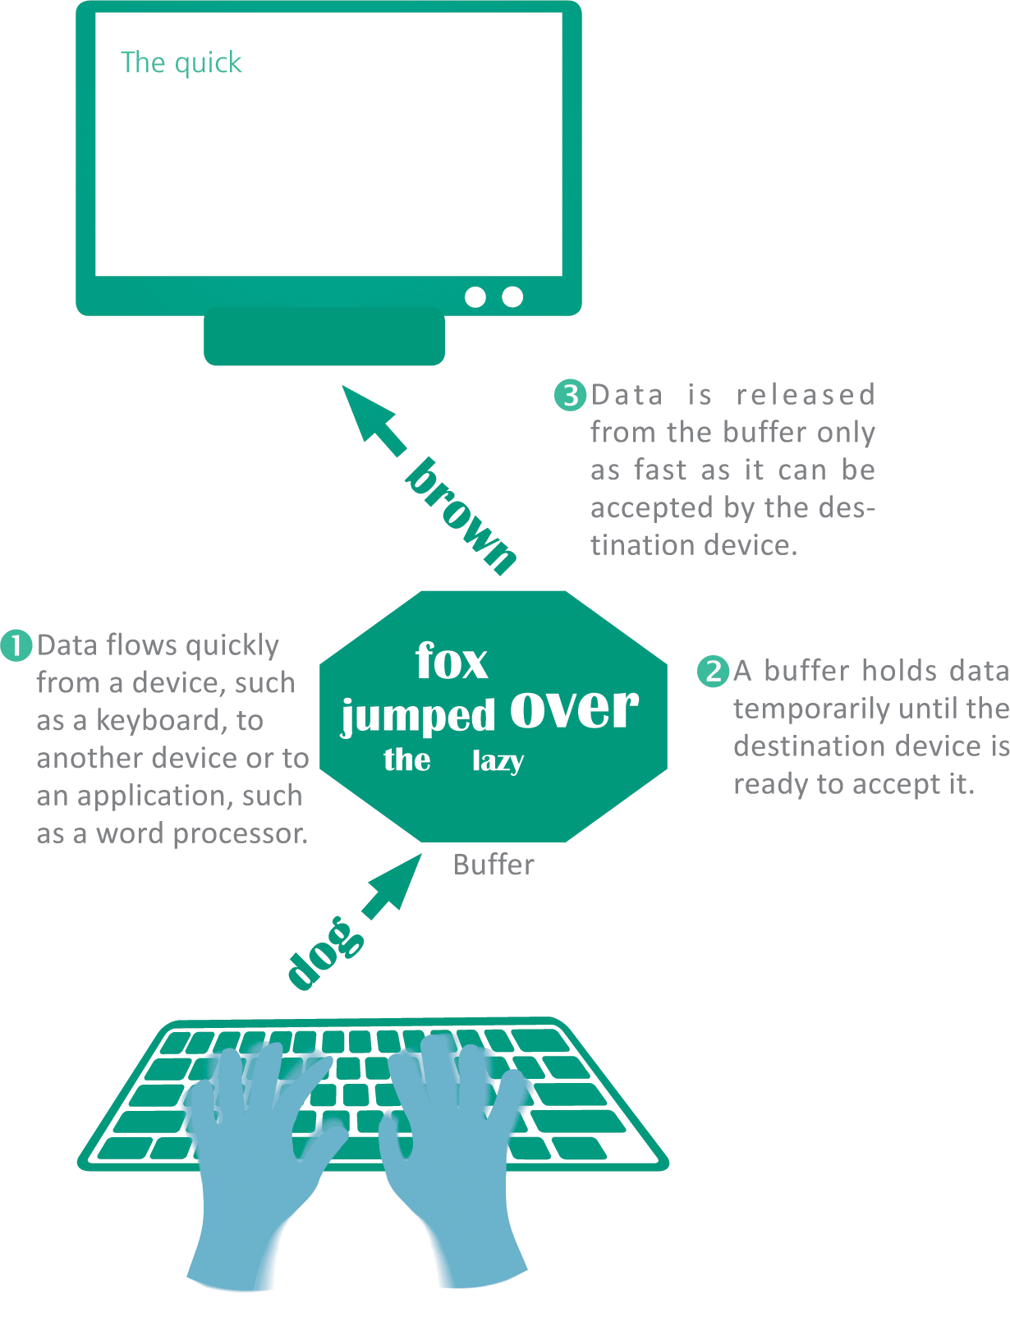

Operating System Basics
An OS ensures that input and output proceed in an orderly manner, using buffers to collect and hold data while the device is busy with other tasks

Slide 34
Microsoft Windows
Microsoft Windows is installed on more than 80% of the world’s personal computers
The Windows OS got its name from the rectangular work areas displayed on its screen-based desktop
Windows evolved from a Microsoft OS called DOS (Disk Operating System) that was designed to run on early PCs with Intel or Intel-compatible microprocessors
The most recent versions of Windows are Windows 7, Windows 8, and Windows 10

Slide 35
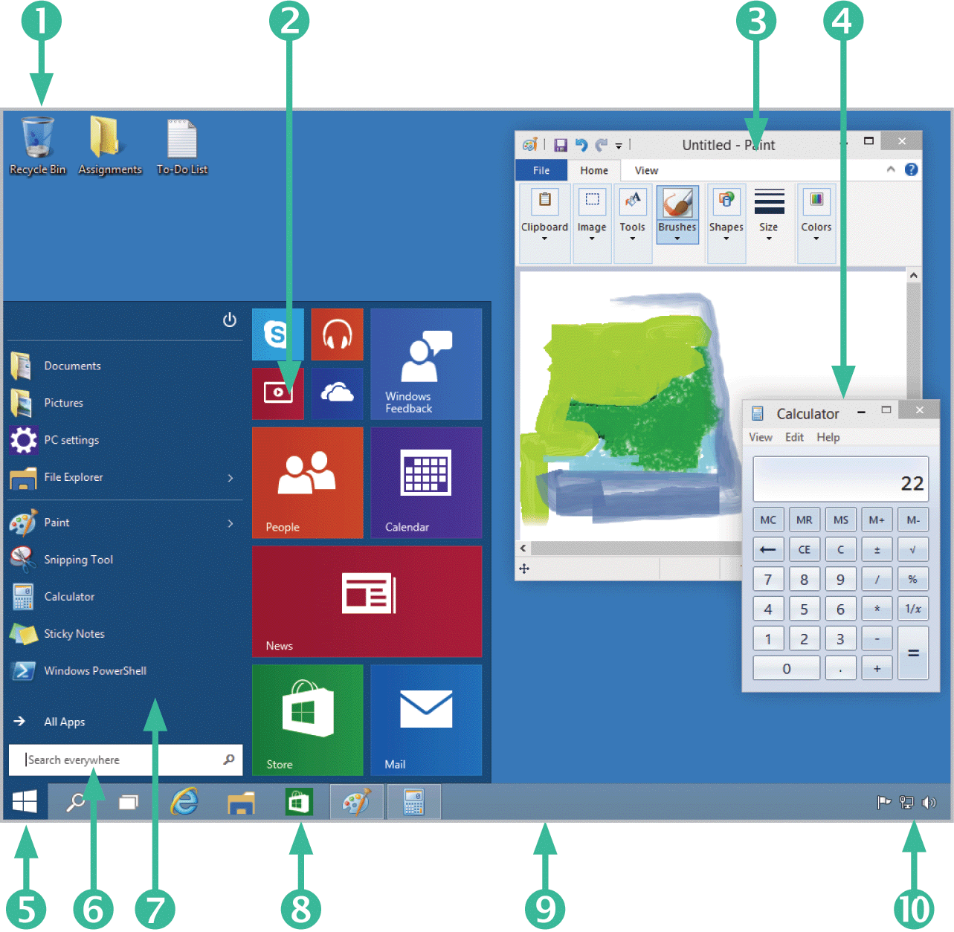
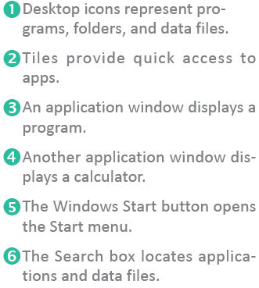
Microsoft Windows
Cont…

Slide 36
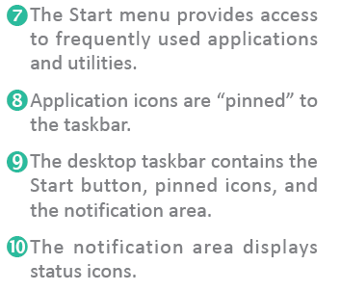
Microsoft Windows

Slide 37
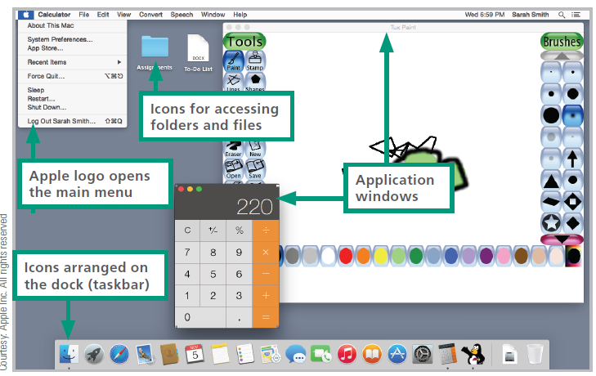
OS X
As a desktop operating system, OS X features beautifully designed icons and multiple rectangular work areas to reflect multitasking capabilities

Slide 38
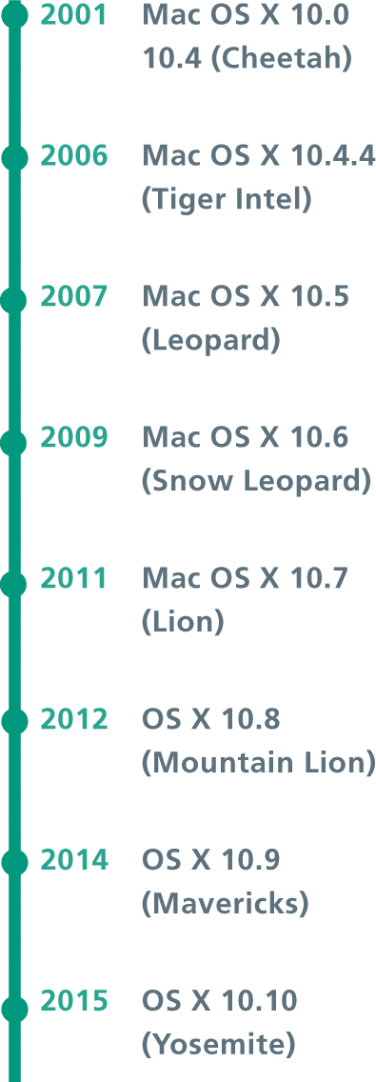
OS X
In 2012, Apple released OS X 10.8 and officially dropped “Mac” from the operating system’s name

Slide 39
OS X
OS X has a reputation for being an easy-to-use, reliable, and secure operating system
OS X uses a kernel based on UNIX, a server operating system that includes industrial-strength memory protection features that contribute to a low incidence of errors and glitches

Slide 40
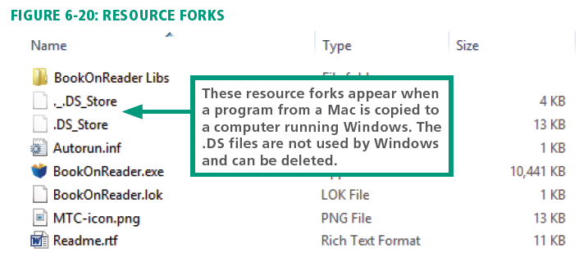
OS X
Files maintained by OS X have two parts, called forks:
  The data fork is similar to files in other operating systems; it contains data, such as the commands for a program and graphics for a photo
  The resource fork is a companion file that stores information about the data in the data fork, such as the file type and the application that created it

Slide 41
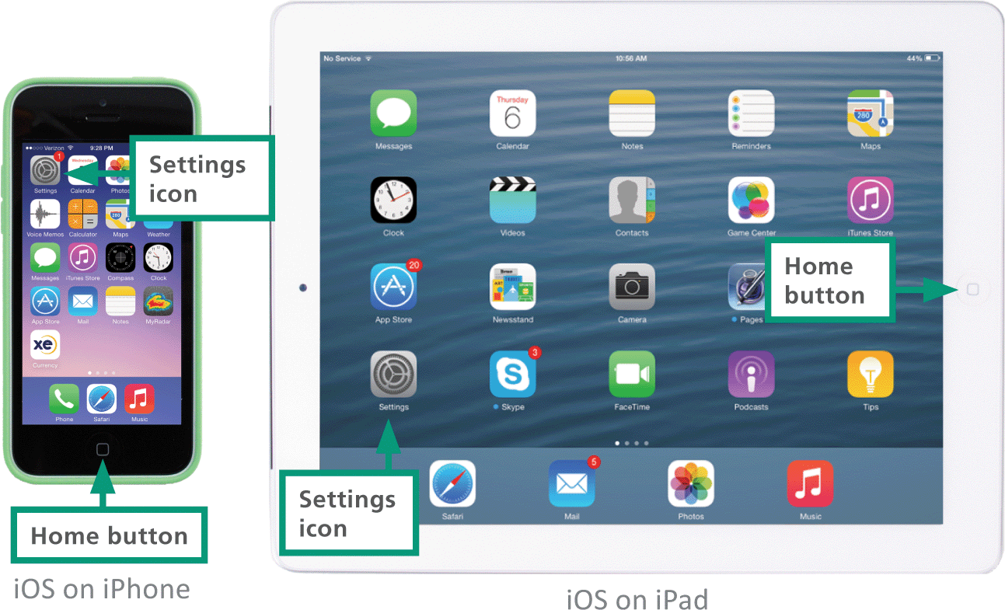
iOS
iOS is derived from the OS X code and shares its UNIX roots
Both OSs feature icons with similar design aesthetic

Slide 42
iOS
Limitations to iOS:
iOS limits your selection of apps to those provided by the online Apple App Store, unless you make unauthorized modifications to “jailbreak” the phone
Background processes, such as music, voice calls, and notifications, provide very limited multitasking capabilities

Slide 43
Android
Developed in 2007, Android is a mobile operating system that is a popular platform for tablet computers, smartphones, and ebook readers
Android devices have a screen-based home button rather than a physical button
In addition to touchscreen input, the Android OS supports voice input for Google searching, voice dialing, navigation, and other applications

Slide 44
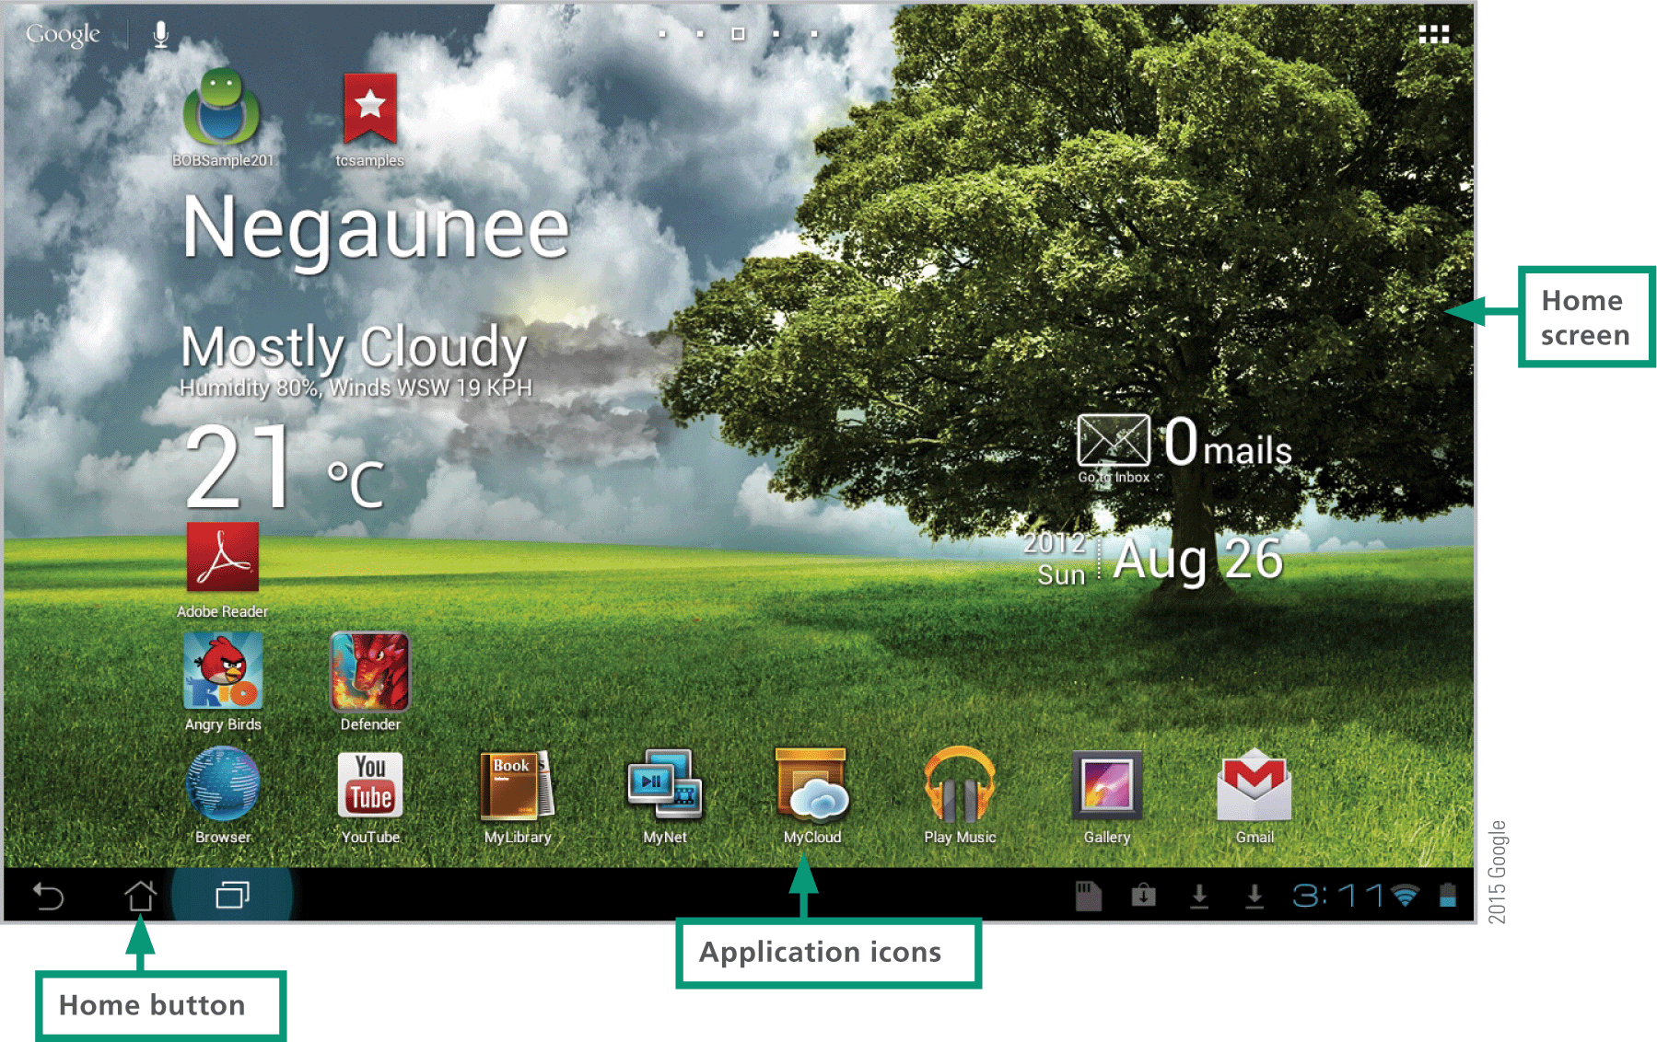
Android

Slide 45
Chrome OS
Google launched an OS called Chrome OS in 2009 with a kernel based on an open source OS called Linux
Chrome OS is an example of a thin client because it depends substantially on processing and storage provided by a remote computer—in this case, cloud-based servers
Unlike iPads, Chromebooks support multiple users, but provide limited storage space
Chromebooks boot very quickly to a simple desktop where apps are displayed in the Chrome browser

Slide 46
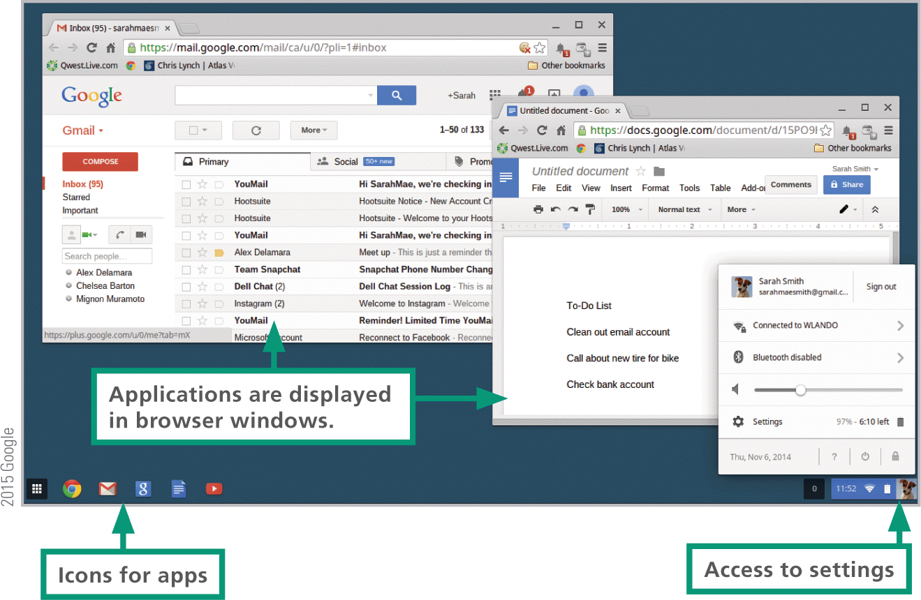
Chrome OS

Slide 47
Virtual Machines
It’s possible to run Windows on a Mac using a virtual machine
A virtual machine (VM) allows one computer to simulate the hardware and software of another
Each VM has its own simulated processor, RAM, video card, input and output ports, and OS
Popular VM software such as VMware and Parallels Desktop can run on most computers with Intel microprocessors, including Intel Macs, PCs, and generic Linux computers

Slide 48
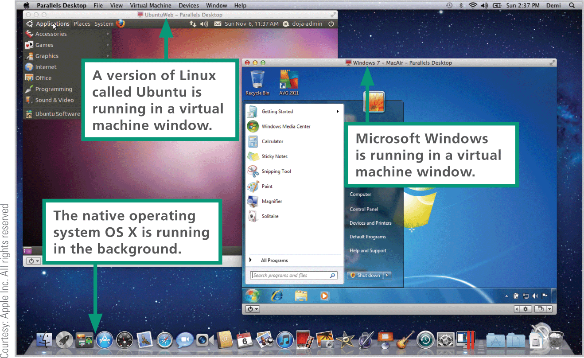
Virtual Machines

Slide 49
Section C: Apps and Applications
Web Apps
Mobile Apps
Local Applications
Portable Software
Uninstalling Software

Slide 50
Web Apps
A Web application (or Web app) is software that is accessed with a Web browser
Web apps are an example of cloud computing
Some popular Web apps include: Gmail, Google Docs, and Turnitin
Most Web apps require no installation at all on your local computer or handheld device

Slide 51
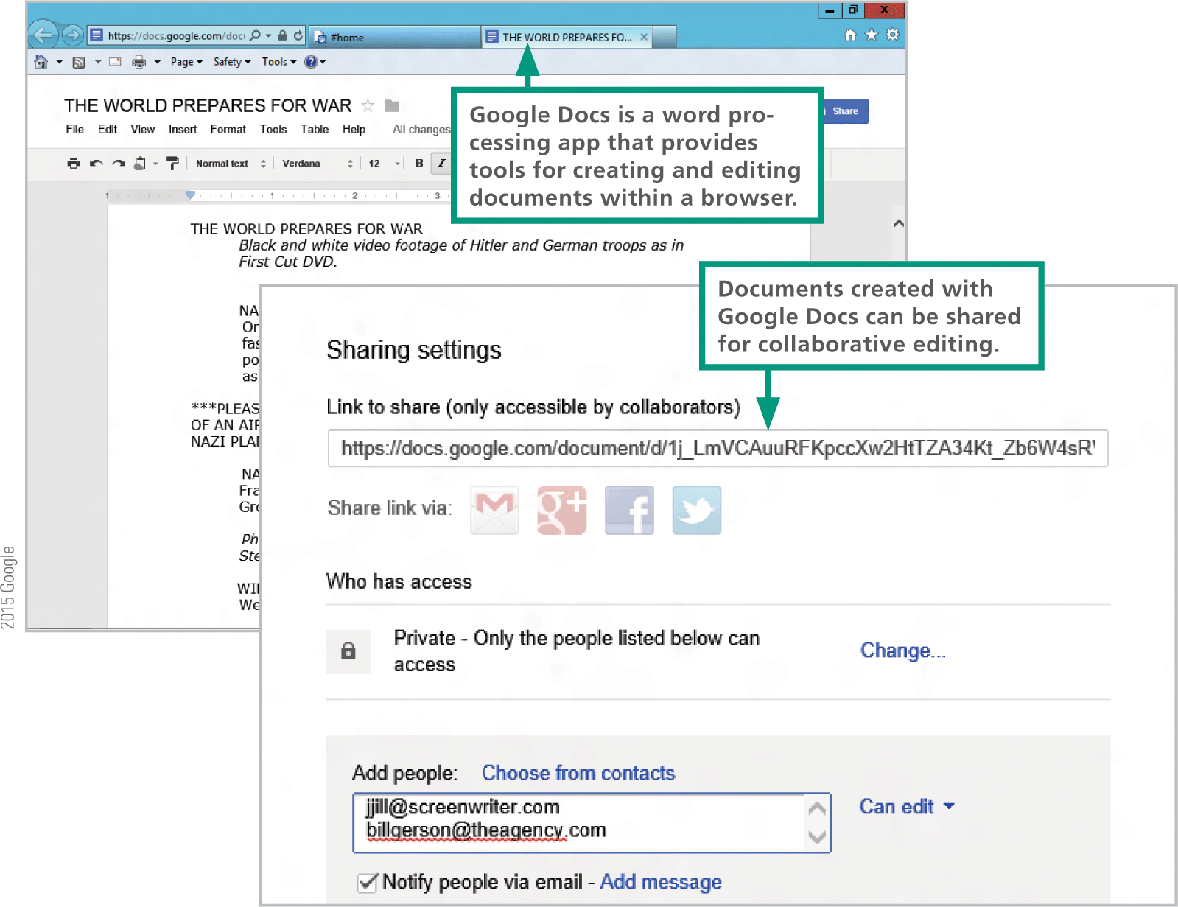
Web Apps
Web apps allow several people to collaborate on projects because the project files are stored on the Web and can be easily shared

Slide 52
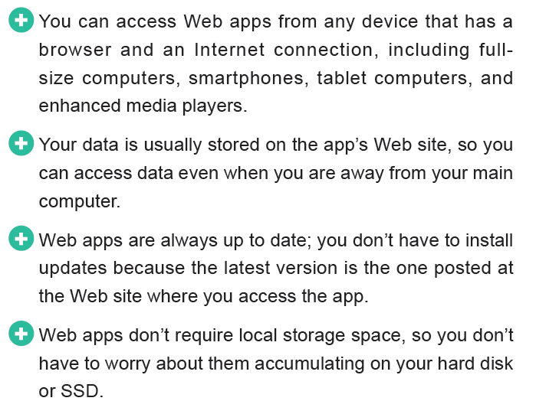
Web Apps
Advantages:

Slide 53
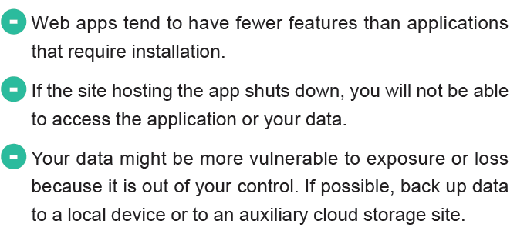
Web Apps
Disadvantages:

Slide 54
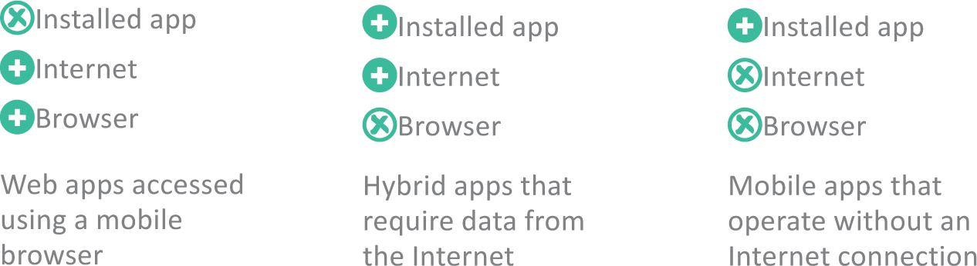
Mobile Apps
A mobile app is designed for a handheld device, such as a smartphone, tablet computer, or enhanced media player
Most handheld devices can use both Web apps and mobile apps
Some apps, such as Yelp and Pandora, are hybrids; a thin client is downloaded from an app store, but during use, data is accessed from the Web

Slide 55
Mobile Apps
iPads, iPhones, and iPods are only allowed to download apps from the official iTunes App Store
Apps are available from other sources, but using them requires an unauthorized change to the device’s software called a jailbreak
After downloading and installing the jailbreak software, your device will be able to install apps from a variety of sources other than the iTunes App Store
The process of making unauthorized modifications to any mobile device is called rooting

Slide 56
Local Applications
A local application is installed on a computer’s hard disk
Office suites, games, and professional software tools are common examples of local applications for desktop and laptop computers

Slide 57
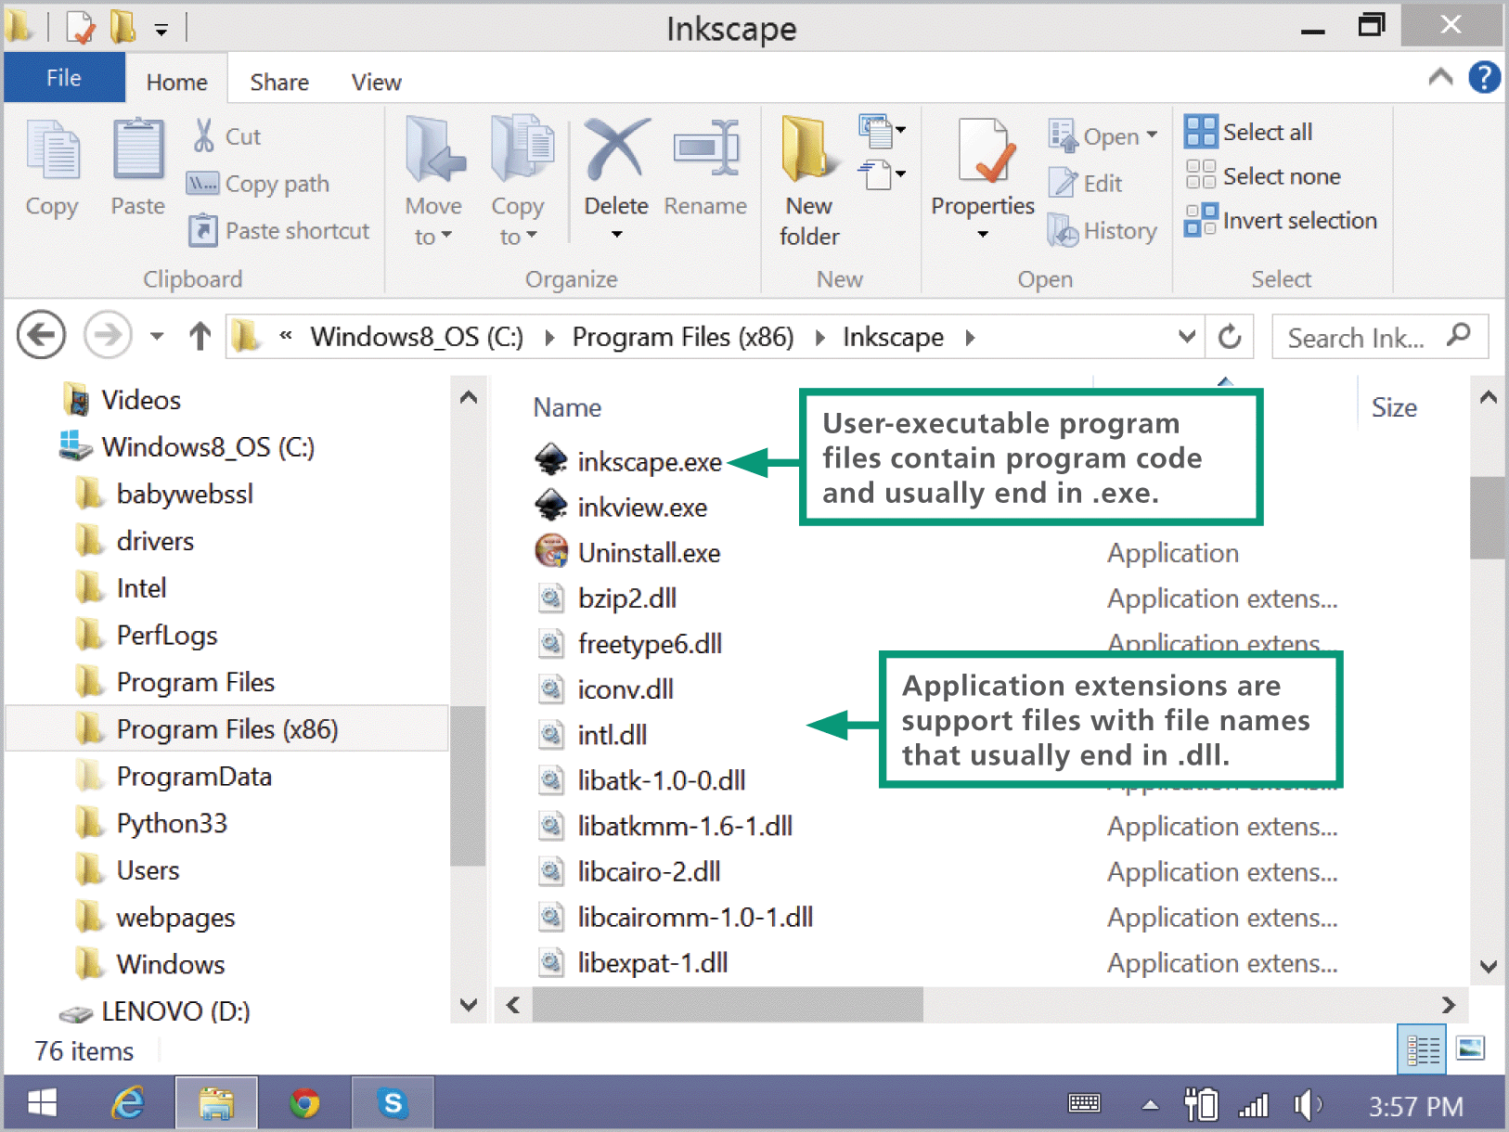
Local Applications
Software designed for computers that run Microsoft Windows is commonly composed of multiple files; the main executable file has an .exe extension—for example, Inkscape.exe
Additional files required for Windows application software contain support modules called application extensions with file names that end in .dll

Slide 58
Local Applications
Software for PCs contains a setup program that guides you through the installation process
During the installation process, the setup program usually performs the following activities:

Slide 59
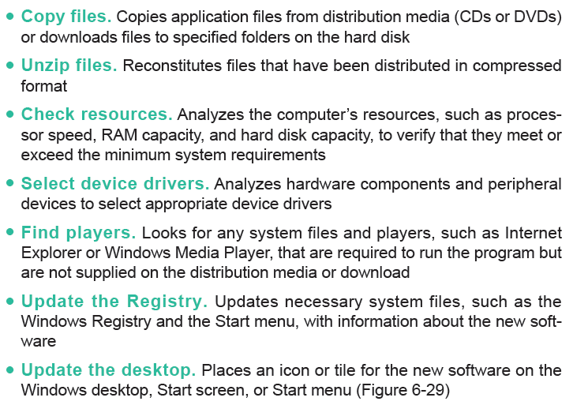
Local Applications

Slide 60
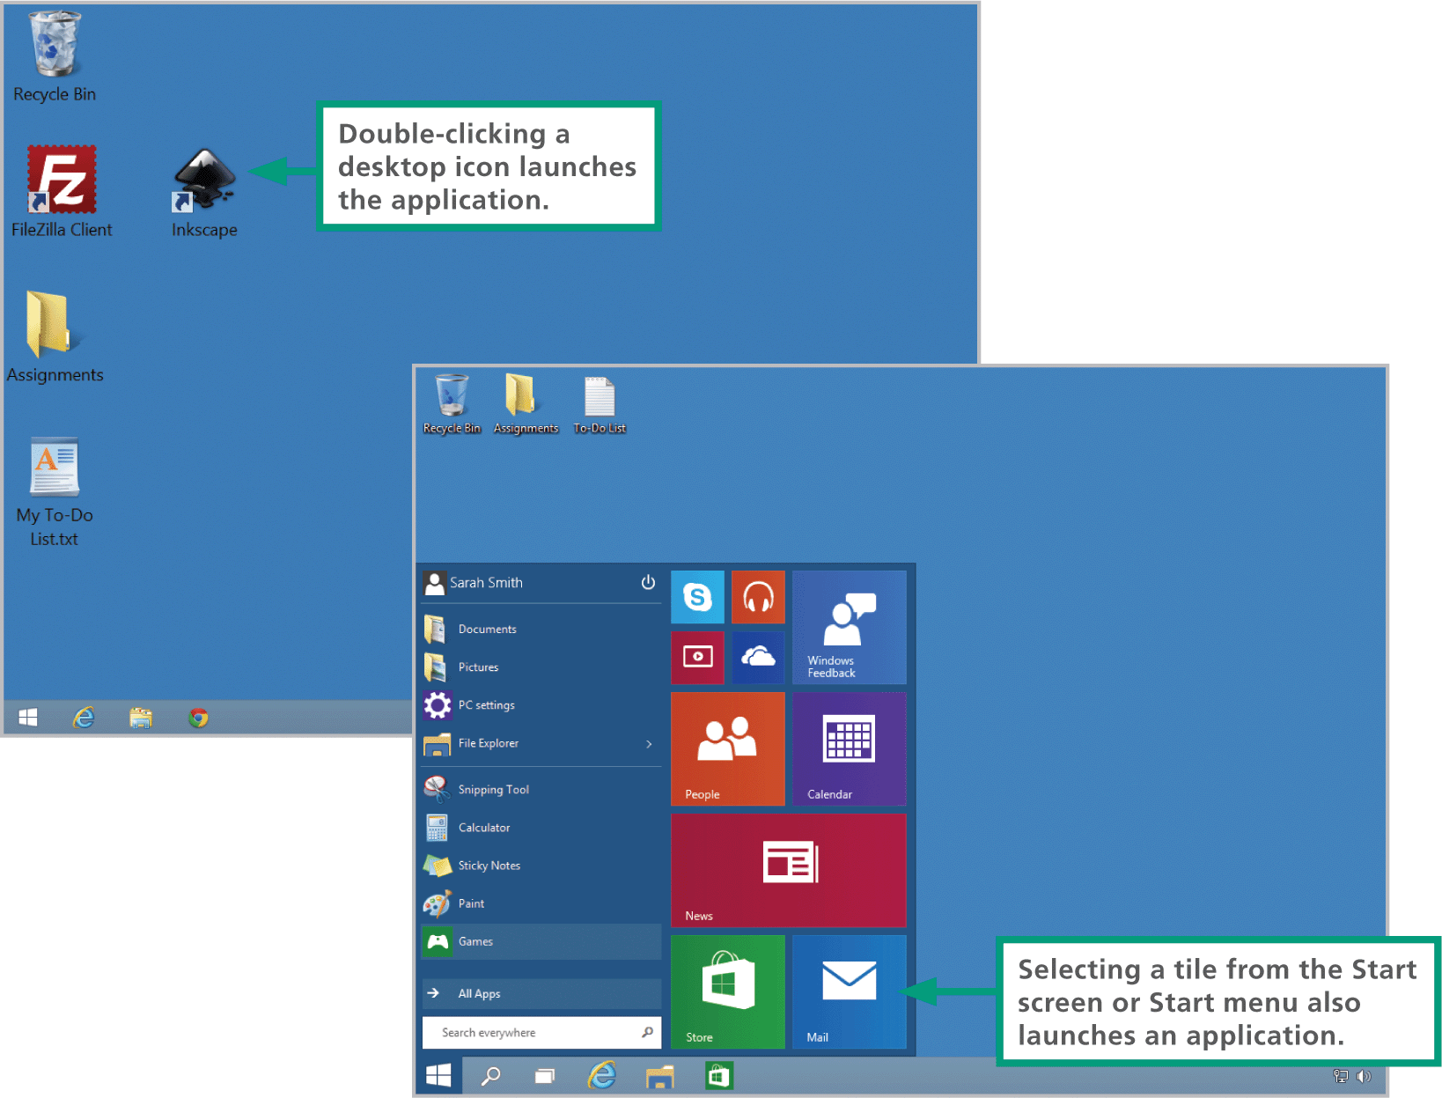
Local Applications

Slide 61
Portable Software
Portable software is designed for PCs and it runs from removable storage, such as a USB flash drive
There are a limited number of portable apps, but the available selection covers most essential tasks
Portable software is so simple to install that it is sometimes referred to as install-free software

Slide 62
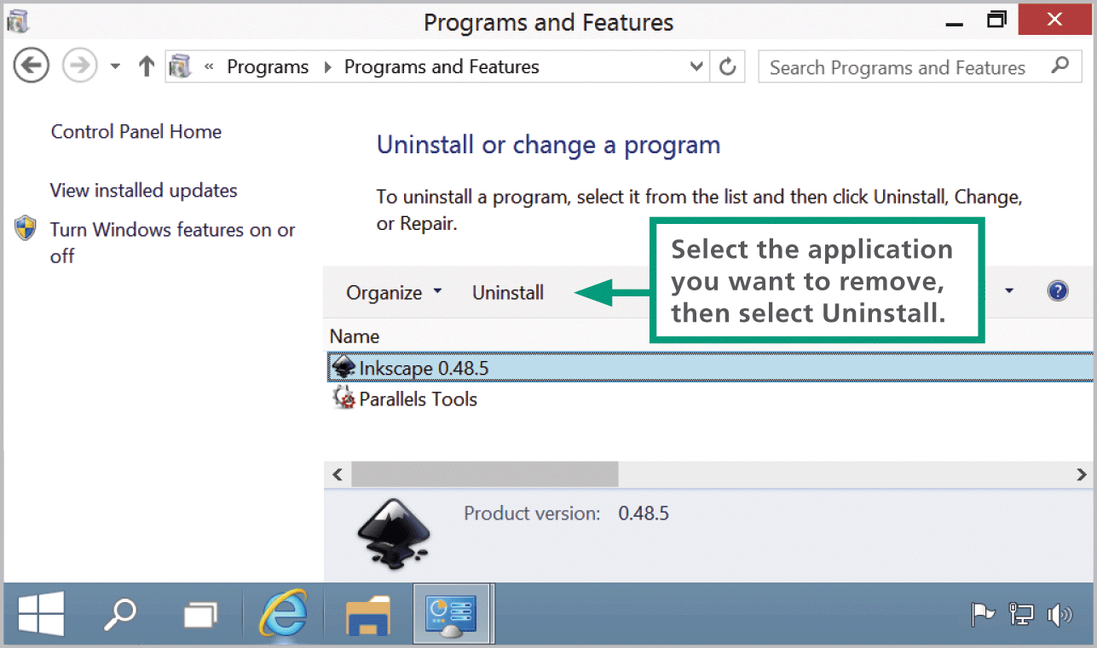
Uninstalling Software
The process of removing software differs for PCs and Macs
Most Mac users simply use Finder to locate the program’s APP file or folder and move it to the trash
The Windows OS includes an uninstall utility, which deletes the software’s files form various folders on your computer’s hard disk

Slide 63
Section D: Productivity Software
Office Suite Basics
Word Processing
Spreadsheets
Databases
Presentations

Slide 64
Office Suite Basics
Office suites, such as Microsoft Office, are sometimes referred to as productivity software
An office suite is a collection of programs that typically include word processing, spreadsheet, and presentation modules
In the context of office suites, the term module refers to a component, such as a word processing module

Slide 65
Word Processing
Word processing software has replaced typewriters for producing many types of documents, including reports, letters, memos, papers, and book manuscripts
A typical word processor window displays a work area, called a workspace, that represents a blank piece of paper; the window also includes controls for viewing and formatting the document

Slide 66

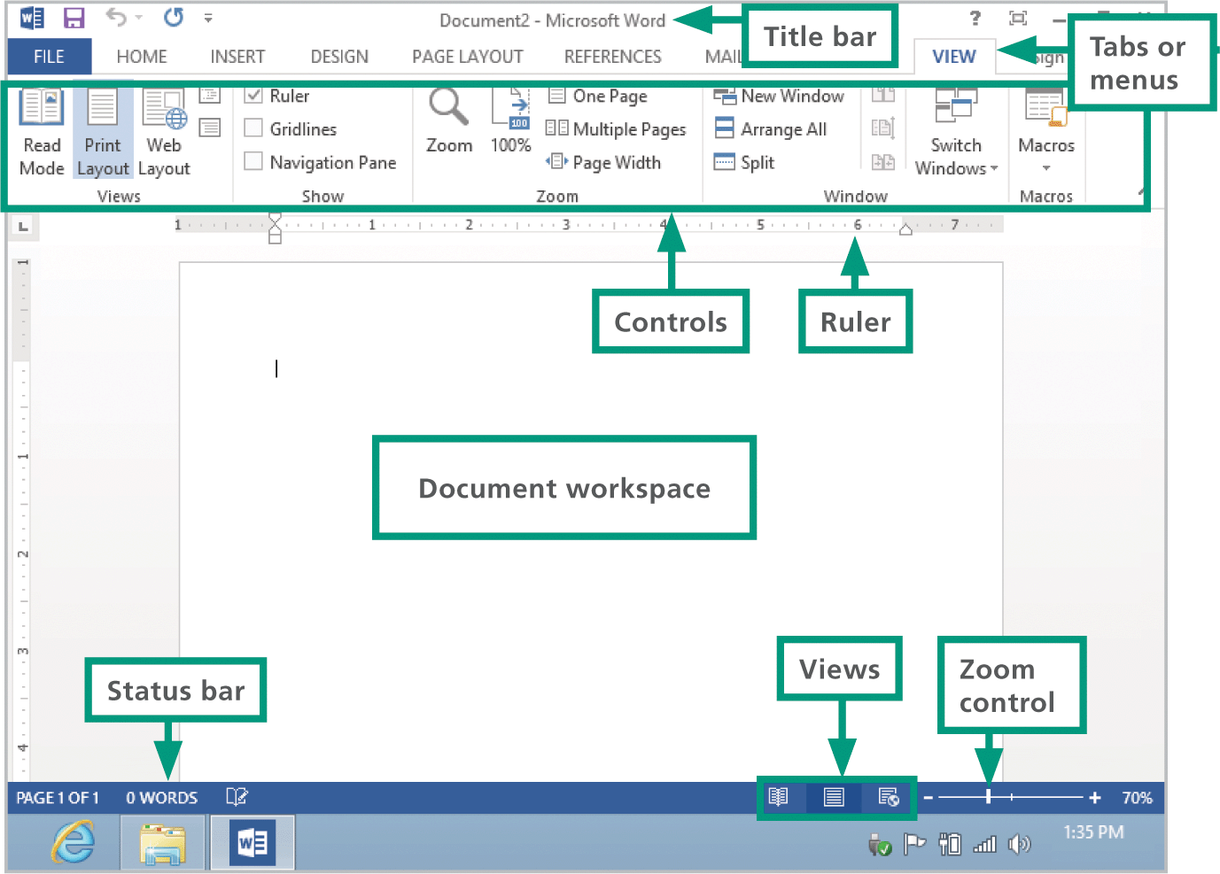
Word Processing

Slide 67
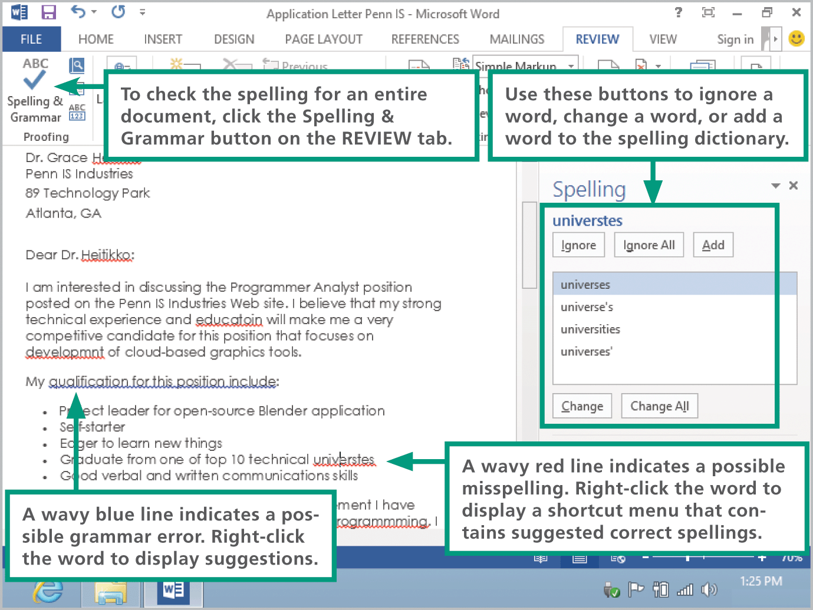
Word Processing

Slide 68
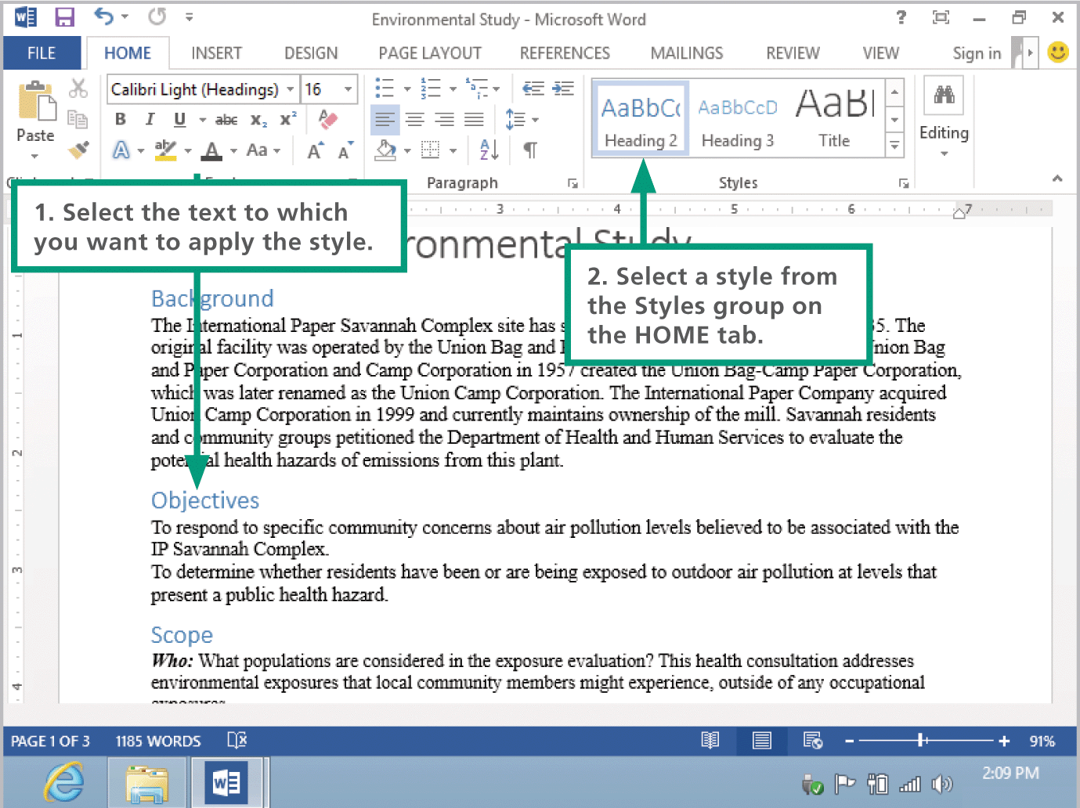
Word Processing

Slide 69
Spreadsheets
A spreadsheet uses rows and columns of numbers to create a model or representation of a real situation
Spreadsheet software, such as Microsoft Excel and Google Docs Sheets, provides tools to create electronic spreadsheets
Because it is so easy to experiment with different numbers, spreadsheet software is particularly useful for what-if analysis

Slide 70
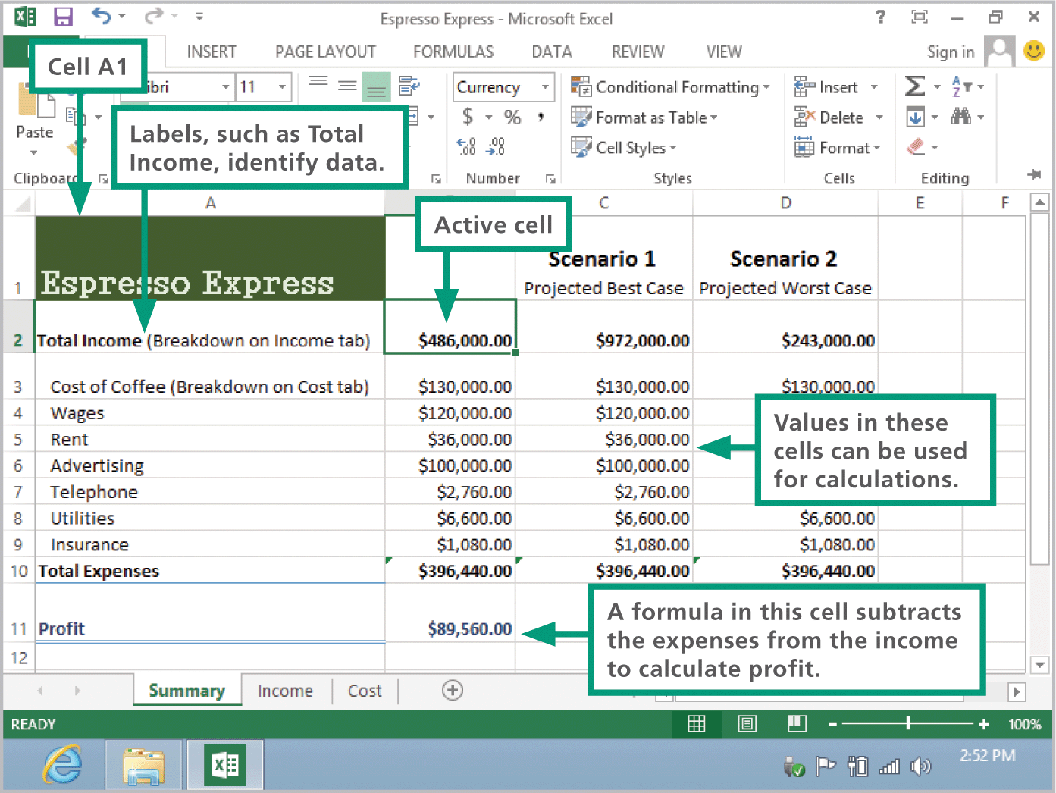
Spreadsheets

Slide 71
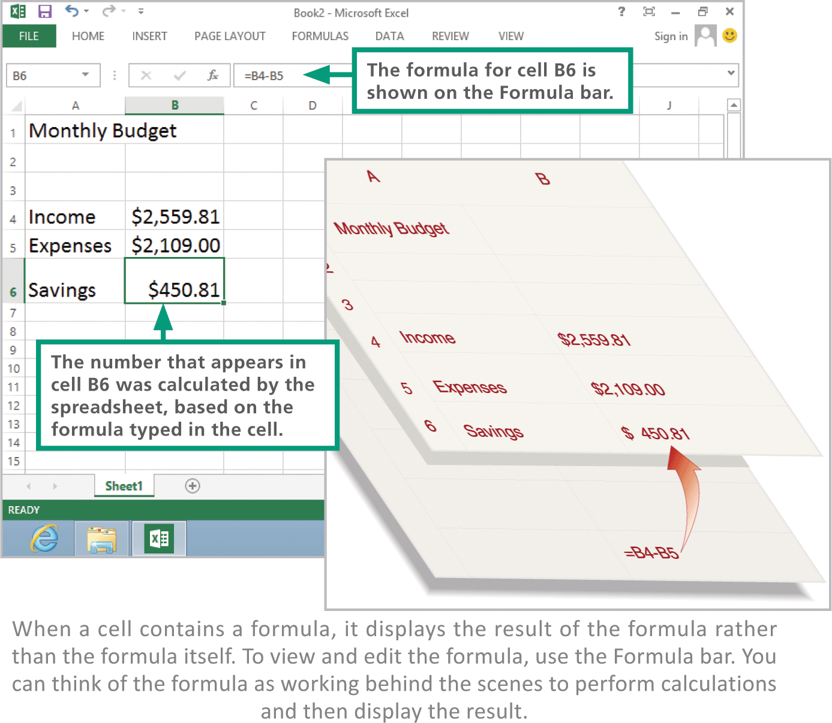
Spreadsheets

Slide 72
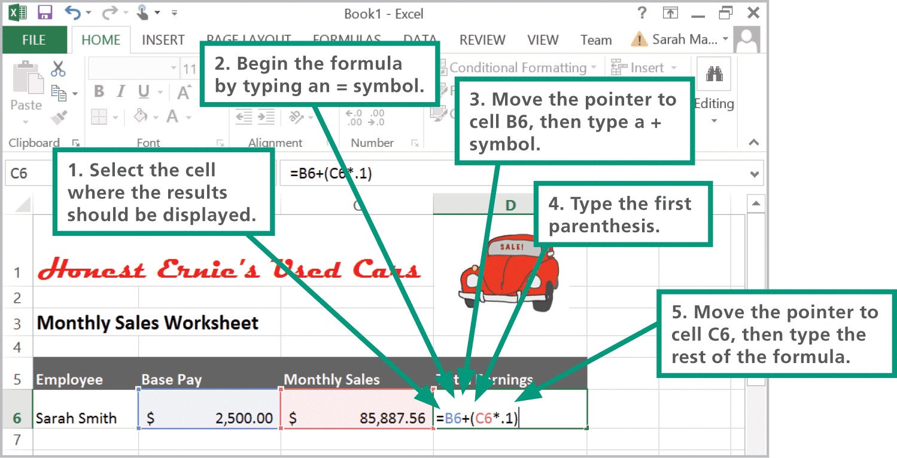
Spreadsheets

Slide 73
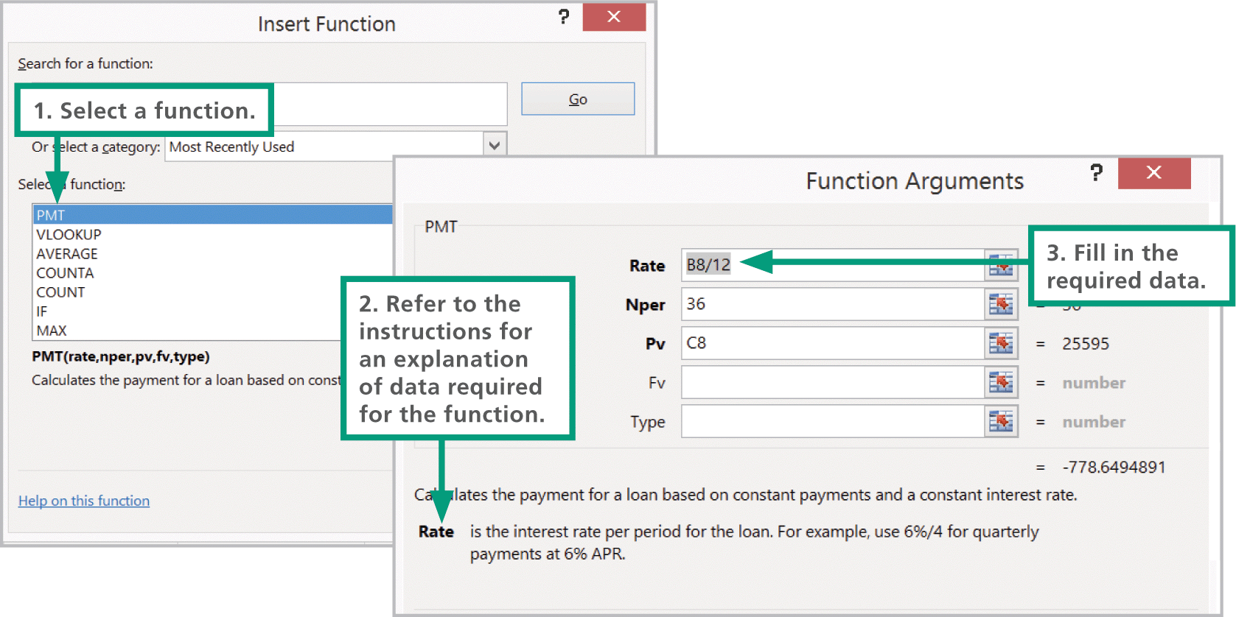
Spreadsheets

Slide 74
Spreadsheets
When you change the contents of any cell in a worksheet, all the formulas are recalculated; this automatic recalculation feature ensures that the results in every cell are accurate for the information currently entered in the worksheet
Unless you specify otherwise, a cell reference is a relative reference—that is, a reference that can change
An absolute reference never changes when you insert rows, or copy and move formulas

Slide 75
Databases
The term database has evolved from a specialized technical term into a part of our everyday vocabulary
In the context of modern usage, a database is simply a collection of data that may be stored on one or more digital devices
Database software helps you enter, find, organize, update, and report information stored in a database
Database software stores data as a series of records, which are composed of fields that hold data
  A record holds data for a single entity—a person, place, thing, or event
  A field holds one item of data relevant to a record

Slide 76

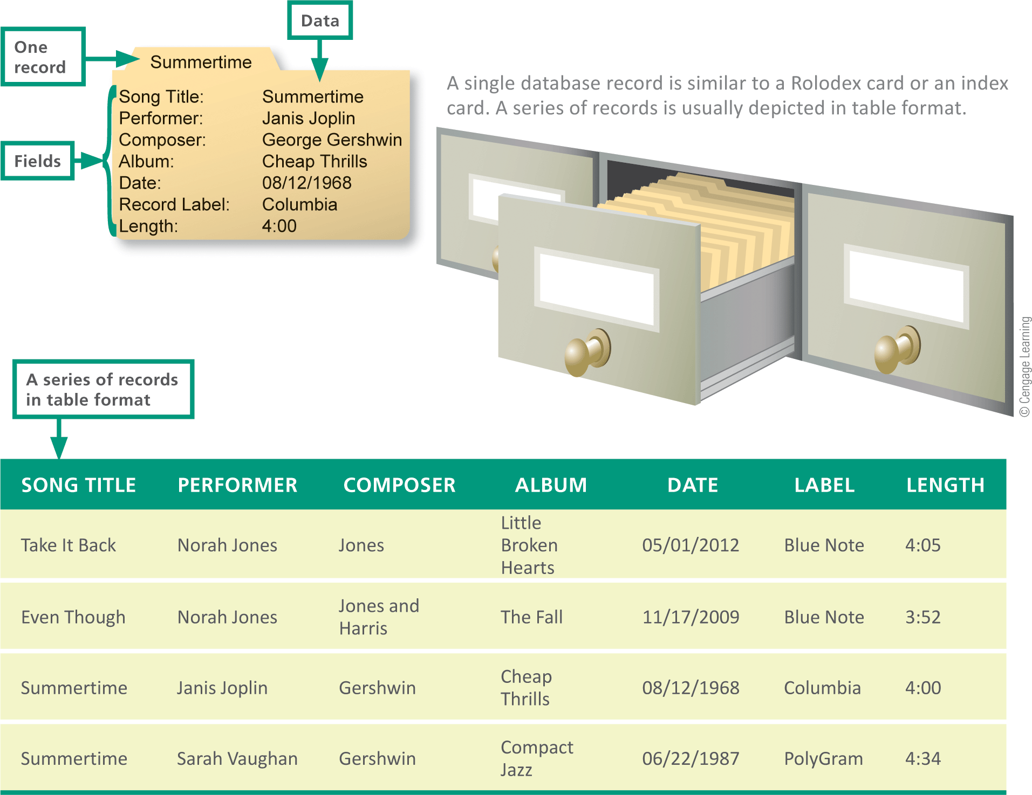
Databases

Slide 77
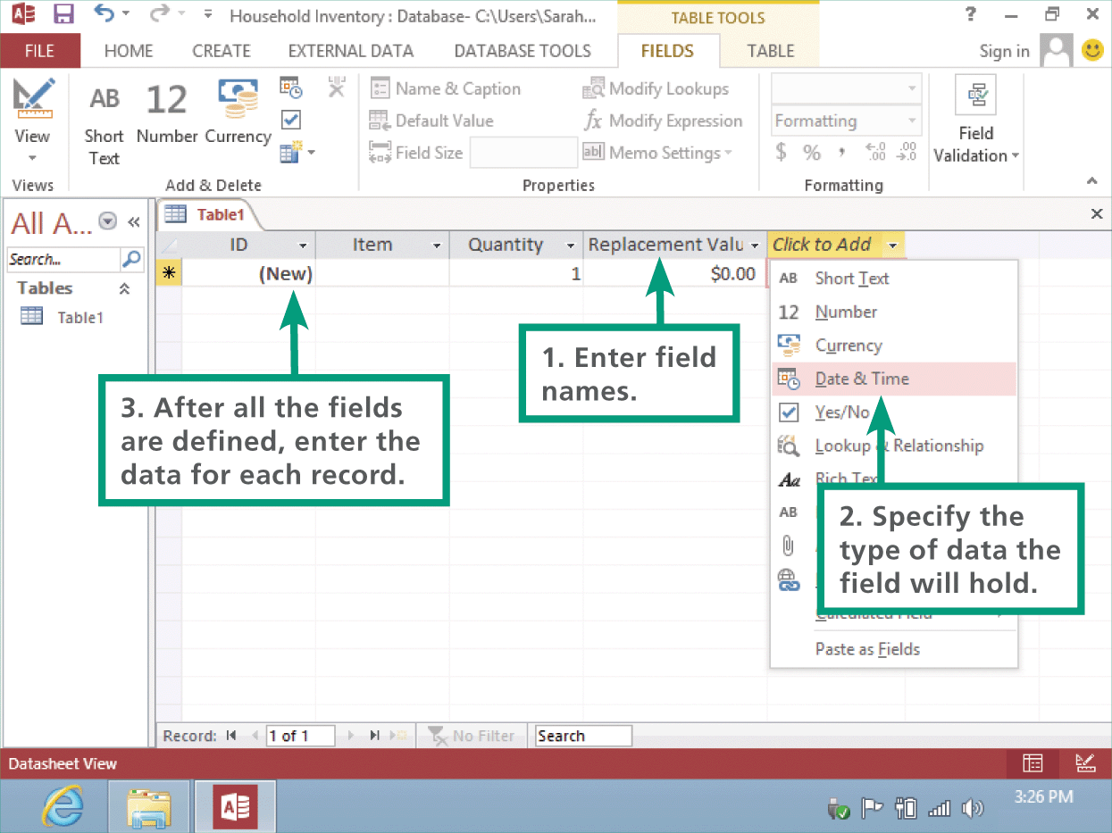
Databases

Slide 78
Presentations
Presentation software supplies the tools for combining text, photos, clip art, graphs, animations, and sound into a series of electronic slides that can be shown on a screen or projector
Popular prsentation software products include Microsoft PowerPoint, iWork Keynote, and Google Docs Slides

Slide 79
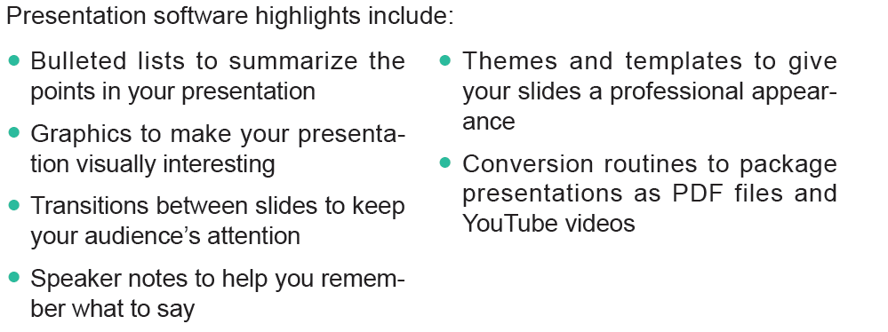
Presentations

Slide 80
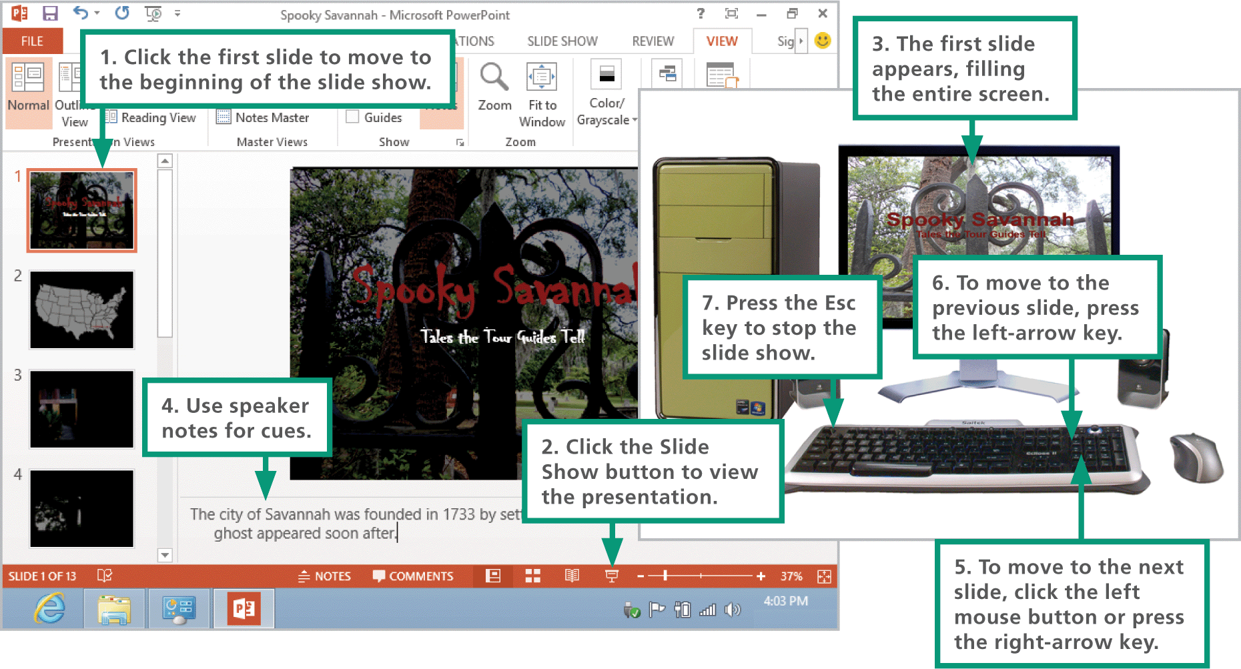
Presentations

Slide 81
Section E: File Management Utilities
File Basics
File Management tools
Application-based File Management
Physical File Storage

Slide 82
File Basics
As you learned in Unit 1, a computer file—or simply a file—is defined as a named collection of data that exists on a storage medium, such as a hard disk, cloud drive, or USB flash drive
When saving a file, you must provide a valid file name that adheres to specific rules, referred to as file-naming conventions, which include:
  Maximum length is 256 characters
  Symbols are not allowed
  No reserved words, such as Aux, Com1, and Nul
  Case is disregarded
  Spaces are allowed

Slide 83
File Basics
When working with Windows, storage devices—where files can be saved—can also be identified by a device letter
A disk partition is a section of a hard disk drive that is treated as a separate storage unit; most hard drives are configured with a single partition that contains the OS, programs, and data

Slide 84
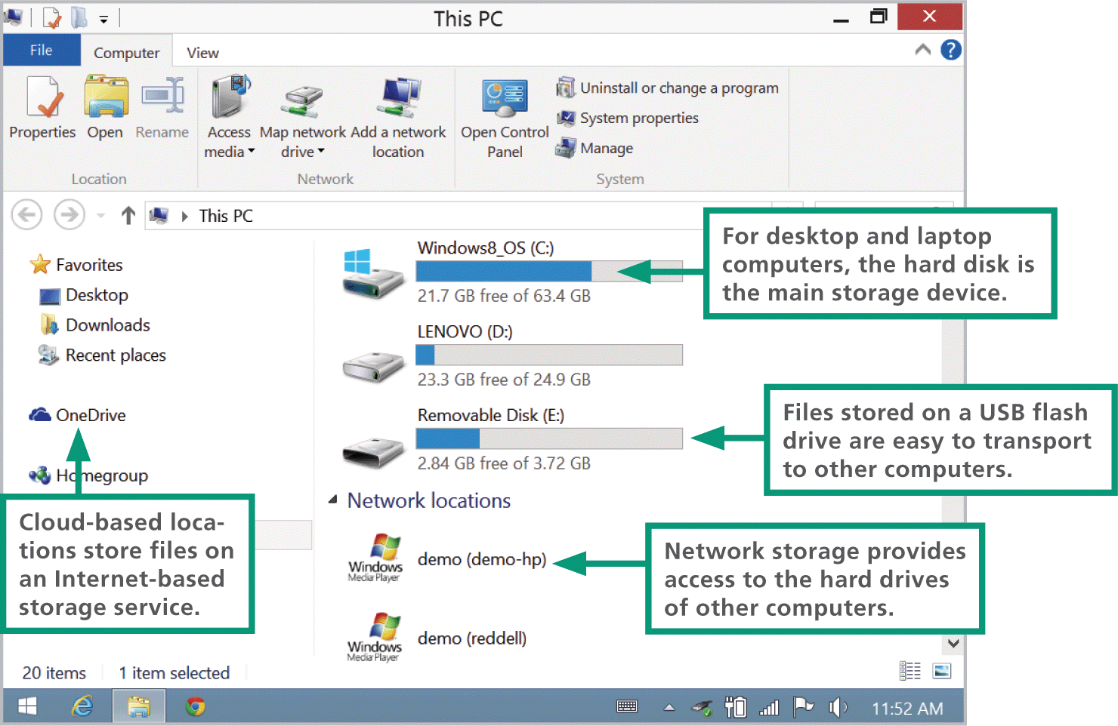
File Basics

Slide 85
File Basics
Every storage device has a directory containing a list of its files
The main directory is referred to as the root directory
A root directory can be subdivided into smaller lists; each list is called a sub-directory
Each subdirectory is depicted as a folder
A computer file’s location is defined by a file path, which on a PC includes the drive letter, folder(s), file name, and extension

Slide 86
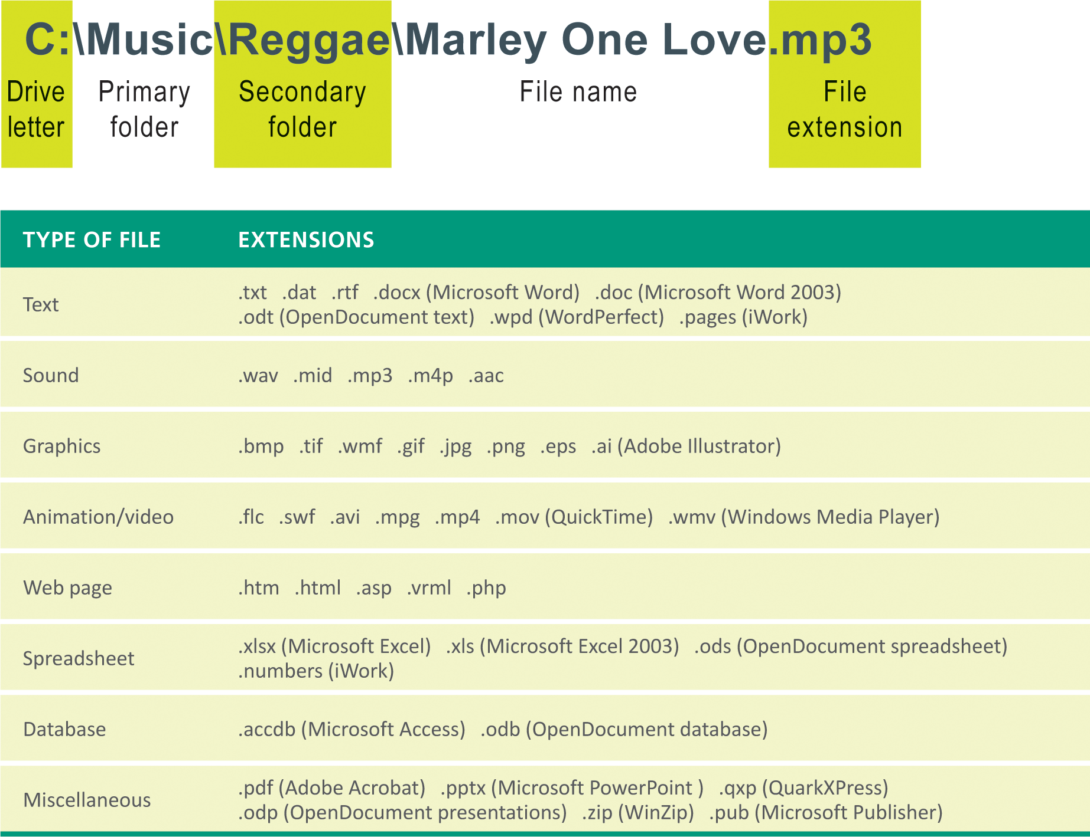
File Basics

Slide 87


File Management Tools
Operating systems provide file organization tools called file management utilities
Windows offers a utility called File Explorer, which is launched from the icon on the taskbar
OS X offers a utility called Finder, which is launched from the on the dock

Slide 88
File Management Tools
File management utilities are useful for locating files and for viewing their contents
The software application associated with a specific file type is called a default application
You can select the application that you want to use by right-clicking the file and selecting the application from a list

Slide 89
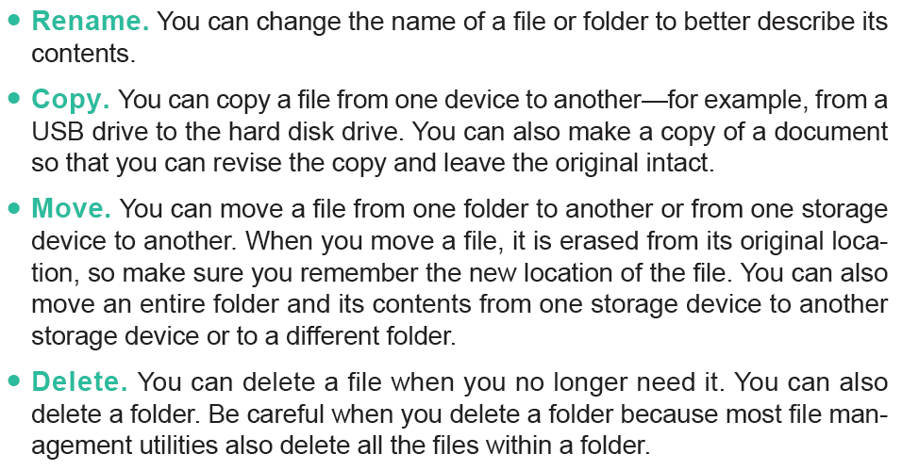
File Management Tools
In addition to locating files and folders, file management utilities help you manipulate files and folders in the following ways:

Slide 90

File Management Tools
Windows and OS X offer a set of preconfigured personal folders, such as Documents and Music, for storing your personal data files

Slide 91

File Management Tools
Cont…

Slide 92

File Management Tools
Cont…

Slide 93

File Management Tools

Slide 94
Application-based File Management
Applications, such as Word and Excel, generally provide a way to open files and save them in a specific folder on a designated storage device
Saving files is easy; simply use the Save option provided by your application, specify a location for the file, and give it a name

Slide 95
Physical File Storage
The structure of files and folders displayed by File Explorer is called a logical storage model because it helps you create a mental picture of the way files are organized in a hierarchy of folders
A physical storage model describes what actually happens on the disks and in the circuits
The formatting process creates the equivalent of electronic storage bins
Magnetic and optical media are divided into circular tracks and then further divided into pie-shaped sectors

Slide 96
Physical File Storage
The OS uses a file system to keep track of the names and locations of files that reside on a storage medium, such as a hard disk
To speed up the process of storing and retrieving data, a disk drive usually works with a group of sectors called a cluster or a block
To delete data from a disk in such a way that no one can ever read it, you can use a special file shredder software that overwrites supposedly empty sectors with random 1s and 0s; this is handy if you want to sell or donate your computer and want to make sure your personal data is no longer on the hard disk

Slide 97
Unit 6 Complete

