Slide 1
Unit 4
The Web
ENHANCED EDITION

Slide 2
Unit Contents
Section A: Web Basics
Section B: Browsers
Section C: HTML
Section D: HTTP
Section E: Search Engines

Slide 3
Section A: Web Basics
Web Overview
Evolution
Web Sites
Hypertext Links
URLs

Slide 4
Web Overview
The Web is not the Internet
The Internet is a global data communications network
The Web is just one of the many technologies that use the Internet to distribute data

Slide 5
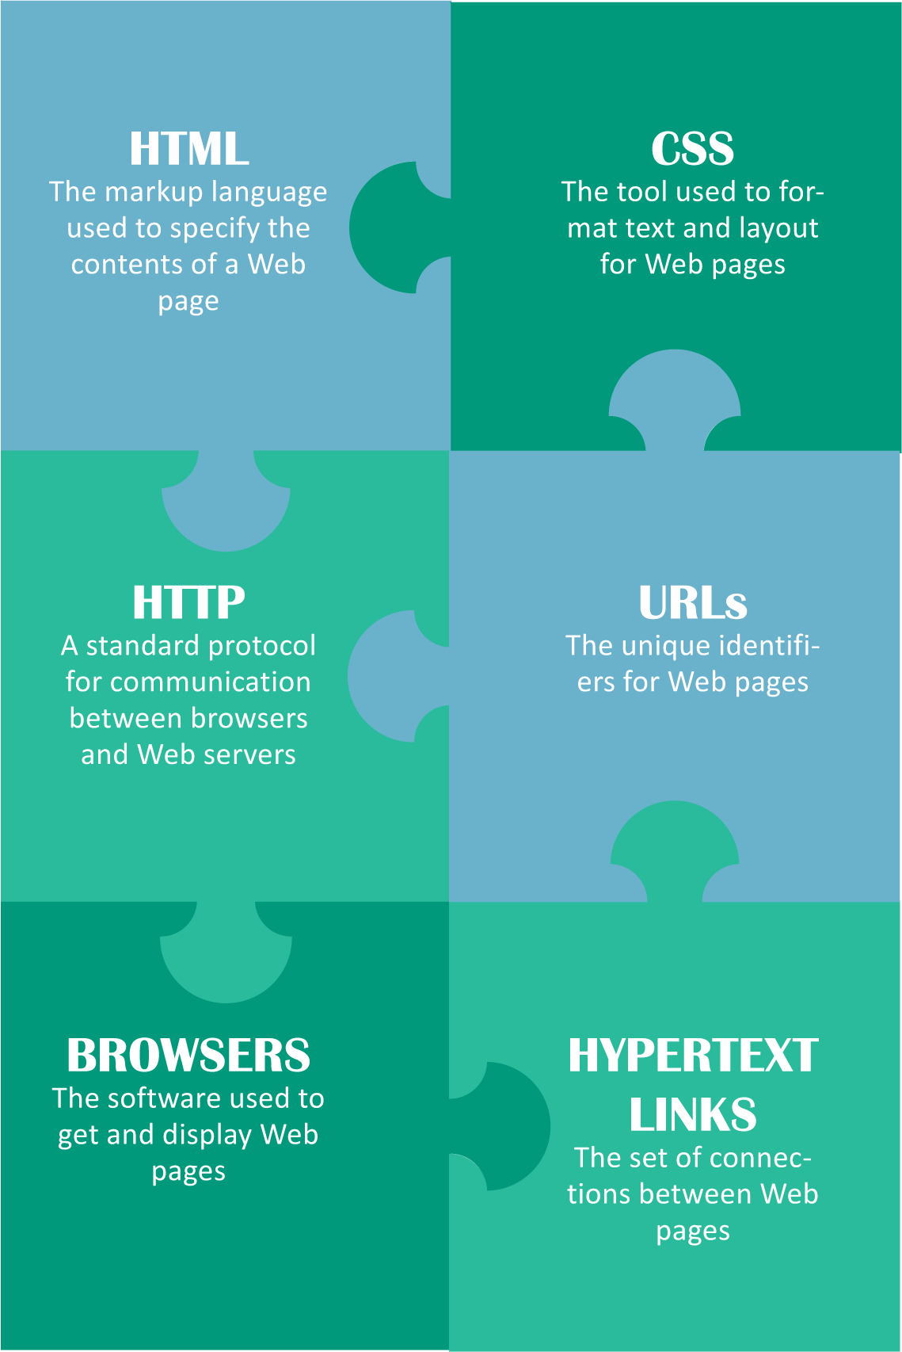
Web Overview
The World Wide Web (usually referred to simply as the Web) is a collection of HTML documents, images, videos, and sound files that can be linked to each other and accessed over the Internet using a protocol called HTTP

Slide 6
Evolution
In 1993 there were a total of 130 Web sites; by 1996 there were 100,000 Web sites
Today, there are more than a billion Web sites and new sites appear every day
Ted Nelson coined the term hypertext to describe a computer system that could store literary documents; link them in logical relationships; and allow users to comment on what they read

Slide 7
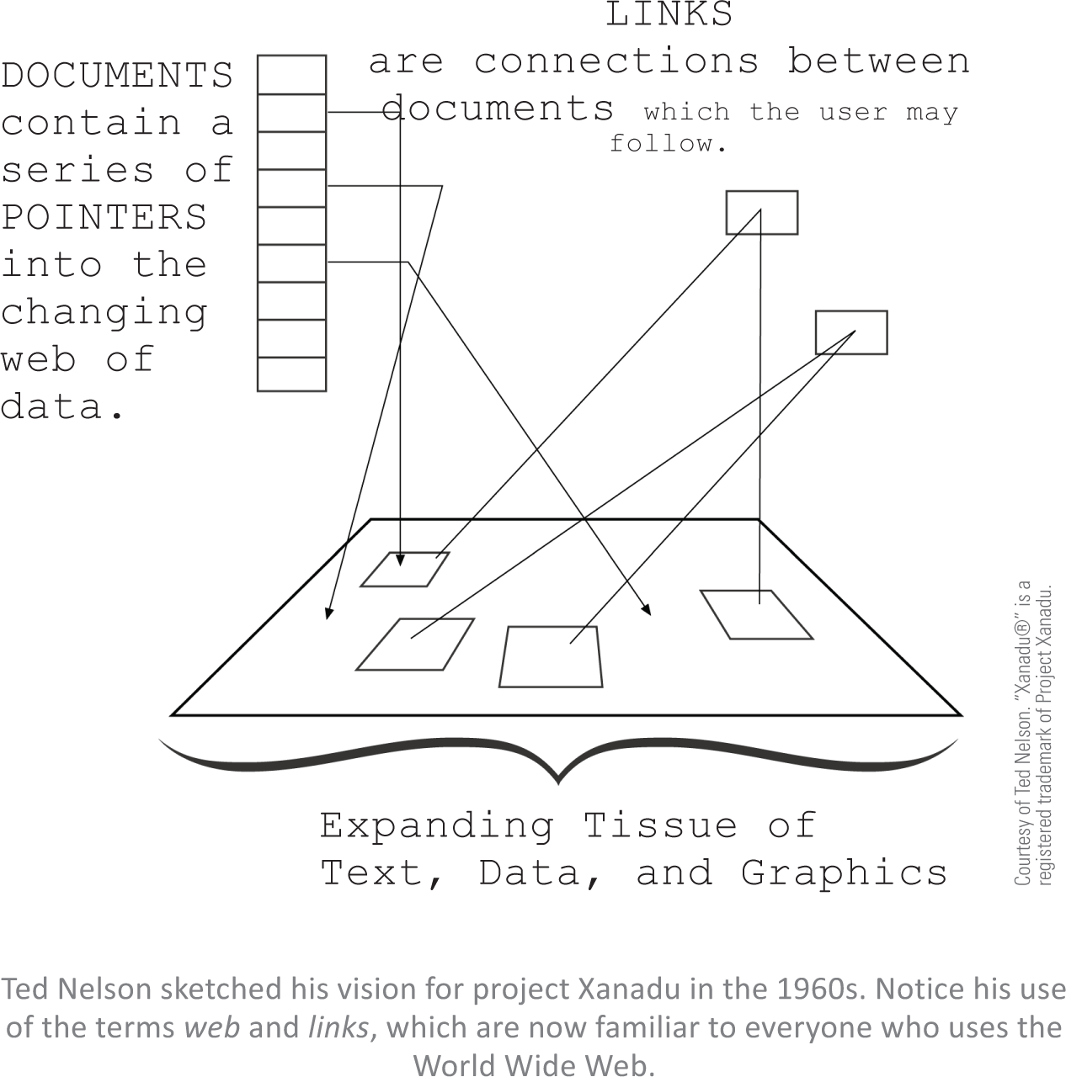
Evolution

Slide 8
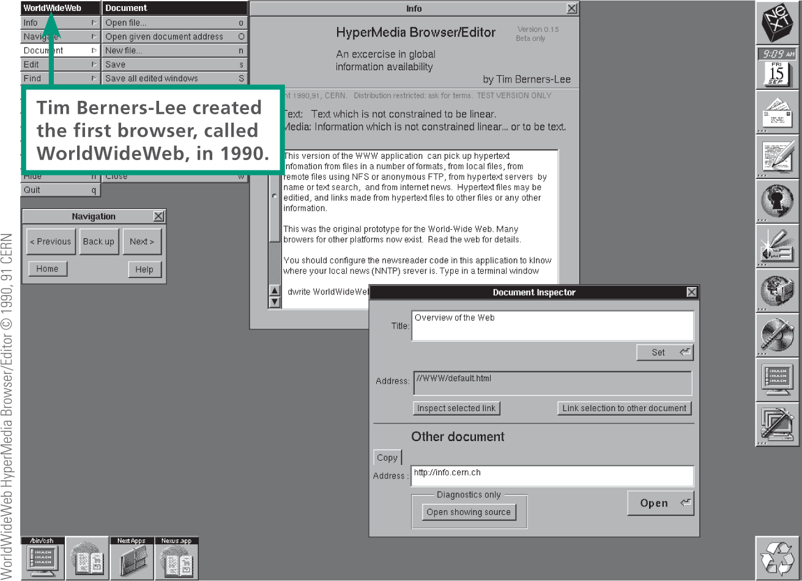
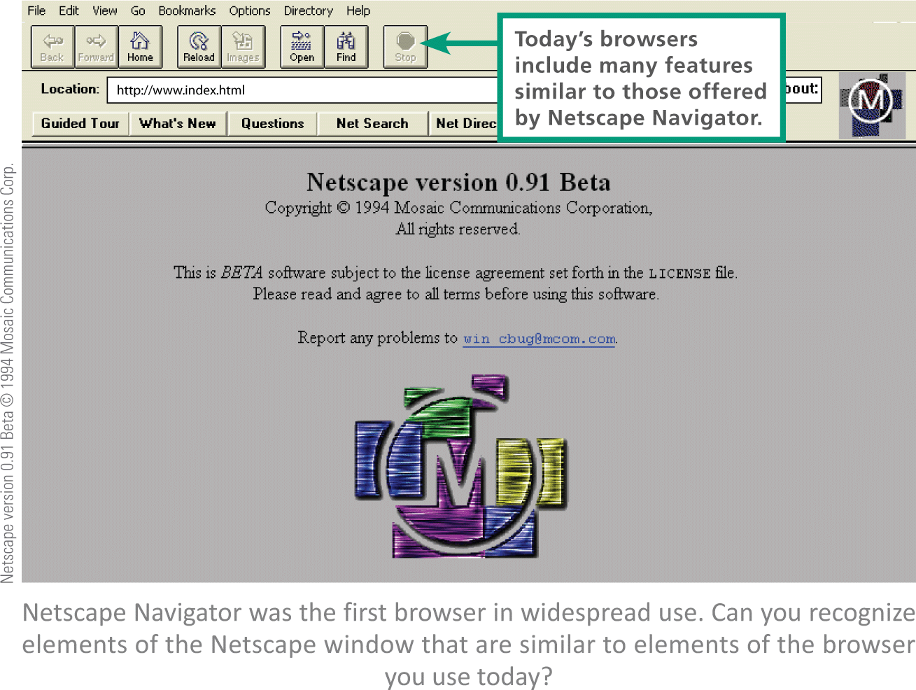
Evolution
In 1990 British scientist Tim Berners-Lee developed specifications for URLs, HTML, and HTTP – the foundation technologies of today’s Web
Berners-Lee created the Web browser software Nexus
In 1993 Marc Andreessen at the University of Illinois created the Web browser Mosaic which led to the development of the popular browser Netscape

Slide 9
Web Sites
A Web site typically contains a collection of related information organized and formatted so it can be accessed using a browser
A Web server is an Internet-based computer that stores Web site content and accepts requests from browsers
A Web page is based on an HTML source document that is stored as a file on a Web server

Slide 10
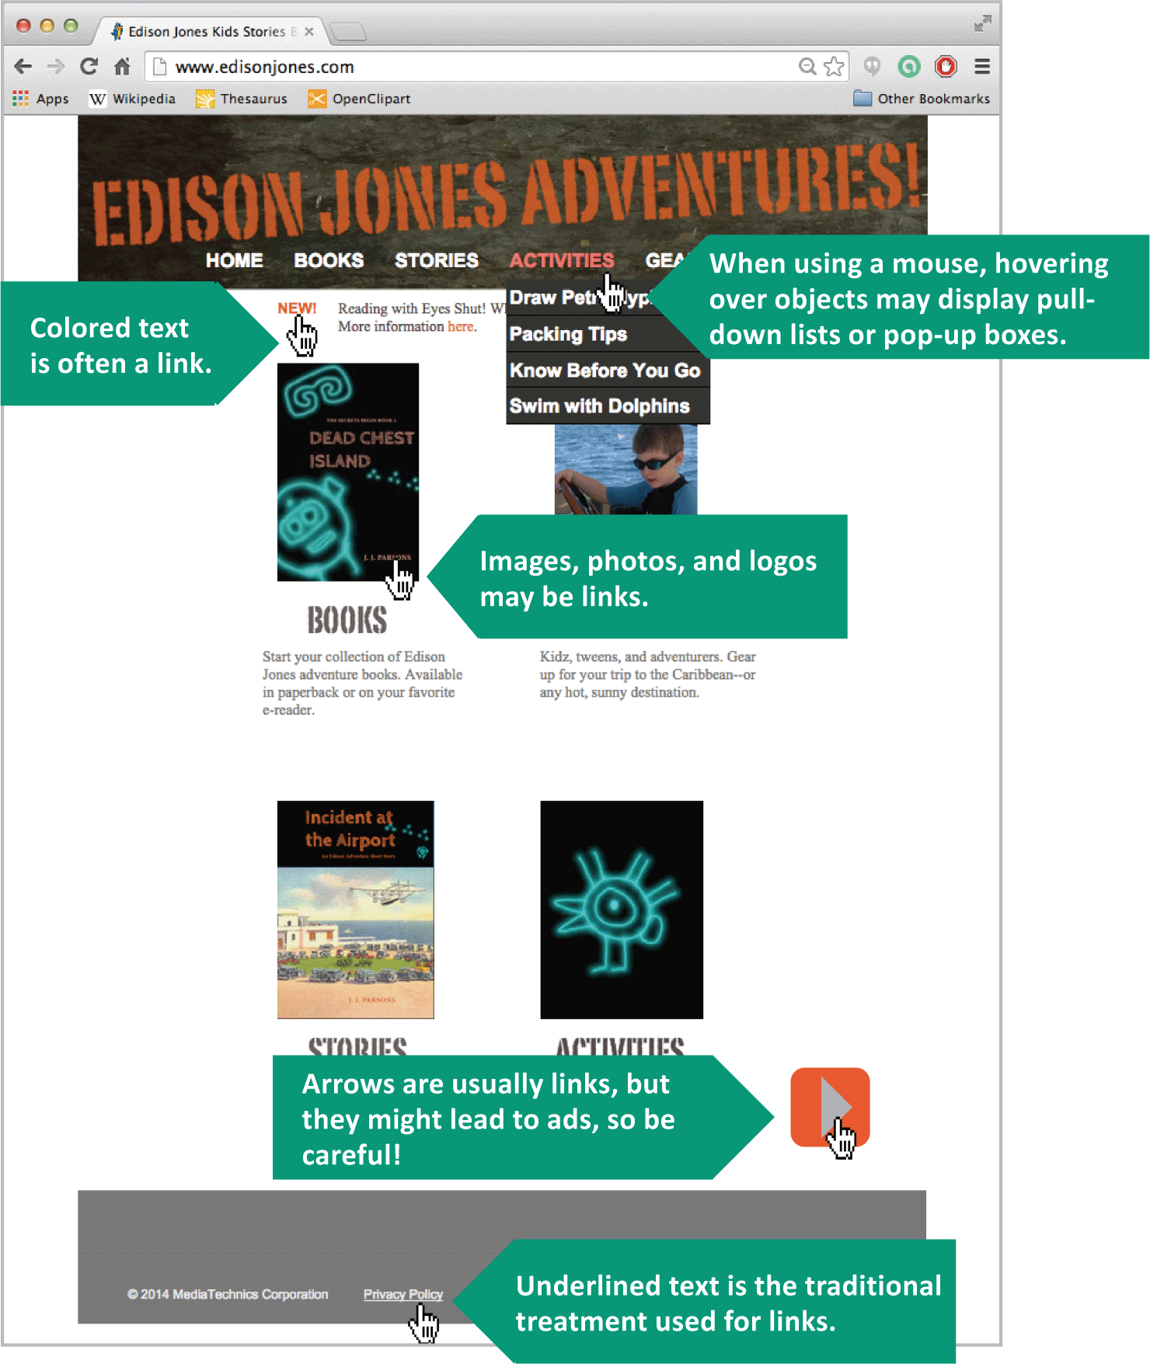
Hypertext Links
Web pages are connected by hypertext links (commonly referred to simply as links)
Links are typically indicated by the following: underlined or colored text, a photo, button, tab, or object

Slide 11
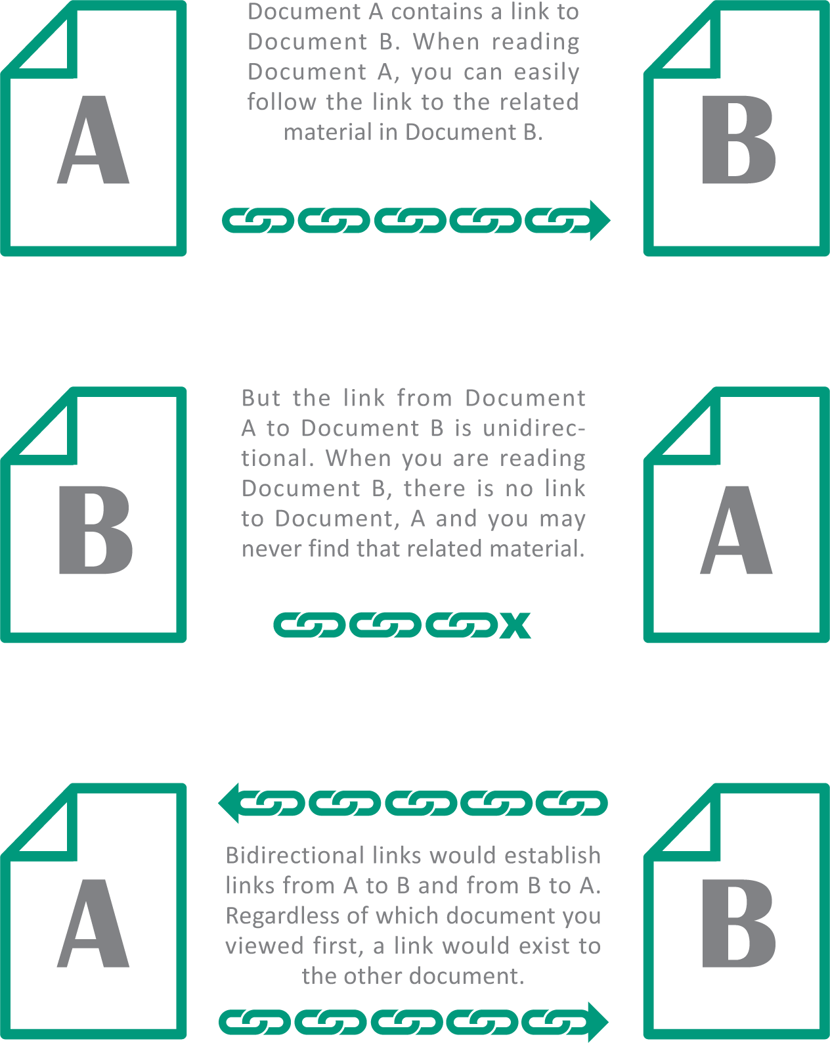
Hypertext Links
Web pages have unidirectional links; Document A links to Document B, but not vise versa
Bidirectional links connect two documents using a two-way link that can be followed from either document

Slide 12
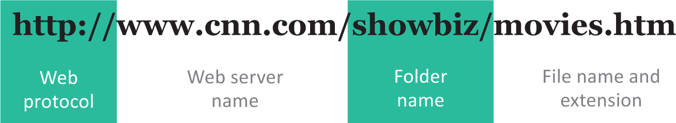
URLs
Every Web page has a unique address called a URL (Uniform Resource Locator, pronounced “you are ELL”)
Most URLs begin with http:// to indicate the Web’s standard communications protocol
The file name of a specific Web page always appears last in the URL

Slide 13
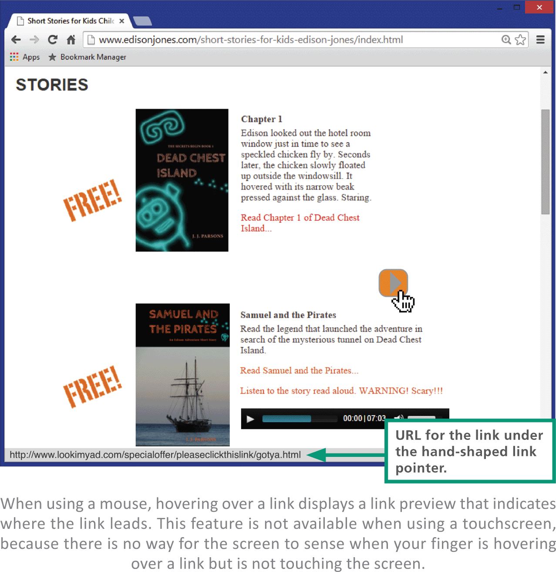
URLs
Links aren’t URLs, but a link contains the URL that “links” to another Web page
Rules for correctly typing a URL:
  A URL never contains spaces
  The http:// can be omitted
  Always use a forward slash (/)
  Duplicate the URL’s capitalization exactly – some Web servers are case sensitive

Slide 14
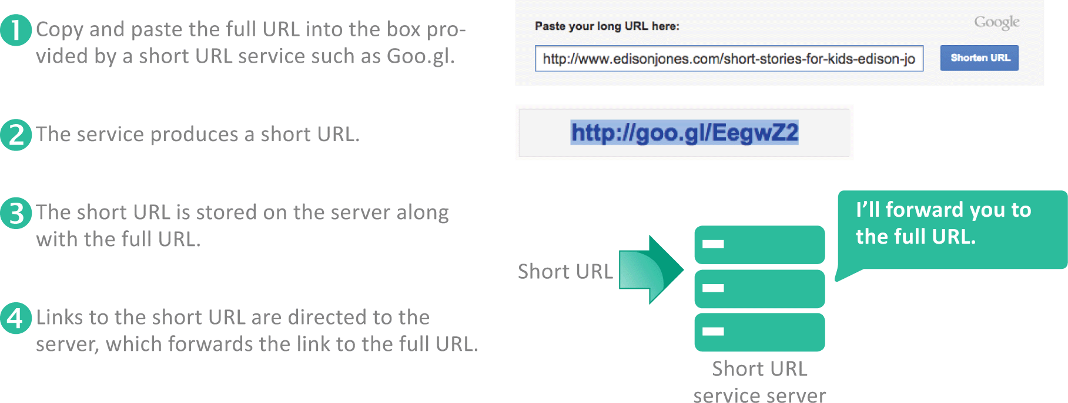
URLs
Many URLs are long and complex; this can be a problem
Several services, such as Bitly and Goo.gl, create short URLs

Slide 15
Section B: Browsers
Browser Basics
Customization
Browser Cache
Plugins and Extensions

Slide 16
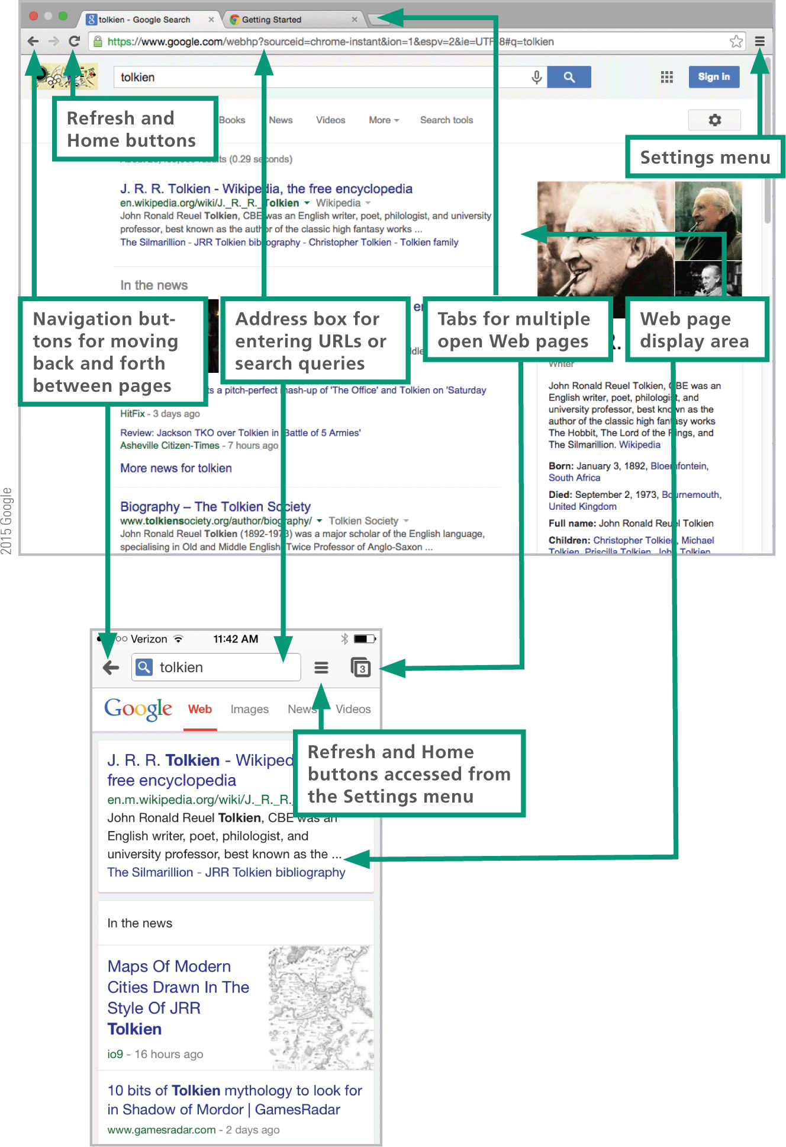
Browser Basics
The essential elements of a browser include:
  An entry area for URLs and searches
  Navigation controls
  A refresh button
  A home button
  A settings menu
  And a display area

Slide 17
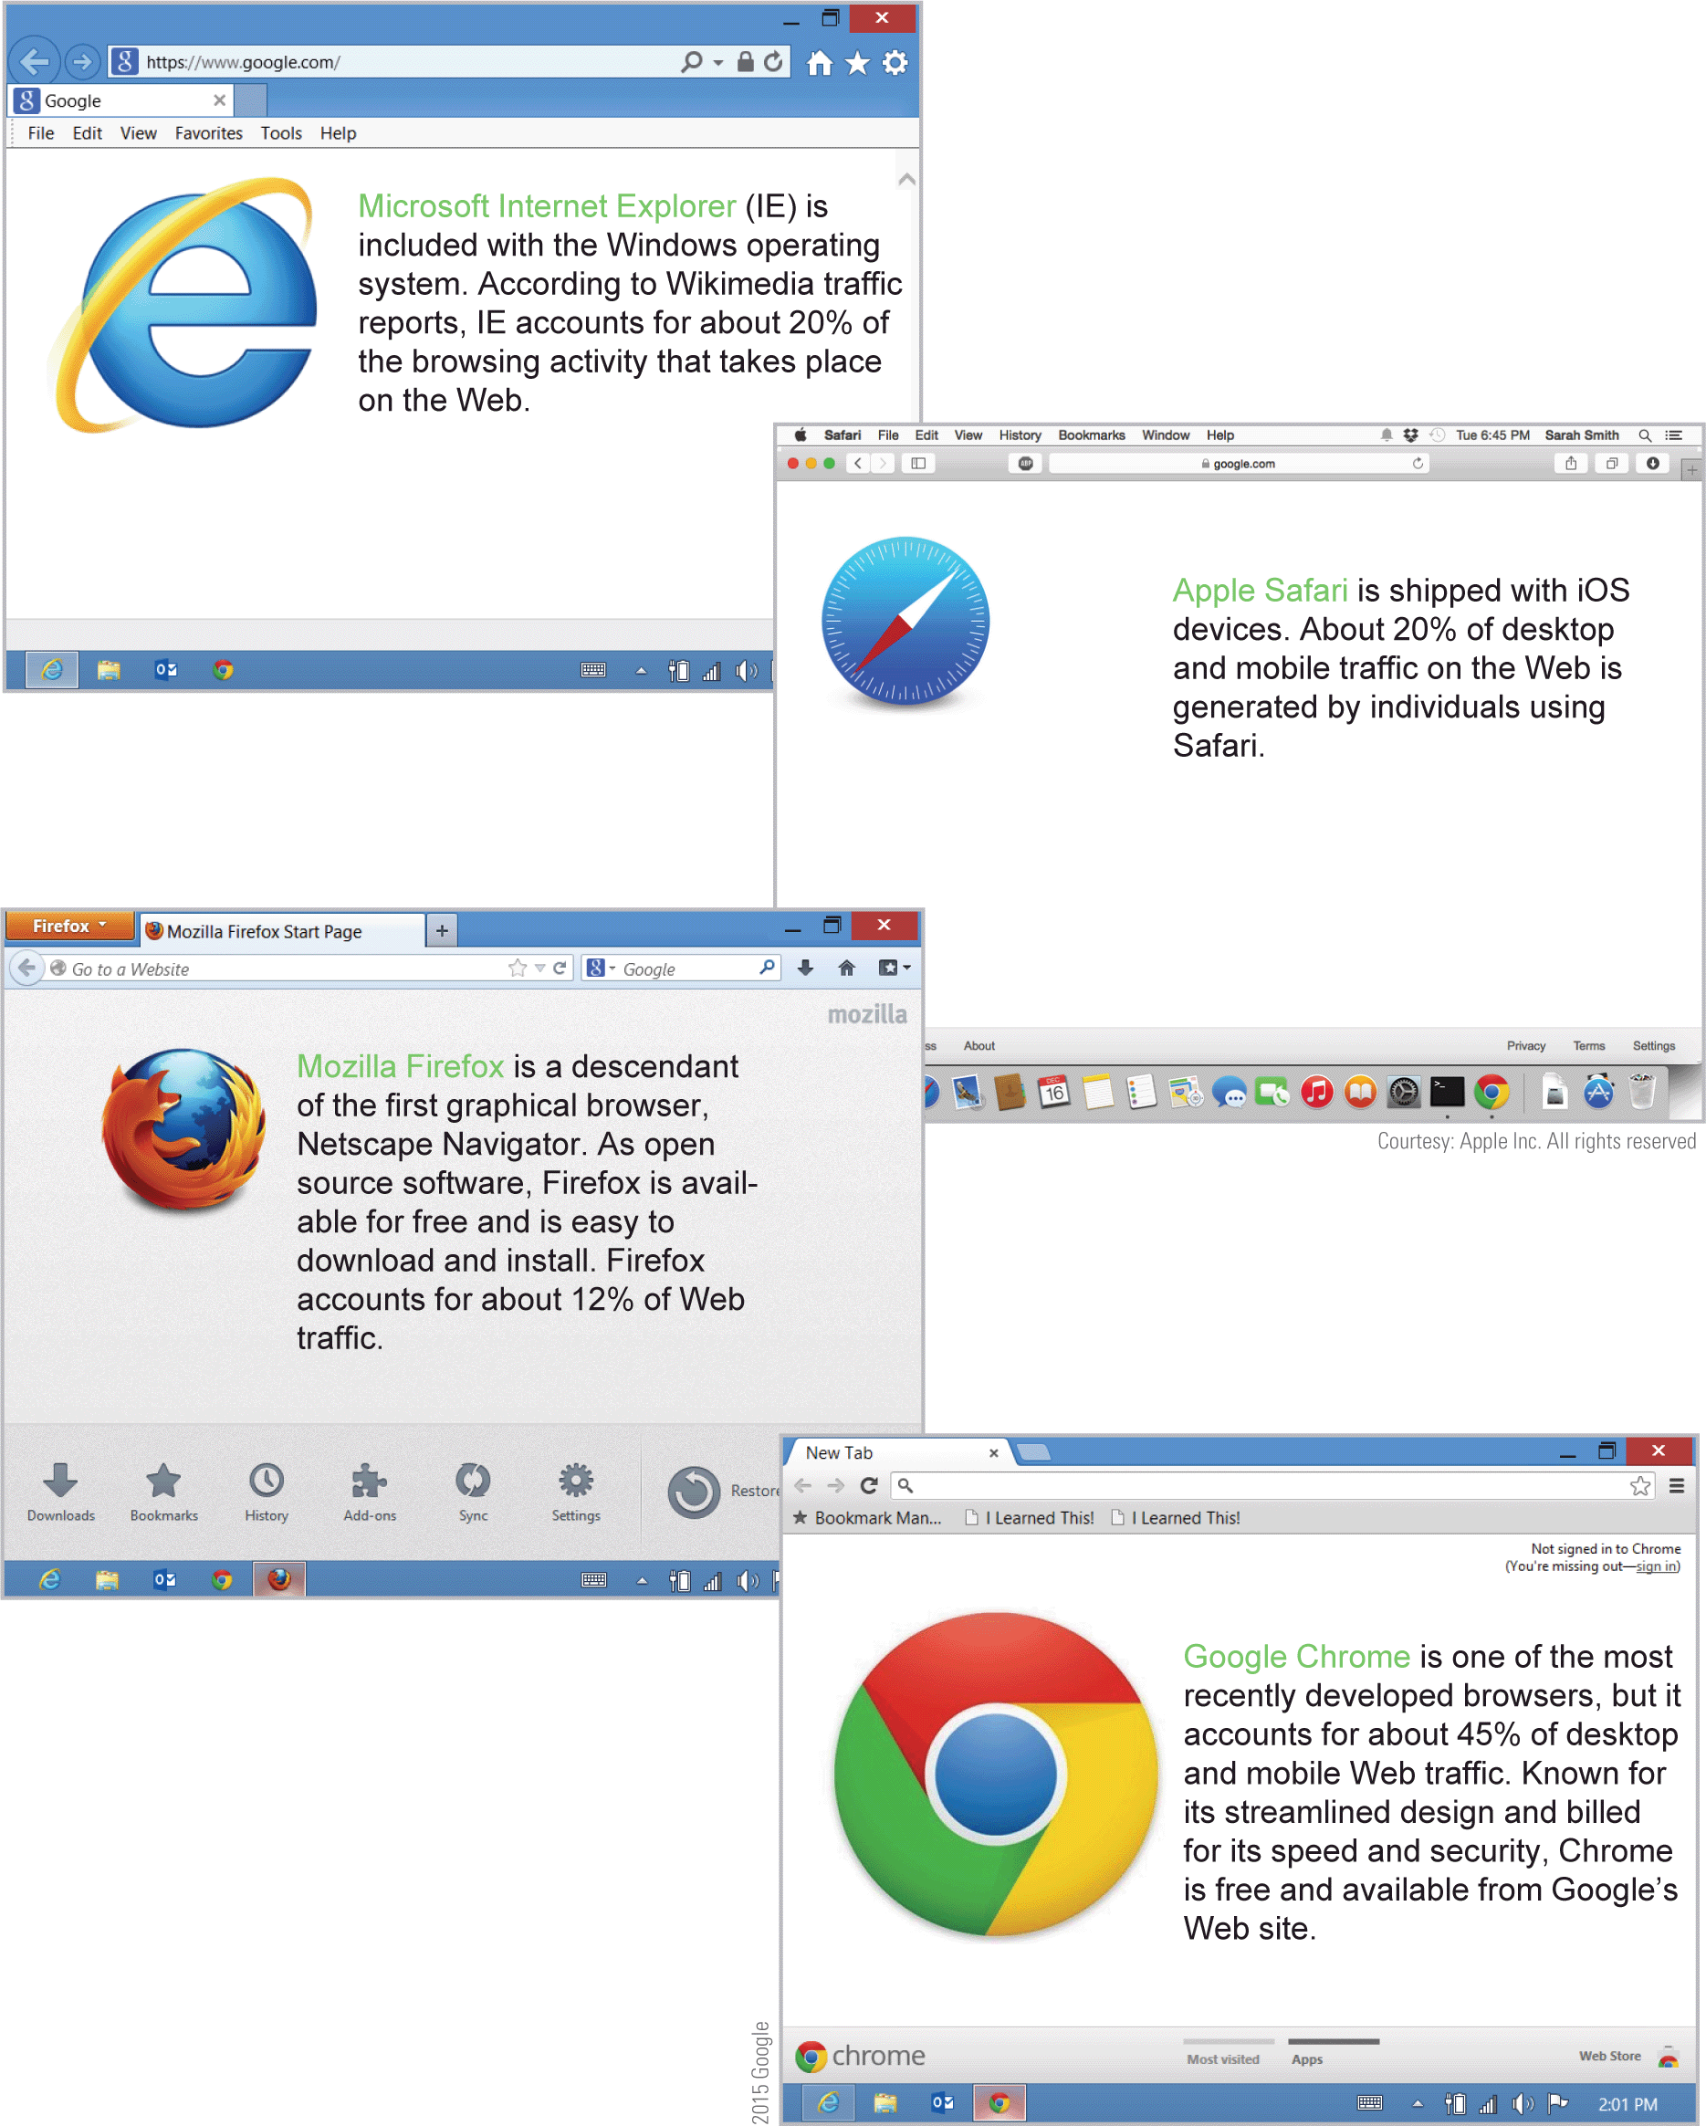
Browser Basics
Today’s most popular browsers are:
  Apple
  Safari
  Google Chrome
  Microsoft Internet Explorer (IE)
  Mozilla Firefox

Slide 18
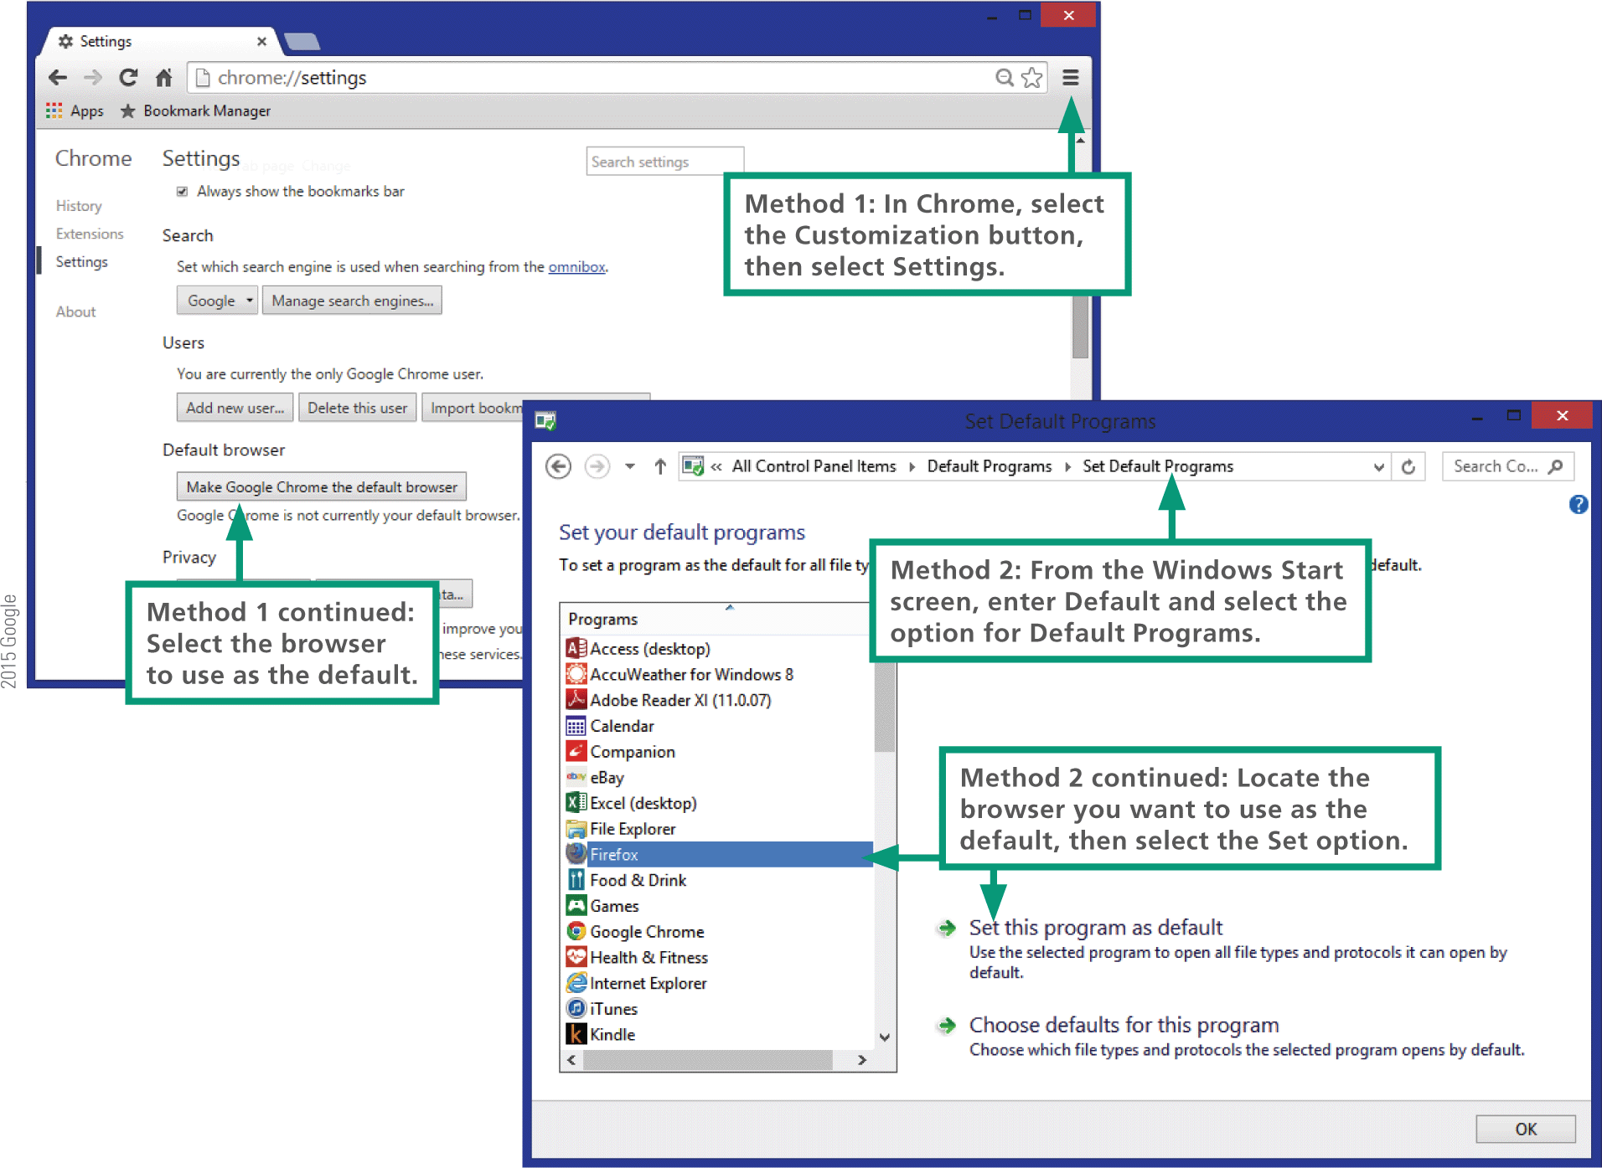
Browser Basics
You can designate a default browser so that it is automatically used when you click a link in an email message or PDF file

Slide 19
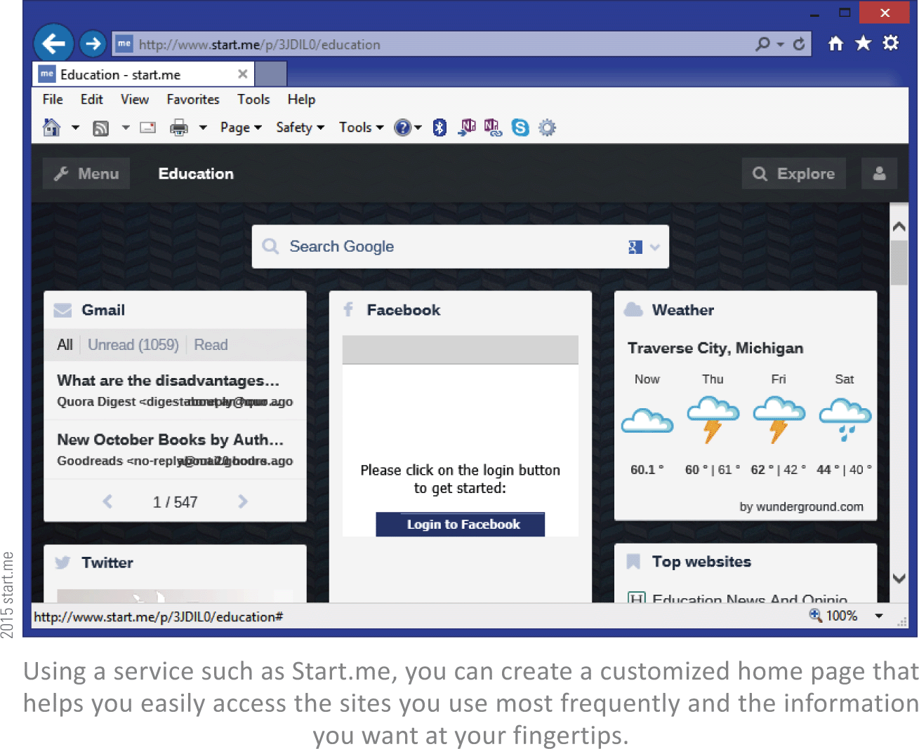
Customization
You can customize your browser by doing the following:
  change your home page
  customize bookmarks and favorites
  control tab behavior
  select predictive services
  adjust password settings

Slide 20
Customization
Customizable options:
  Predictive services look ahead and anticipate what you might do when searching the Web; they also fill in form data based on entries you’ve made before, such as your email address and phone number
  Bookmarks (or Favorites, as they are called in IE) link to pages that you use frequently
  Browser tabs allow your browser to queue up multiple Web pages so that you can easily switch between them

Slide 21
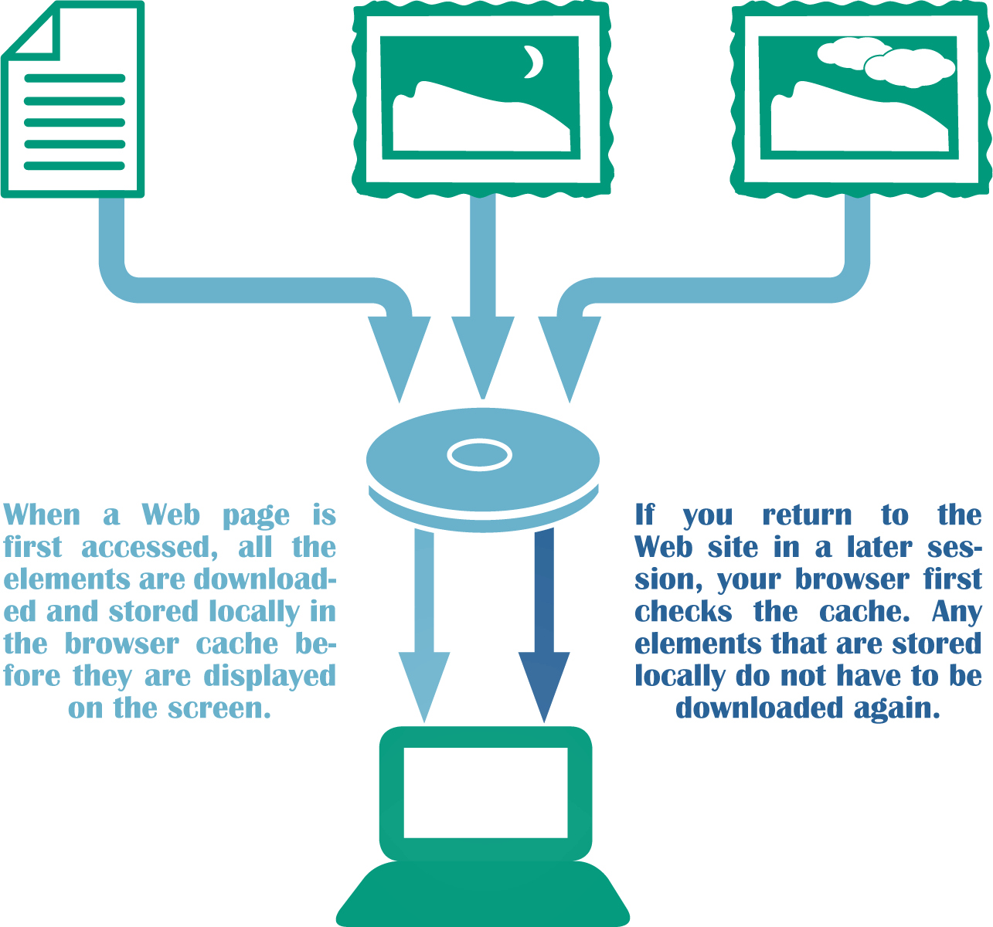
Browser Cache
Browsers pull HTML documents, images, and other Web page elements to your local device; ads are pulled down too
When your browser fetches pages and graphics to form a Web page, it stores that material on your device in temporary files referred to as a browser cache, Web cache, or browser history

Slide 22
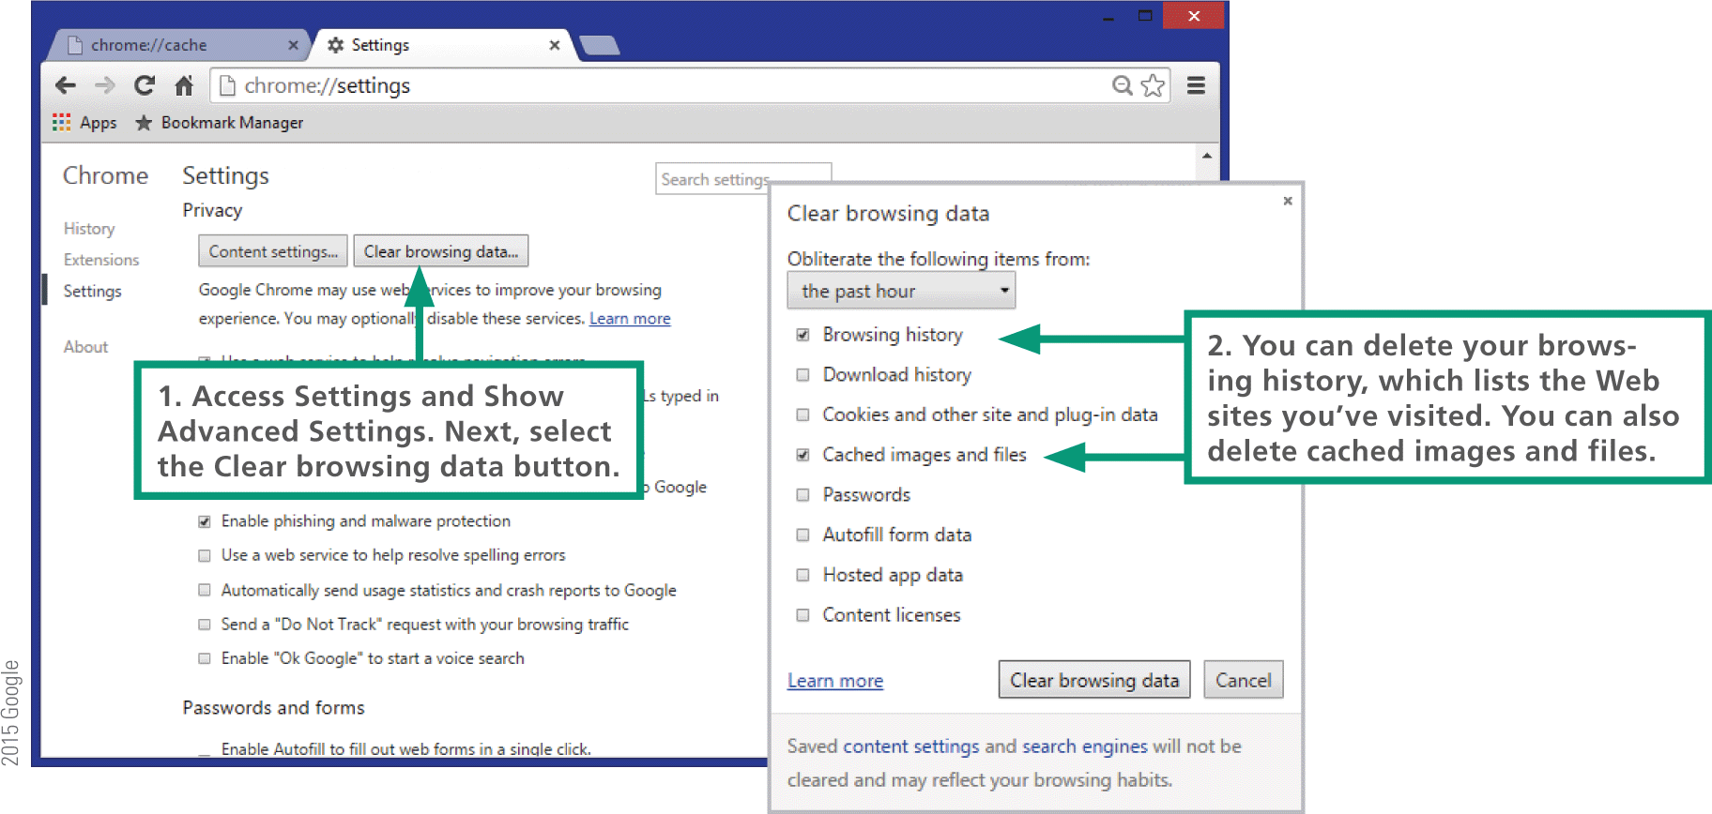
Browser Cache
Browsers include settings for limiting the time cached files remain on your device, limiting the amount of space they can use on the hard disk and deleting all the cached files

Slide 23
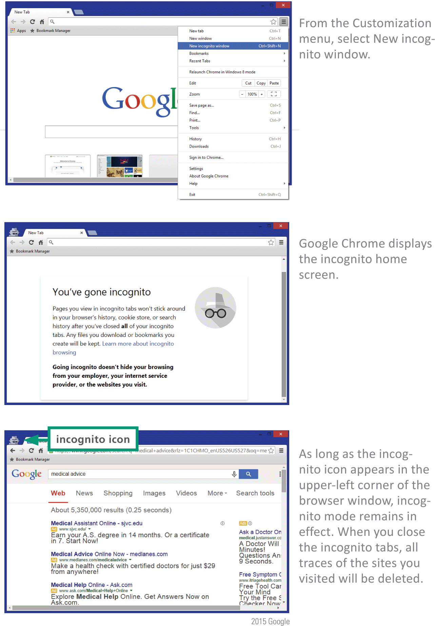
Browser Cache
In addition to the cache your browser maintains a History list of sites that you’ve visited; you can delete the History list, usually using a process similar to clearing a browser cache
Today’s browsers also offer private browsing modes, in which traces of your activity are not maintained in the History list or browser cache; use it when you prefer not to leave a trail that can be seen by others who gain access to a device you have recently used

Slide 24
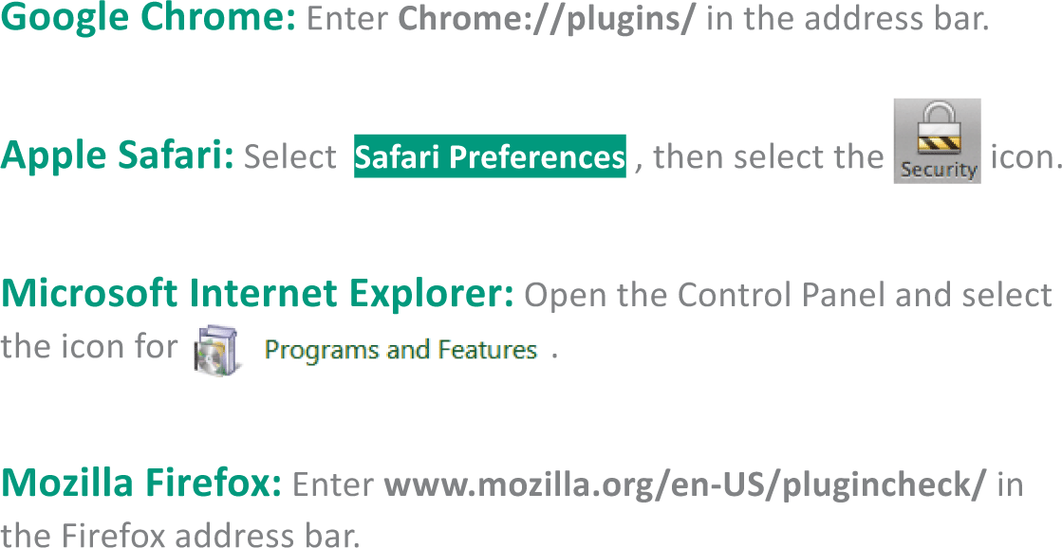
Plugins and Extensions
A plugin is a program that extends a browser’s ability to work with file formats
Popular plugins include:
  Adobe Reader for PDF files
  Adobe Flash Player
  QuickTime Player
  Microsoft Silverlight for playing animations
  Java

Slide 25
Plugins and Extensions
A browser extension adds features to a browser
Browser extensions give the browser more features and functionality
A popular extension called AdBlock removes advertisements from Web pages
Google’s toolbar is an example of a browser extension

Slide 26
Section C: HTML
HTML Basics
HTML Editing Tools
CSS
Dynamic Web Pages
Site Creation

Slide 27
HTML Basics
HTML is the foundation for professionally designed corporate Web sites
The current version, HTML5, was introduced in 2010
HTML is called a markup language because authors mark up documents by inserting special instructions called HTML tags that specify how the document should appear when displayed in a browser window

Slide 28
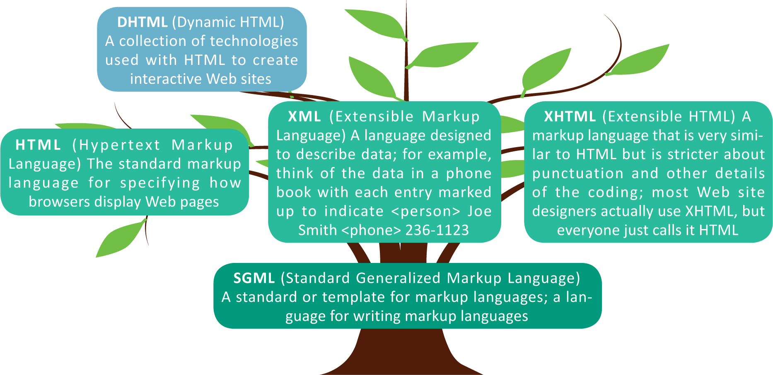
HTML Basics
HTML is a member of a family of markup languages

Slide 29


HTML Basics
HTML tags are incorporated into an HTML document, which is similar to a word processing file but has an .htm or .html extension
Tags, such as <h1> and <p>, are enclosed in angle brackets embedded in the document
  <h1> indicates a heading
  <p> indicates a new paragraph
This is how it would look in a browser:

Slide 30
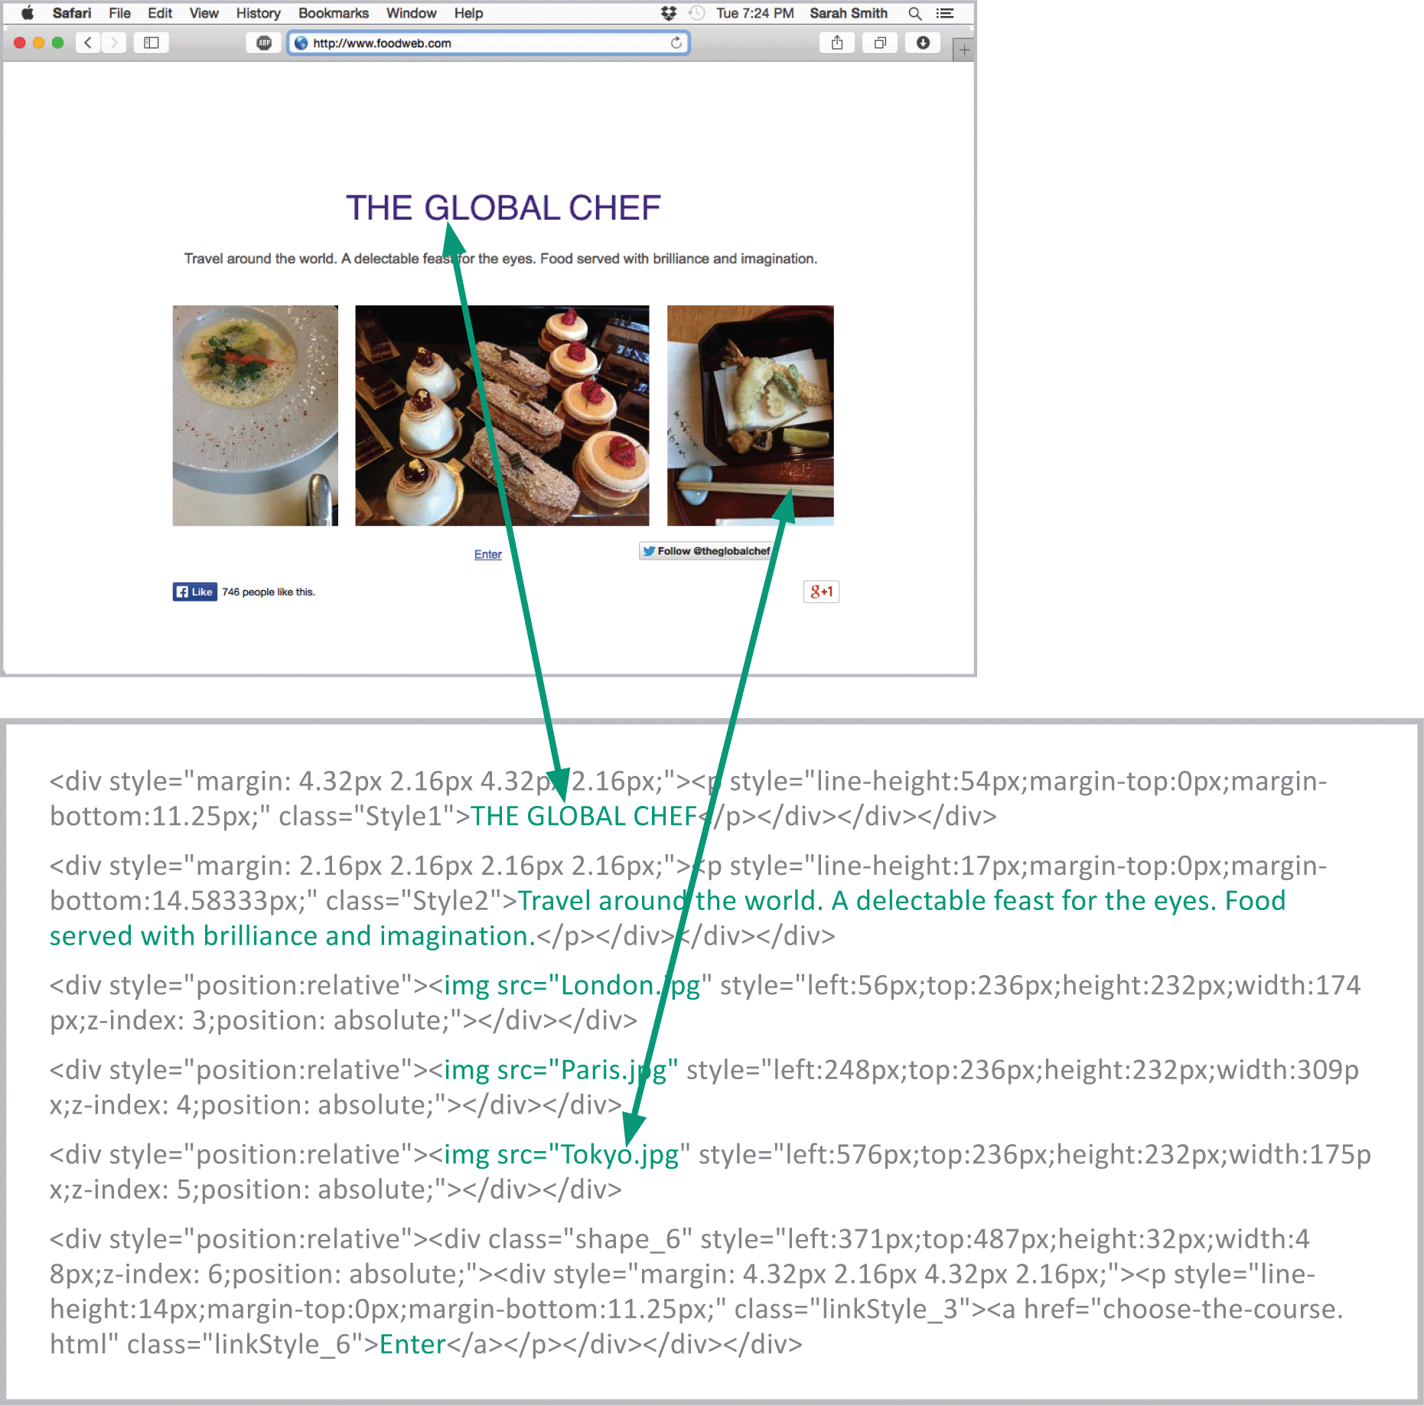
HTML Basics
An HTML document is sometimes referred to as a source document because it is the source of the HTML tags used to construct a Web page

Slide 31
HTML Editing Tools
Tools for creating Web pages
  HTML conversion utility – creates an HTML document from a conventional document, spreadsheet or other text-based file
  Online HTML editor – a template-like tool provided by most Web hosting companies
  Locally installed HTML editor – offers professional features for managing extensive corporate Web sites; others are geared toward creating smaller personal Web sites
  Text editor – with these tools, you start from scratch, with a blank page, and enter HTML codes along with the text that you want for your Web page

Slide 32
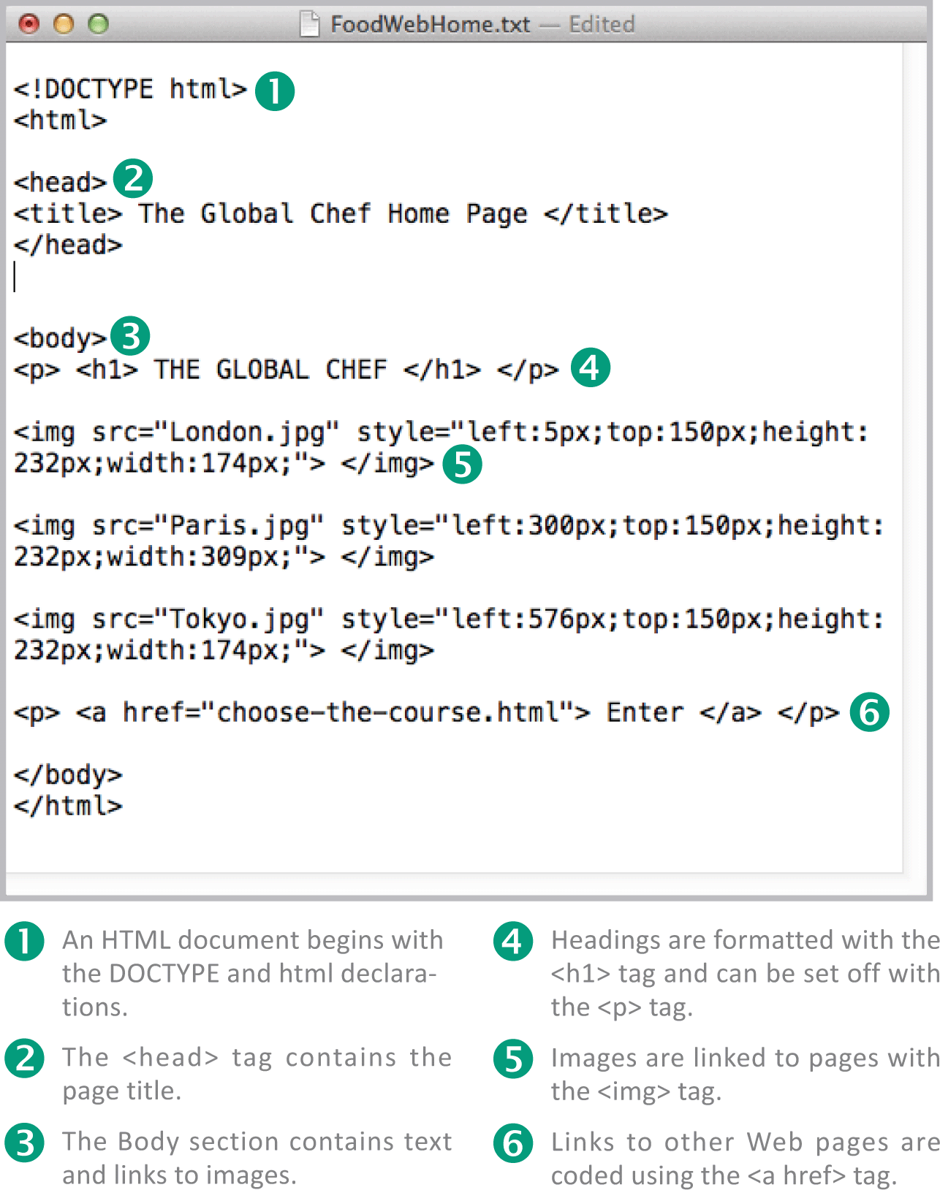
HTML Editing Tools
The framework for an HTML document consists of two sections: the head and the body

Slide 33
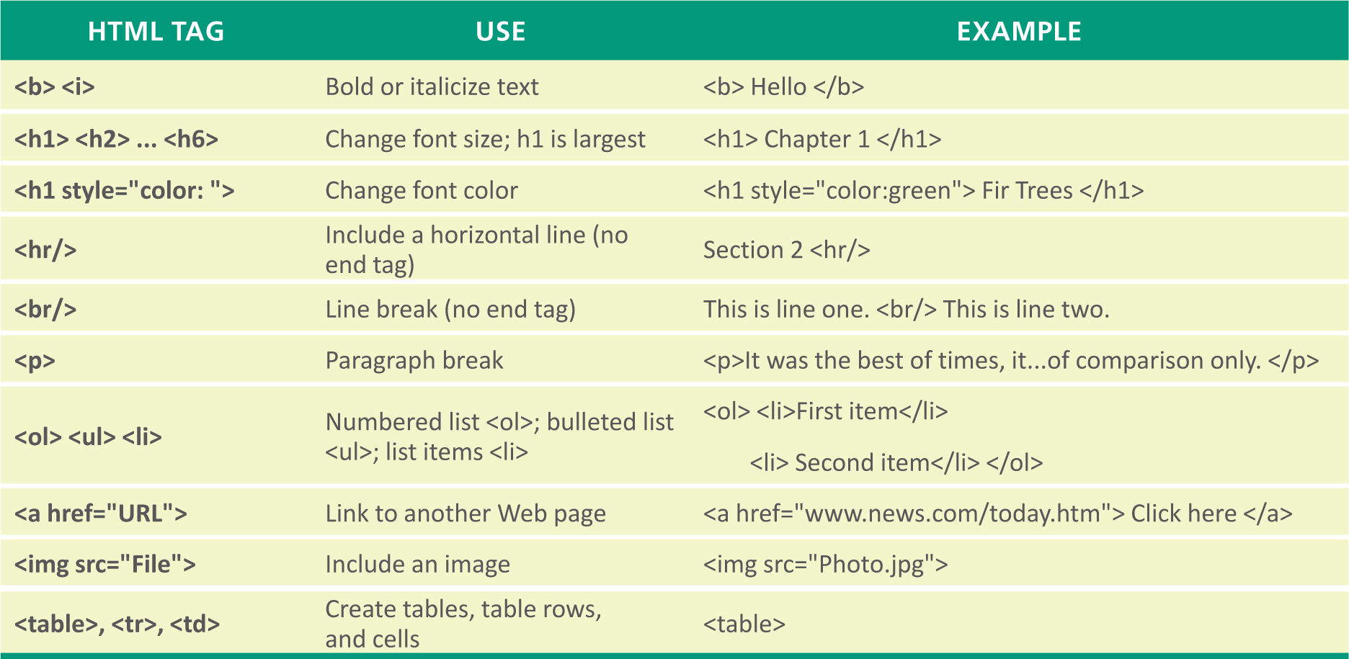
HTML Editing Tools
You can use tags to mark sections of text that should appear in different styles, specify images you want to appear, and create clickable links to other Web pages

Slide 34
CSS
CSS stands for Cascading Style Sheets and is a set of detailed style specifications for an HTML document
These specifications are called style rules, which include settings for font colors, font sizes, background colors, borders, text alignment, link formats, and margins
Three types of style sheets are:
  Inline – style sheets can be intermixed with an HTML doc; the use of inline CSS is avoided by professional designers
  Internal – included with the header of an HTML doc; places formatting elements where they can be edited
  External – style rules are placed in a separate file with a .css extension; for Web sites with more than one page, an external CSS is the recommended approach

Slide 35
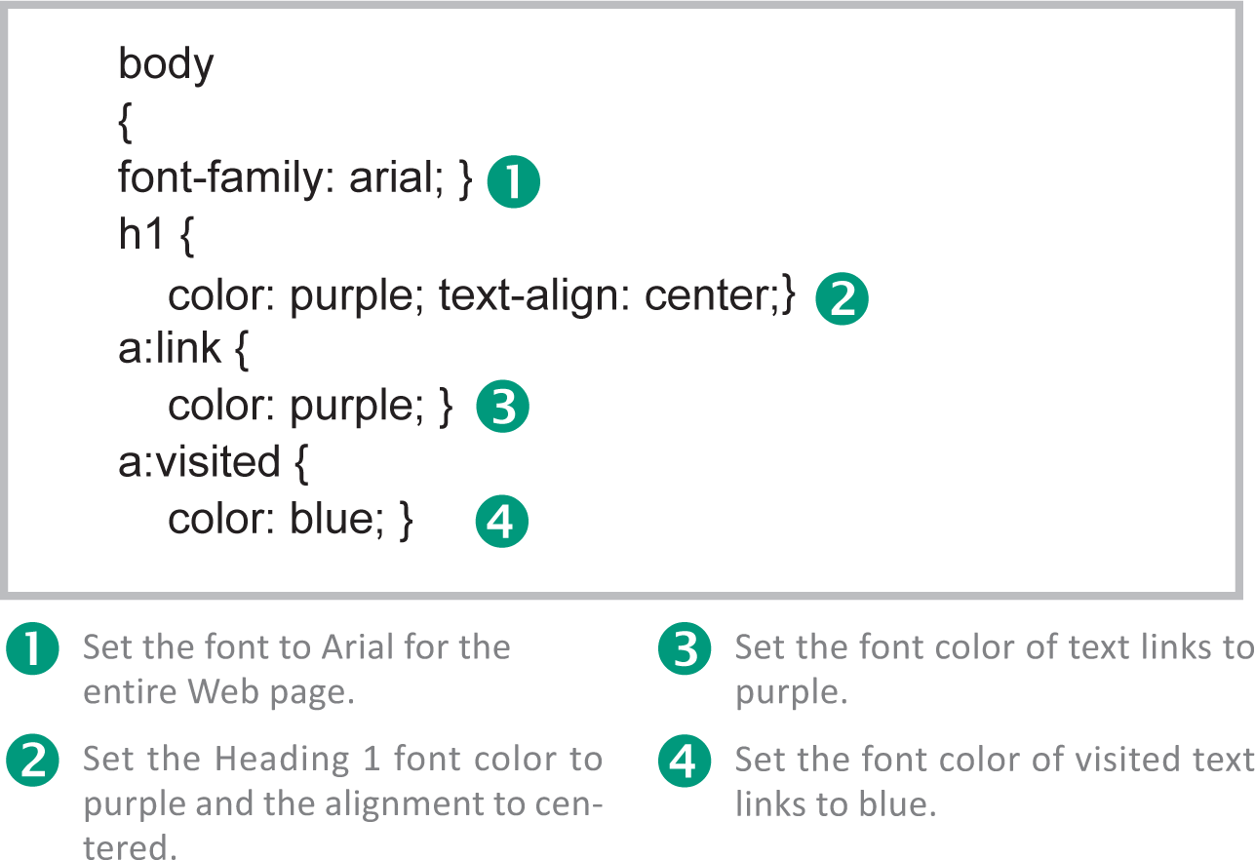
CSS
A style rule:

Slide 36
Dynamic Web Pages
Using HTML and CSS, Web designers can create a static Web page that displays the same information, regardless of who accesses it
A dynamic Web page displays customized content in response to keyboard or mouse actions, or based on information supplied directly or indirectly by the person viewing the page
Dynamic elements can be incorporated in Web pages with the addition of instructions, called scripts, written with scripting languages, such as JavaScript

Slide 37
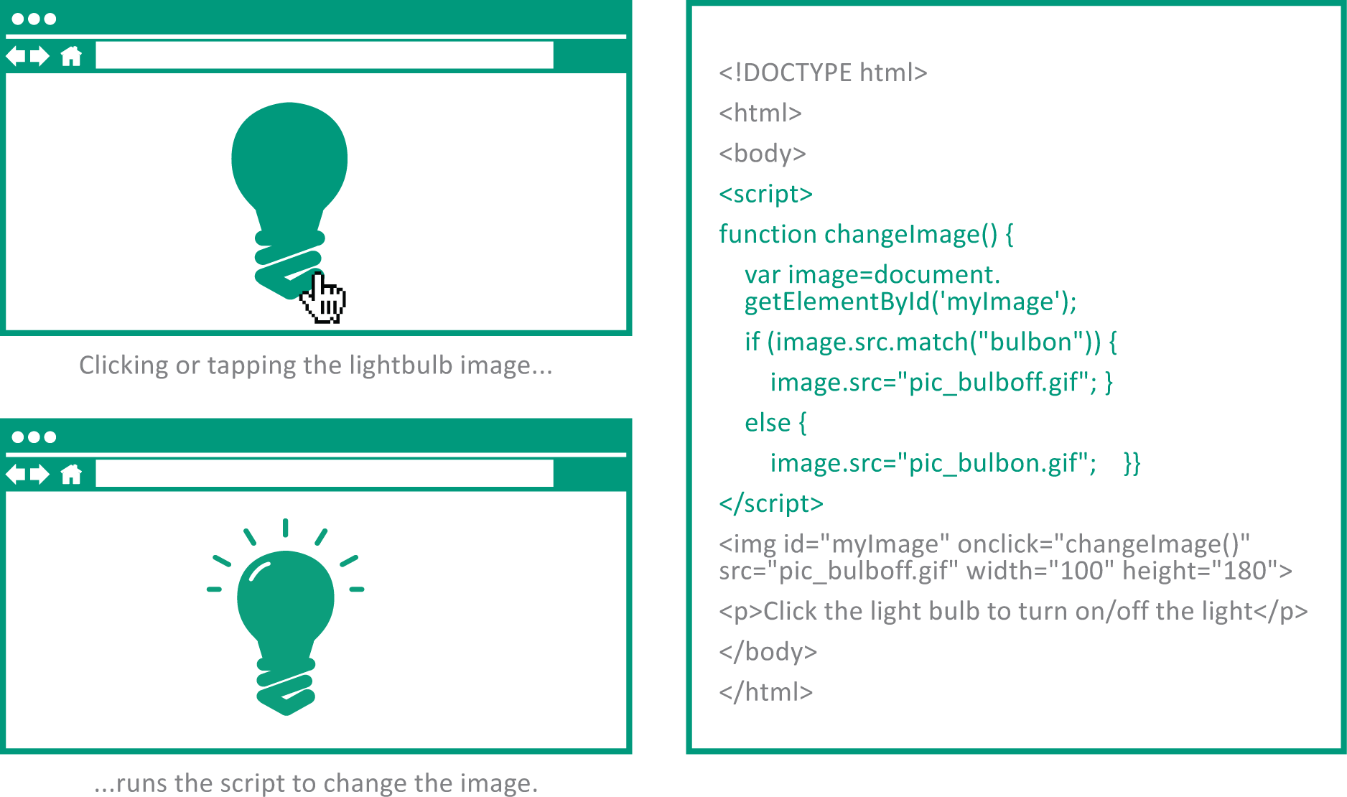
Dynamic Web Pages
Client-side scripts are embedded in an HTML document and run locally when a Web page is displayed in a browser; they are used to customize aspects of the user interface and for simple interactions

Slide 38
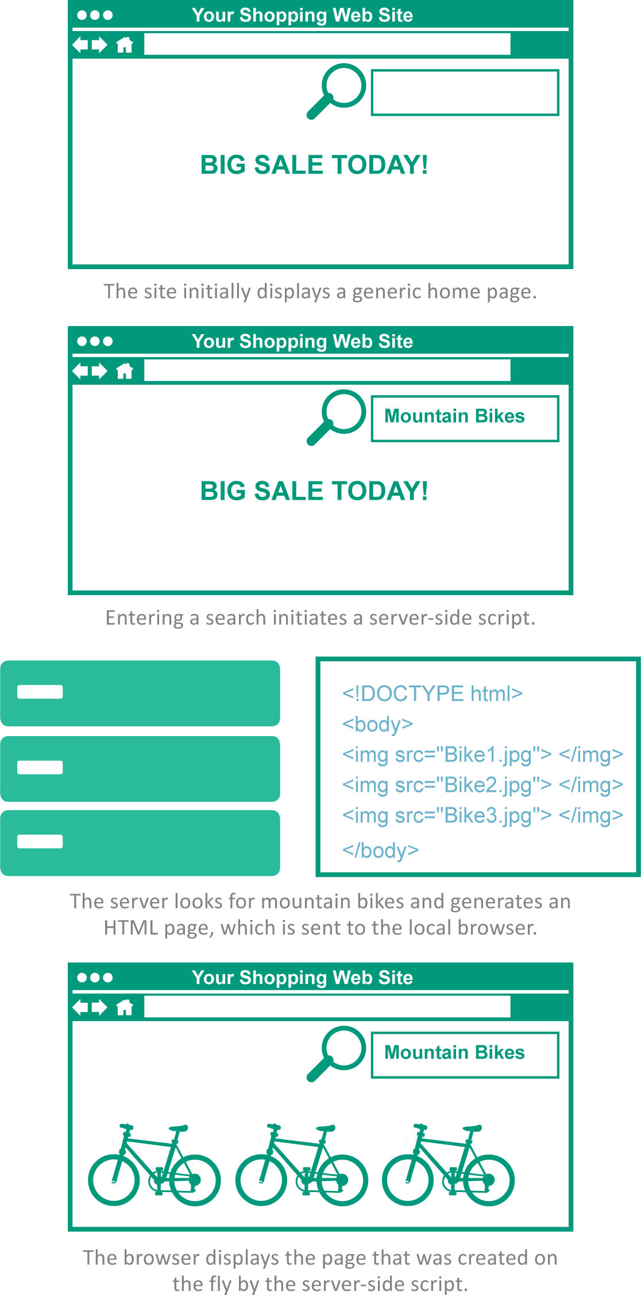
Dynamic Web Pages
Server-side scripts run on Web servers rather than on your local drive; they typically access information from a database and use that information to create customized Web pages on the fly

Slide 39
Site Creation
The steps for establishing a Web site include:
  Selecting a hosting service
  Choosing a domain
  Posting Web pages
  Testing pages in various browsers

Slide 40
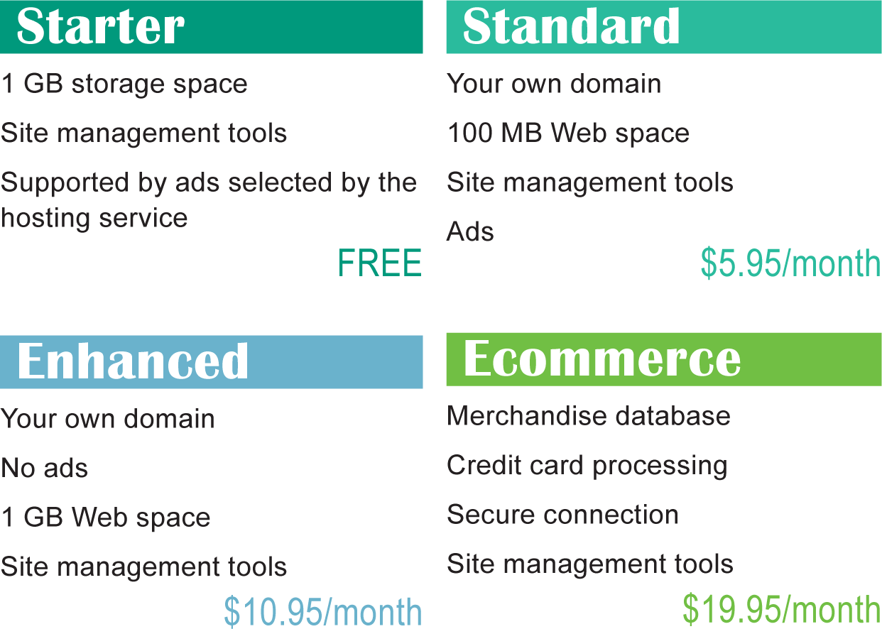
Site Creation
A Web hosting service is a company that provides space on a server to house Web pages; hosting services, such as GoDaddy, offer a variety of hosting plans

Slide 41
Section D: HTTP
HTTP Basics
Cookies
HTTPS

Slide 42
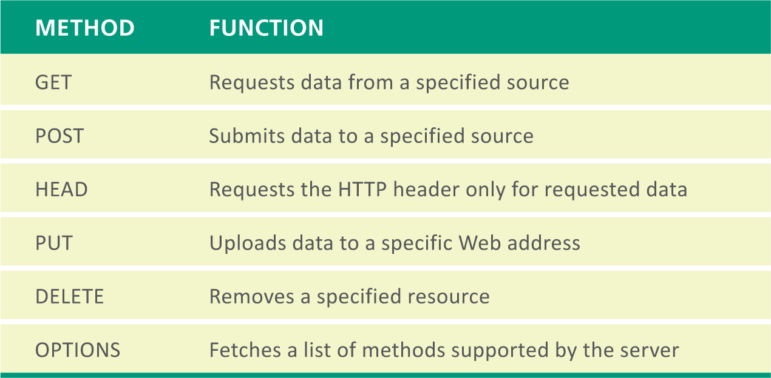
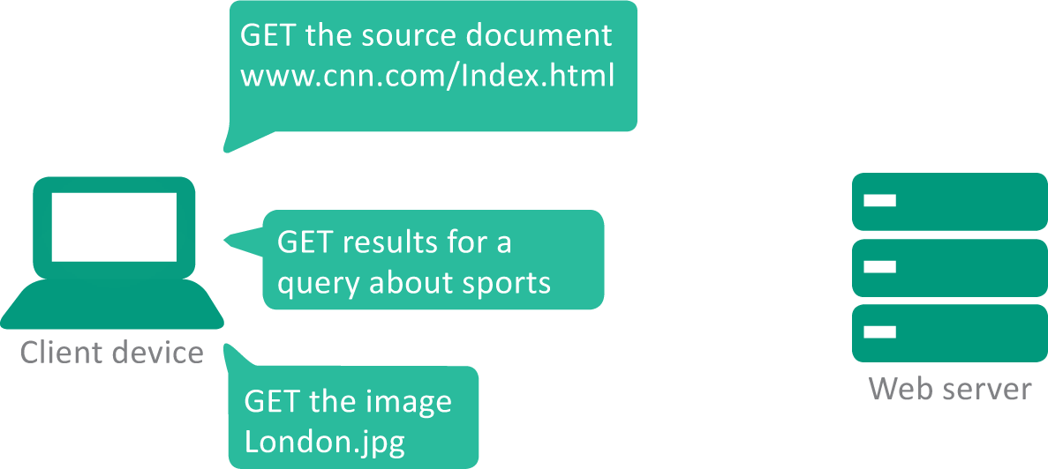
HTTP Basics
HTTP is a communication protocol that works with TCP/IP to get the elements for Web pages to a local browser
A set of commands called HTTP methods help your browser communicate with Web servers

Slide 43
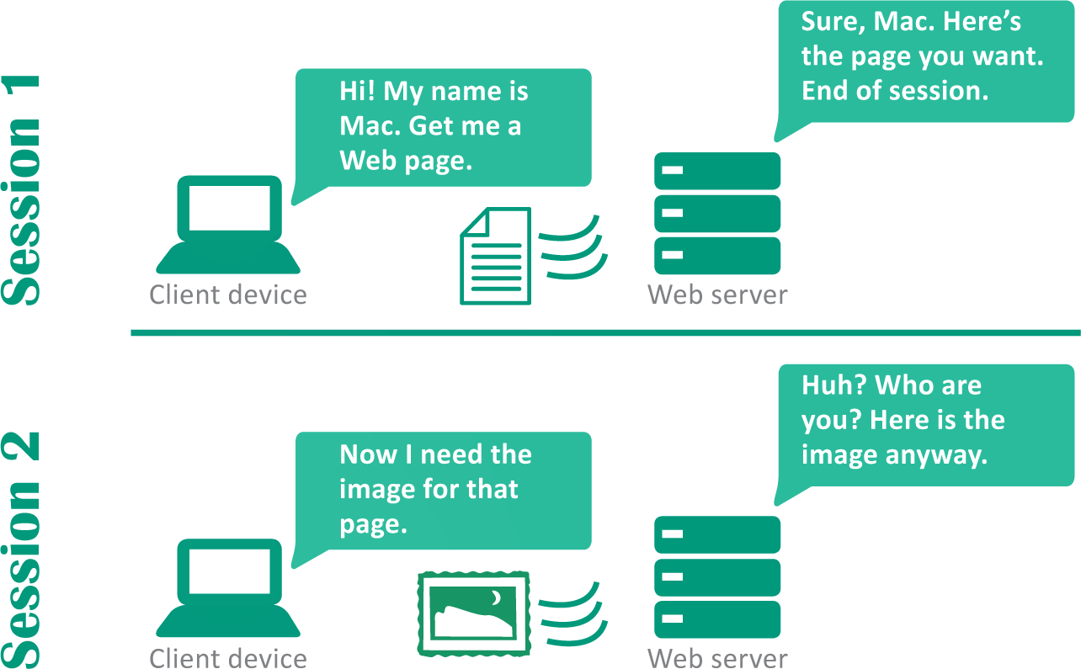
HTTP Basics
An HTTP session is a sequence of transactions most commonly used to request data from a Web server and return the files needed to display a Web page in a browser window
Because the server does not “remember” its state from one session to the next, HTTP is called a stateless protocol

Slide 44
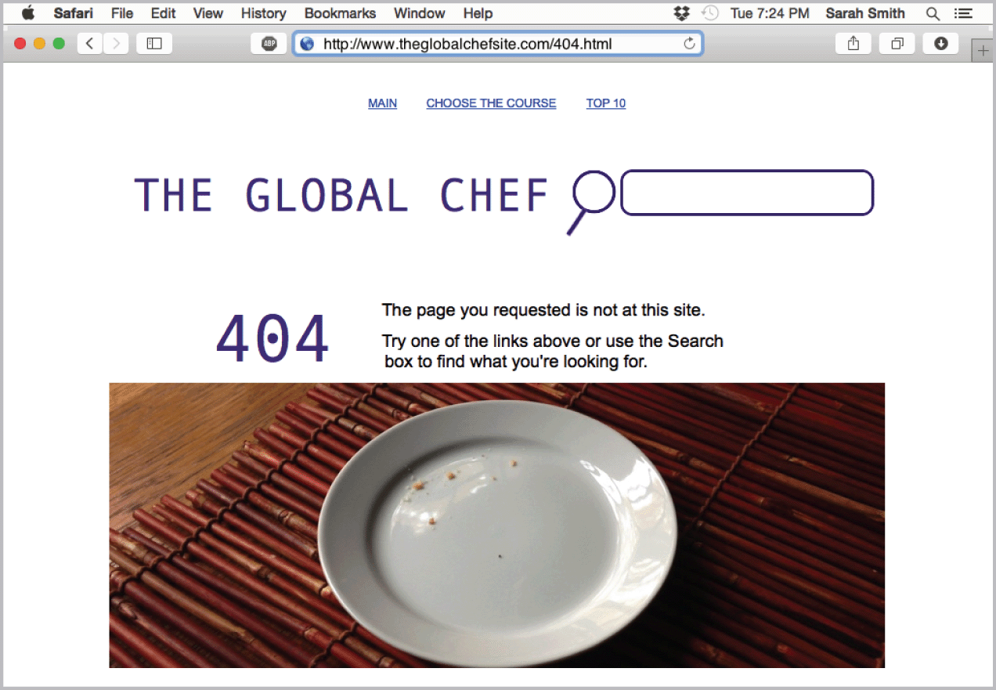
HTTP Basics
A Web server’s response to a browser’s request includes an HTTP status code that indicates whether the browser’s request could be fulfilled; the status code 200 means that the request was fulfilled
A “404 Not Found” message is displayed when a Web server sends a 404 status code indicating a source doesn’t exist

Slide 45
Cookies
A cookie (technically an HTTP cookie) is a small chunk of data generated by a Web server and stored as a text file in memory or on disk
Web sites use cookies to:
  Monitor your path through a site
  Gather information
  Collect personal information
  Verify that you have logged into a site using a valid ID

Slide 46
Cookies
There are two kinds of cookies: session cookies and persistent cookies
  Session cookies – cookies stored in memory and deleted when the browser is closed
  Persistent cookies – cookies that are stored on a device after a session ends; some are programmed to time out after a designated date

Slide 47
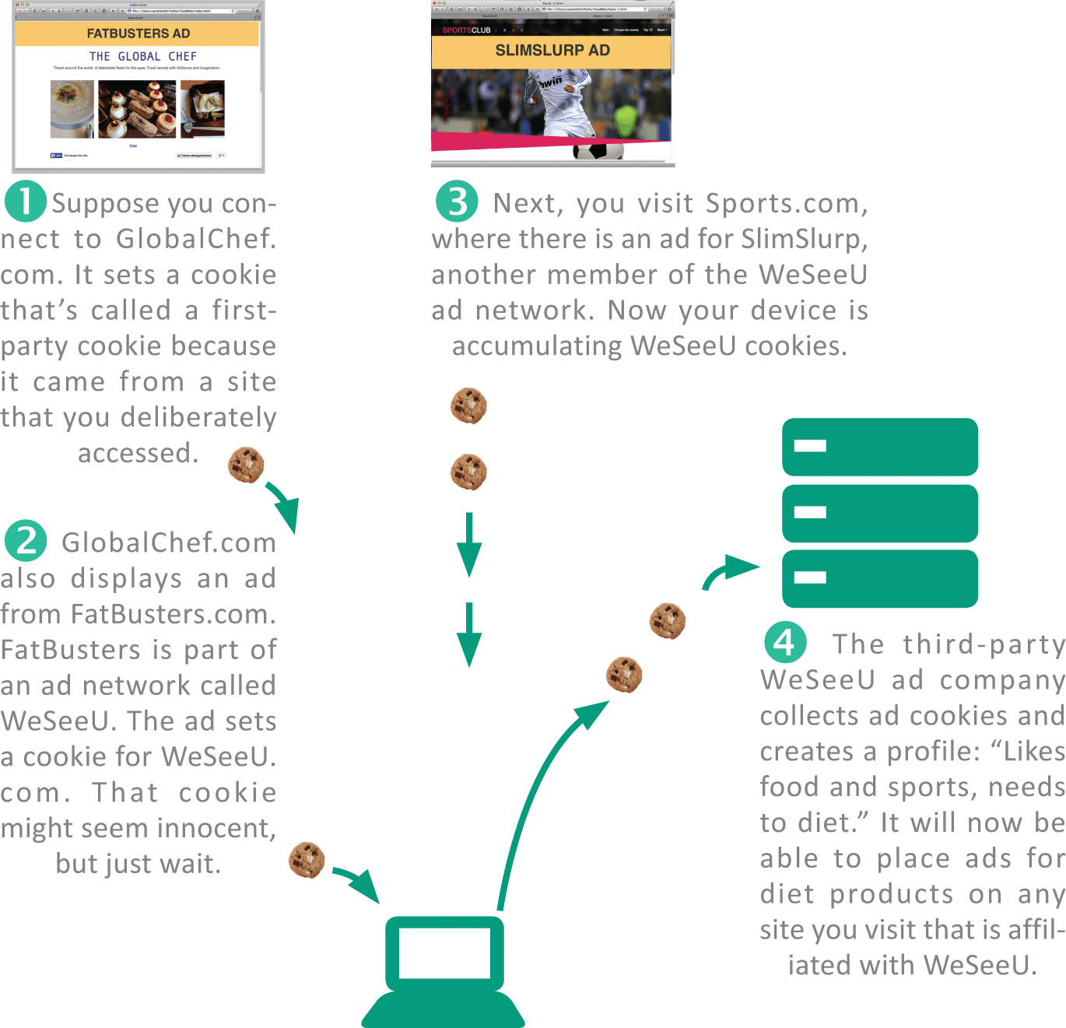
Cookies
A first-party cookie is set by the domain that hosts a Web page
A third-party cookie is set by a site other than the one you connected to

Slide 48
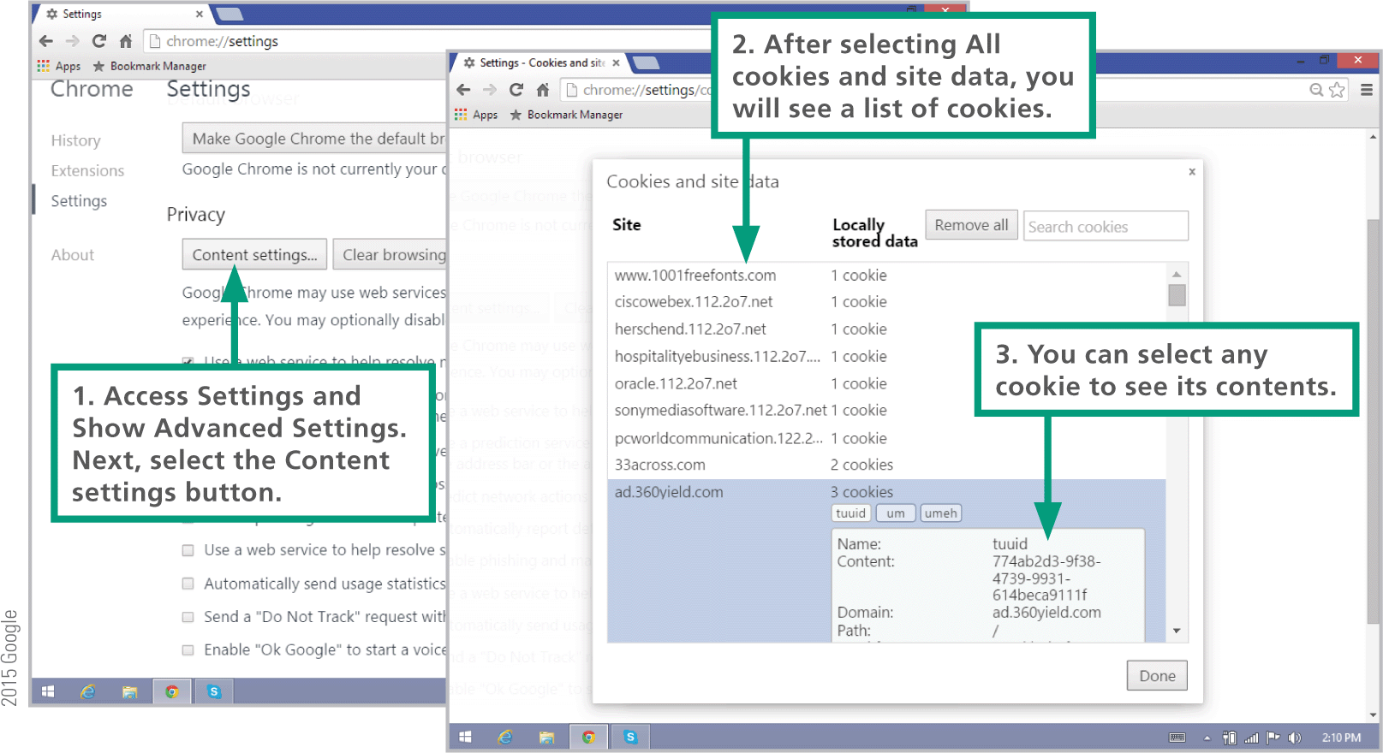
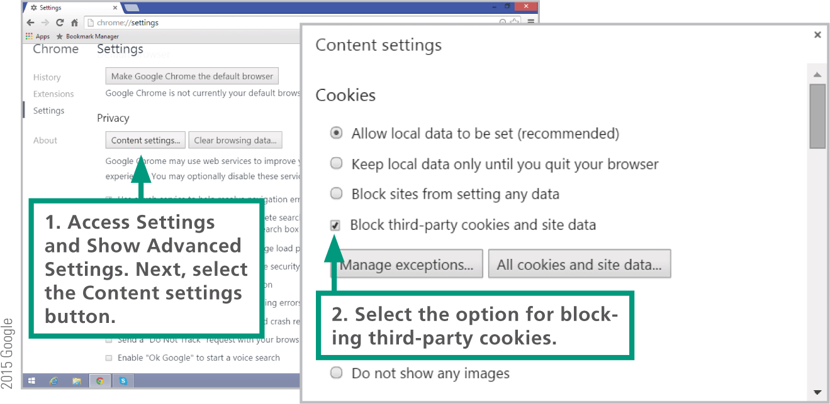
Cookies

Slide 49
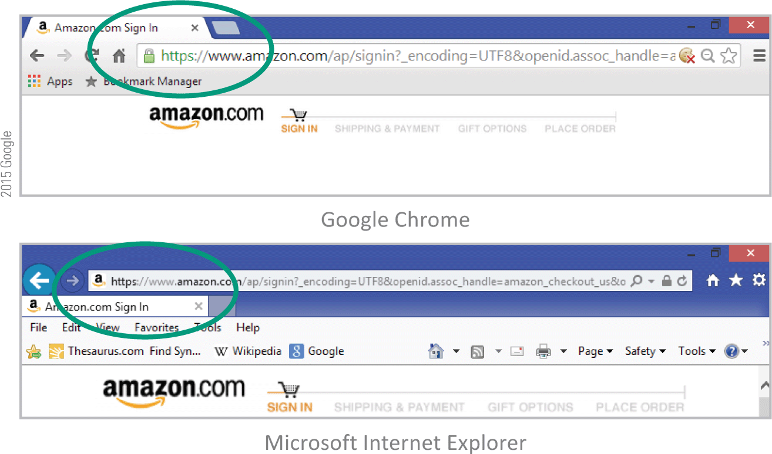
HTTPs
The data that you transmit to a Web server can be secured if it is sent over an HTTP Secure connection, which encrypts the data stream between client devices and servers

Slide 50
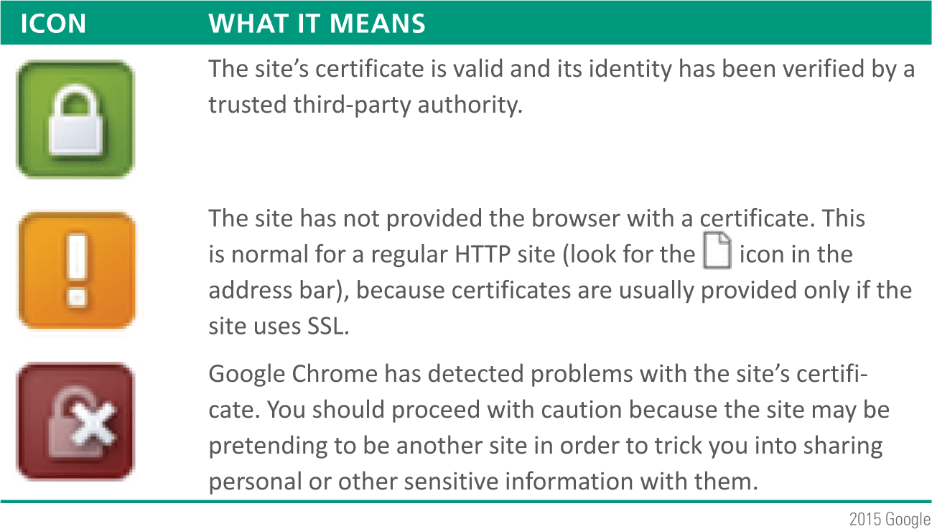
HTTPs
Sites that use HTTP Secure are required to present an SSL certificate to the browser; this helps the browser verify that the site is not pretending to be another site
Look for these certificate icons when you want secure browsing:

Slide 51
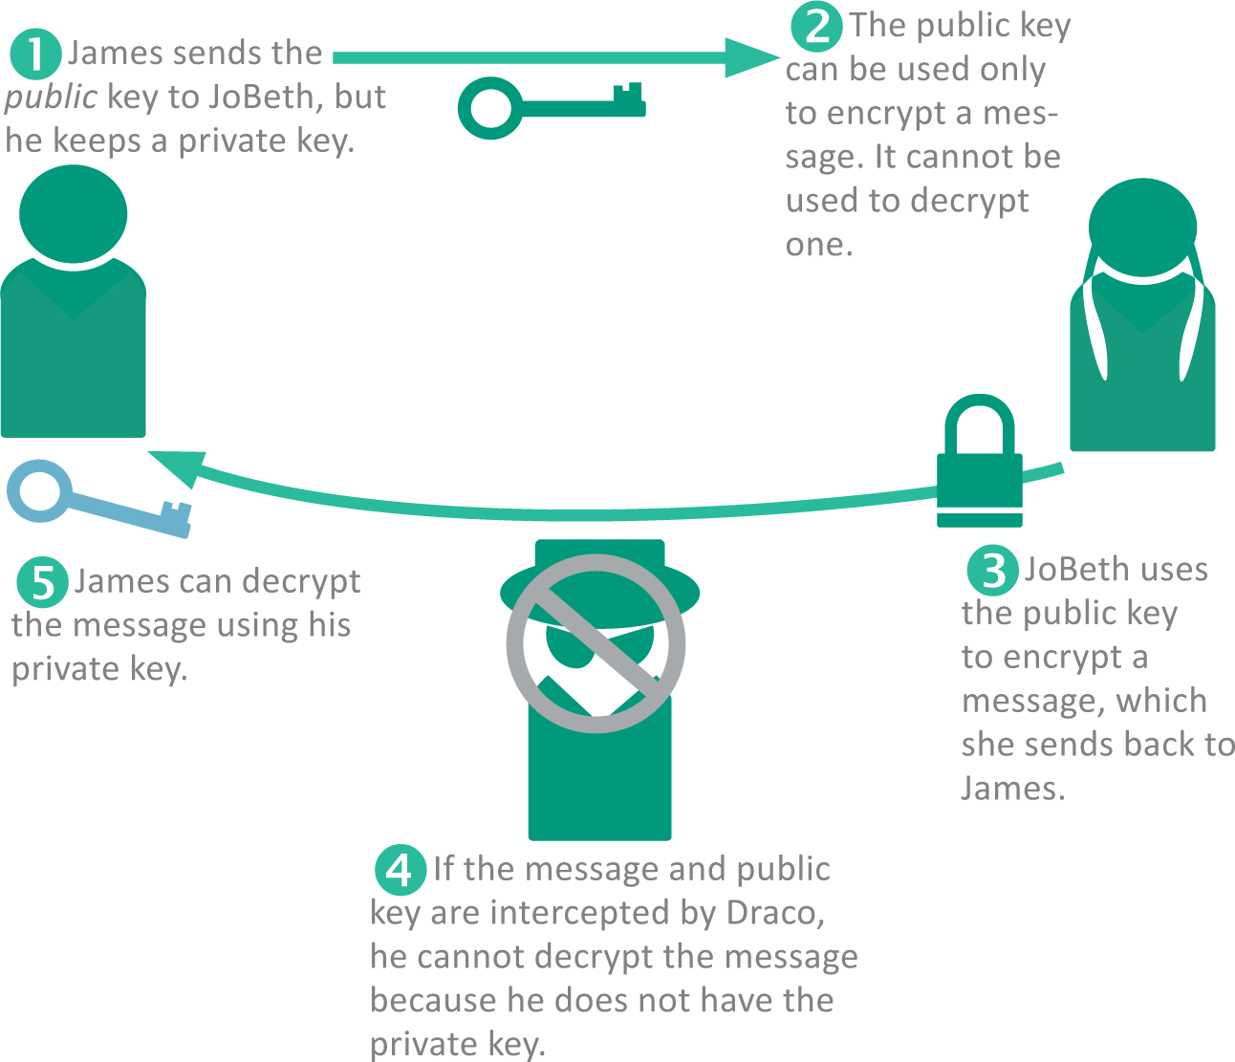
HTTPs
HTTP Secure is based on HTTP and a public key encryption technology called SSL/TLS
Public key encryption is a very clever process that requires one key to encrypt data, but a different key to decrypt it; the encryption key can’t be used to decrypt the message

Slide 52
Section E: Search Engines
Search Engine Basics
Formulating Searches
Search Privacy
Using Web-based Source Material

Slide 53
Search Engine Basics
A Web search engine (commonly referred to simply as a search engine) is a computer program designed to help people locate information on the Web by formulating simple queries consisting of one or more words called keywords or search terms
A search engine contains four components:
  Web crawler – combs the Web to gather data that’s representative of the contents of Web pages
  Indexer – processes the information gathered by the crawler into a list of keywords and URLs stored in a database
  Database – stores billions of index references to Web pages
  Query processor – allows you to access the database by entering search terms, and then produces a list of Web pages that contain content relevant to your query

Slide 54
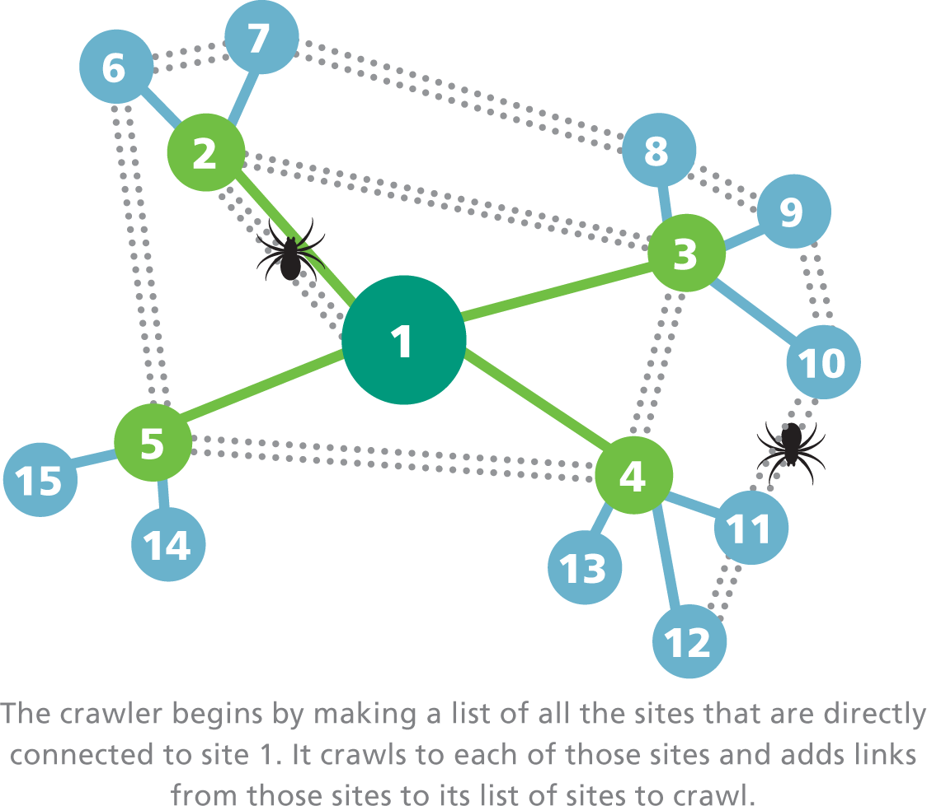
Search Engine Basics
A Web crawler (also referred to as a Web spider) is a computer program that is automated to methodically visit Web sites
Web crawlers download Web pages and submit them to an indexing utility for processing
Web crawlers use a search algorithm to traverse the Web and can run multiple processes in parallel; sophisticated algorithms keep processes from overlapping or getting stuck in loops

Slide 55
Search Engine Basics
Web crawlers generally do not gather material from the invisible Web, which encompasses pages that require password-protected logins and pages that are dynamically generated with server-side scripts
The potential volume of dynamically generated pages, such as all the possible pages that Amazon.com could generate from its inventory database, is just too great to feasibly index
To access information related to online merchandise or library catalogs, you might have to go directly to the merchant’s or library’s Web site and use its local search tools

Slide 56
Search Engine Basics
A search engine indexer is software that pulls keywords from a Web page and stores them in an index database; its purpose is to make pages easy to find based on their contents
A search engine’s query processor looks for your search terms in the search engine’s indexed database and returns a list of relevant Web sites; Google’s query processor handles more than 45,000 queries per second – on some days the total number of queries exceeds 6 billion!

Slide 57
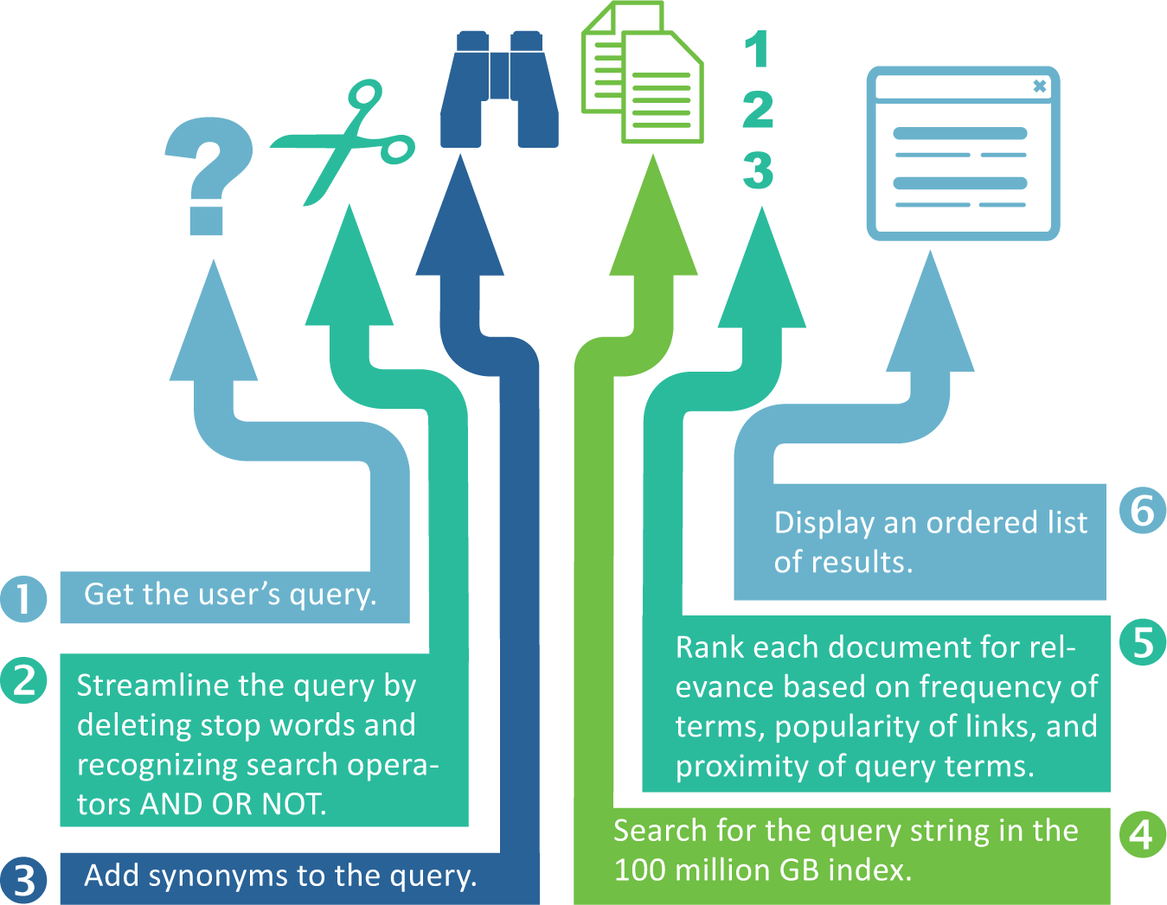
Search Engine Basics

Slide 58
Search Engine Basics
Query processors find millions of pages of results matching the query; the order in which they are listed depends on the search engine’s ranking algorithm
Google keeps this algorithm a closely guarded secret so that the Web site developers can’t manipulate pages to get better placement
Link popularity is a measure of the quality and quantity of the links from one Web page to others

Slide 59
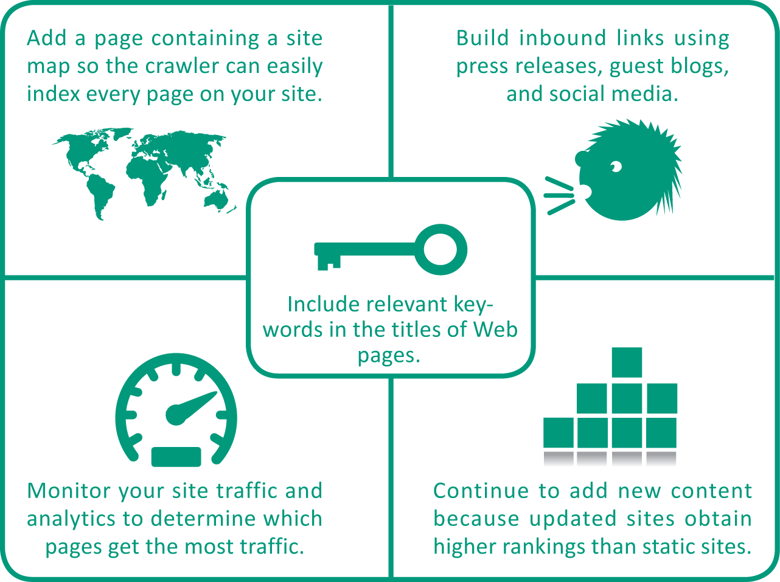
Search Engine Basics
A series of techniques called search engine optimization (SEO) can affect the ranking and visibility of Web pages
Search engine companies, Google, Yahoo!, and Bing, provide guidelines for optimizing Web sites and the pages they contain

Slide 60
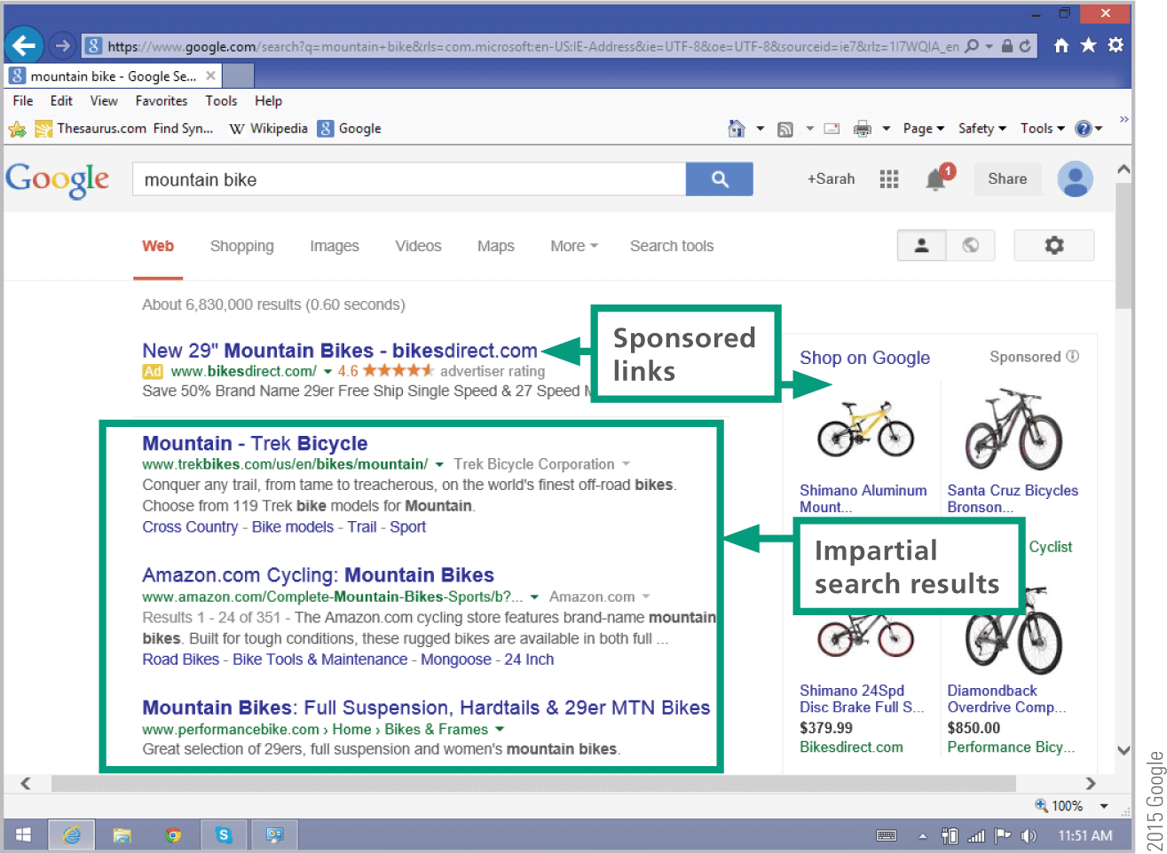
Search Engine Basics
Some search engines accept paid ads called sponsored links, which are bumped to the top positions on the results list; other search engines also accept paid ads but place them in a clearly marked area

Slide 61
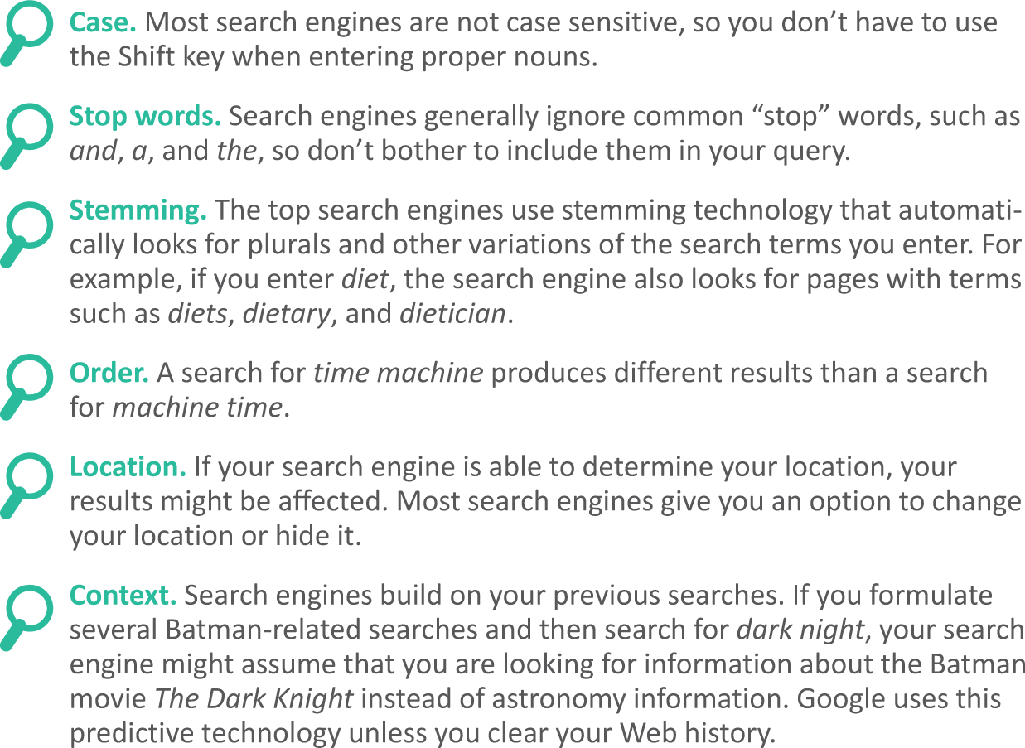
Formulating Searches
Most search engines work with keyword queries in which you enter one or more words, called search terms, related to the information you want to find

Slide 62
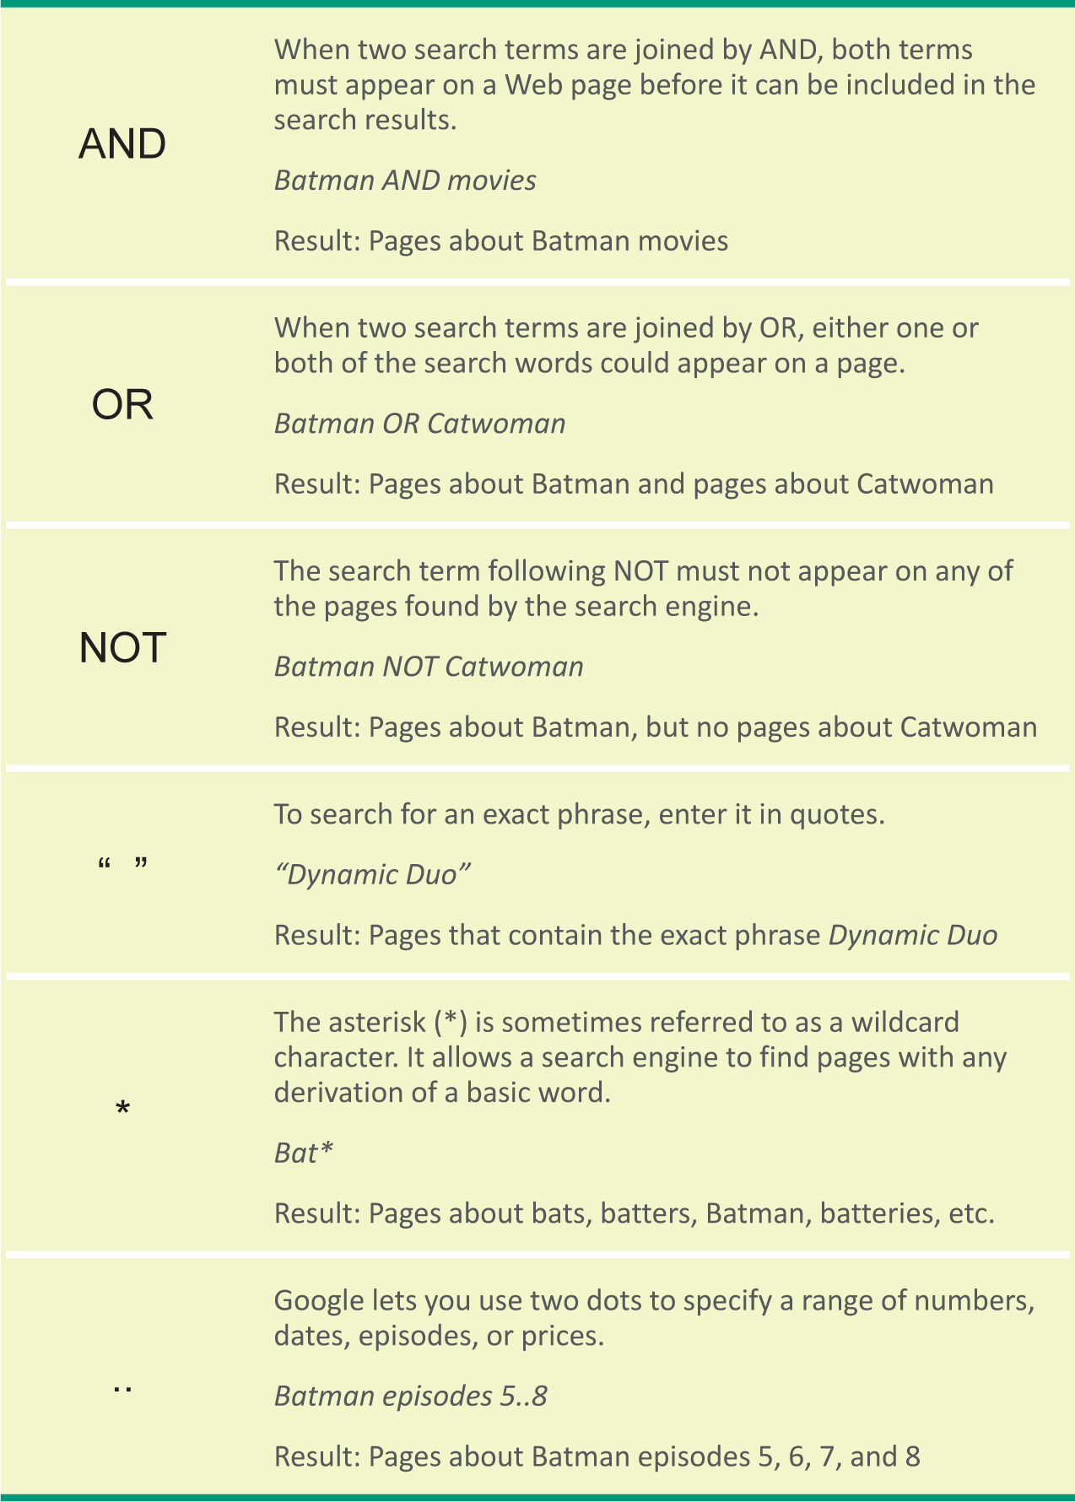
Formulating Searches
Narrowing a search can reduce the number of results and produce a more targeted list
A search operator is a word or symbol that describes a relationship between search terms and thereby helps you create a more focused query

Slide 63
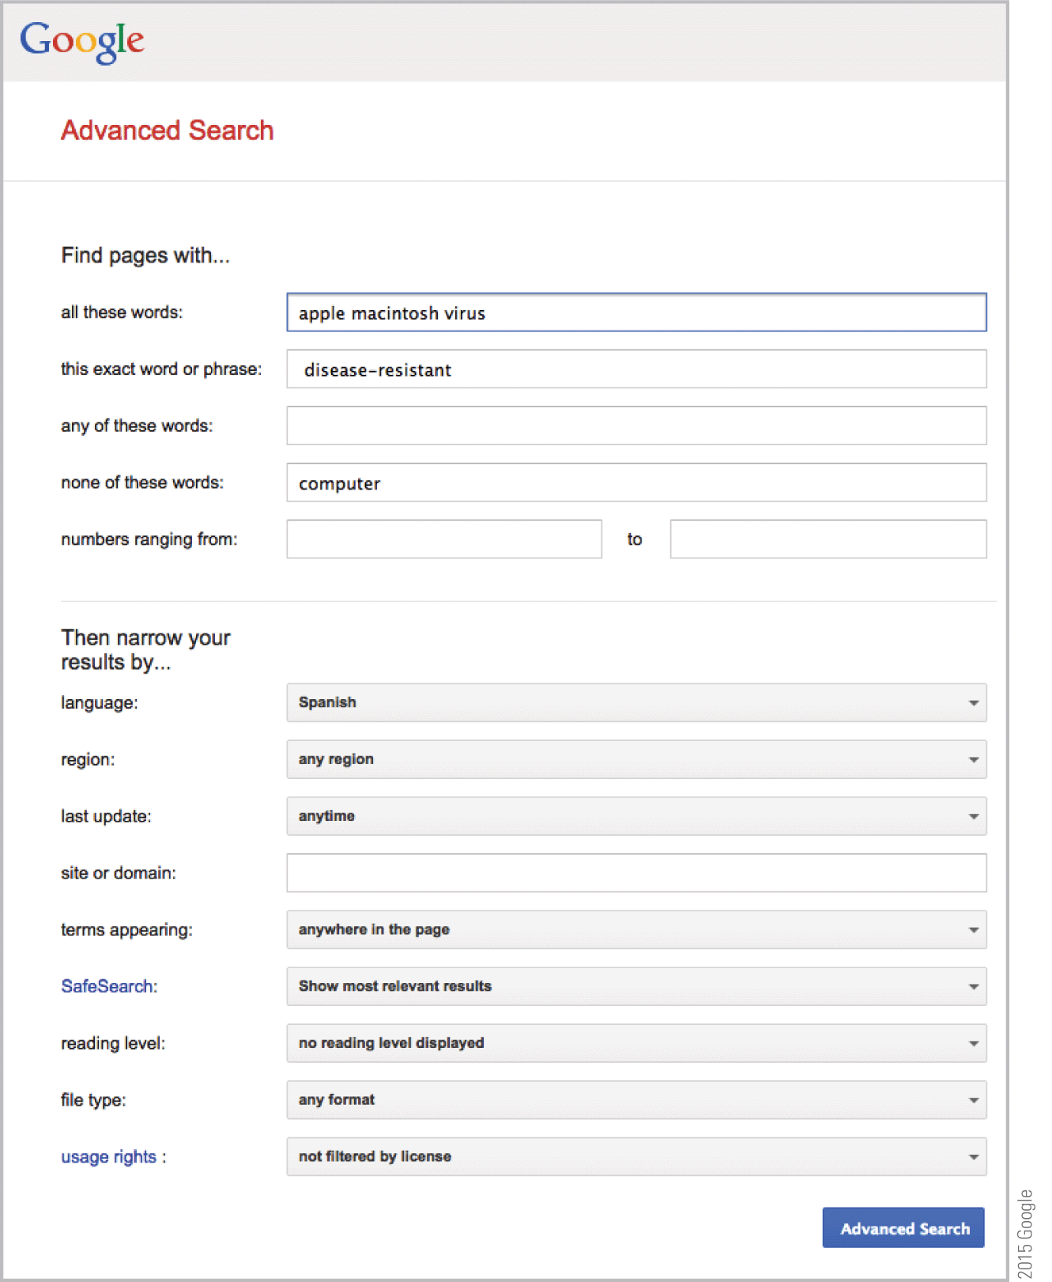
Formulating Searches
Many search engines provide ways to make your searches more precise and obtain more useful results; Google Advanced search is one example

Slide 64
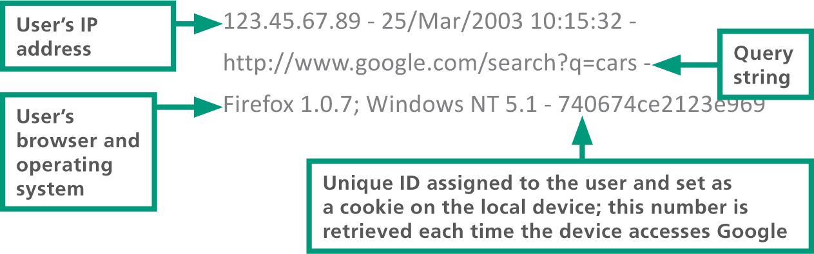
Search Privacy
Your search history contains a list of queries that you’ve made in a specific search engine
Your search history is not the same as your browser history, which is a list of Web sites you’ve visited and is maintained by your browser
Search history is stored in server logs on the search engines’ computers

Slide 65
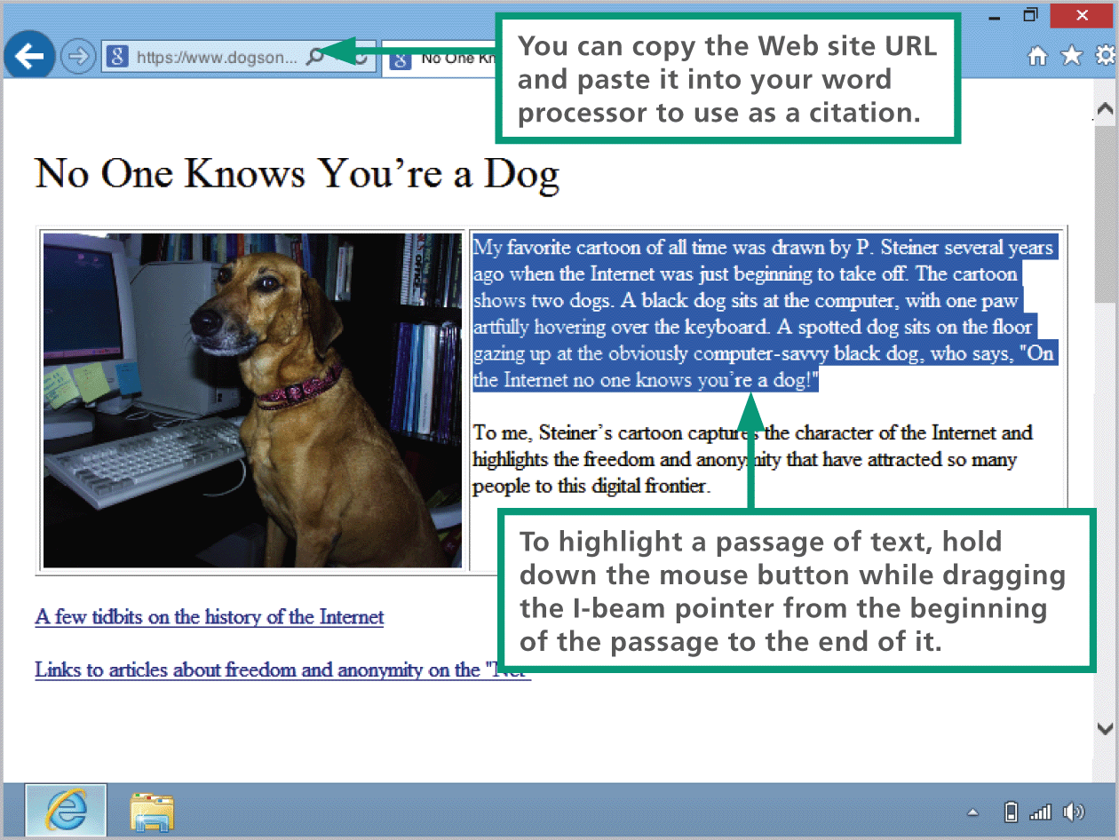
Using Web-based Source Material
Most browsers provide Copy and Save commands that allow you to obtain text and images from a Web page
To keep track of the source for each text section, you can highlight the Web page’s URL in the Address box, use the Copy command, and then paste the URL into your document

Slide 66
Using Web-based Source Material
Presenting someone else’s work as your own is plagiarism
If you copy text, pictures, or other works from a Web page, be sure to credit the original author
Information that identifies the source of an excerpted work is called a citation
Written documents, such as reports and projects, generally include footnotes, endnotes, or inline citations formatted according to a standard style, such as MLA, APA, or Chicago
In the United States, the Fair Use Doctrine allows limited use of copyrighted material for scholarship and review without obtaining permission

Slide 67
Unit 4 Complete

