Slide 1
Unit 3
Networks
ENHANCED EDITION

Slide 2
Unit Contents
Section A: Network Basics
Section B: The Internet
Section C: Internet Access
Section D: Local Area Networks
Section E: File Sharing

Slide 3
Section A: Network Basics
Communication Systems
Communication Channels
Network Topology
Network Nodes
Communication Protocols

Slide 4
Communication Systems
Networks can be classified in many ways; as a network user, you’ll want to keep in mind the idea of control and how it affects your privacy and security
A network links things together
A communication network (or communication system) links together devices to data and information can be shared among them

Slide 5
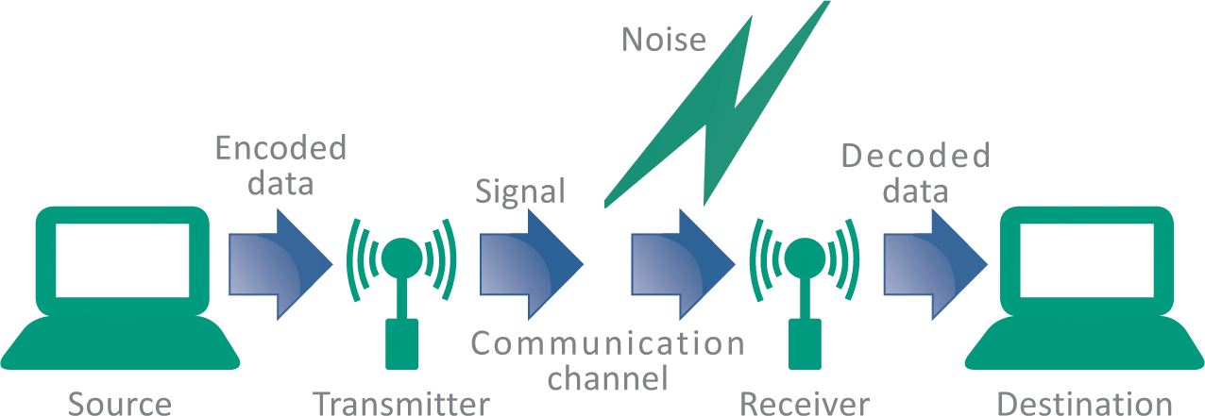
Communication Systems
In 1948, Claude Shannon, and engineer at Bell Labs, published and article describing a communication system model applicable to networks of all types
His diagram illustrates the essence of a network:

Slide 6
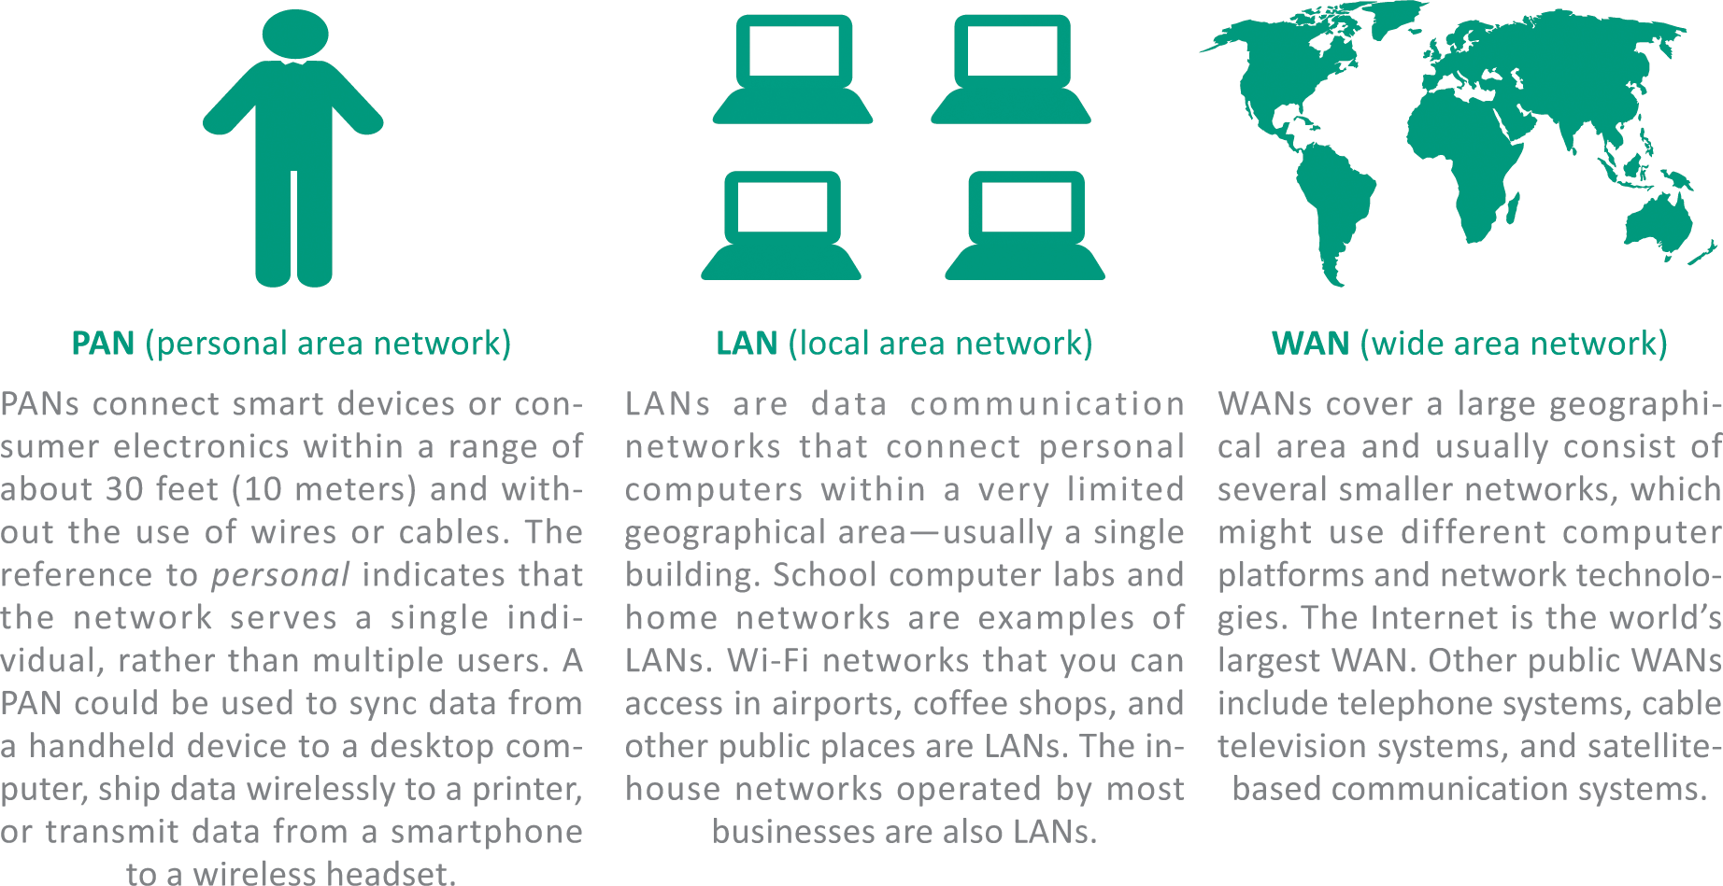
Communication Systems
Networks can be classified according to their size and geographic scope

Slide 7
Communication Channels
A communication channel is the medium used to transport information from one network device to another
Wired channels transport data through wires and cables
Wireless channels transport data from one device to another without the use of cable or wires

Slide 8
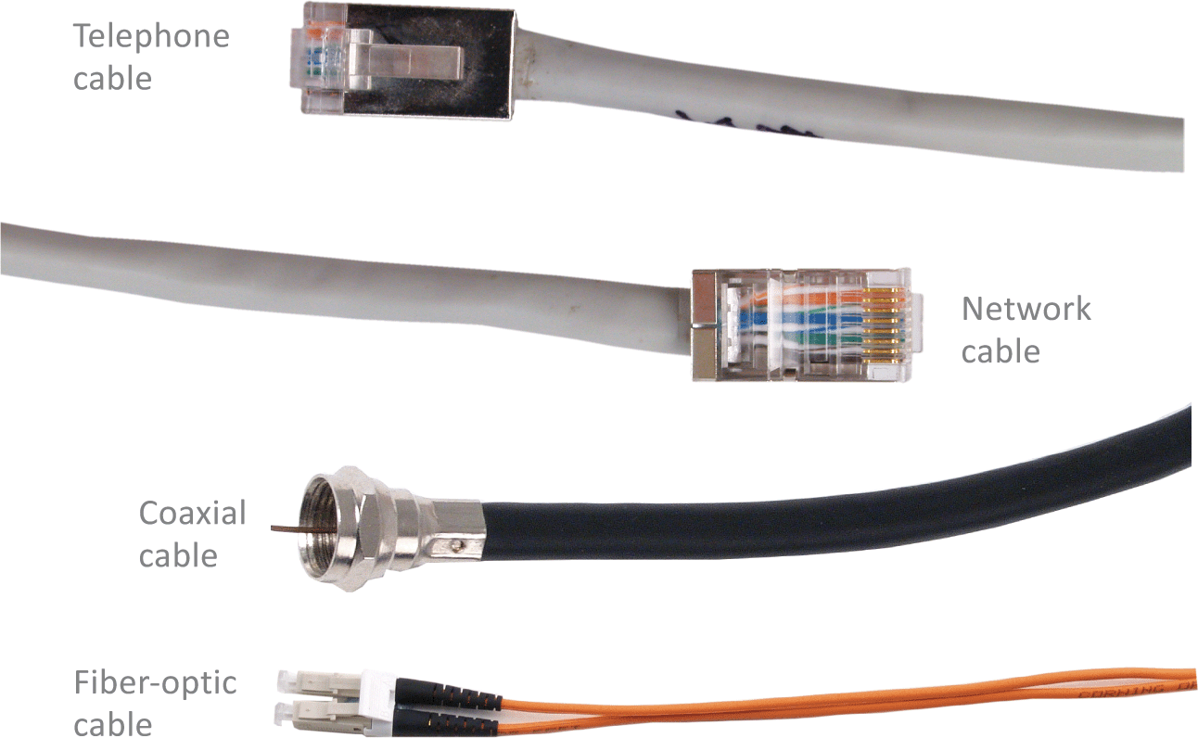

Communication Channels
Wired channels include twisted pair wires used for telephone land lines, coaxial cables used for cable television networks, Category 6 cables used for LANs, and fiber-optic cables used for high-capacity trunk lines

Slide 9
Communication Channels
When you set up a wired connection, you don’t have to worry about hackers intercepting your data from outside your house
There are ways to tap into a wired network, but they require physical access to the cable or fairly sophisticated snooping equipment

Slide 10
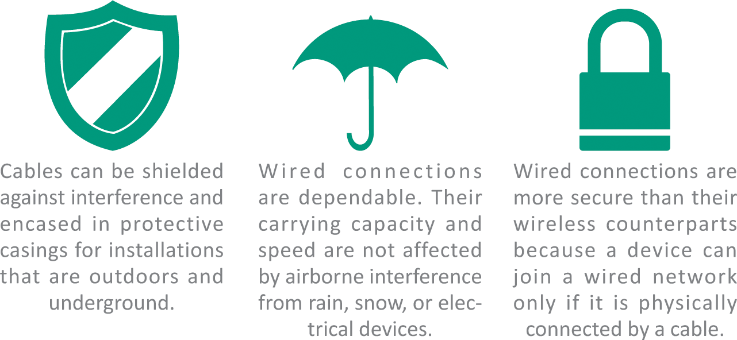
Communication Channels

Slide 11
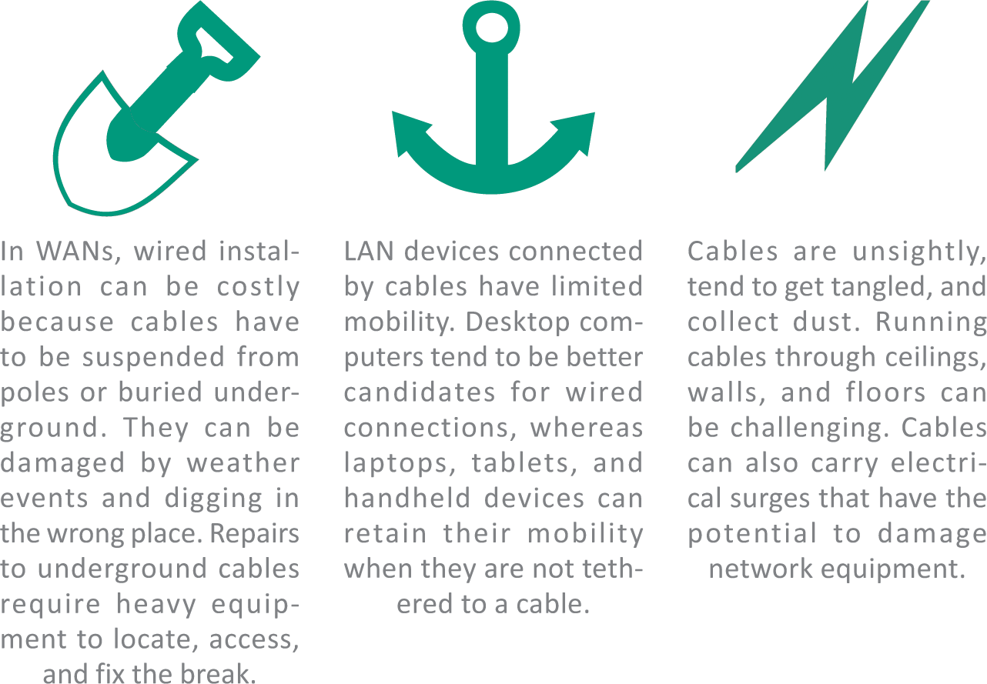
Communication Channels

Slide 12
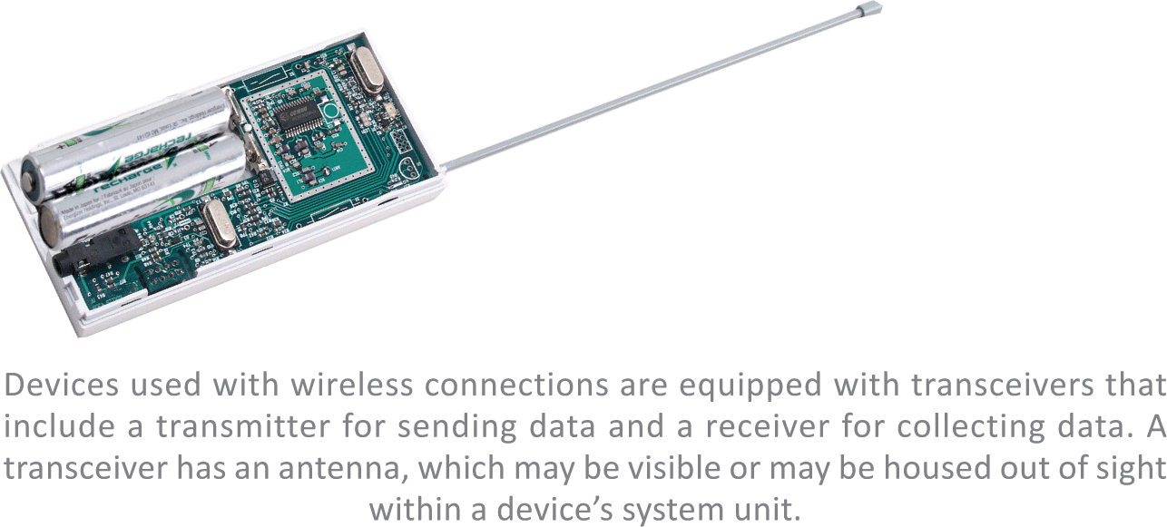
Communication Channels
The most widespread wireless channels for communication networks are radio signals and microwaves
Most wireless channels transport data as RF signals commonly called radio waves
RF signals are sent and received by a transceiver (a combination of a transmitter and a receiver) that is equipped with an antenna

Slide 13
Communication Channels
Microwaves (the waves themselves, not your oven!) provide another option for transporting data wirelessly
Microwaves are electromagnetic signals that can be aimed in a single direction and have more carrying capacity than radio waves
Microwave installations usually provide data transport for large corporate networks

Slide 14
Communication Channels
Advantages of wireless
  Mobility
  No unsightly cables
  Less susceptible to power spikes
Disadvantages of wireless
  Speed
  Range
  Security
  Licensing

Slide 15
Communication Channels
Bandwidth is the transmission capacity of a communication channel
Network channels that are capable of moving at least two megabits of data per second (2 Mbps) are classified as broadband
Channels slower than 2 Mbps are classified as narrowband

Slide 16
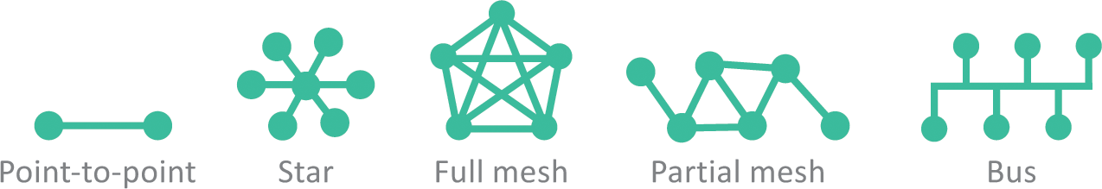
Network Topology
In the context of communication networks, topology refers to the structure and layout of network components, such as computers, connecting cables, and wireless signal paths
  Point-to-point topology refers to the process of peripheral devices connecting to a host device using expansion ports, USB cables, or Bluetooth
  Star topology connects multiple devices to each other, either as a full mesh or a partial mesh
  The less popular bus topology connects devices in a linear sequence

Slide 17
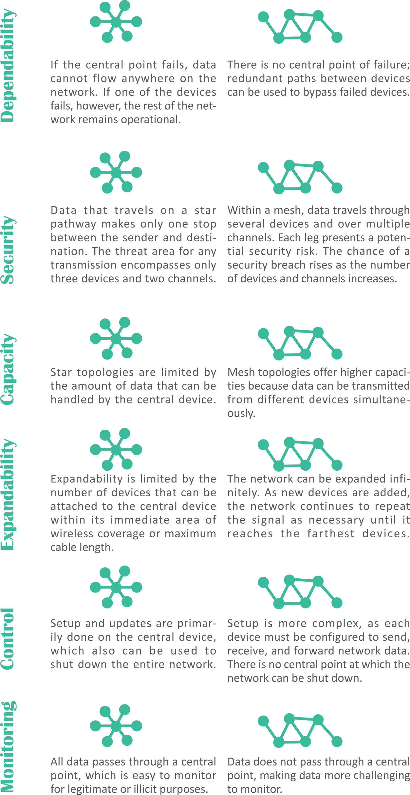
Network Topology

Slide 18
Network Nodes
Any device on a network is called a node
Devices on a network are classified as DTEs or DCEs
  DTE stands for data terminal equipment and can be any device that stores or generates data
  DCE stands for data communication equipment; these devices control the speed of data over networks, convert signals from cables to wireless, check for corrupted data, and route data to its destination

Slide 19
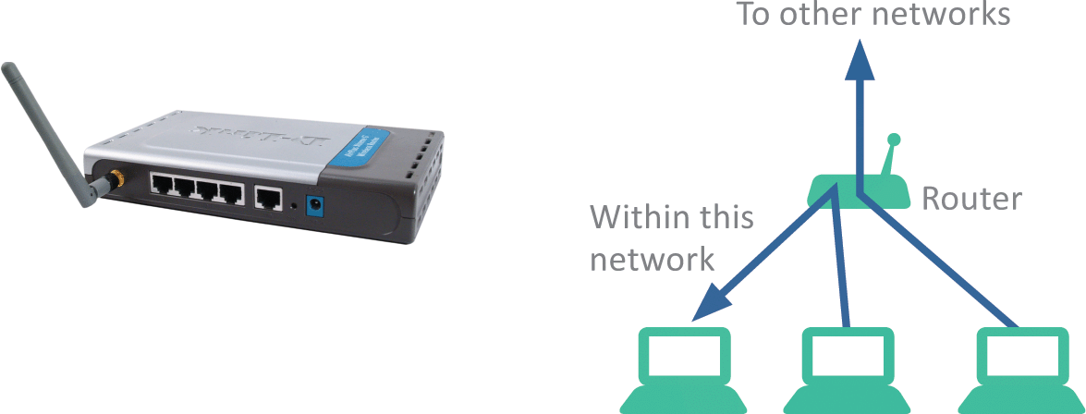
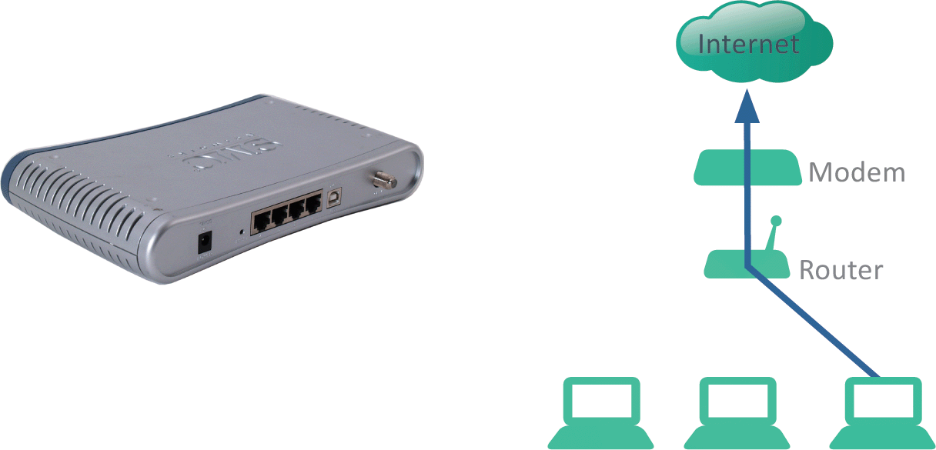
Network Nodes
A router is a device that controls the flow of data within a network and also acts as a gateway to pass data from one network to another
A modem contains circuitry that converts the data-carrying signals from a digital device to signals that can travel over various communications channels

Slide 20
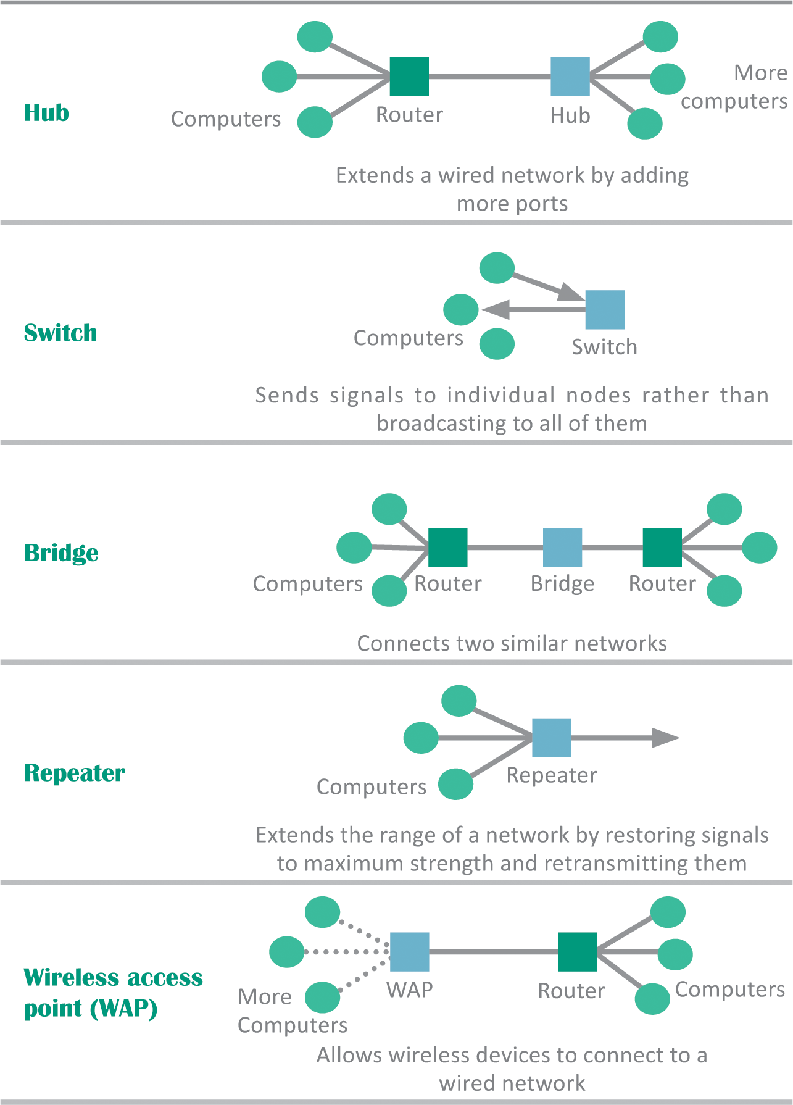
Network Nodes
DCEs such as repeaters, switches, and hubs can extend the range of your home network

Slide 21
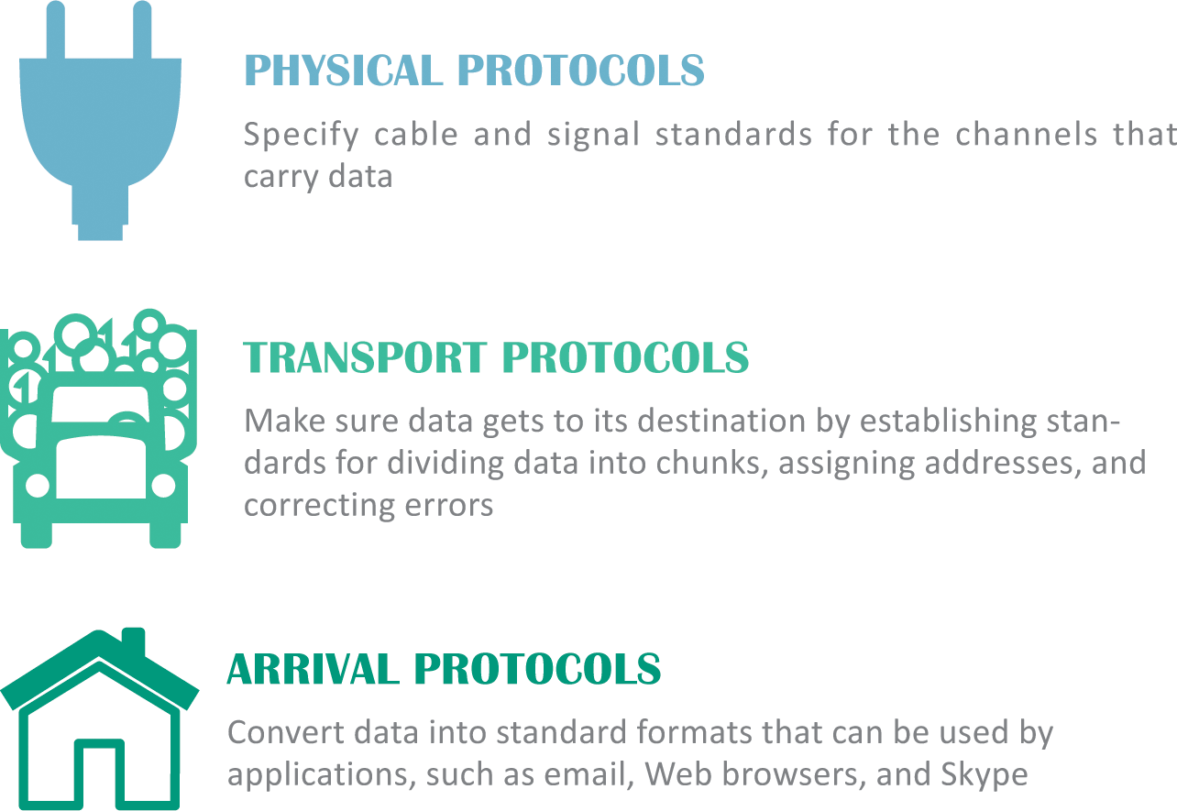
Communication Protocols
In the context of networks, a communication protocol refers to a set of rules for efficiently transmitting data from one network node to another
This process is called handshaking
Networks use more than one protocol, and the collection of protocols for a network is referred to as a protocol stack

Slide 22
Section B: The Internet
Background
Internet Infrastructure
Packets
Internet Addresses
Domain Names

Slide 23
Background
The history of the Internet begins in 1957
In a response to the Soviet Union launching Sputnik, the first man-made satellite, the U.S. government resolved to improve its scientific and technical infrastructure
One of the resulting initiatives was the Advanced Research Projects Agency (ARPA)

Slide 24
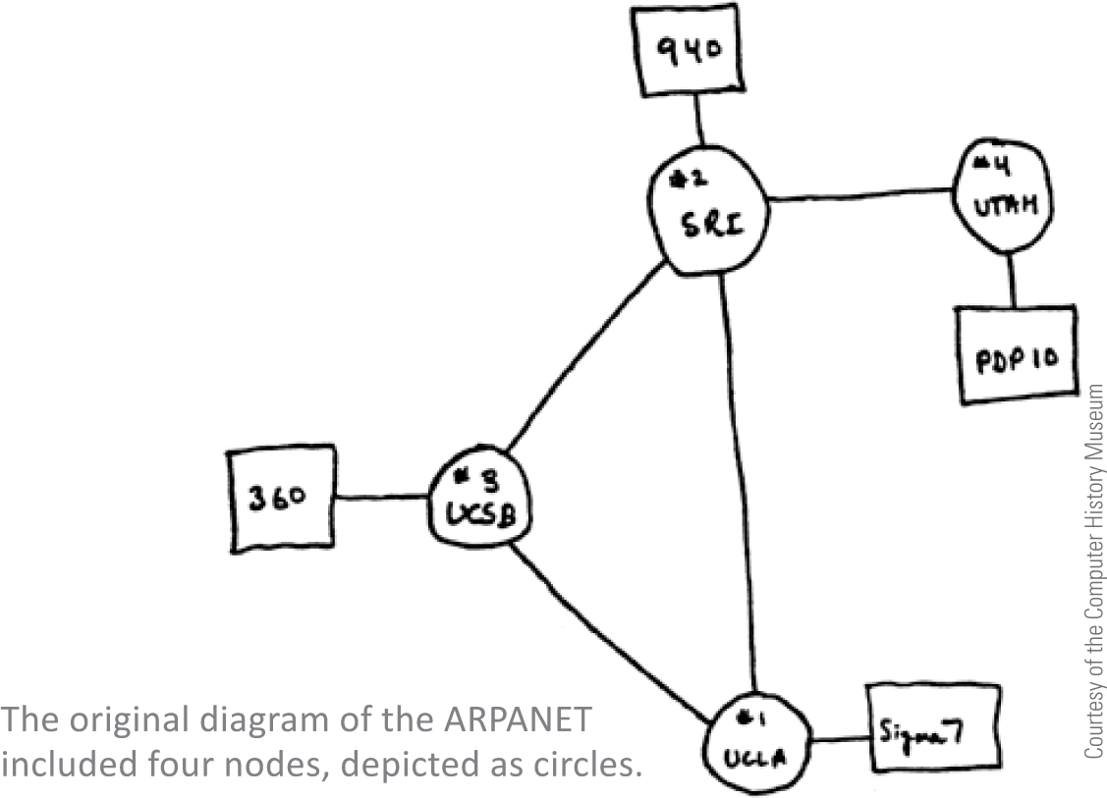
Background
ARPA designed a project to help scientists communicate and share valuable computer resources, and called it The ARPANET
The ARPANET, created in 1969, connected computers at UCLA, the Stanford Research Institute, the University of Utah, and UC California at Santa Barbara

Slide 25
Background
Early Internet pioneers used primitive command-line user interfaces to send email, transfer files, and run scientific calculations on Internet supercomputers
In the 1990s, software developers created new user-friendly Internet access tools, and Internet accounts became available to anyone willing to pay a monthly subscription fee

Slide 26
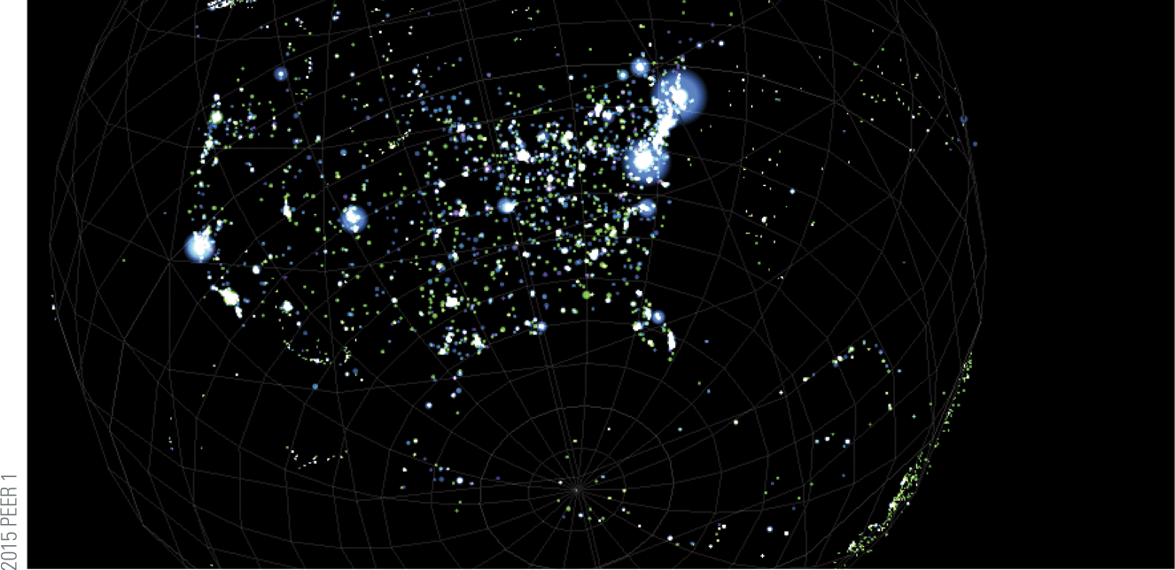
Background
Today’s Internet, with an estimated 500 million nodes and more than 2 billion users, is huge
It is estimated that the Internet handles more than an exabyte of data every day; an exabyte is 1.074 billion gigabytes – a nearly unimaginable amount of data!

Slide 27
Background
In theory, no single person, organization, company, or government runs the Internet
Internet governance is simply a set of shared protocols, procedures, and technologies that evolve through common agreement among network providers
The organization that supervises internet addressing is ICANN, the Internet Corporation for Assigned Names and Numbers

Slide 28
Internet Infrastructure
The way networks fit together is referred to as the Internet Infrastructure
Tier 1 networks, such as AT&T, represent the top of the Internet hierarchy and form the Internet backbone, a system of high-capacity routers and fiber-optic communication links providing the main routes for data speeding across the Internet
Networks that form the Internet are maintained by Internet service providers (ISPs)
ISPs exchange data at Internet exchange points (IXPs)

Slide 29
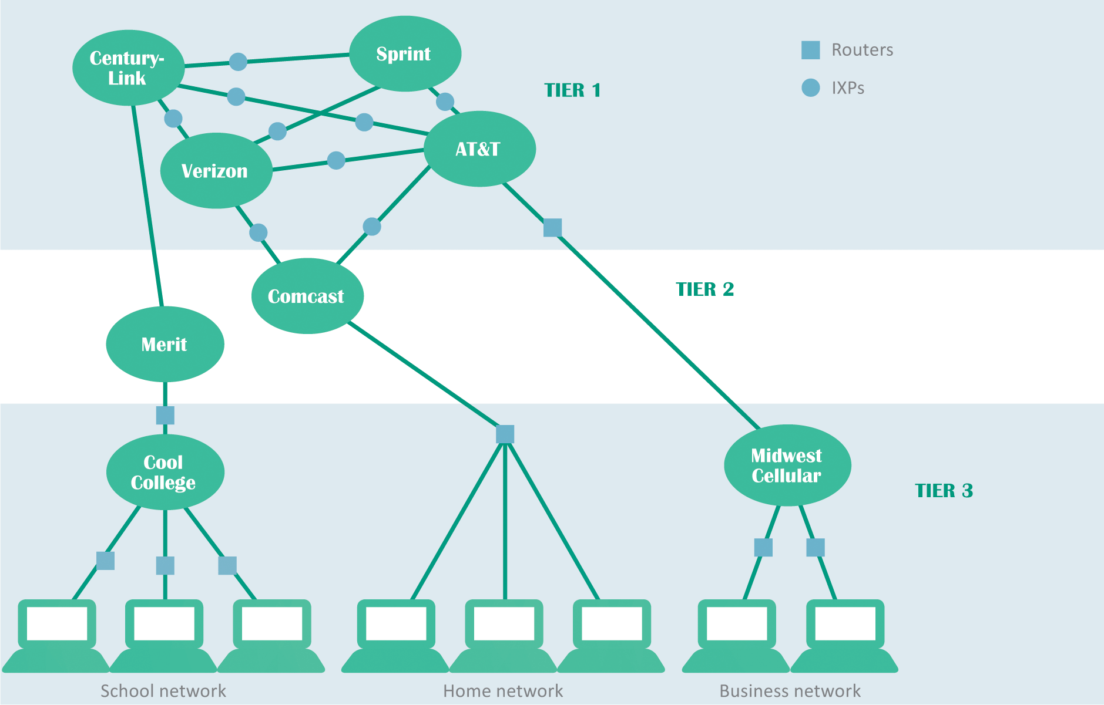
Internet Infrastructure

Slide 30
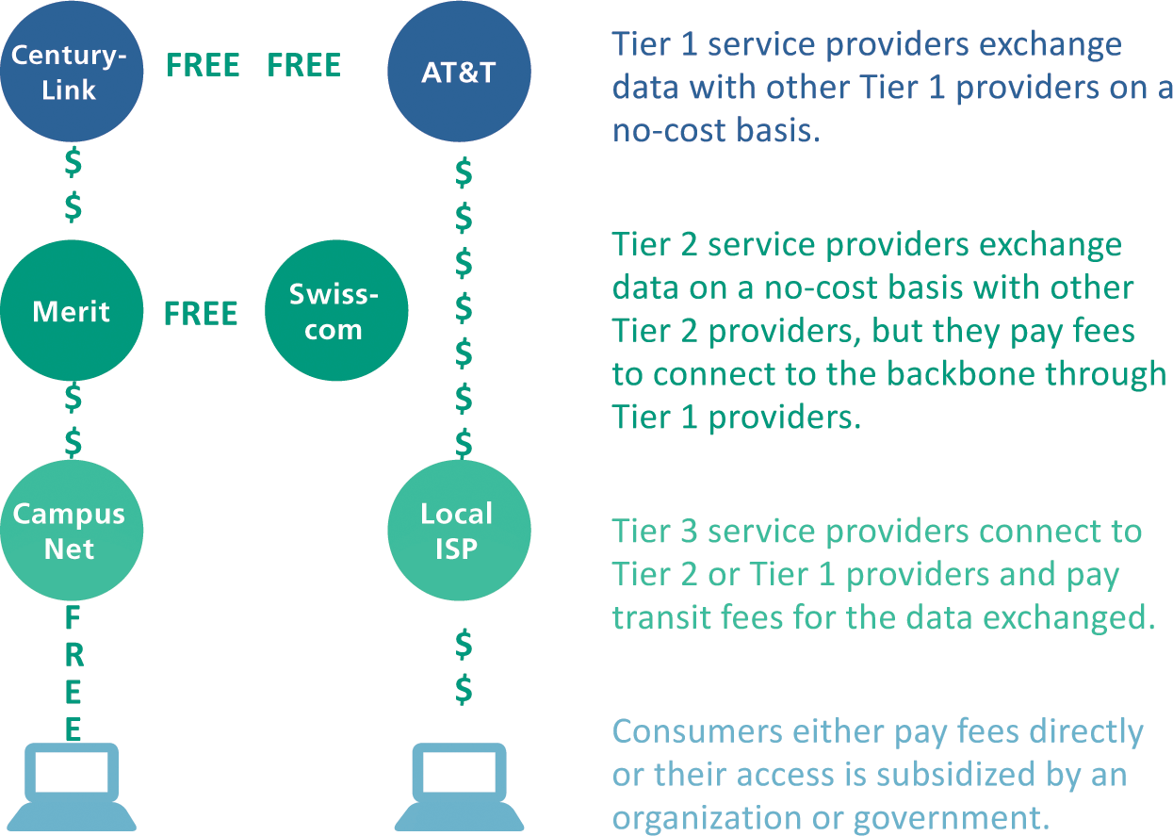
Internet Infrastructure
The internet is not free; ISPs make a substantial investment in equipment and infrastructure to connect consumers
Tier 1 ISPs own and maintain millions of dollars of data communication equipment

Slide 31
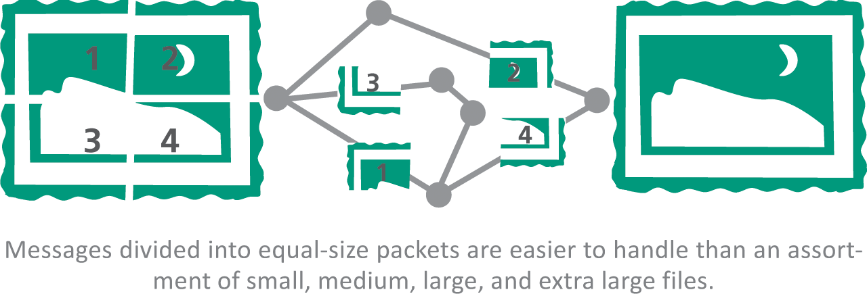
Packets
A packet is a parcel of data that is sent across a computer network; when packets reach their destination, they are reassembled into the original message according to their sequence numbers

Slide 32
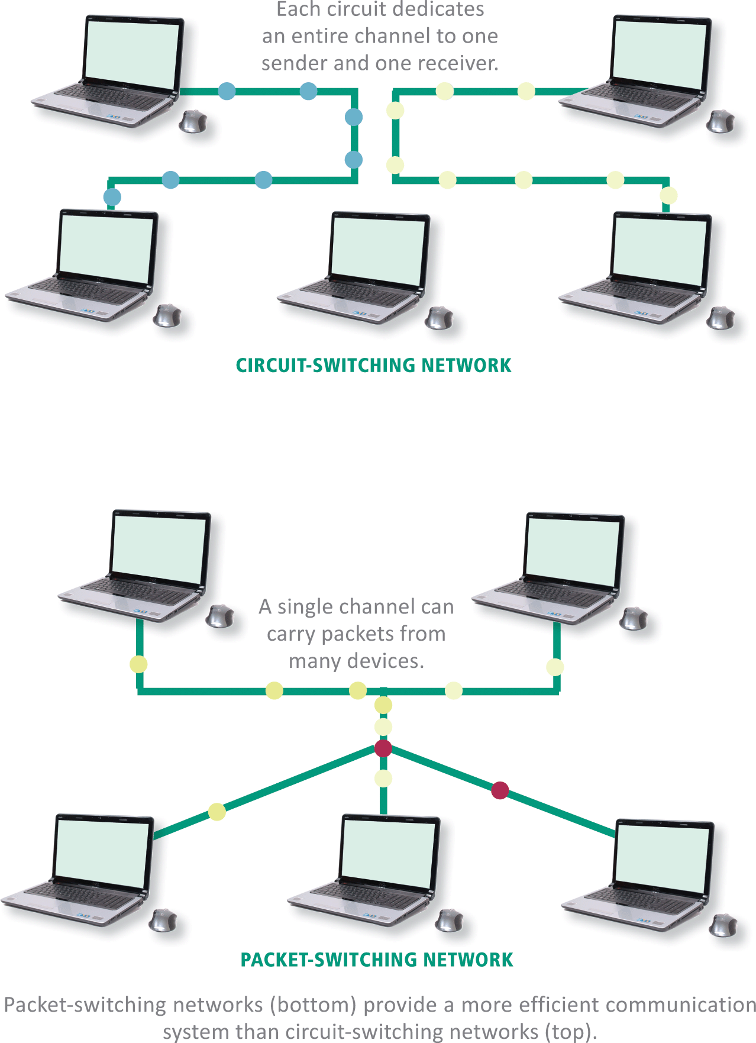
Packets
Communication networks use a technology called circuit switching, which establishes a private link between one telephone and another for the duration of a call
A more efficient alterative to this process is packet switching technology, which divides a message into several packets that can be routed independently to their destination

Slide 33
Packets
One of the core Internet protocols, TCP (Transmission Control Protocol) is responsible for dividing files into chunks, adding headers containing information for reassembling packets in their original order, and verifying that the data was not corrupted while in transit (a process called error checking)
UDP (User Datagram Protocol) is an alternative transport protocol which is faster than a TCP but does not perform error checking and cannot reorder packets

Slide 34
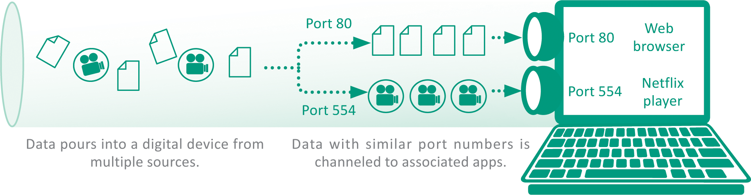
Packets
A communication port (usually referred to simply as a port) is a virtual end point for data entering and leaving a digital device
Communication ports are not a physical circuit, but rather an abstract concept of a doorway, an opening, or a portal through which data flows

Slide 35
Internet Addresses
Internet Addresses are controlled by IP (Internet Protocol), which is part of the Internet protocol suite
Many devices on the Internet have permanently assigned IP addresses called static addresses
IP defines two sets of addresses: IPv4 and IPv6
  IPv4 – (Internet Protocol version 4); is the Internet address standard; uses 32-bit addresses to identify Internet connected devices
  IPv6 – (Internet Protocol version 6); uses 128 bits for each address; produces billions and billions of unique Internet addresses

Slide 36
Internet Addresses
Internet addresses that are temporarily assigned to a device are called dynamic addresses
IP addresses can be assigned by a network administrator, but more commonly they are automatically assigned by DHCP (Dynamic Host Configuration Protocol)
A private IP address can be allocated by any network without supervision from ICANN – but it cannot be used to send data over the Internet; it’s not routable

Slide 37
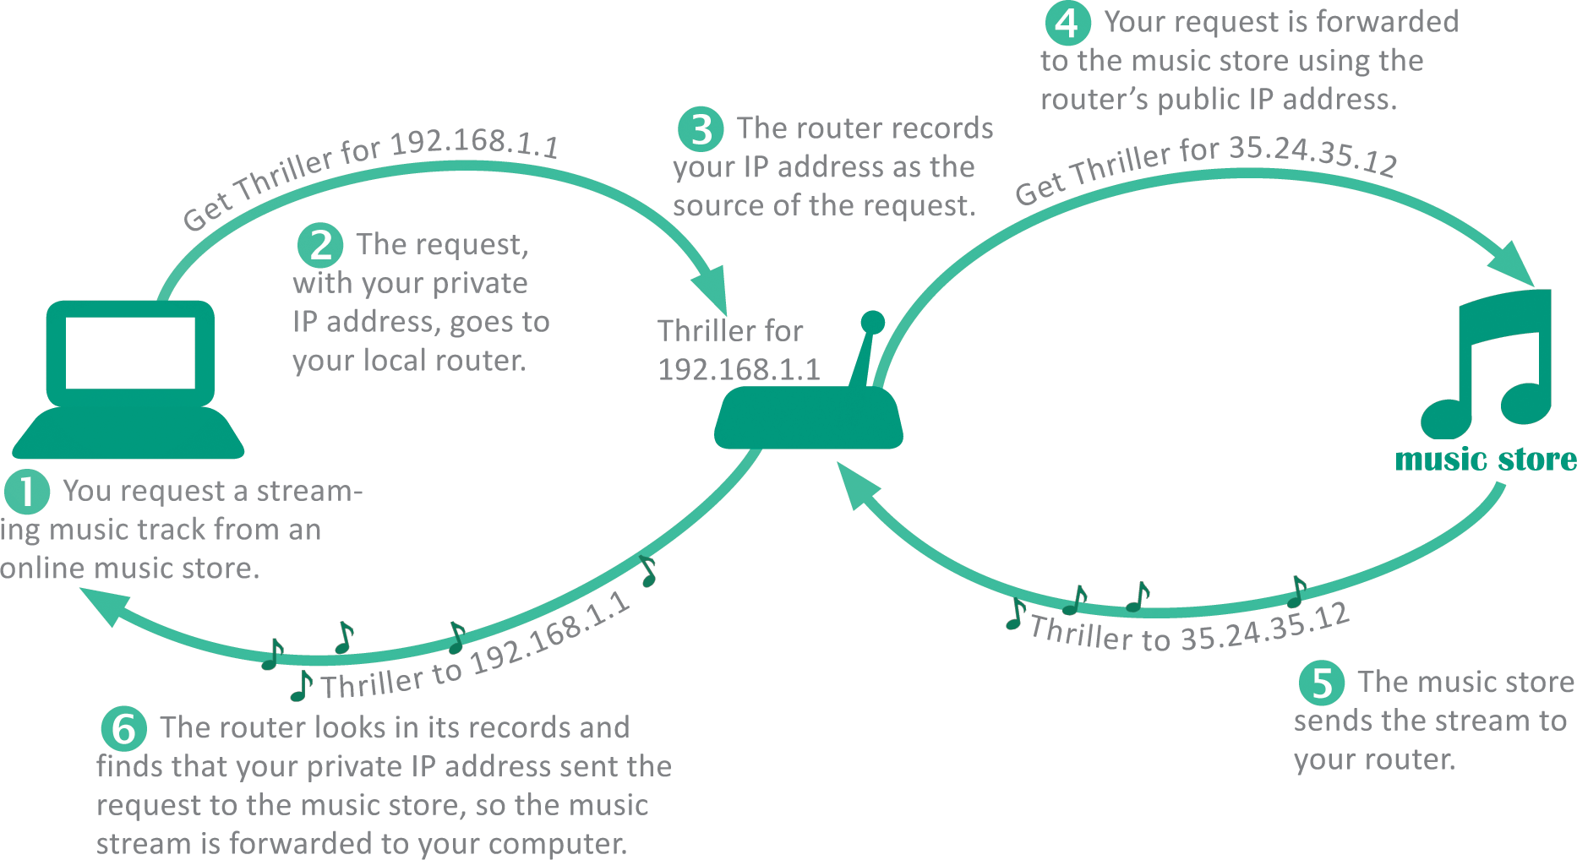
Internet Addresses
Because a private IP address cannot be routed over the Internet a local router connects instead
The local router has a public IP address that is routable over the Internet

Slide 38
Domain Names
It’s hard to remember the string of numbers in an IP address; most Internet destinations also have an easy-to-remember domain name, such as nike.com
The mechanism for tracking domain names and their corresponding IP addresses is called the domain name system (DNS)
A domain name ends with an extension that indicates its top-level domain, such as .edu or .org
Domain name servers are scattered around the world and maintain lists of all domain names and their corresponding IP addresses

Slide 39
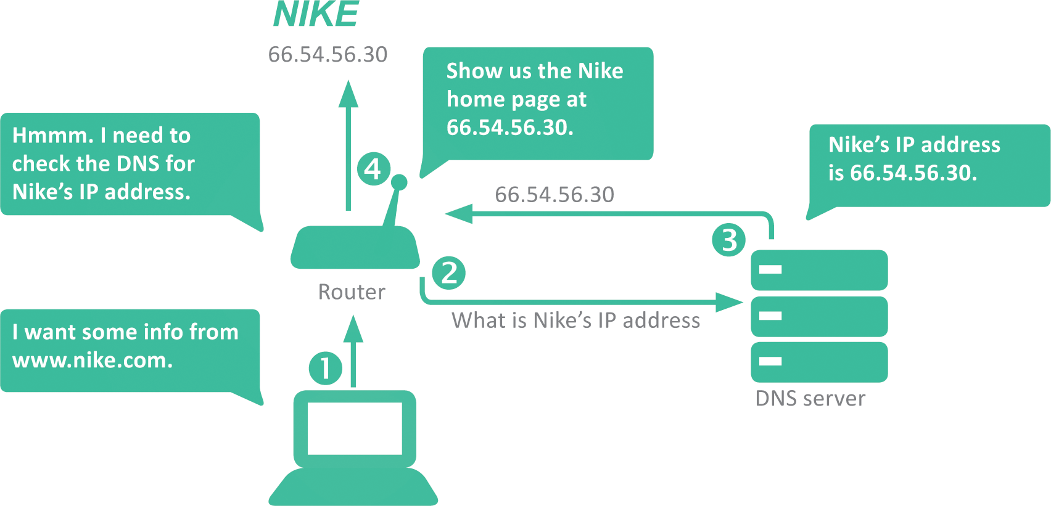
Domain Names

Slide 40
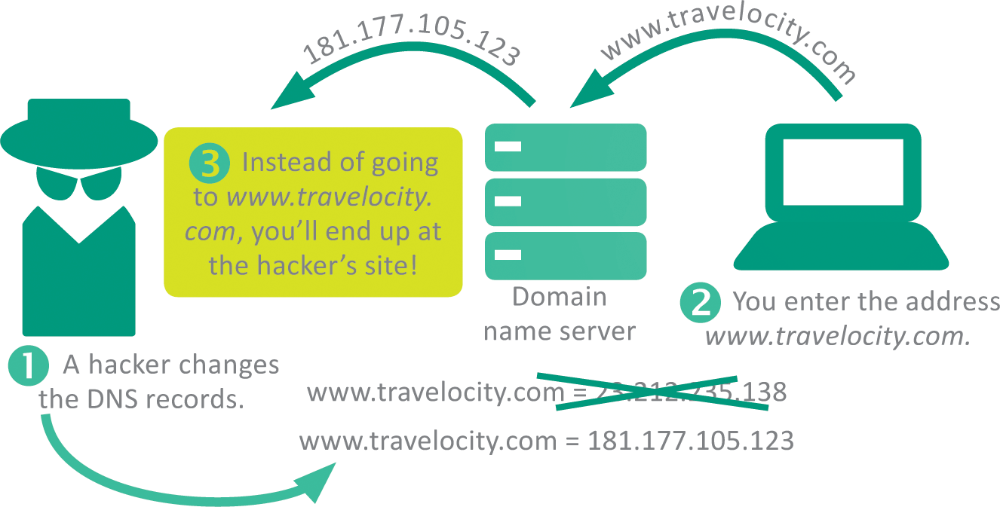
Domain Names
Altering DNS records can change the destination of email, browser connections, and download requests
Unauthorized changes to the DNS are called DNS spoofing

Slide 41
Section C: Internet Access
Connection Basics
Cable Internet Service
Telephone Network Internet Service
Satellite Internet Service
Mobile Broadband Service
Wi-Fi Hotspots

Slide 42
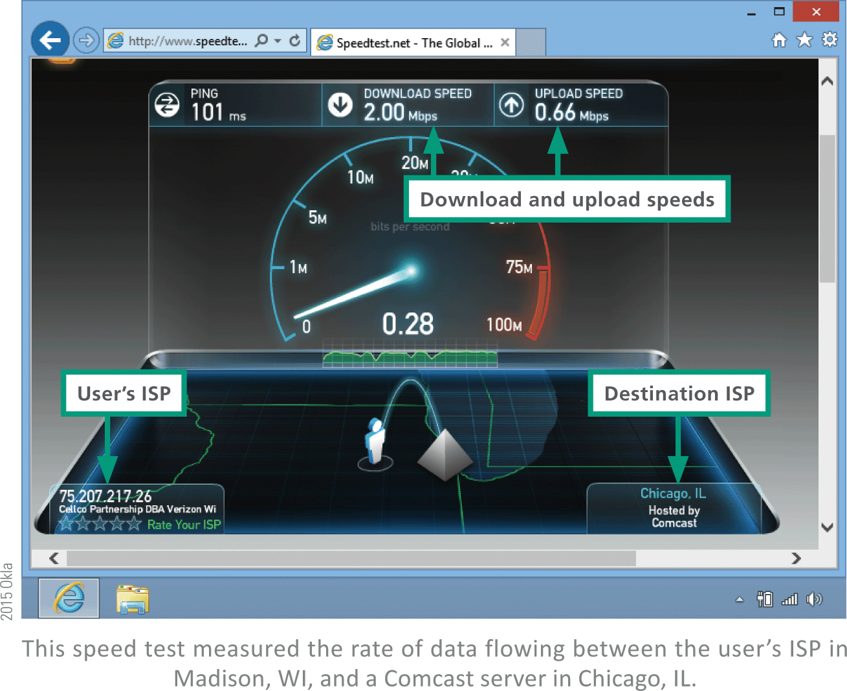
Connection Basics
Data travels over the Internet at an incredible speed, but that speed varies; some Internet services are faster than others
It is easy to check the speed of your Internet connection by running a few online tests

Slide 43
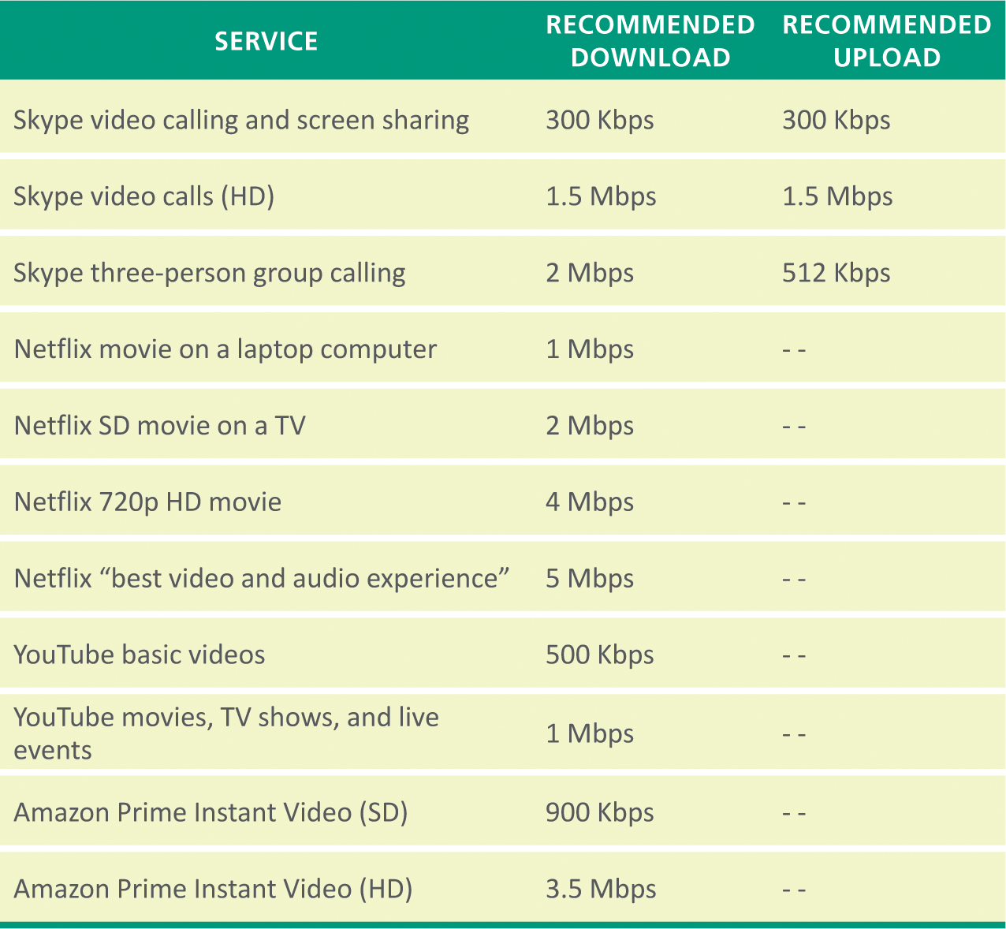
Connection Basics
The most common measurement of connection speed is the amount of data that can be transmitted in a specified time; technically, it is a measure of capacity

Slide 44
Connection Basics
ISPs control connection speeds based on the service plan you’ve selected
Your bandwidth cap is the top speed allowed by your plan
During peak times, ISPs can place further limits on speed, a process called bandwidth throttling
When Internet upload speed differs from download speed, you have an asymmetric connection
When upload and download speeds are the same, you have a symmetric connection

Slide 45
Connection Basics
Ping is utility software designed to measure responsiveness
Ping rate indicates how quickly data can reach a server and bounce back to you
Latency is the elapsed time for data to make a round-trip from point A to point B and back to point A
Jitter measures the variability of packet latency caused when network traffic and interference can delay packets and create erratic data flow
Packet loss refers to data that never reaches its destination or gets discarded because it arrives too late

Slide 46
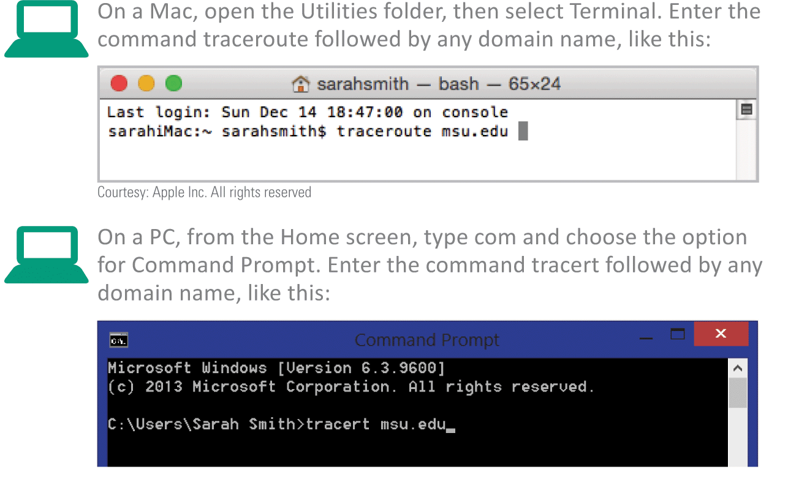
Connection Basics
To determine whether or not your slow Internet connection is caused by your ISP or your computer you can use a Traceroute, a network diagnostic tool that lists each router and server

Slide 47
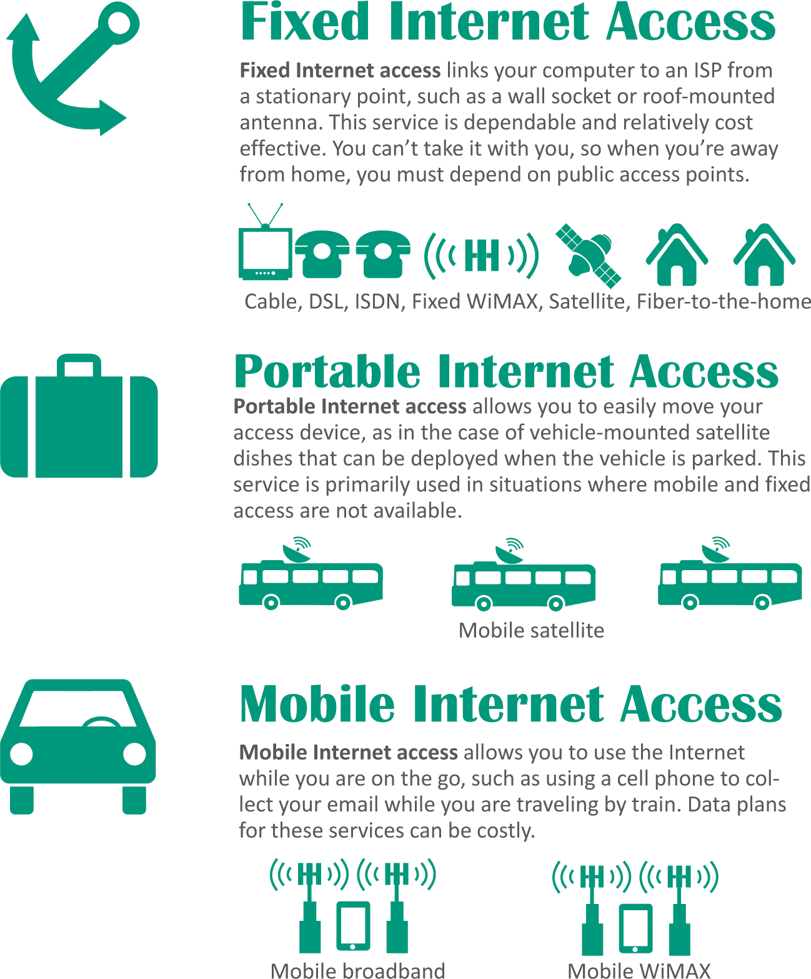
Connection Basics
Although public Internet access is available in many locations, such as coffee shops and libraries, most consumers like the convenience of having their own Internet connection

Slide 48
Cable Internet Service
The gold standard of fixed Internet access is cable Internet service, which is offered by the same companies that supply cable television
CATV stands for community antenna television
With cables branching out from a central location, the topology of a CATV system works well as the infrastructure for a digital data network

Slide 49
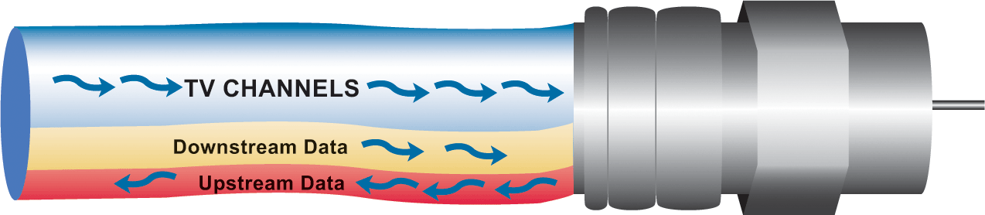
Cable Internet Service
CATV coaxial and fiber-optic cables have plenty of bandwidth to carry television signals for hundreds of channels in addition to digital data
CATV cables provide bandwidth for television signals, incoming data signals, and outgoing data signals

Slide 50
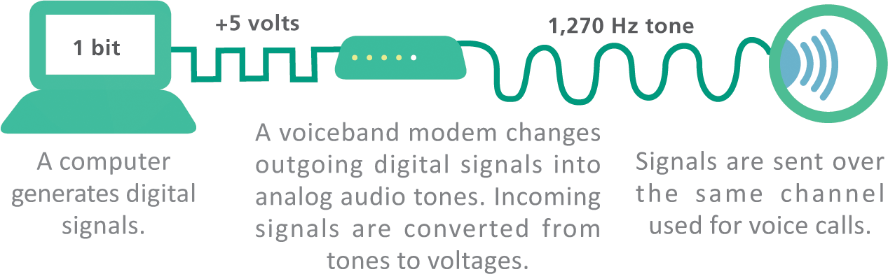
Telephone Network Internet Service
Telephone companies offer four types of service: dial-up, ISDN, DSL, and FTTH
A dial-up connection is a fixed Internet connection that uses a voiceband modem and the telephone company’s circuit-switched network to transport data between your computer and your ISP
A voiceband modem converts digital signals from a computer into audible analog signals that can travel over telephone lines

Slide 51
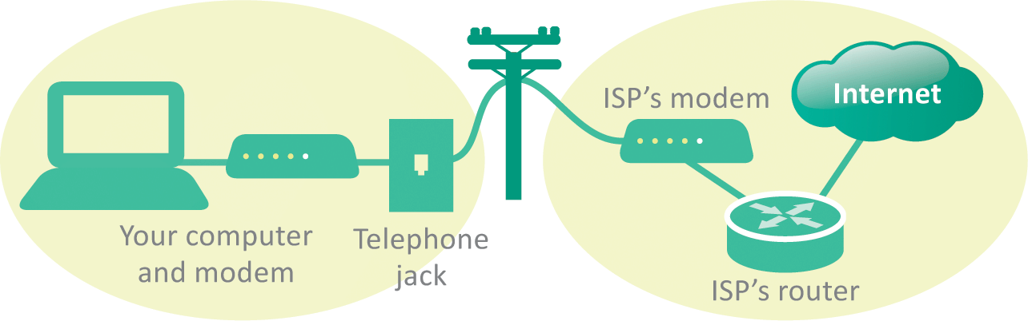
Telephone Network Internet Service
When you use a dial-up connection, a voiceband modem places a regular telephone call to your ISP; the circuit remains connected for the duration of the call to carry data between your computer and the ISP

Slide 52
Telephone Network Internet Service
ISDN stands for Integrated Services Digital Network; it divides a telephone line into two channels, one for data and one for voice, by using packet switching
DSL (digital subscriber line) is a high-speed, digital, always-on, Internet access technology that runs over standard phone lines; it’s offered by AT&T’s U-verse service
FTTH (fiber-to-the-home) is the use of high-capacity fiber-optic cables, rather than coaxial cables, to connect homes to broader municipal networks

Slide 53
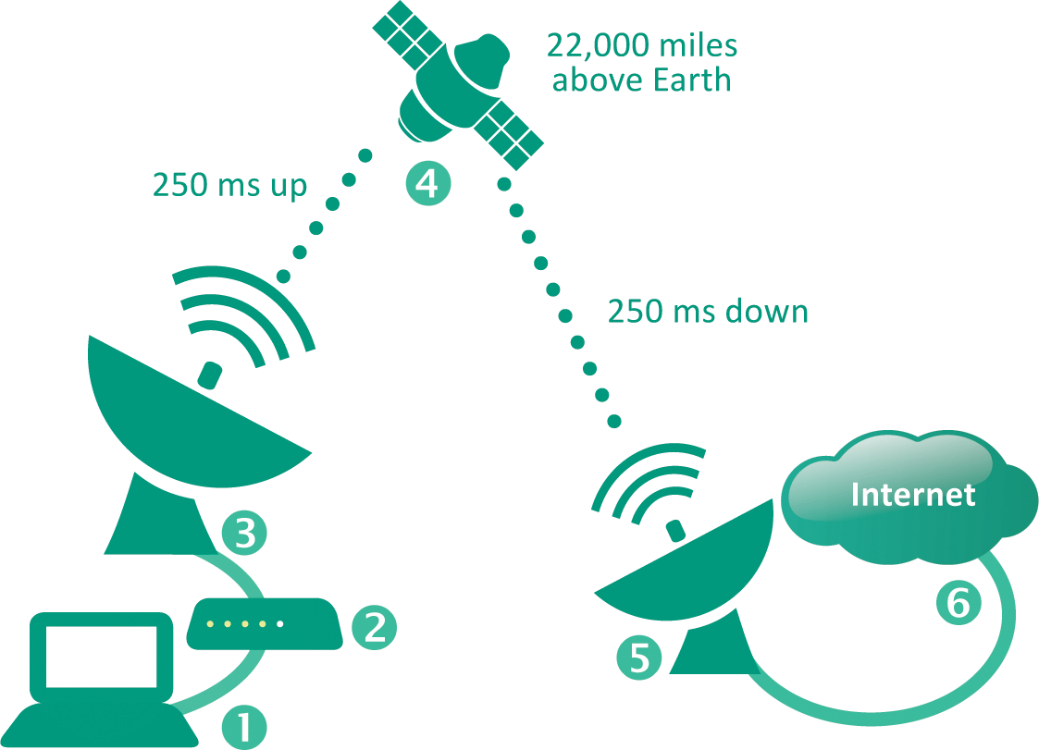
Satellite Internet Service
Satellite Internet service is a means of distributing broadband asymmetric Internet access by broadcasting signals to a satellite
In many rural areas, satellite Internet service is the only alternative to a slow dial-up connection

Slide 54
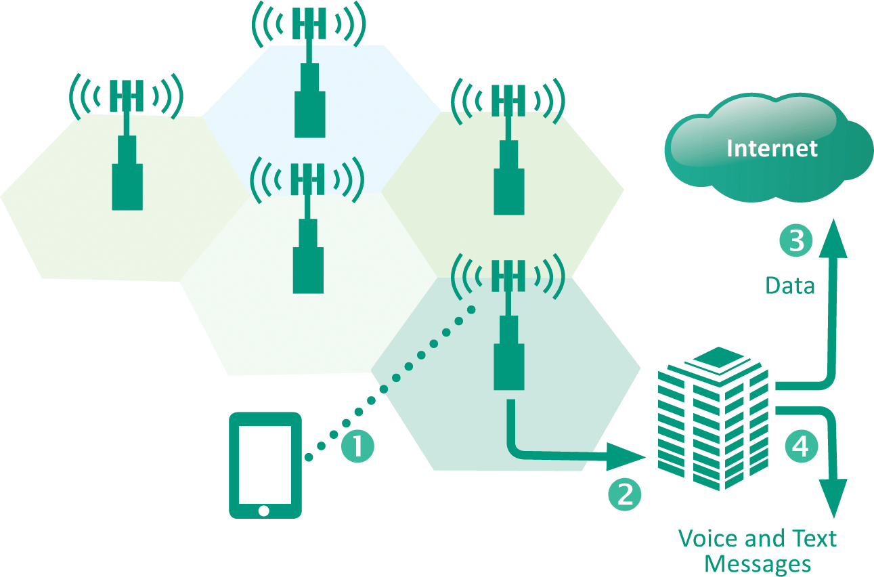
Mobile Broadband Service
Mobile broadband service has become so compelling that most of the Web has undergone a visual makeover to fit the requirements of smartphone-sized screens
Cell networks transmit voice and data using radio signals; the signals flow between a device and a cellular radio tower (1), transmitters and receivers on each tower cover a specific area and use a unique frequency; data signals are passed to ground stations (2), where they are forwarded over a packet-switched network to the Internet (3); voice signals may be routed to a circuit-switched network (4)

Slide 55
Mobile Broadband Service
Mobile broadband has evolved through several generations; the most recent of these generations are 3G and 4G
  3G (third generation) service was available in the U.S. beginning in 2001; common protocols include CDMA and GSM EDGE
  4G (fourth generation) technologies, such as WiMAX and LTE, rolled out in 2011

Slide 56
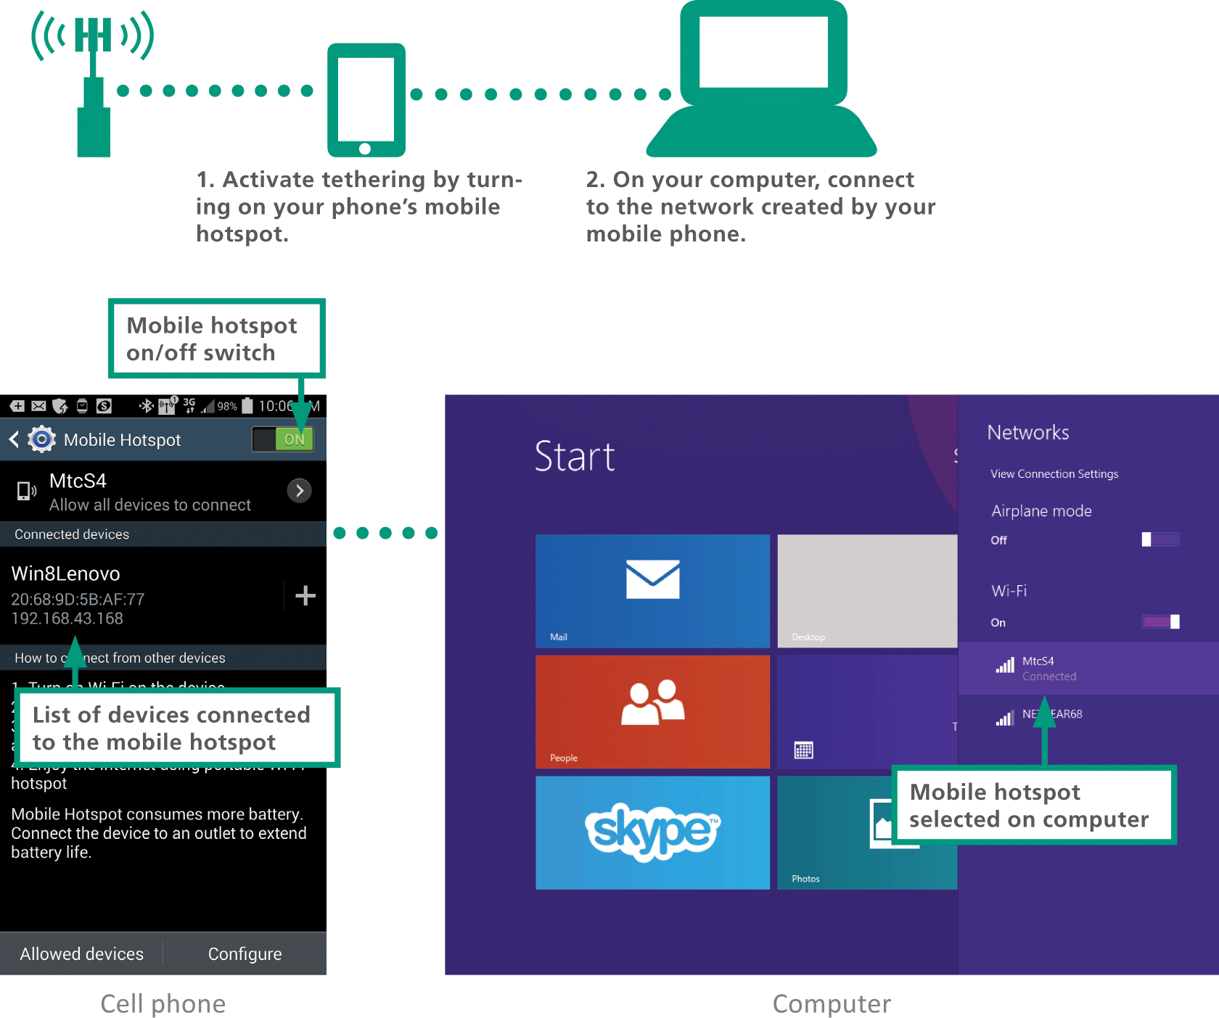
Mobile Broadband Service
Most of today’s smartphones include a tethering feature that connects wirelessly with other digital devices
Setting up tethering to create a mobile hotspot is easy, just remember though that data sent over the connection accumulates toward your monthly data usage total

Slide 57
Wi-Fi Hotspots
A Wi-Fi hotspot is a wireless local area network that offers Internet access to the public
The network has an Internet connection and device called an access point that broadcasts Wi-Fi signals within a range of about 150 feet

Slide 58
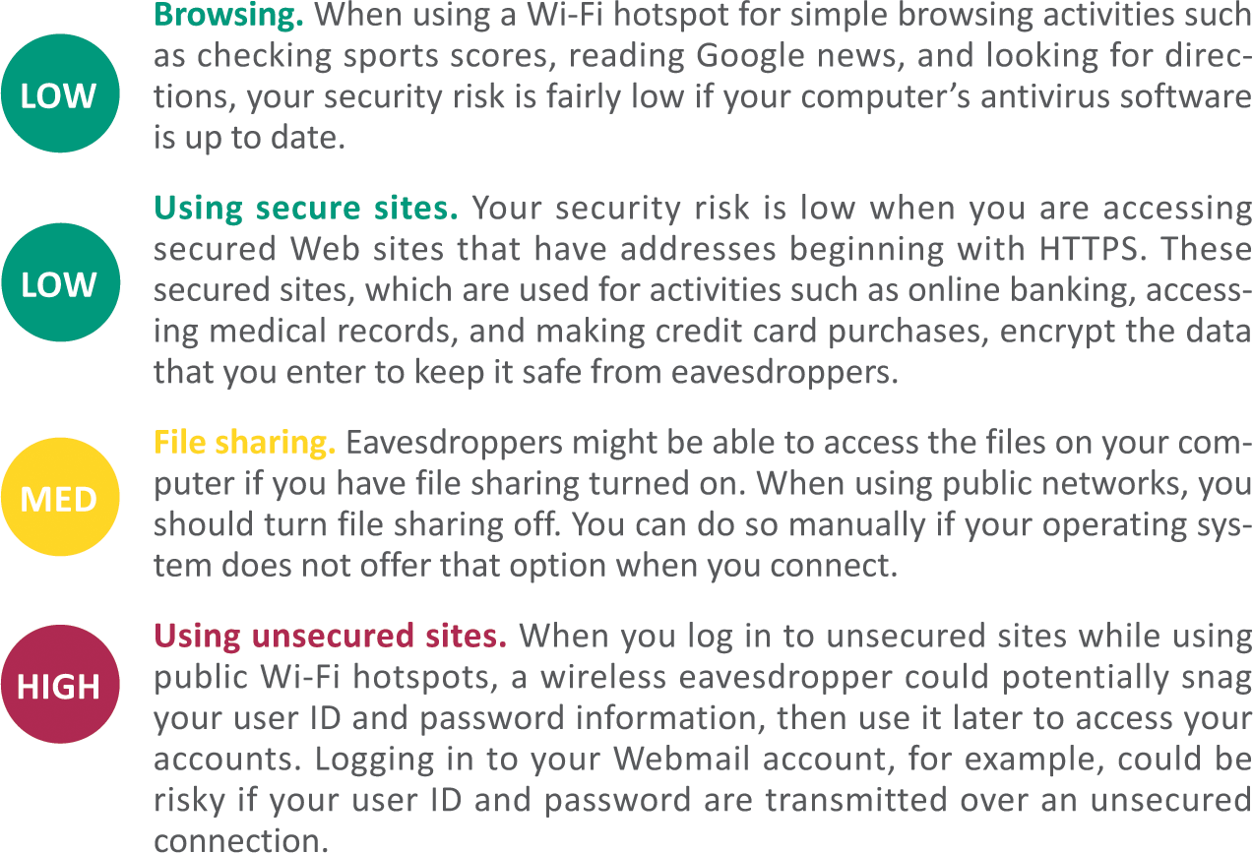
Wi-Fi Hotspots

Slide 59
Section D: Local Area Networks
LAN Basics
Ethernet
Wi-Fi
Set Up Your Own Network
Network Monitoring
IoT Networks

Slide 60
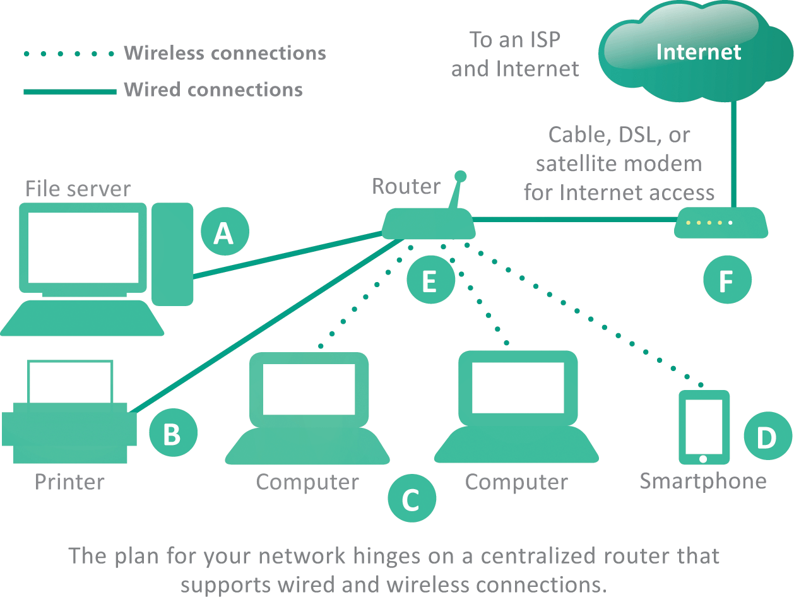
LAN Basics
Local area networks are often referred to as LANs
They are designed to provide connectivity for devices within a limited area, typically within the premises of a home, office building, business, or school

Slide 61
LAN Basics
LANs can be classified by their protocols; Ethernet and Wi-Fi are the two most popular
The Windows OS provides a tool for setting up a LAN called a homegroup; this makes it easy to share files among local computers, but does not provide Internet access
Most LANs are set up using a router so that they have proper security and Internet access
The circuitry that enables a device to access a LAN is called a network interface controller (NIC)
NICs contain a MAC address (media access control address) used to identify devices on LANs

Slide 62
Ethernet
Ethernet is a wired network technology that is defined by IEEE 802.3 standards
Ethernet’s success is attributable to several factors
  Easy – it’s easy to understand, implement, manage, and maintain
  Secure – the wired connections in an Ethernet LAN are more secure than wireless LAN technologies
  Inexpensive – as a nonproprietary technology, Ethernet equipment is available from a variety of vendors; market competition keeps prices low
  Flexible – current Ethernet standards allow extensive flexibility in network configurations
  Compatible – Ethernet is compatible with Wi-Fi wireless technology; it’s easy to mix wired and wireless devices on a single network

Slide 63
Ethernet
Ethernet was originally a bus topology in which computers were all strung along a cable like birds on a power line
Today’s Ethernet LANs are usually arranged in a star topology with computers wired to central switching circuitry that is incorporated in modern routers
Data sent from a computer on the network is transmitted to the router, which then sends the data to the destination device

Slide 64
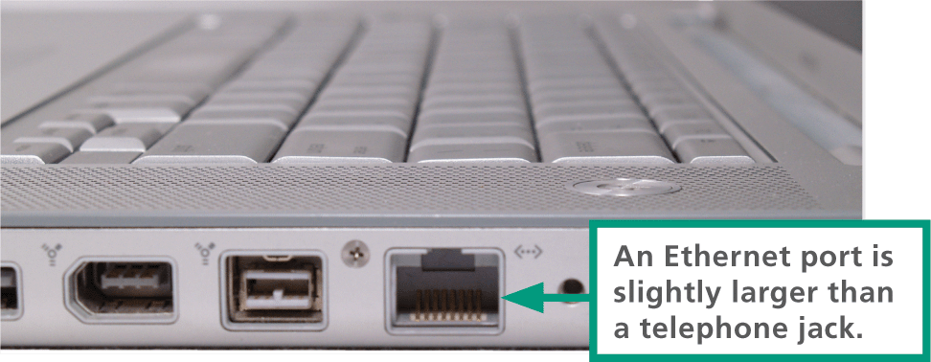
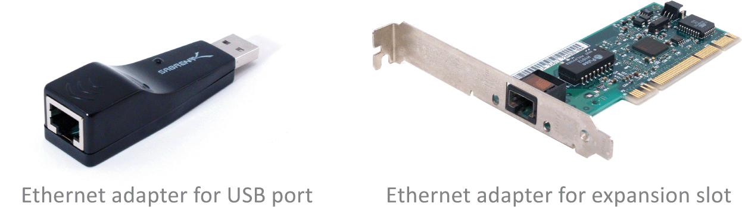
Ethernet
Many computers have a built-in Ethernet port located on the system case; the port looks very similar to an oversized telephone jack
If you want a wired network connection but your computer has no Ethernet port, you can purchase and install an Ethernet adapter (also called an Ethernet card)

Slide 65
Wi-Fi
Wi-Fi refers to a set of wireless networking technologies defined by IEEE 802.11 standards
A Wi-Fi device transmits data as radio waves and is compatible with Ethernet, so you can use the two technologies in a single network
You can set up Wi-Fi in two ways
  Wireless mesh topology – devices broadcast directly to each other
  Star topology – a centralized broadcasting device, a wireless access point, coordinates communication among network devices

Slide 66
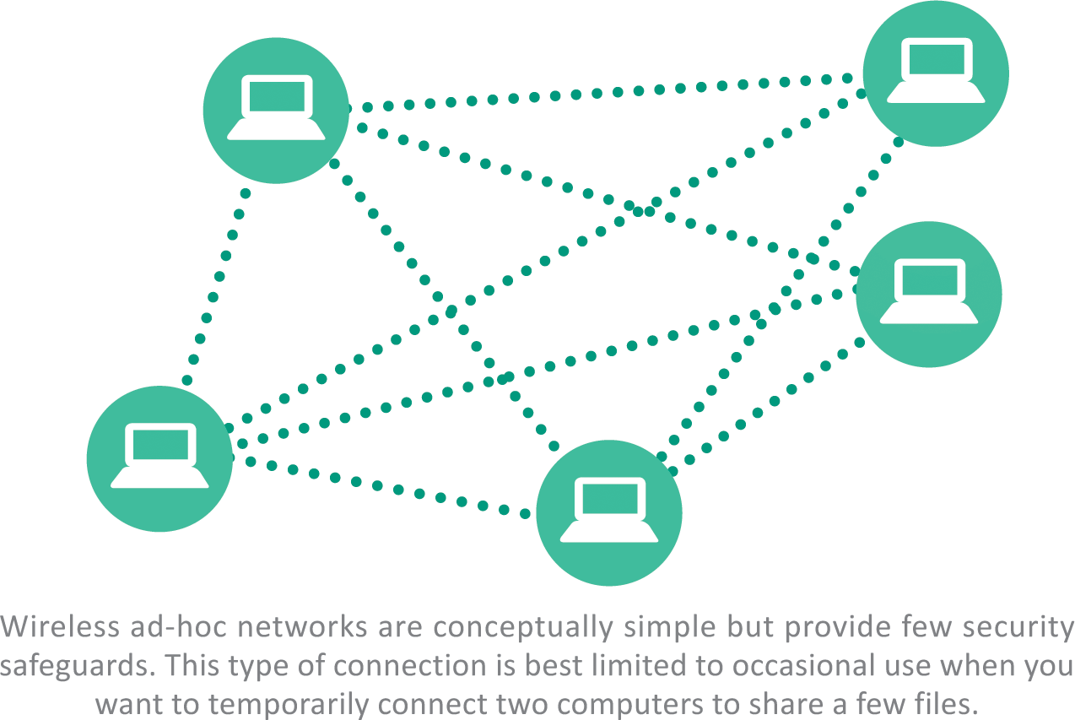
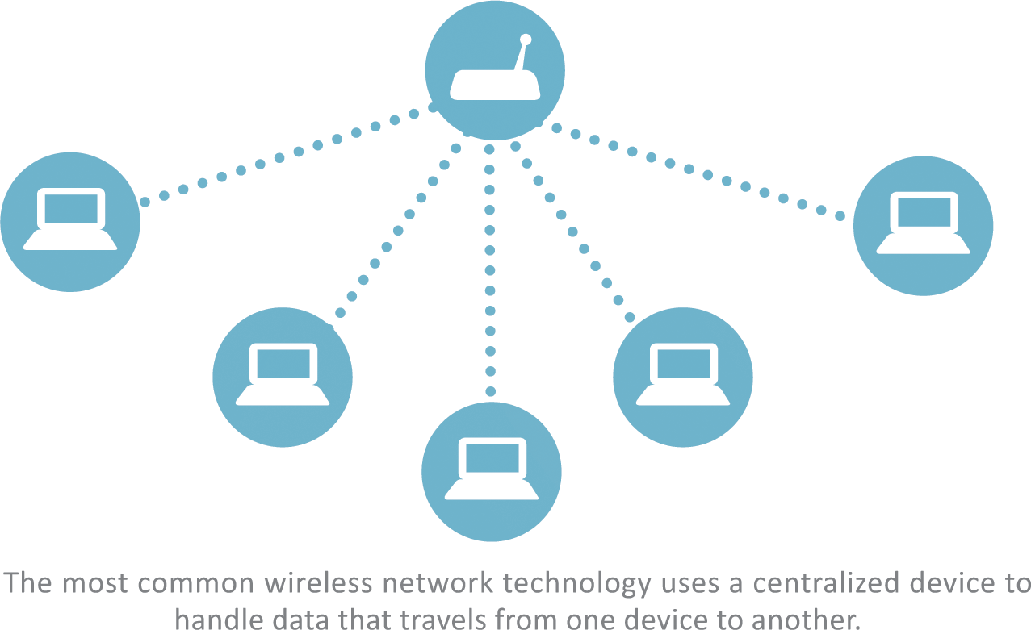
Wi-Fi

Slide 67
Set Up Your Own Network
Having your own network is great, but LANs can be a security risk
Here’s how to set up your own safe and secure LAN:
  Plug in the router and connect it to your Internet modem
  Configure the router
  Connect wired and wireless devices
  Change the router password
  Create an SSID (service set identifier); this will be the name of your wireless network
  Continued…

Slide 68
Set Up Your Own Network
  Activate wireless encryption to scramble and unscramble data
    WEP (wired equivalent privacy) is the oldest and weakest wireless encryption protocol
    WPA (Wi-Fi Protected Access) and its cousins, WPA2 and PSK, offer more security
  Create a wireless encryption key (a network security key or password)
  Configure the Guest Network (a second network on your LAN’s router)
  Activate DHCP (assigns addresses to each device that joins your network)

Slide 69
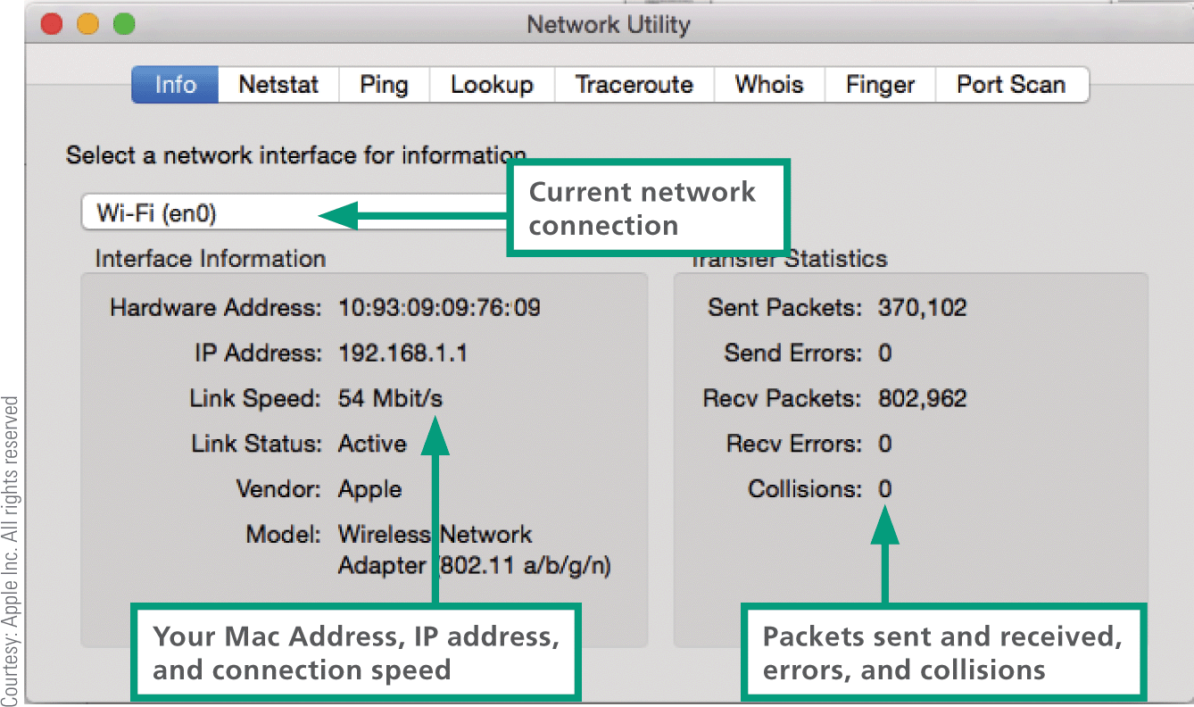
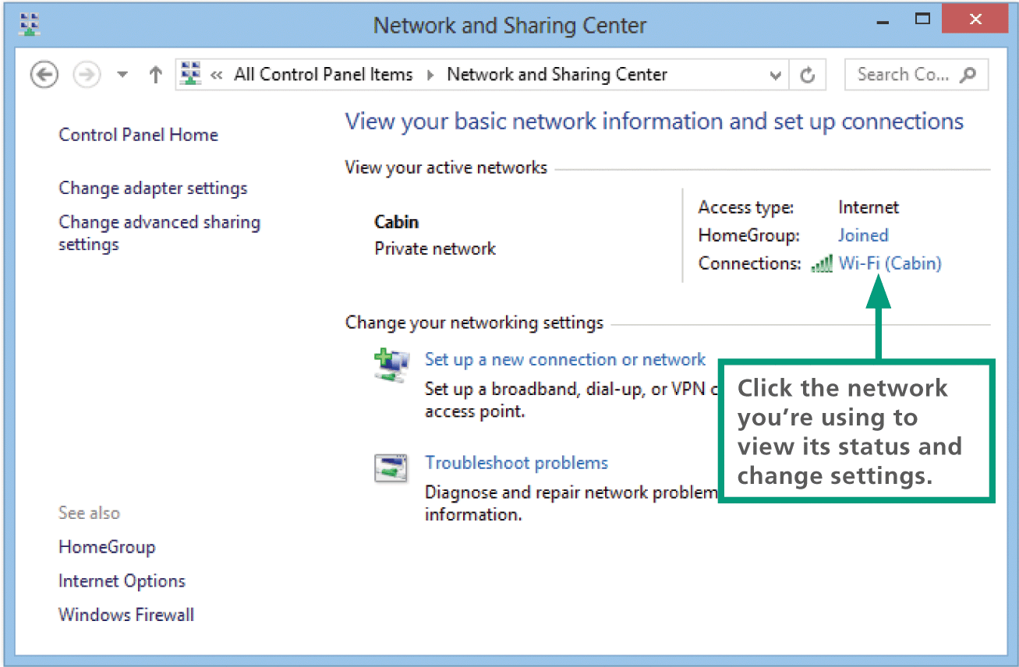
Network Monitoring
When your network has stopped sending and receiving packets, you might be able to correct the problem by turning off your router and Internet modem, waiting a few seconds, and then turning them on again

Slide 70
IoT Networks
The Internet of Things (IoT) connects active sensors and passive tags to communications networks, making it easy to remotely monitor places and things
Wi-Fi is fairly power hungry, so it’s not an optimal IoT technology
Existing wireless technologies such as RFID and NFC offer potential solutions
Additional low-power short-range technologies developed specifically for IoT networks include Bluetooth Smart, ZigBee, and Z-Wave

Slide 71
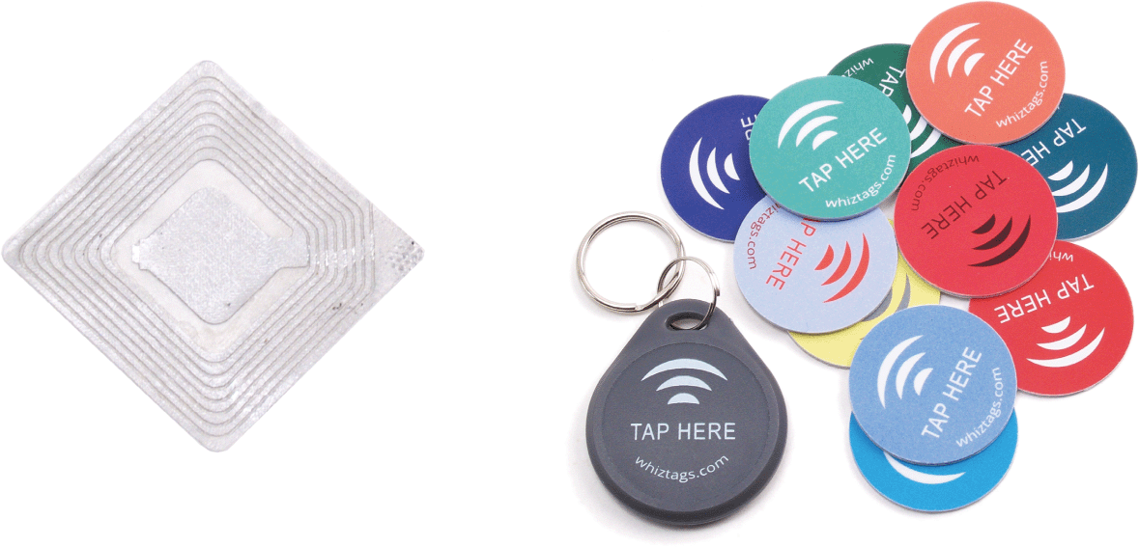
IoT Networks
A sensor, such as a thermometer or heart rate monitor, actively collects data
A tag contains passive data; an RFID tag in a passport, for example, contains personal data, such as the name and birth date that are stored on the tag, which is read electronically
An NFC tag might be attached to merchandise, so that you can tap it with your cell phone to see its price and specifications

Slide 72
Section E: File Sharing
File Sharing Basics
Accessing LAN Files
Sharing Your Files
Internet-based Sharing
Torrents

Slide 73
File Sharing Basics
File sharing allows files containing documents, photos, music, and more to be accessed from computers other than the one on which they are stored
Sharing can take place within a LAN or across multiple networks, including the Internet

Slide 74
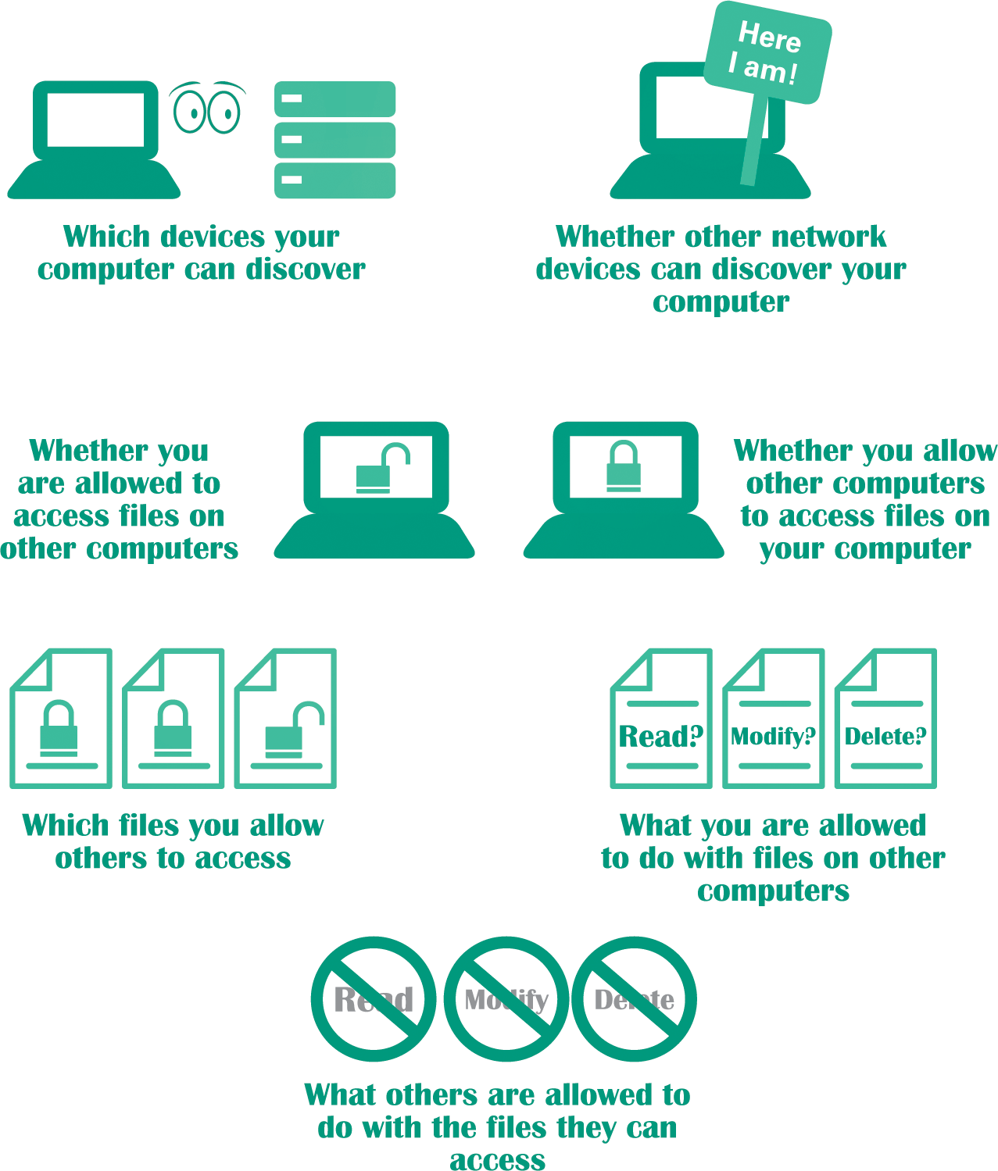
File Sharing Basics
Your ability to share files with other devices on a network depends on several factors

Slide 75
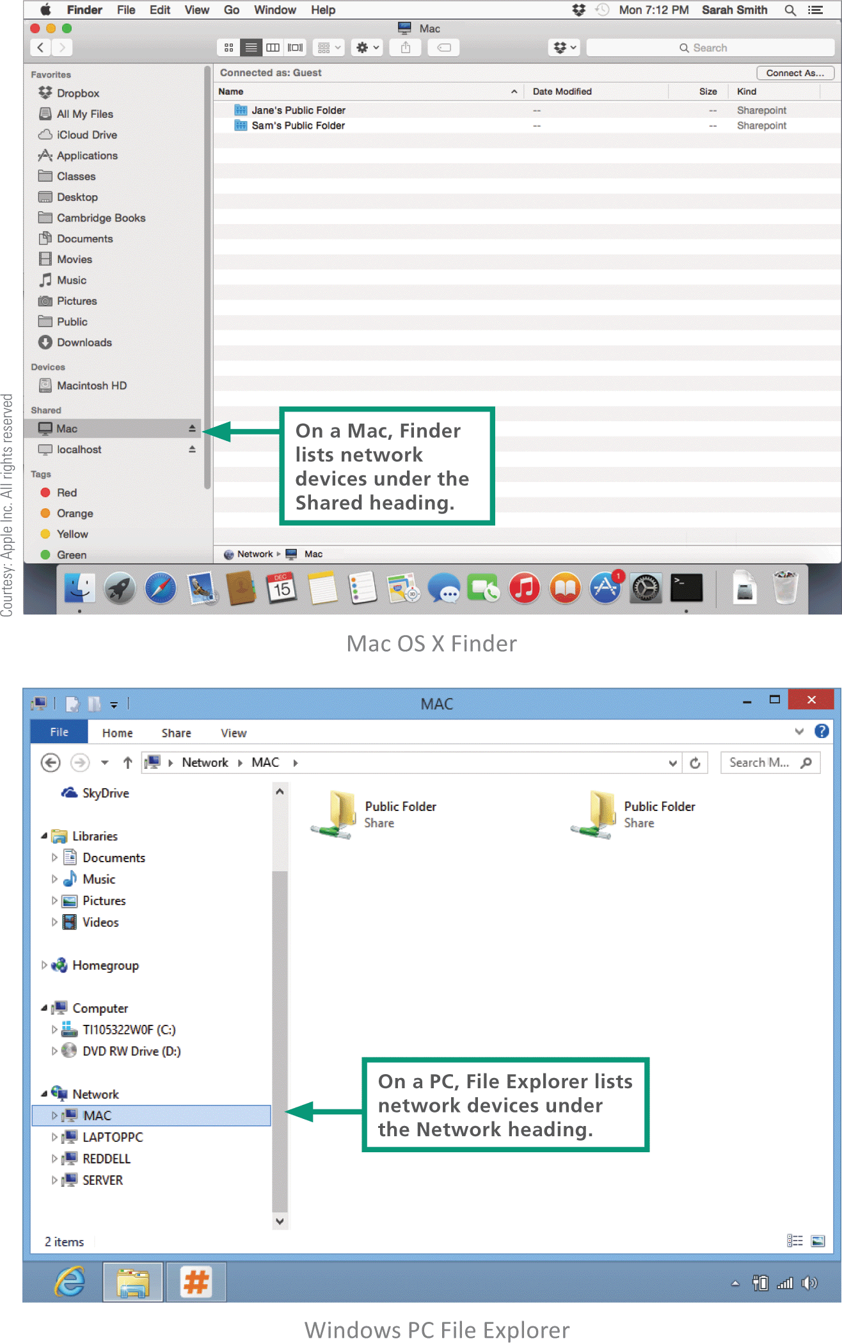
Accessing LAN Files
To see a list of devices on your network, you can use your OS’s file management utility, such or as Window’s File Explorer or Mac OS X’s Finder

Slide 76
Accessing LAN Files
The network utilities provided by operating systems automatically detect other devices when network discovery is turned on
Network discovery is a setting that affects whether your computer can see other devices on a network, and whether your computer can be seen by others; it works in different ways on different devices
  Mobile devices – the OS may not offer a way to see other devices on a network
  Macs – OS X devices have no user-modifiable network discovery settings; offers file sharing instead
  Windows – Some OSs offer network discovery that allows users to turn it off or on

Slide 77
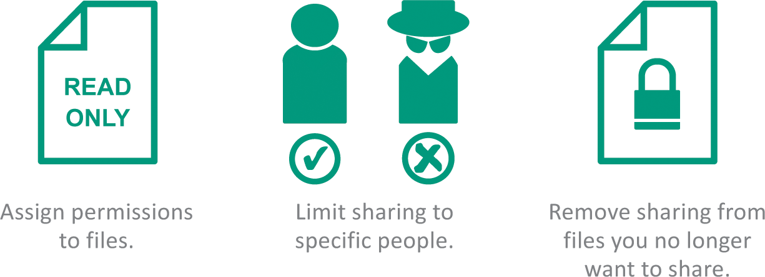
Sharing Your Files
Permissions specify how shared files can be used
  Read and write permission – (full control) allows access for opening, viewing, modifying, and deleting files
  Read permission – allows authorized people to open a file and view it, but not modify or delete it
  Write-only permission – works like drop box, allowing people to put files in one of your folders, but not open, copy, or change any files you have stored there

Slide 78
Internet-Based Sharing
FTP (File Transfer Protocol) provides a way to transfer files from one computer to another over any TCP/IP network, such as a LAN or the Internet
You can access FTP servers with FTP client software, such as FileZilla, or with a browser
Dropbox and similar file hosting services store files in the cloud

Slide 79
Torrents
The concept of sharing files over the Internet, that started in the 1990s, spurred development of sophisticated, distributed protocols such as BitTorrent
BitTorrent is a file sharing protocol that distributes the role of a file server across a collection of dispersed computers
A BitTorrent network is designed to reduce the bandwidth bottleneck that occurs when many people attempt to download the same very large file, such as a feature-length film, or interactive 3-D computer game

Slide 80
Torrents
How a BitTorrent works:
  A BitTorrent network server breaks a movie file into pieces and begins to download those pieces to the first computer that requested the movie
  As more computers request the file, they become part of a “swarm” that uses peer-to-peer technology to exchange movie segments with each other
  After the server has downloaded all the segments to the swarm, its job is complete and it can service other requests
    Cont…

Slide 81
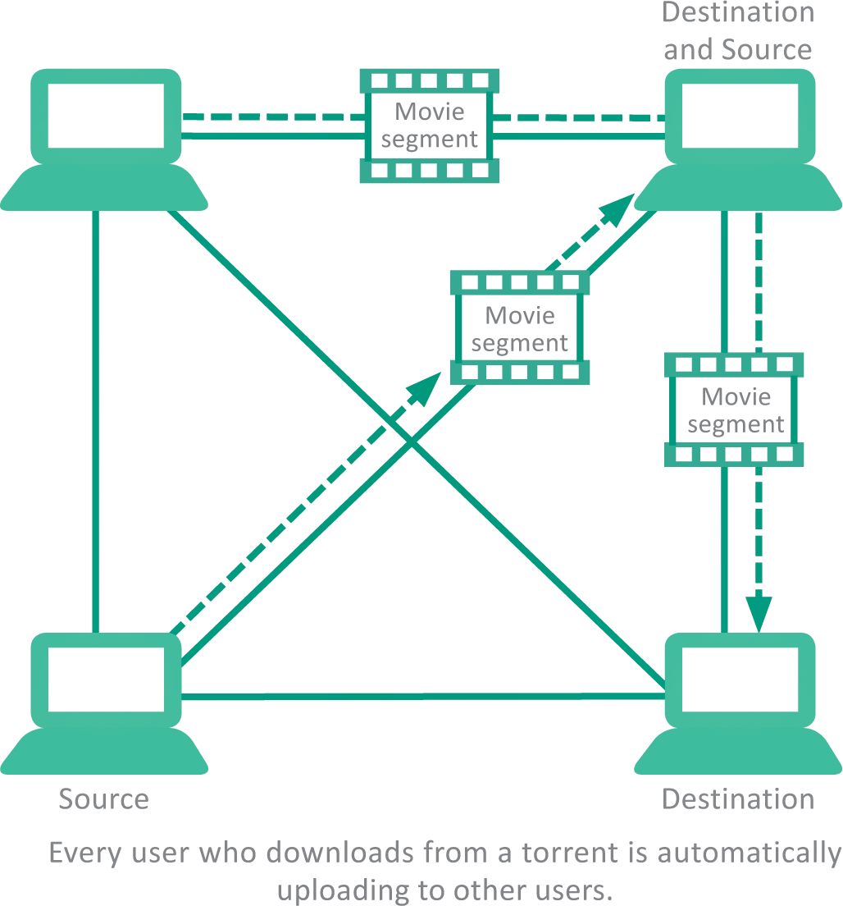
Torrents
The swarm continues to exchange movie segments until every computer in the swarm has the entire movie

Slide 82
Unit 3 Complete

