Slide 1
Unit 2
Digital Devices
ENHANCED EDITION

Slide 2
Unit Contents
Section A: Device Basics
Section B: Device Options
Section C: Processors and Memory
Section D: Storage
Section E: Input and Output

Slide 3
Section A: Device Basics
Computers
Circuits and Chips
Components
Maintenance

Slide 4
Computers
At its core, a computer is a multipurpose device that accepts input, processes data, stores data, and produces output, all according to a series of stored instructions
Input is whatever is typed, submitted, or transmitted to a computer
Output is the result produced by a computer

Slide 5
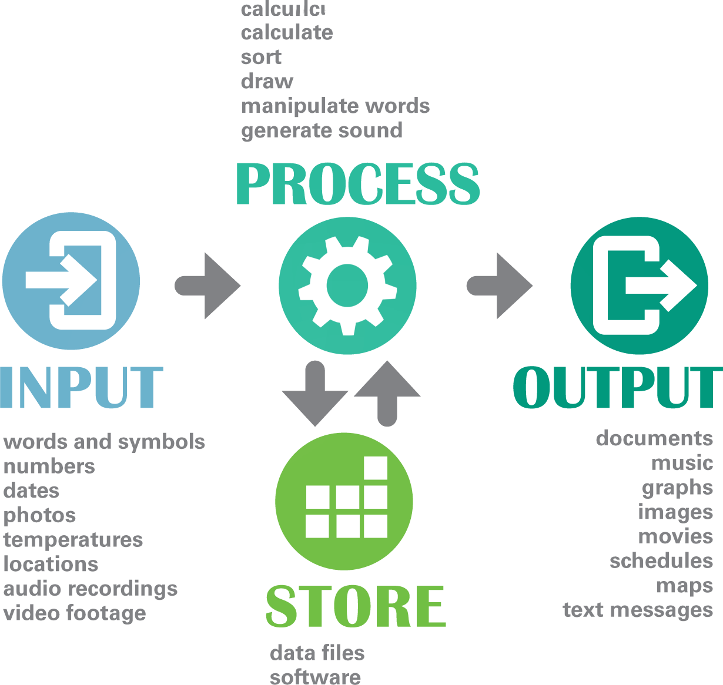
Computers
Notes:
Figure 2-1

Slide 6
Computers
The instructions that tell a digital device how to carry out processing tasks are referred to as a computer program, or simply a program
Programs form the software that sets up a computer to do a specific task

Slide 7
Computers
When a computer “runs” software, it performs the instructions to carry out a task
The first computers were “programmed” to perform a specific task by connecting wire circuitry in a certain way
The term stored program means that a series of instructions for computing a task can be loaded into a computer’s memory

Slide 8
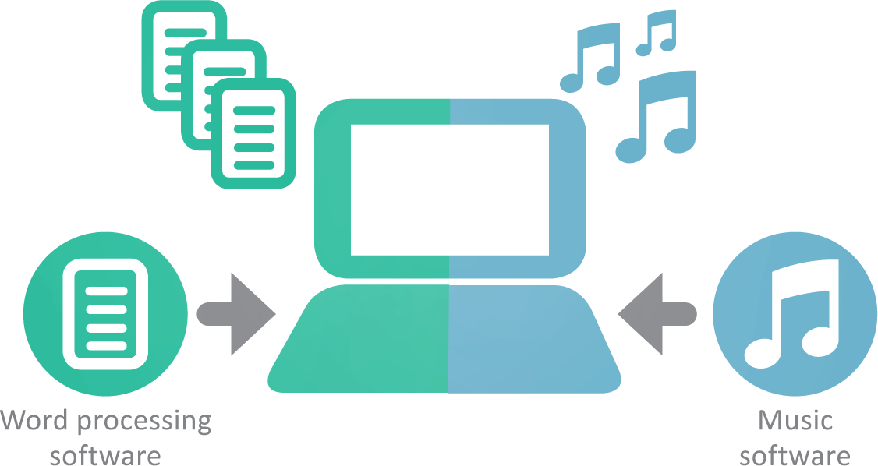
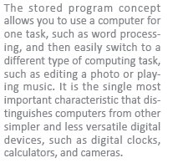
Computers

Slide 9
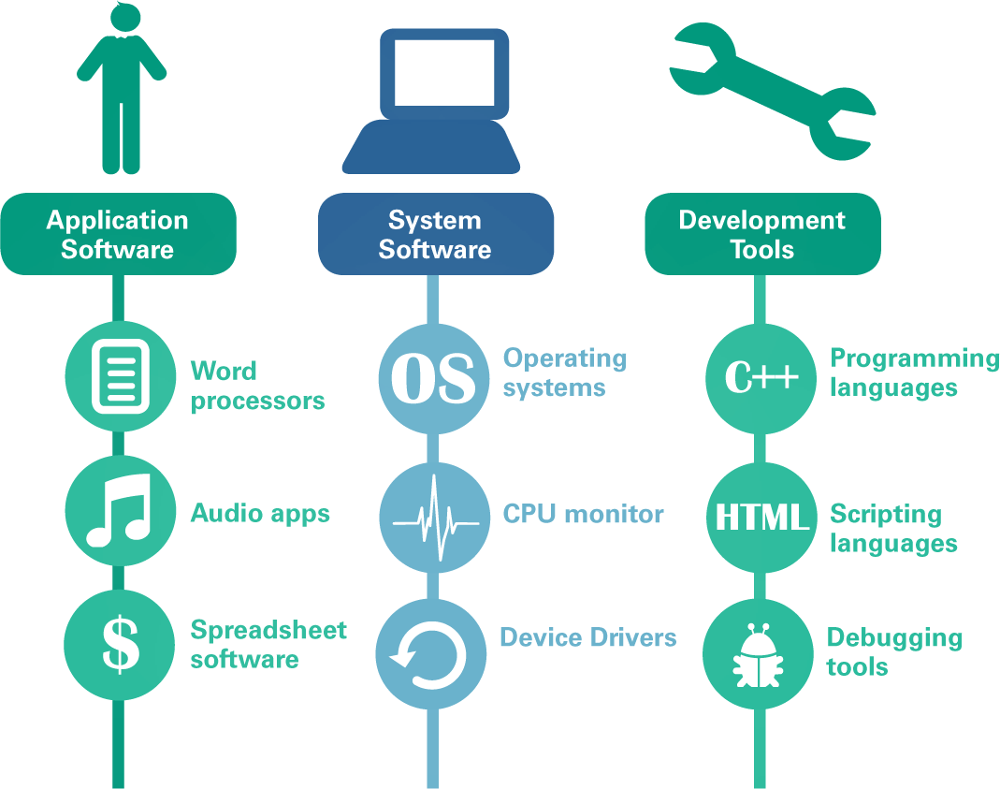
Computers
Computers run three main types of software:
  Application software
  System software
  Development tools

Slide 10
Computers
Application Software is a set of computer programs that helps a person carry out a task
The primary purpose of system software is to help the computer system monitor itself in order to function efficiently (an example of system software is a computer operating system or OS)
Development tools are used for creating software applications, Web sites, operating systems, and utilities

Slide 11
Circuits and Chips
The small circuit boards and integrated circuits you see when you open up a digital device are the essence of digital electronics
Digital electronics represent data bits as electrical signals that travel over circuits in much the same way that electricity flows over a wire when you turn on a light switch

Slide 12
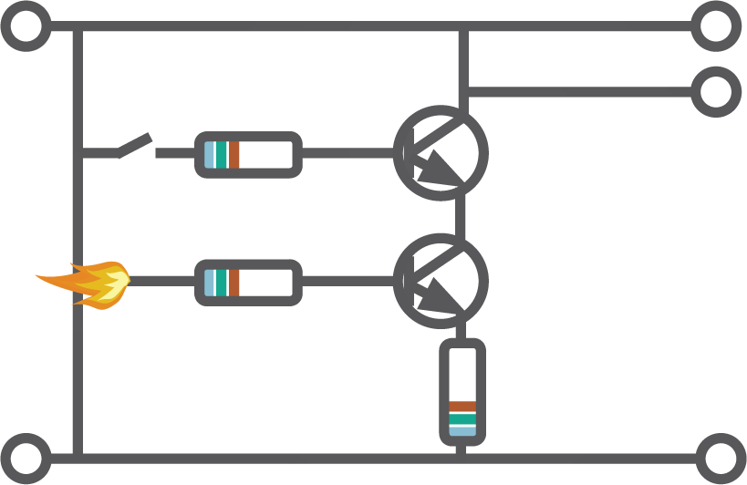
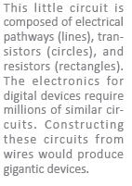
Circuits and Chips

Slide 13
Circuits and Chips
An integrated circuit (IC) is a set of microscopic electronic circuits etched onto a thin slide of semiconducting material
The terms computer chip, microchip, and chip are commonly used to refer to integrated circuits
Semiconductors, such as silicon and germanium, are substances with properties between those of a conductor (like copper) and an insulator (like wood)

Slide 14
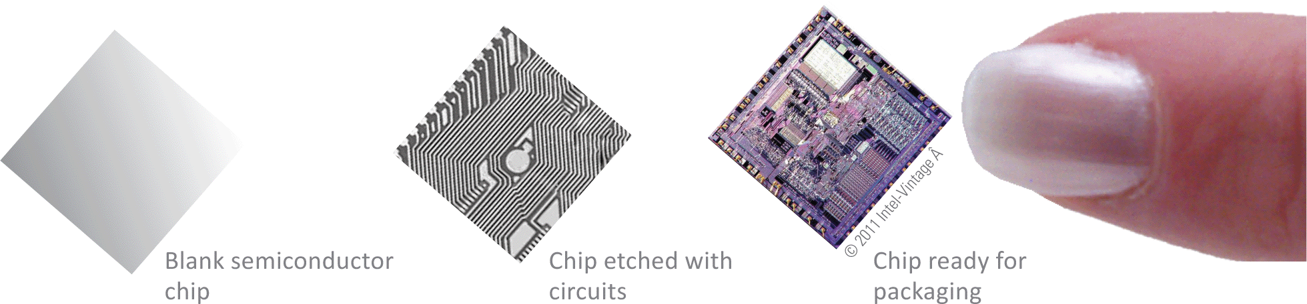
Circuits and Chips

Slide 15

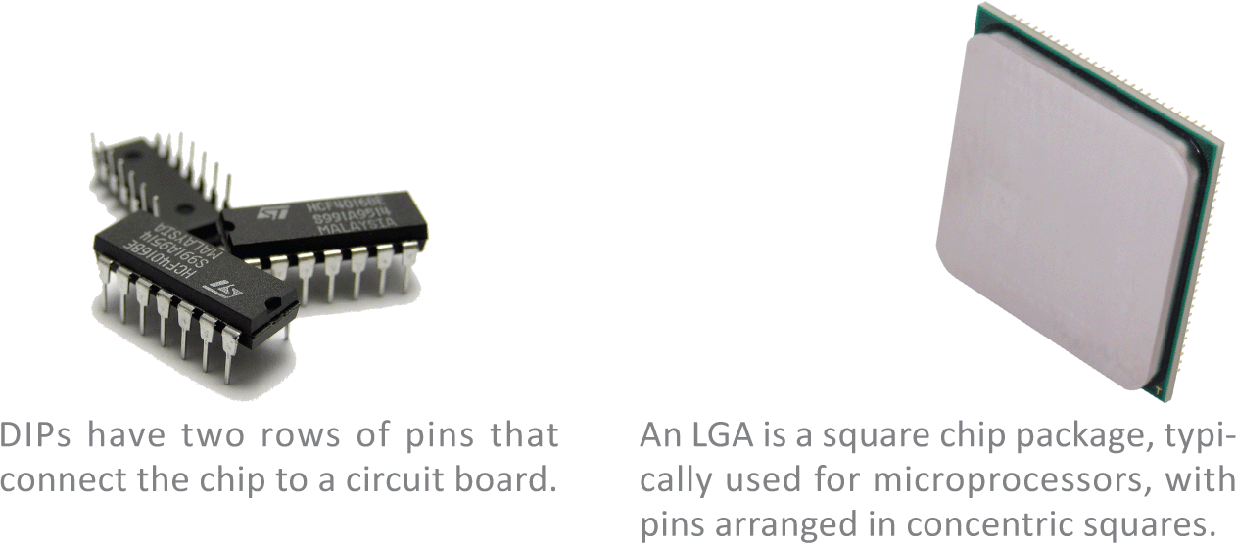
Circuits and Chips

Slide 16
Circuits and Chips
The electronic components of most digital devices are mounted on a circuit board called a system board, motherboard, or main board
The system board houses all essential chips and provides connecting circuitry between them

Slide 17
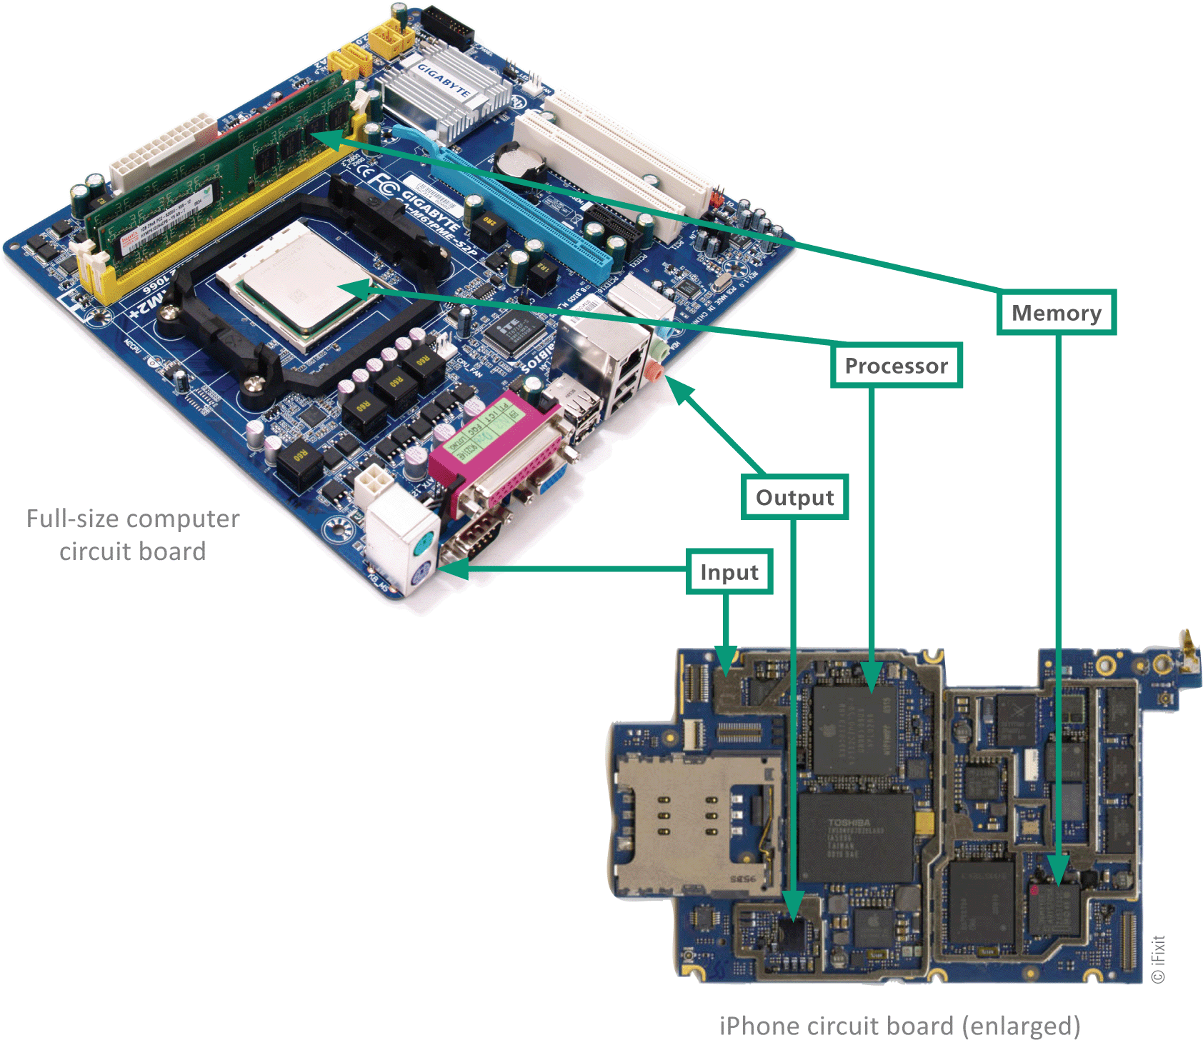
Circuits and Chips

Slide 18
Components
In the computer industry the term form factor refers to the size and dimensions of a device or components, such as circuit boards and system units
The term system unit is tech speak for the part of a digital device that holds the system board
Some popular form factors include: component, clamshell, and slate

Slide 19
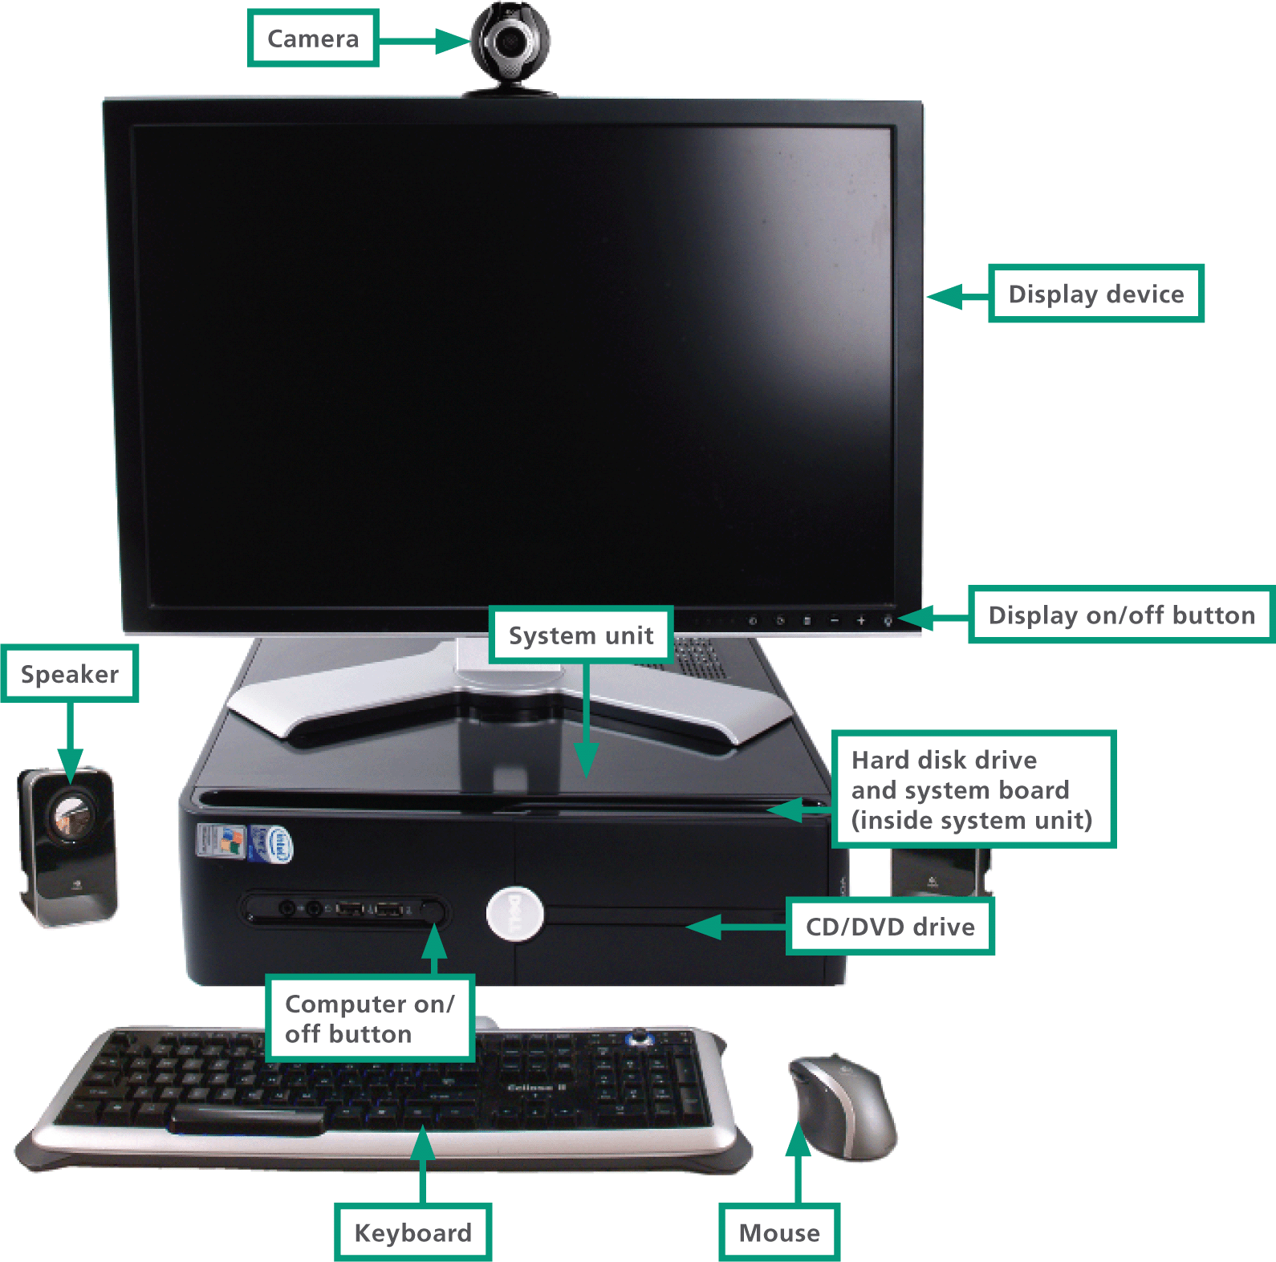

Components

Slide 20
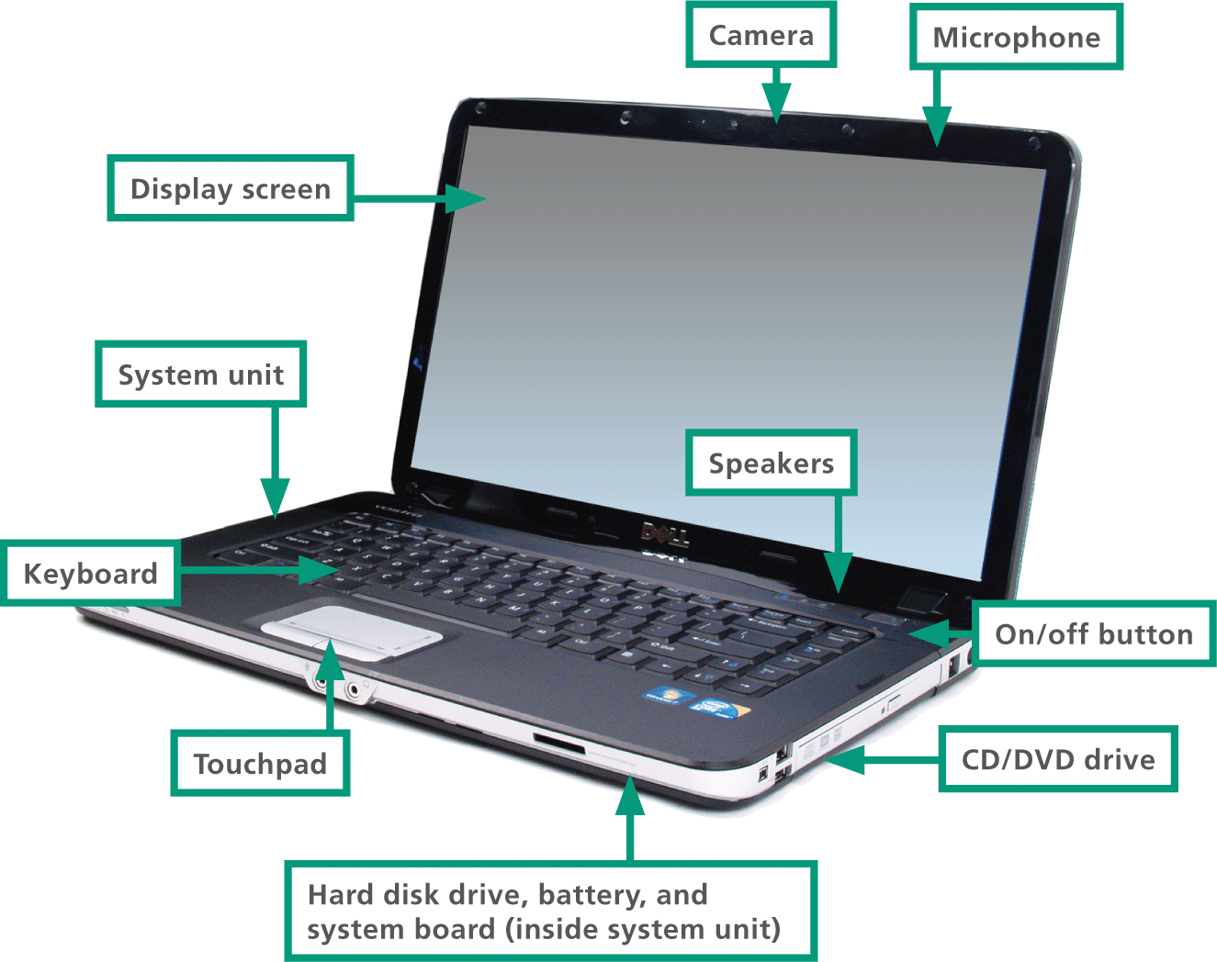

Components

Slide 21
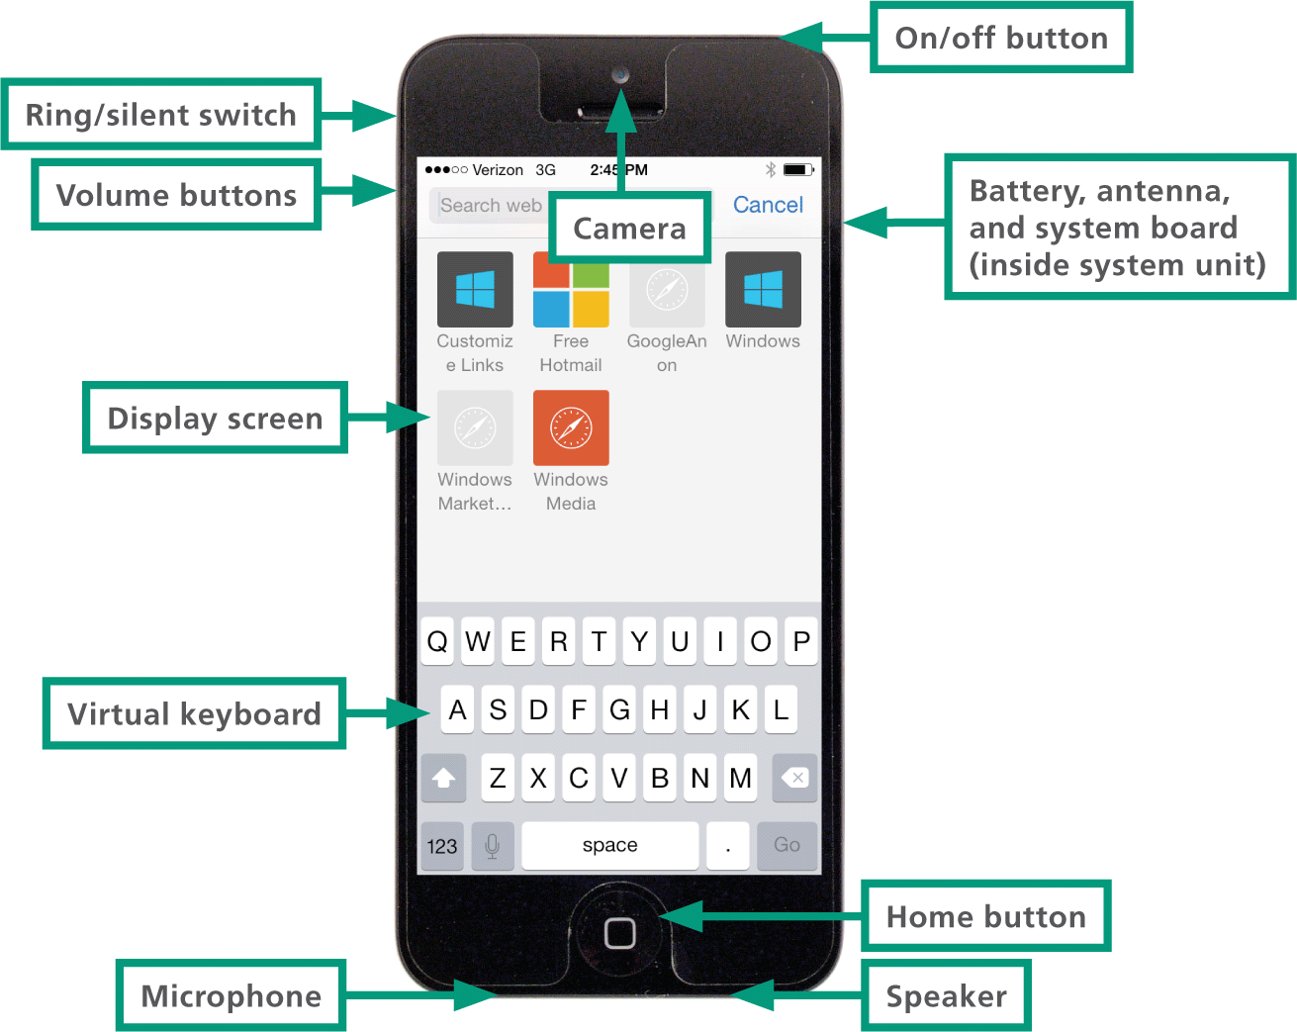
Components

Slide 22
Maintenance
You can extend the life of your digital devices with regular maintenance
There are four components of digital devices that require maintenance:
  System unit
  Keyboard
  Screen
  Battery

Slide 23

Maintenance

Slide 24
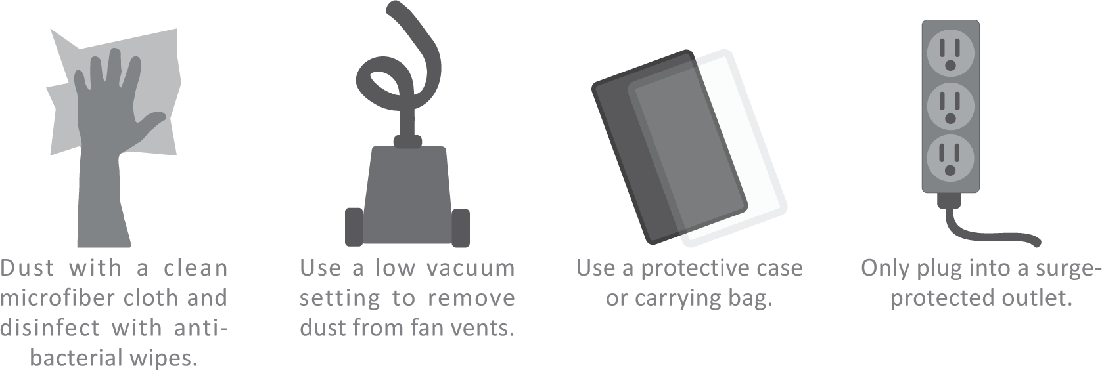
Maintenance
Basic system unit maintenance is simple; keep the unit clean, prevent it from overheating, shield it from damage and protect it from electrical surges

Slide 25
Maintenance
Touchscreens collect fingerprints and are a breeding ground for bacteria, so it’s a good idea to clean them periodically
Many touchscreens are made from Gorilla Glass, which is designed to resist scratching and cracking, and oleophobic coating, designed to repel oils from fingertips
A plastic screen protector is a good defense against scratches and cracks

Slide 26
Maintenance
Most of today’s battery-powered digital devices contain a lithium ion (Li-ion) battery
Li-ion batteries can overheat and in the worst case, they can explode
Smart consumers don’t operate devices that are hot to the touch

Slide 27
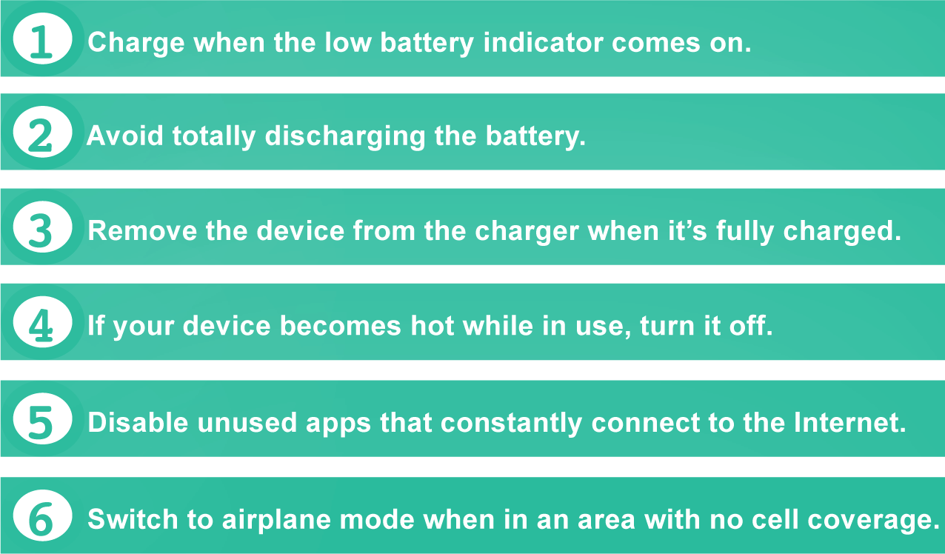
Maintenance

Slide 28
Section B: Device Options
Enterprise Computers
Personal Computers
Niche Devices
Choosing a Digital Device

Slide 29
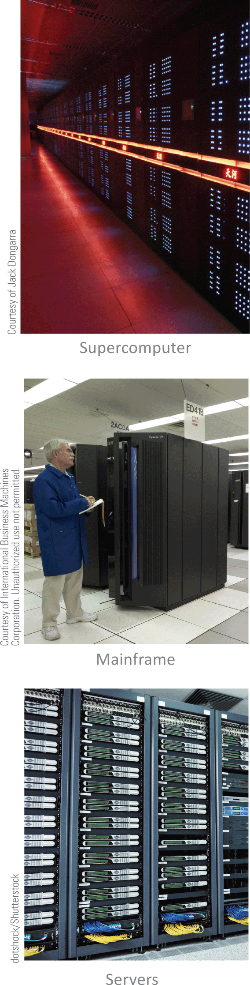

Enterprise Computers
The most powerful computers are generally used in businesses and government agencies
These computers have the ability to service many simultaneous users and process data at very fast speeds
Types of “Big” computers are:
  Supercomputers
  Mainframes
  Servers

Slide 30
Enterprise Computers
Supercomputers: considered the fastest computers in the world at the time of construction; can tackle complex tasks other computers cannot; typical use includes breaking codes, modeling weather systems, and simulating nuclear explosions
Mainframes: a large and expensive computer capable of simultaneously processing data for hundreds or thousands of users; looks like a closet sized cabinet; used to provide centralized storage, processing and management for large amounts of data
Servers: “serves” data to computers in a network; Google search results are provided by servers; about the size of a desk draw and mounted in racks of multiple servers

Slide 31
Personal Computers
A personal computer is designed to meet the computing needs of an individual
The term personal computer can be abbreviated as PC
Personal computers can be classified as:
  Desktop
  Portable
  Mobile devices

Slide 32
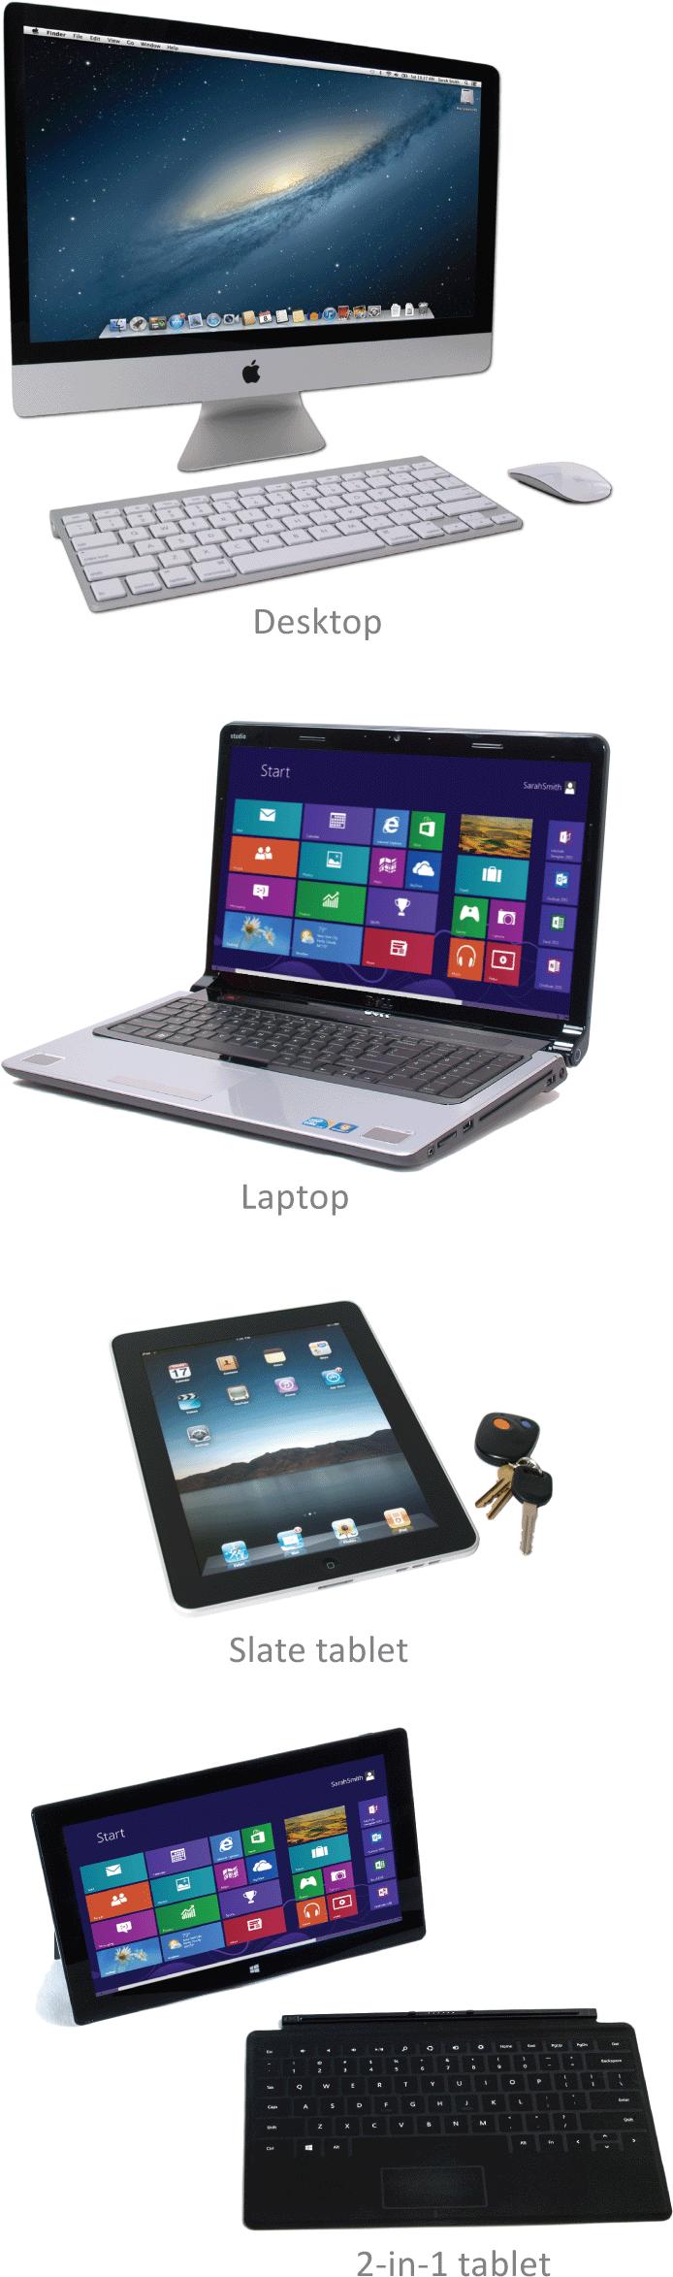
Personal Computers
Desktop: fits on a desk and runs on power from a wall outlet; keyboard is typically separate from the monitor; popular in offices and schools
Portable: runs on battery power; its components are contained in a single case for easy transportation
Laptop: also referred to as a notebook computer; small and lightweight with a clamshell design and keyboard at the base

Slide 33
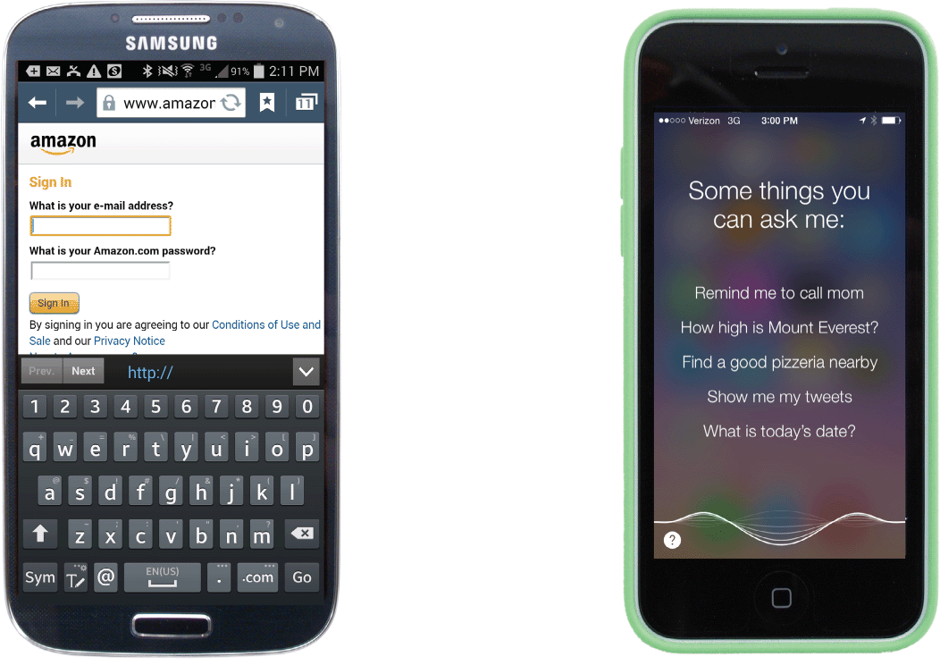
Personal Computers
Tablets: a tablet computer is a portable computing device featuring a touch-sensitive screen used for input and output; uses a specialized OS; a slate tablet configuration has a narrow frame screen that lacks a physical keyboard; Apple iPad is a slate tablet
Smartphones: mobile devices with features similar to a tablet computer; provide telecommunications capabilities over cell phone networks

Slide 34
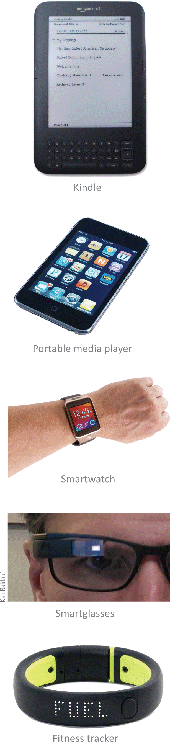
Niche Devices
Niche devices all have one thing in common: They contain a microprocessor
  Ebook readers: designed for displaying the content of digital publications; NOOK and Kindle are eBook readers
  Portable media players: a handheld device that can store and play music; iPod touch is a portable media player
  Game consoles: devices for playing computer games such as Sony’s Play Station and Nintendo’s Wii

Slide 35
Niche Devices
Smartwatches: multifunctional devices that include a camera, thermometer, compass, calculator, cell phone, GPS, media player, and fitness tracker
Smartglasses: include Google Glass; controlled by voice commands or a touchpad on the rim; has a camera and display device that essentially beams an image toward the wearer’s eye
Activity trackers: monitors your steps and heart rate
Smart appliances: Modern refrigerators, washing machines, and other appliances are controlled by integrated circuits called microcontrollers that combine sensors with processing circuitry

Slide 36
Choosing a Digital Device
The following activities can get you started on choosing the right digital device:
  Consider how you plan to use your device
  Choose the type of device
  Decide on a budget and stick to it
  Select a platform
  Check out the device’s specifications

Slide 37
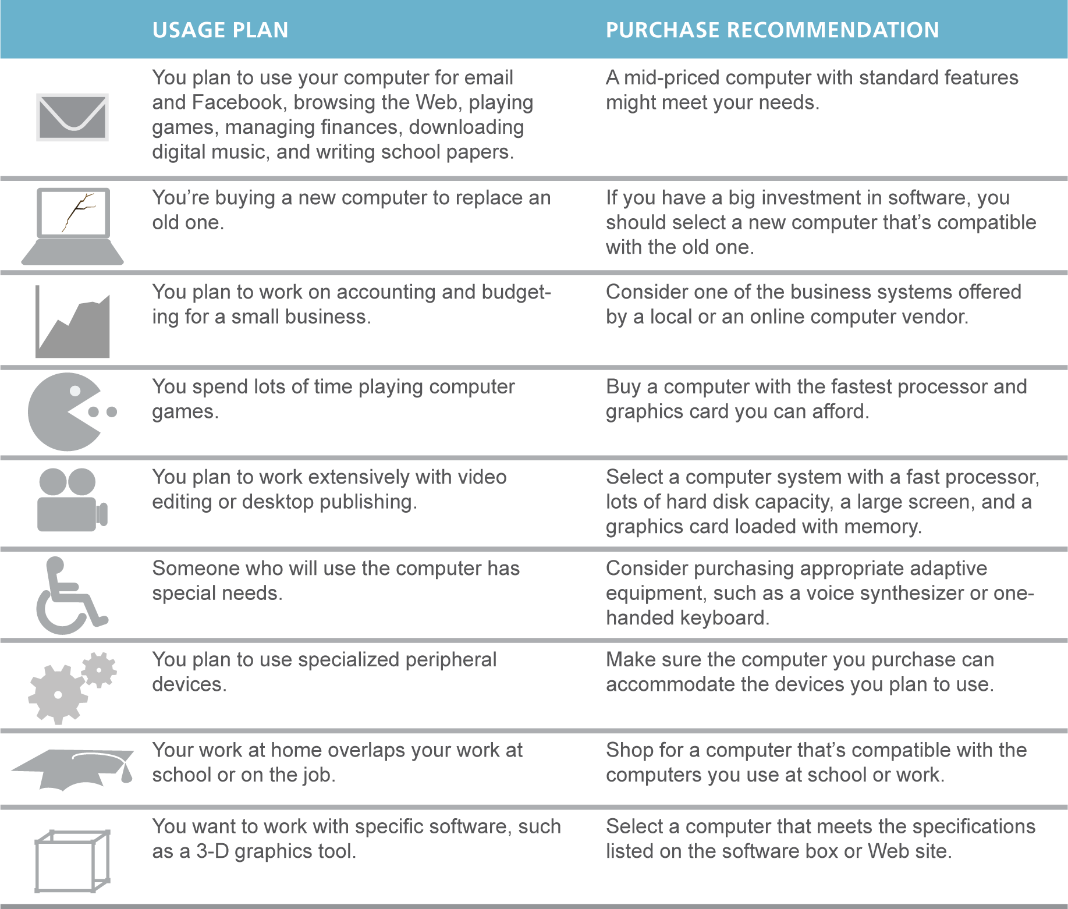
Choosing a Digital Device

Slide 38
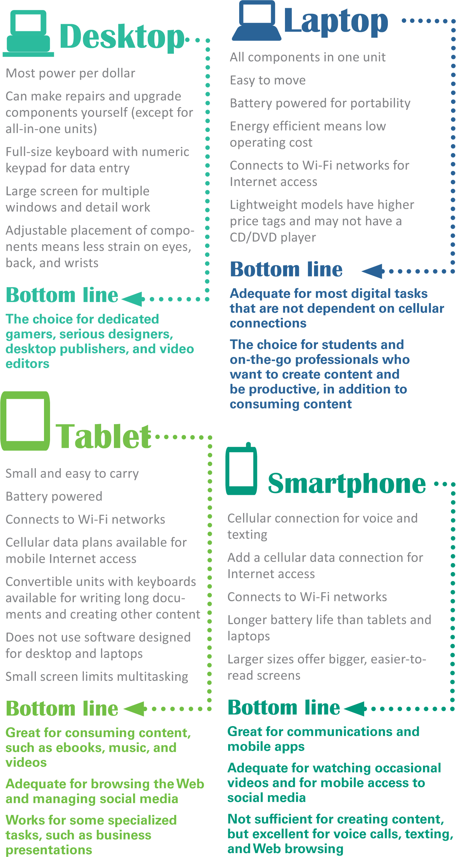
Choosing a Digital Device
The most popular digital devices are desktops, laptops, tablets, and smartphones

Slide 39
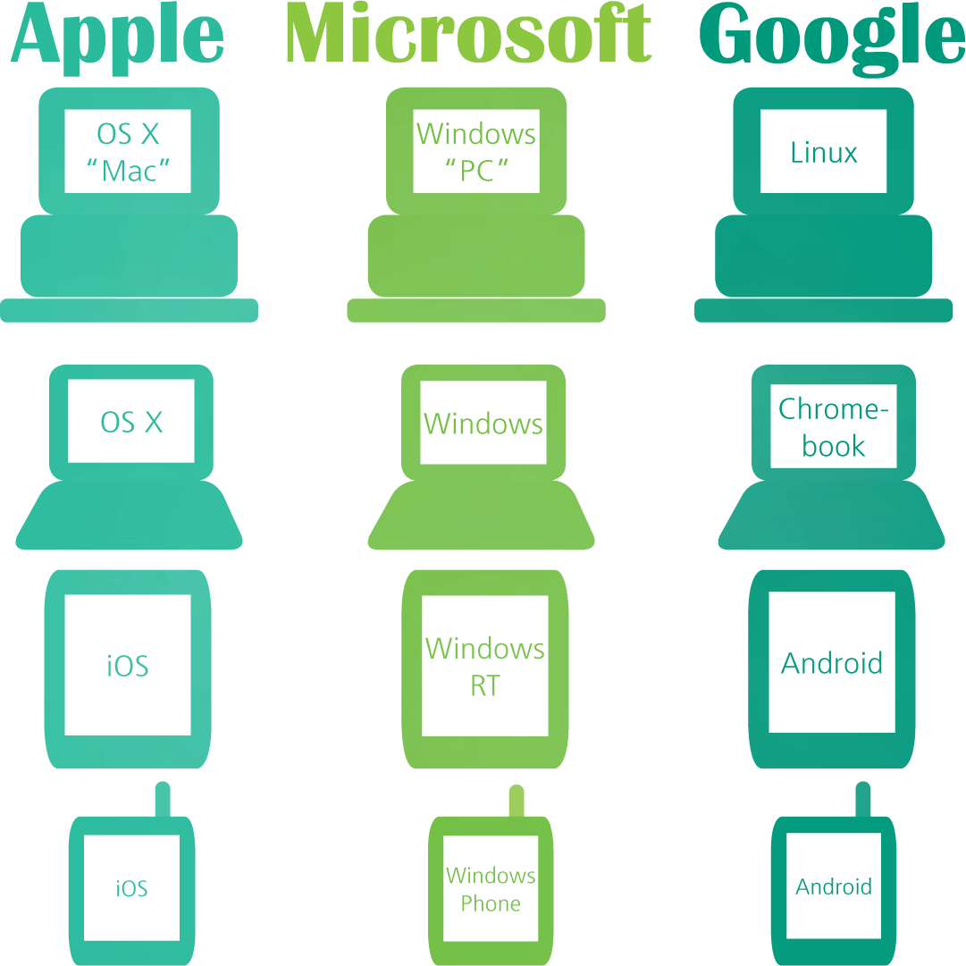
Choosing a Digital Device
Computers that operate essentially the same way and use the same software are said to be compatible or having the same “platform”
You can assess whether two computers are compatible by checking their operating systems

Slide 40
Choosing a Digital Device
Prices for digital devices can vary and depend on screen size, microprocessor size, and memory:
  The price tag for a smartphone is $200-$500
  Tablet computer prices range from $200 - $1,200
  Desktop and Laptop computers usually cost a little more, with price points roughly grouped into three categories:
    Above $1,200
    $500 - $1,200
    Under $500

Slide 41
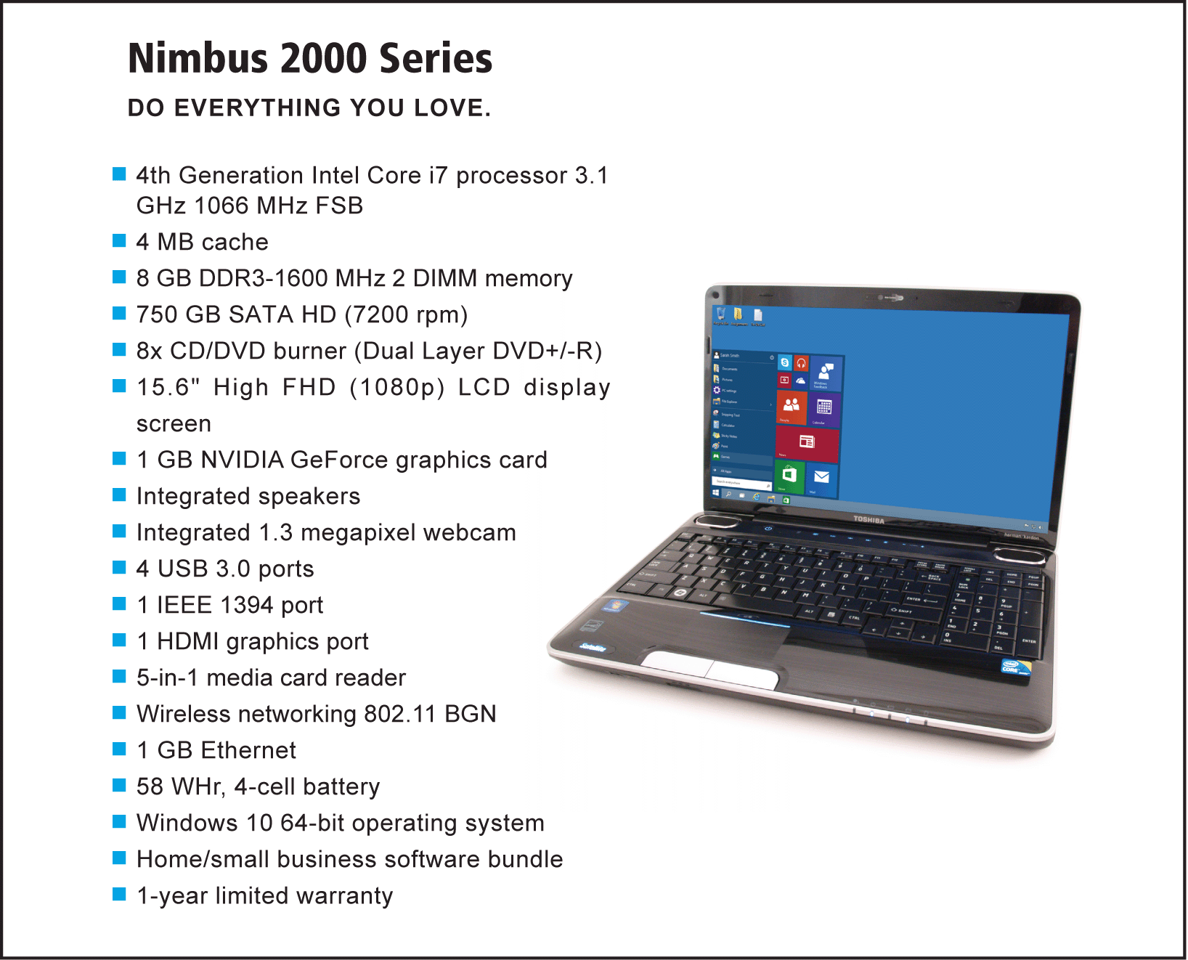
Choosing a Digital Device
Computer ads are loaded with jargon and acronyms, such as RAM, ROM, GHz, GB, and USB

Slide 42
Section C: Processors and Memory
Microprocessors
How Processors Work
Performance
Random Access Memory
Read-Only Memory

Slide 43
Microprocessors
A microprocessor is an integrated circuit designed to process instructions
It is the most important, and usually the most expensive, component of a digital device
Intel Corporation is the world’s largest chipmaker and supplies a sizeable percentage of the microprocessors that power desktops and laptops

Slide 44
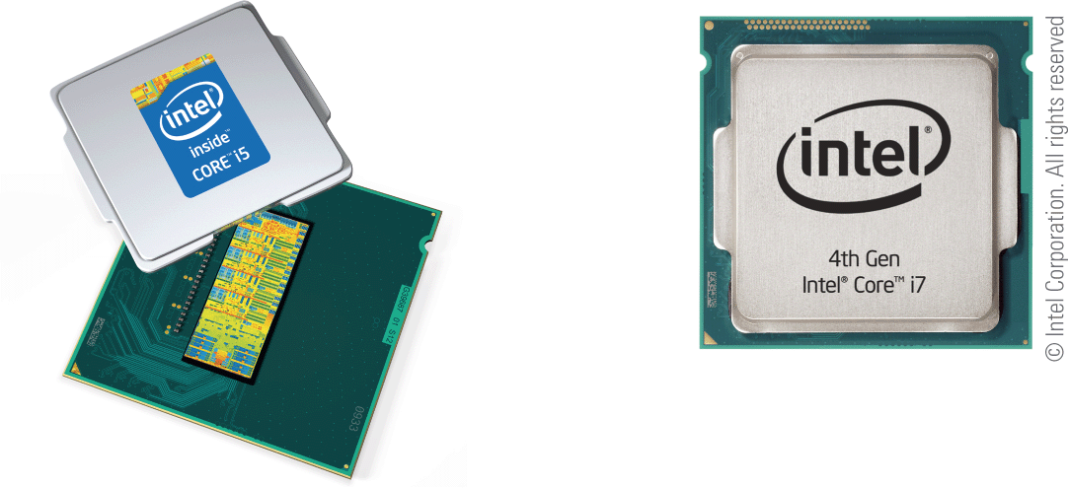
Microprocessors
Intel’s 8086 family of microprocessors powered the original IBM PC
The 8086 chip family set the standard for processors used today
This standard is sometimes referred to as x86
Processors found in today’s desktops and laptops are x86 compatible

Slide 45
Microprocessors
Processors based on ARM technology dominate tablet computers and smartphones
ARM technology was originally designed by ARM Holdings, a British technology company founded by Acorn Computers, Apple Inc., and VLSI Technology
ARM processors are energy efficient – an important characteristic for battery powered devices
ARM processors are found in iPads, iPhones, and Surface tablets

Slide 46
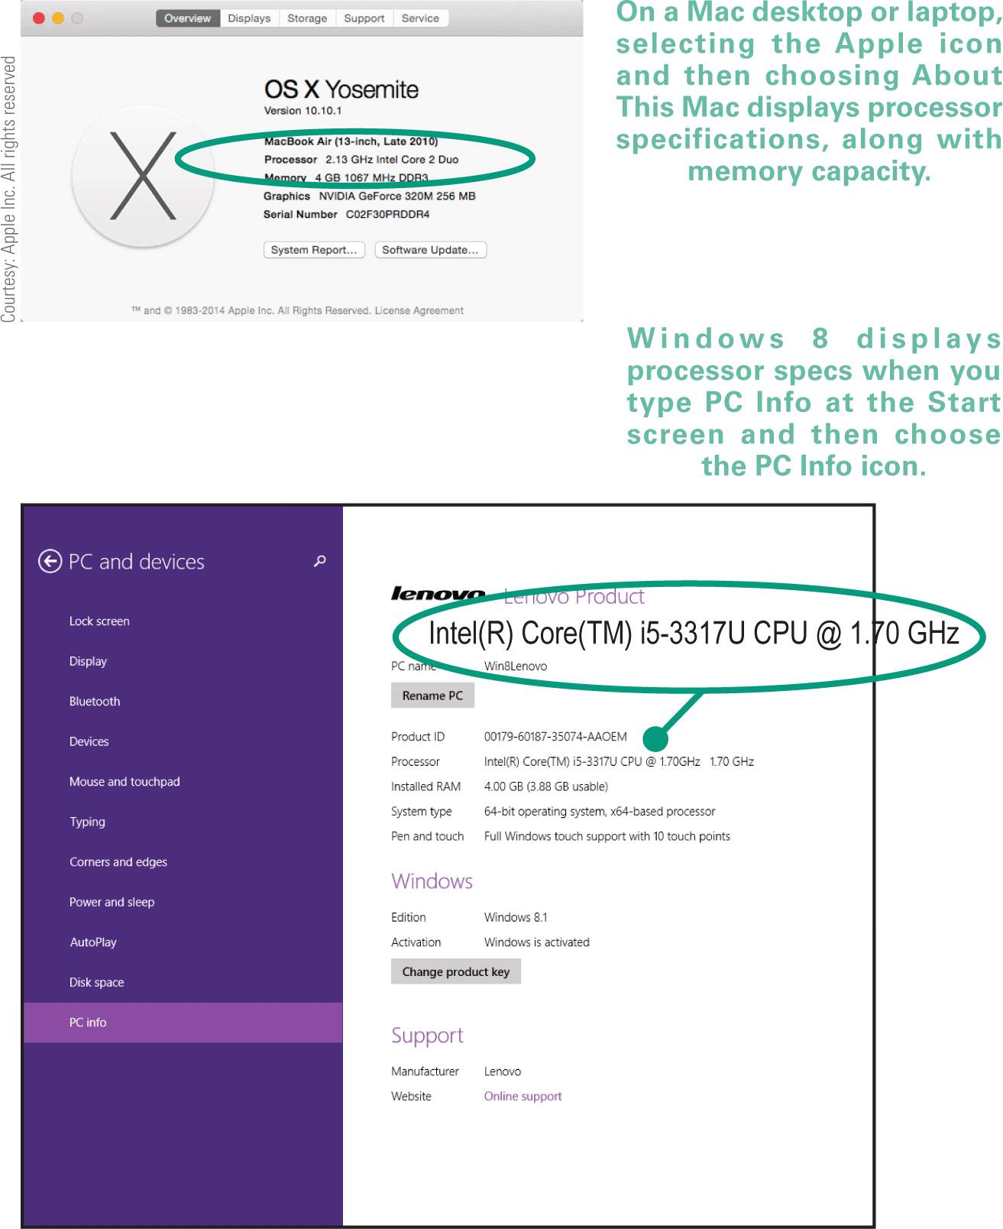
Microprocessors
Finding the microprocessor that’s best for you depends on your budget and the type of work and play you plan to do
If you know the make and model of a digital device, you can generally find processor specifications by searching online

Slide 47
How Processors Work
Microprocessor technology is fascinating in its ability to perform an astounding variety of tasks based on a set of really simple instructions
These instructions are referred to as an instruction set
An instruction set contains a collection of instructions for actions that the circuitry in a microprocessor can perform

Slide 48
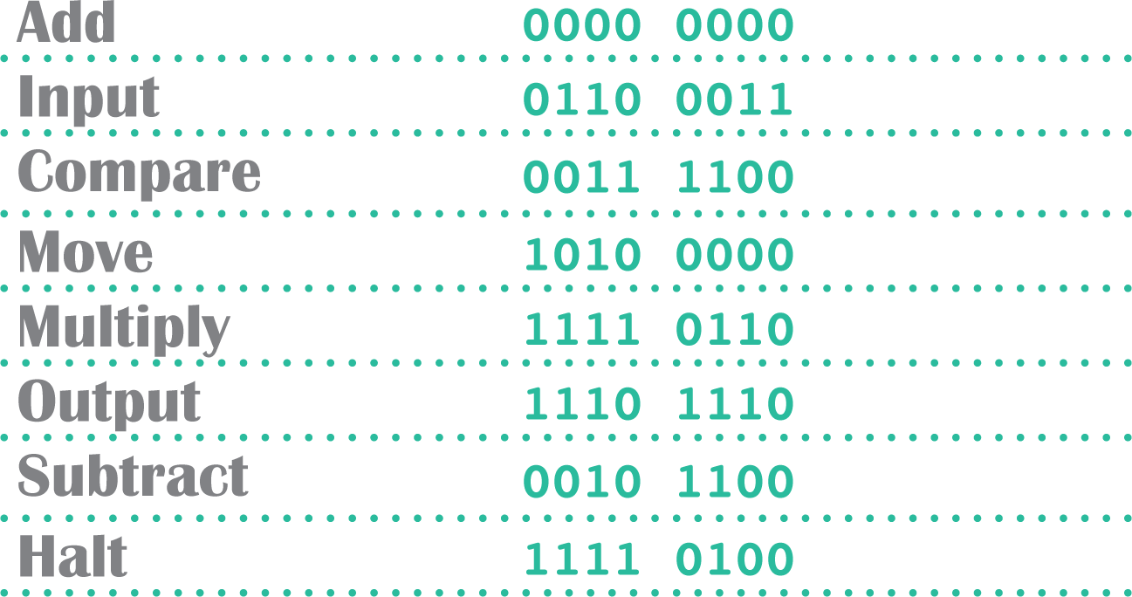
How Processors Work
Microprocessors can’t directly understand programming language, such as C++, BASIC, or Java, so programs have to be converted into machine language that corresponds to the microprocessor’s instruction set

Slide 49
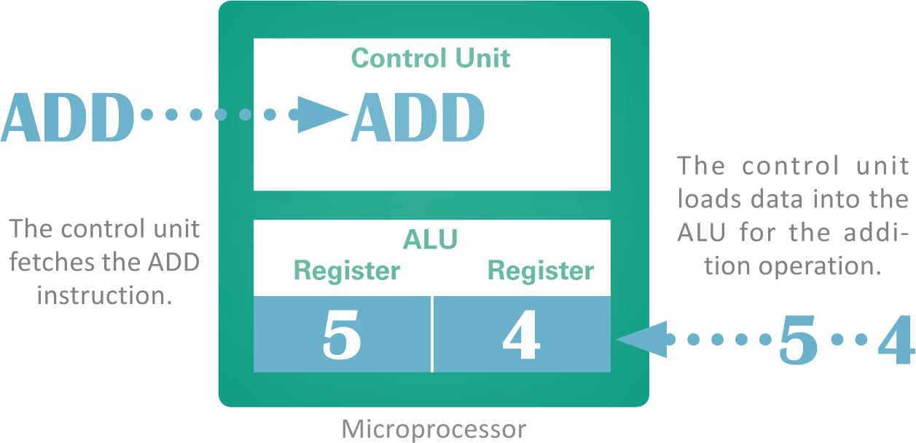
How Processors Work
Operational units of the microprocessor are:
  The ALU (arithmetic logic unit) is part of the microprocessor that performs arithmetic operations, such as addition and subtraction
  The ALU uses registers to hold data that is being processed
  The microprocessor’s control unit fetches each instruction

Slide 50
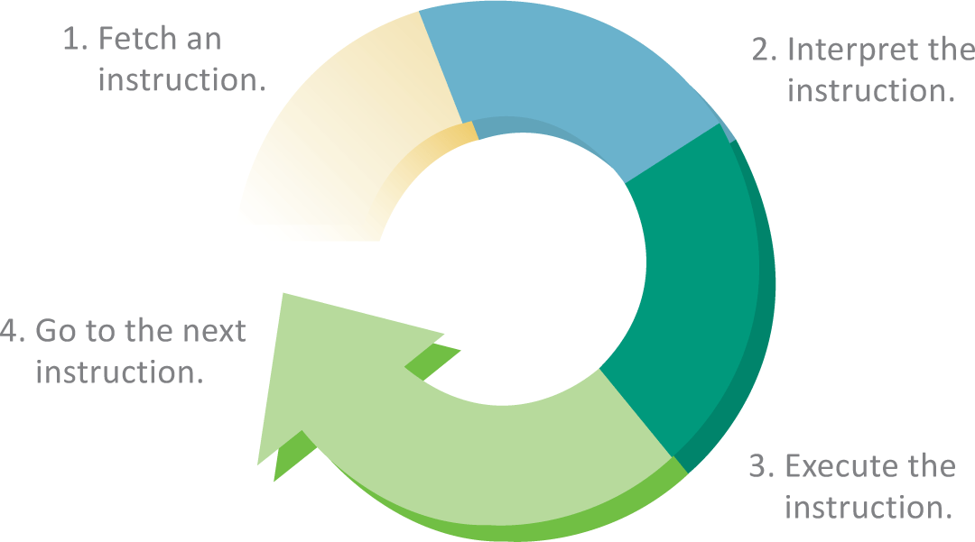
How Processors Work
The term instruction cycle refers to the process in which a computer executes a single instruction

Slide 51
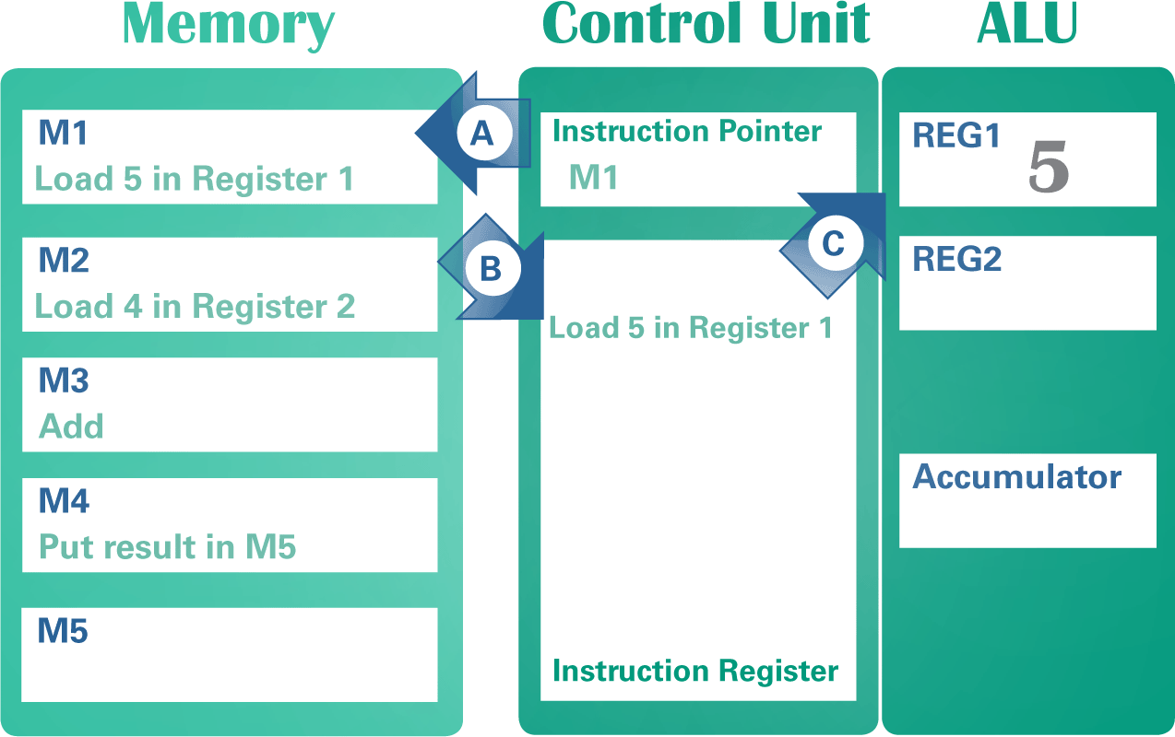
How processors Work
Machine language instructions for programs are held in memory; when the program begins, the memory address of the first instruction is placed in a part of the microprocessor’s control unit called an instruction pointer

Slide 52
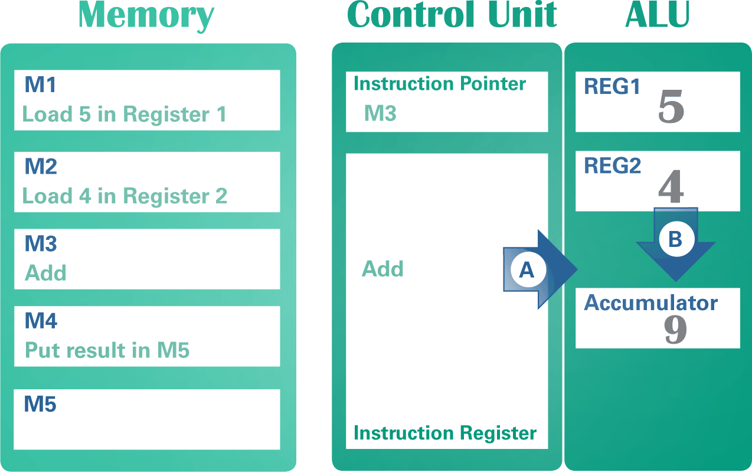
How processors Work
The ALU is responsible for performing arithmetic and logical operations

Slide 53
Performance
A microprocessor’s performance is affected by several factors, including clock speed, number of cores, processing techniques, cache size, word size, and instruction set
  A processor specification, such as 3.4 GHz, indicates the speed of the microprocessor clock – a timing device that sets the pace for executing instructions
  A cycle is the smallest unit of time in a microprocessor’s universe; every action a processor performs is measured by cycles
  Gigahertz (GHz) means a billion cycles per second

Slide 54
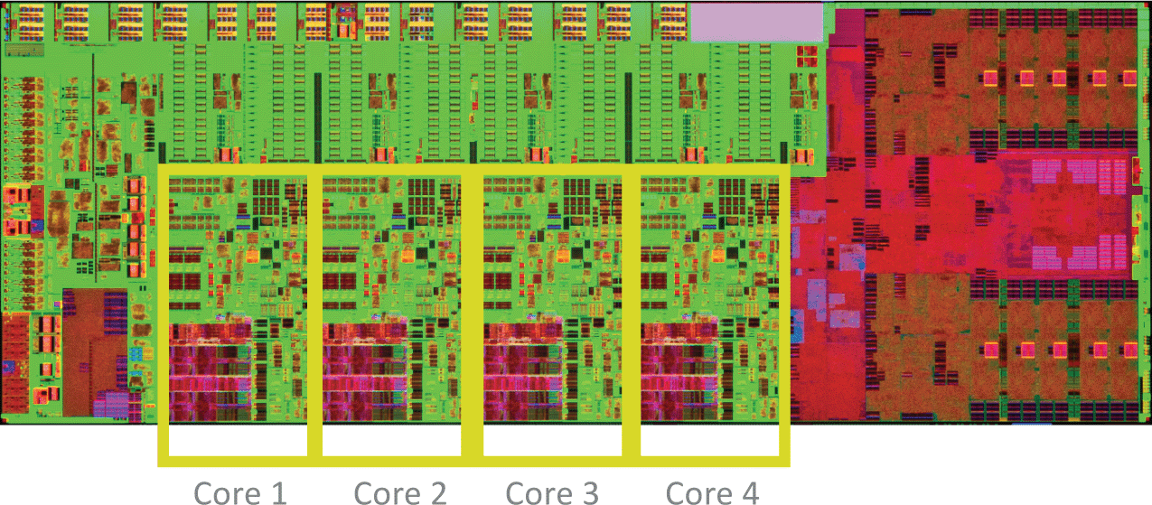
Performance
A microprocessor that contains circuitry for more than one processing unit is called a multicore processor

Slide 55
Performance
Some processors execute instructions “serially” – or one instruction at a time
With serial processing, the processor must complete all steps in the instruction cycle before it begins to execute the next instruction
When a processor begins to execute an instruction before it completes the previous instruction, it is using pipeline processing
Parallel processing executes more than one instruction at a time and works well with today’s multicore microprocessors

Slide 56
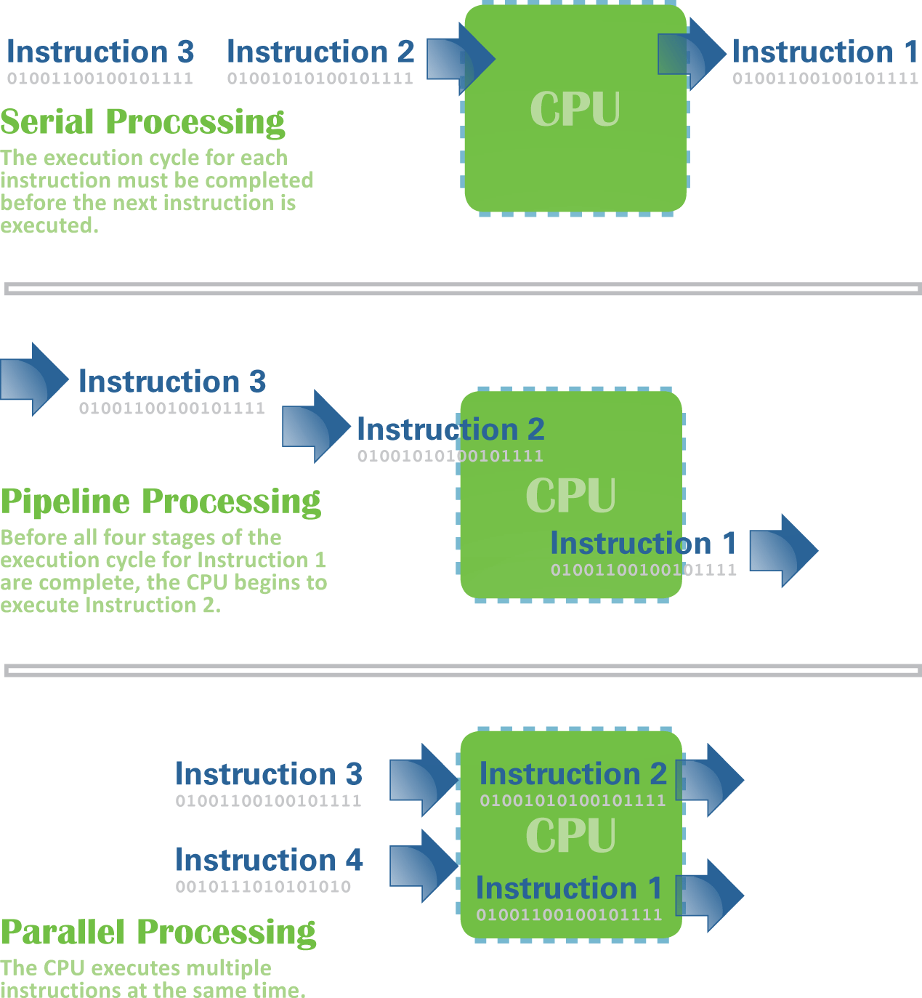
Performance
Pipeline and parallel processing offer better performance than serial processing

Slide 57
Performance
What affects performance?:
  CPU cache (pronounced “cash”) is a special high-speed memory that allows a microprocessor to access data more rapidly
  Word size refers to the number of bits that a microprocessor can manipulate at one time; it limits the amount of memory that the processor can access
  A RISC (reduced instruction set computer) processor performs instructions faster than a CISC (complex instruction set computer) processor

Slide 58
Random Access Memory
RAM (random access memory) is a temporary holding area for data, application program instructions, and the operating system
Higher RAM capacity adds to the expense of a device
In RAM, microscopic electronic parts called capacitors hold the bits that represent data
Most RAM is volatile, meaning it needs electrical power to hold data

Slide 59
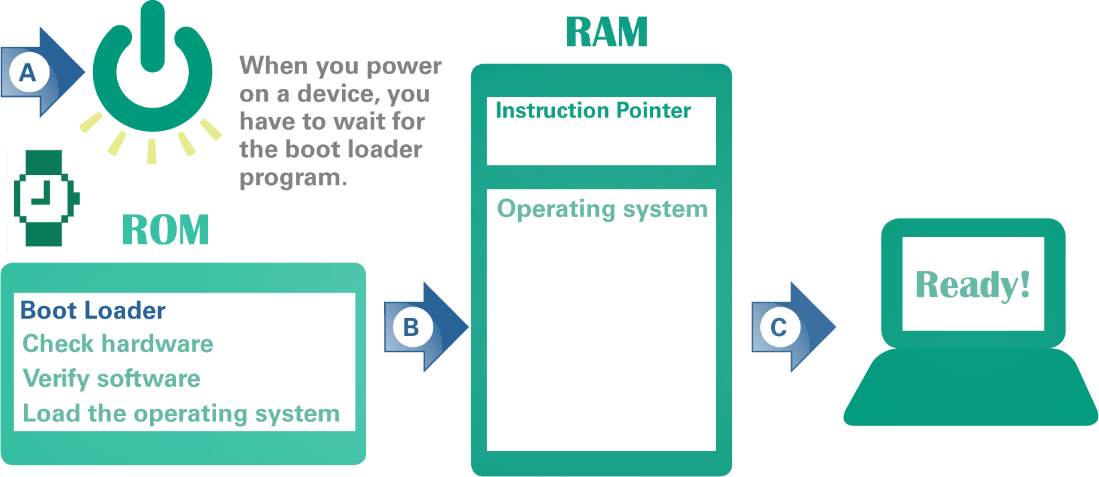
Read-Only Memory
ROM (read-only memory) is a type of memory circuitry that is housed in a single integrated circuit on the system board
ROM contains a small set of instructions and data called the boot loader which tell a digital device how to start

Slide 60
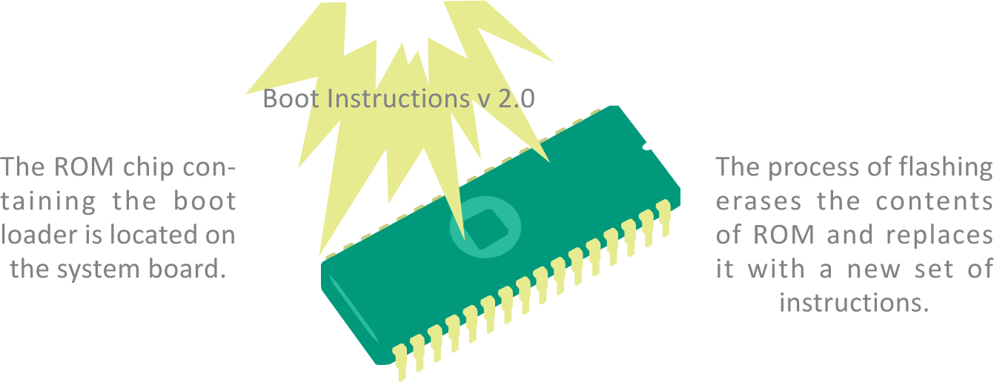
Read-Only Memory
There are several reasons why you might want to change the contents of ROM and boot loader instructions, including:
  Repair
  User modification
  Forensics
  Updates

Slide 61
Section D: Storage
Storage Basics
Magnetic Storage Technology
Optical Storage Technology
Solid State Technology
Cloud Storage
Backup

Slide 62
Storage Basics
Storage is a term used for the components of a digital device designed to hold data permanently
A data storage system has two main components: a storage medium and a storage device
  Storage medium – the disk, tape, CD, or DVD that contains data
  Storage device – the mechanical apparatus that records and retrieves data from a storage medium

Slide 63
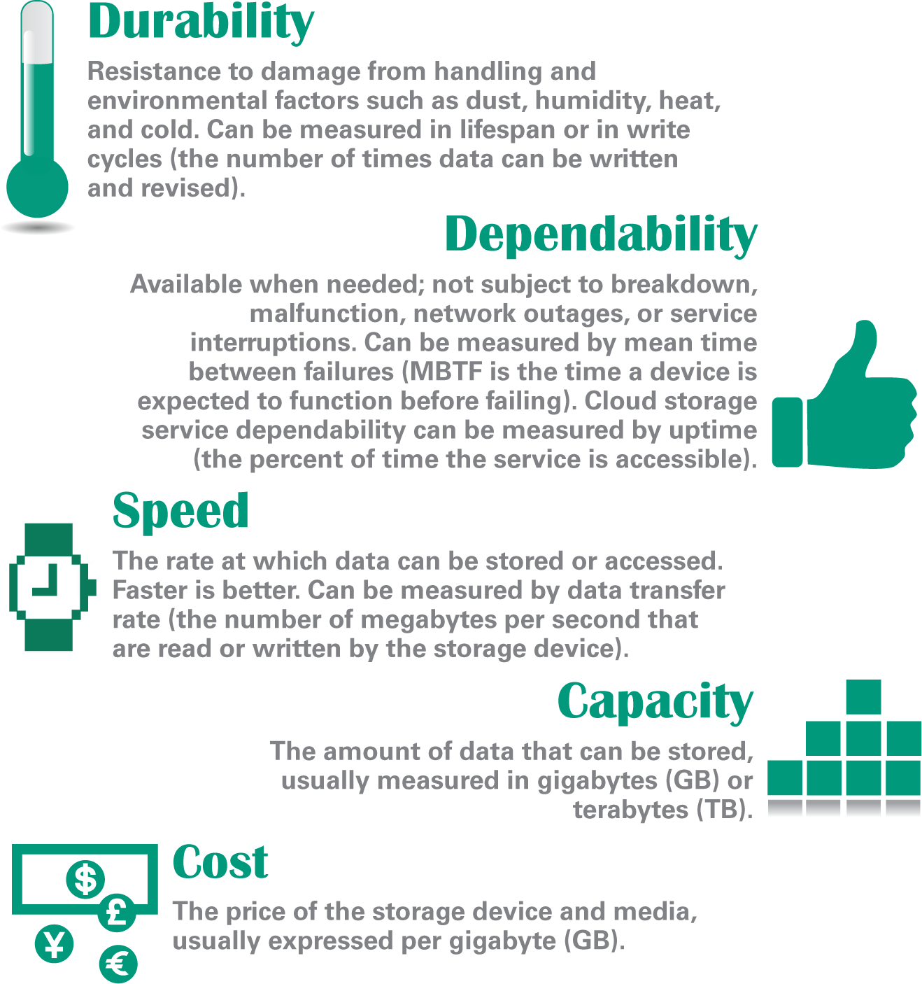
Storage Basics
Each storage technology has its advantages and disadvantages so review their durability, dependability, speed, capacity, and cost before buying

Slide 64
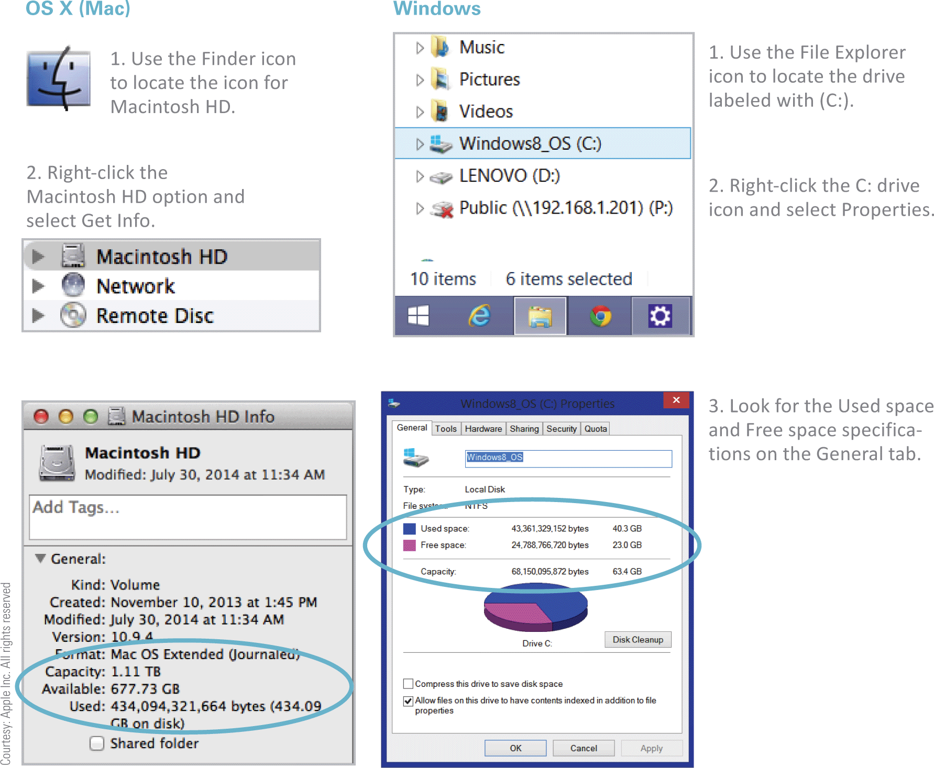
Storage Basics

Slide 65
Magnetic Storage Technology
Magnetic storage technology is used for desktop and laptop hard disk drives, as well as the storage devices used in enterprise computing installations and cloud services
  Magnetic storage represents data by magnetizing microscopic particles on a disk or tape surface
  A hard disk drive contains one or more platters and their associated read-write heads
  A hard disk platter is a flat, rigid disk made of aluminum or glass and coated with magnetic iron oxide particles
  A read-write head mechanism in the disk drive magnetizes particles to write data, and senses the particles’ polarities to read data

Slide 66
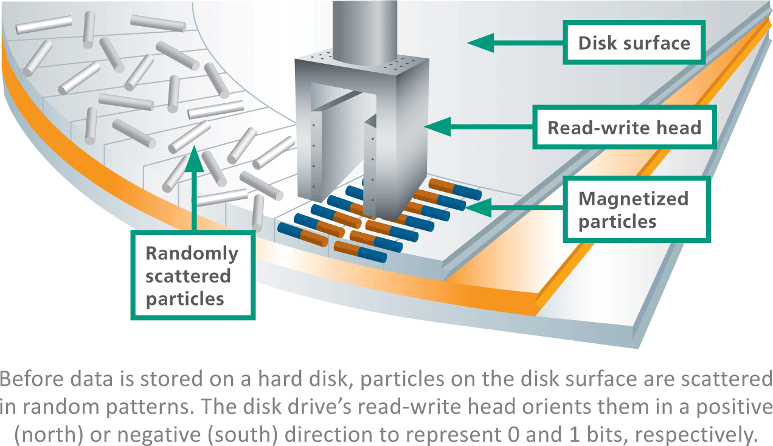
Magnetic Storage Technology

Slide 67
Magnetic Storage Technology
Hard disk drive specifications include:
  Access time – the average time it takes a computer to locate data on the storage medium and read it
  Data transfer rate – the amount of data a storage device can move per second from the storage medium to RAM

Slide 68
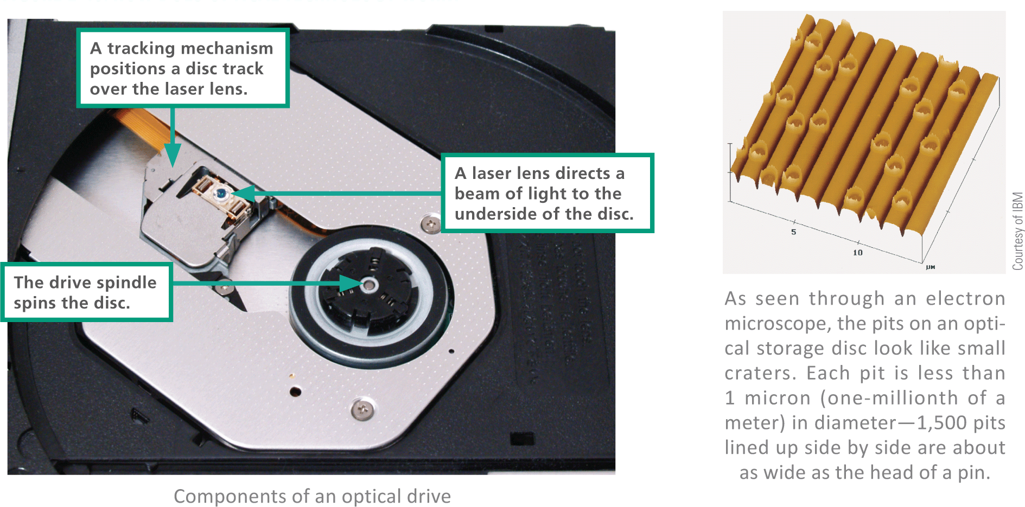
Optical Storage Technology
CD, DVD, and Blu-ray (BD) technologies are classified as optical storage, which represents data as microscopic light and dark spots on the disc surface
The dark spots are called pits; the lighter, non-pitted surface areas of the disc are called lands

Slide 69

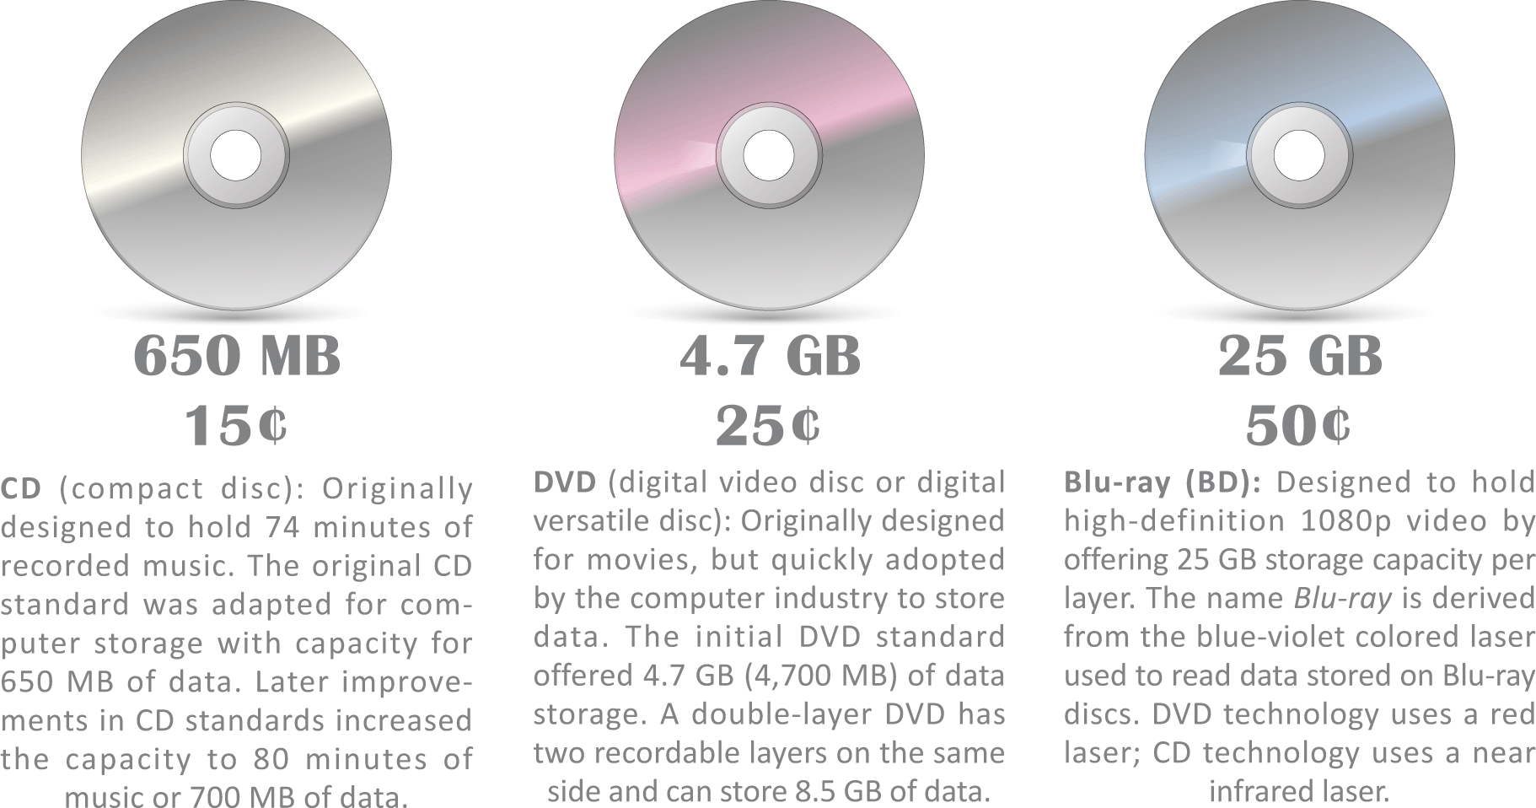
Optical Storage Technology
A single optical drive typically handles CDs, DVDs, and Blu-ray discs, but the costs and capacities of these discs vary

Slide 70
Optical Storage Technology
Optical technologies are grouped into three categories: read-only, recordable, and rewriteable
  ROM. Read-only technology stores data permanently on a disc, which cannot be later added to or changed; can potentially store data for 100 years
  R. Recordable technology uses a laser to change the color in a dye laser sandwiched beneath the clear plastic disc surface; the laser creates dark spots that are read as pits
  RW. Rewritable technology uses phase change technology to alter a crystal structure on the disc surface; altering this structure creates patterns of light and dark spots resembling pits and lands

Slide 71
Solid State Storage Technology
Solid state storage (sometimes called flash memory) stores data in erasable, rewritable circuitry, rather than on spinning disks or streaming tape
Once the data is stored it is non-volatile, meaning the circuits retain data without an external power source

Slide 72
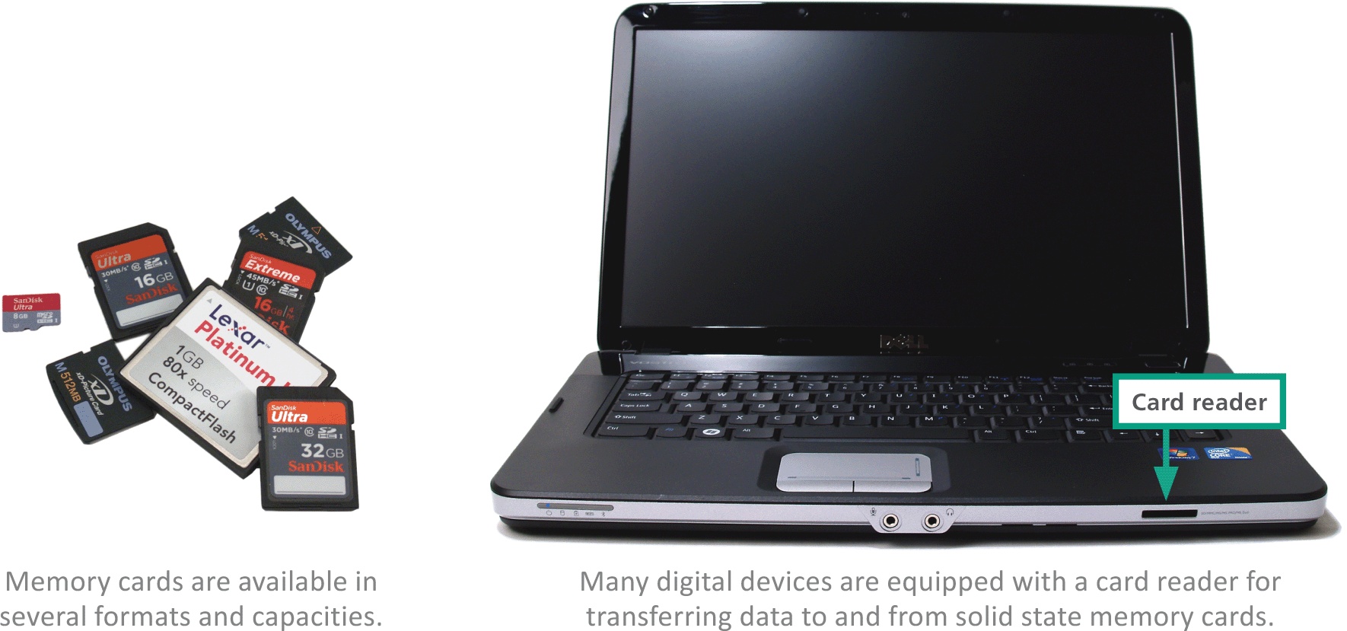
Solid State Storage Technology
A memory card is a flat, solid state storage medium commonly used to transfer files from digital cameras and media players to computers

Slide 73
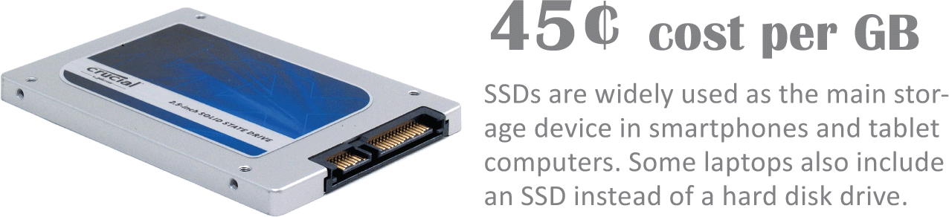
Solid State Storage Technology
A solid state drive (SSD) is a package of flash memory that can be used as a substitute for a hard disk drive
A USB flash drive is a portable storage device that plugs directly into a computer’s system unit using a built-in USB connector

Slide 74
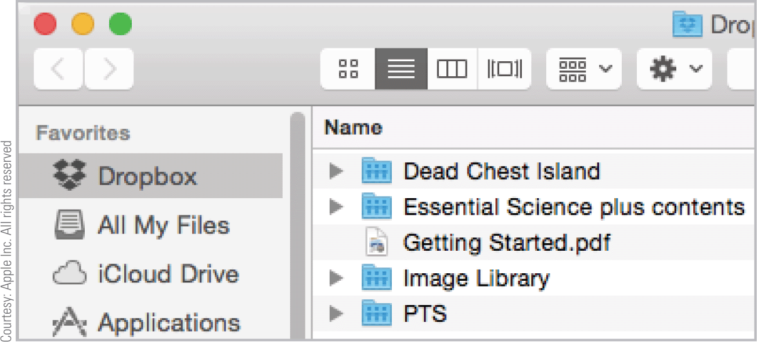
Cloud Storage
Remote storage is housed on an external device that can be accessed from a network
Remote storage can also be available as an Internet service, in which case it is called cloud storage
Cloud storage is provided to individuals by services such as Apple iCloud, Microsoft OneDrive, Google Drive, and Dropbox

Slide 75
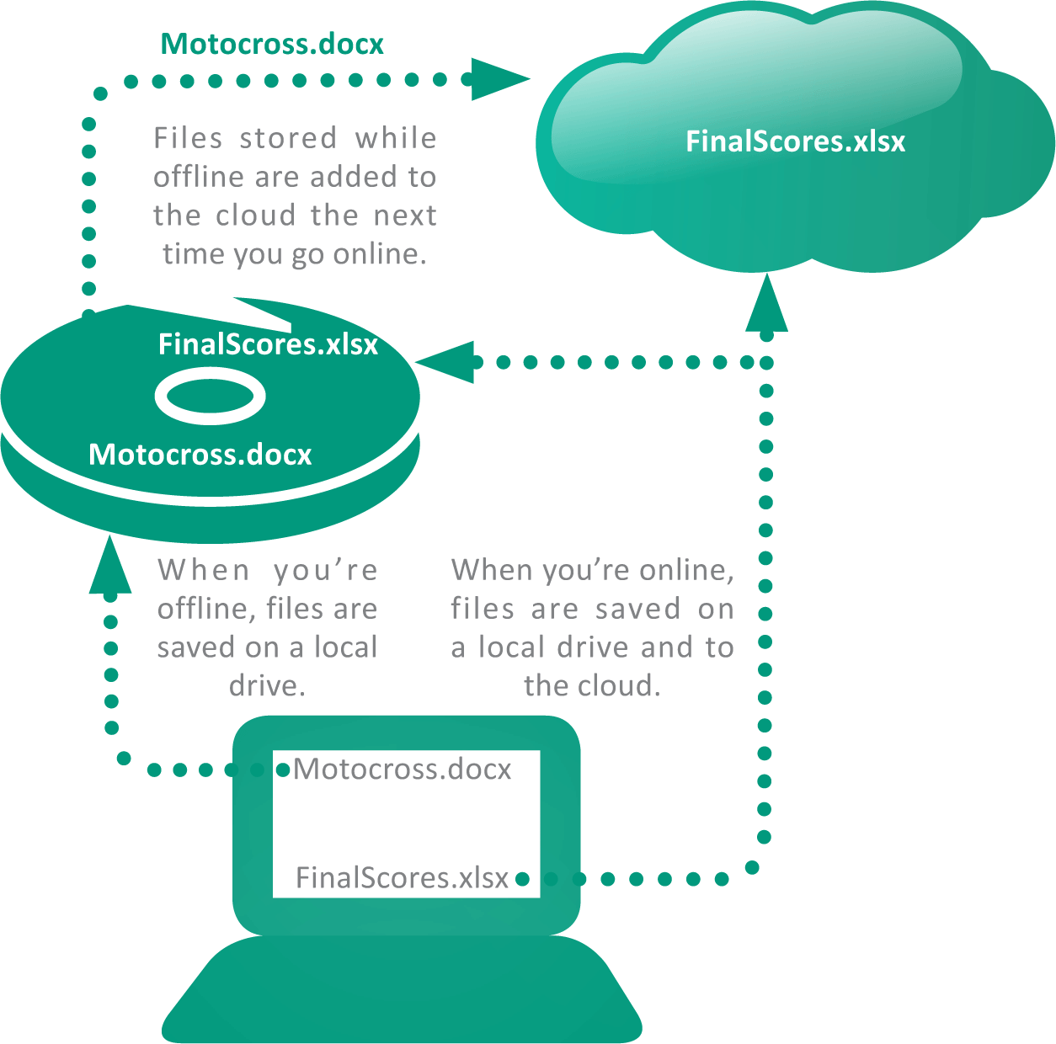
Cloud Storage
Some cloud implementations offer a synchronization feature that automatically duplicates files stored on a local device by also saving them in the cloud

Slide 76
Cloud Storage
Cloud Storage basics:
  Security and privacy risks – the more places your data is stored and the more networks on which it tavels, the more susceptible it becomes to hackers and spying agencies
  Service outages – when a cloud storage site has an outage, all the data stored there become temporarily inaccessible
  Discontinuation of service – some cloud storage providers have closed down their services with little warning

Slide 77
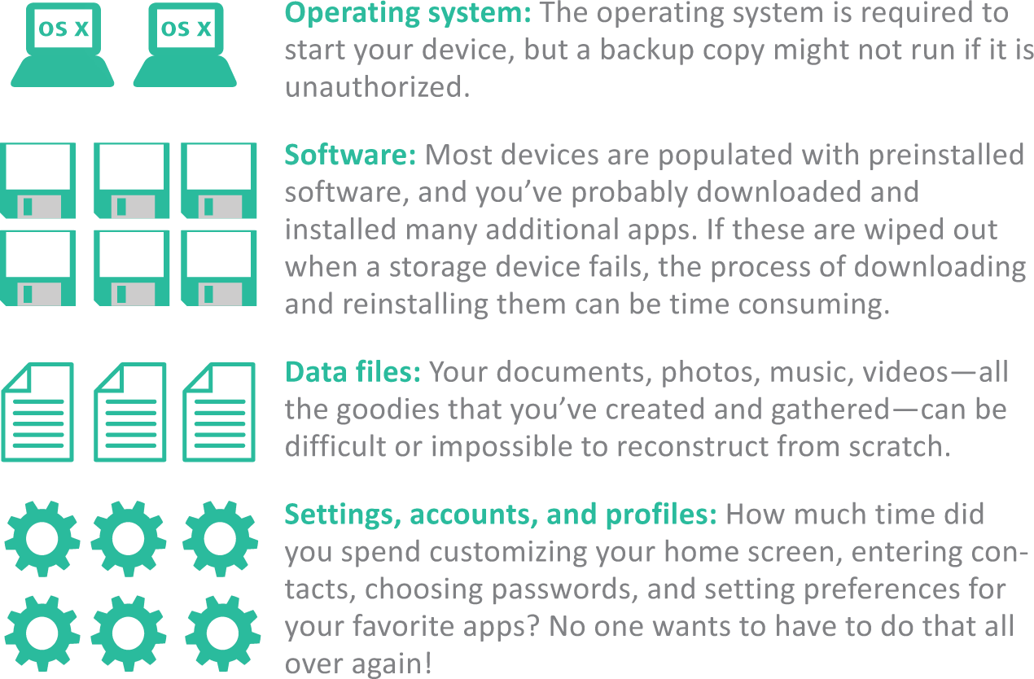
Backup
A backup is a copy of one or more files that is made in case the originals become damaged or lost
Figuring out what to backup is important; backing up everything isn’t always practical

Slide 78
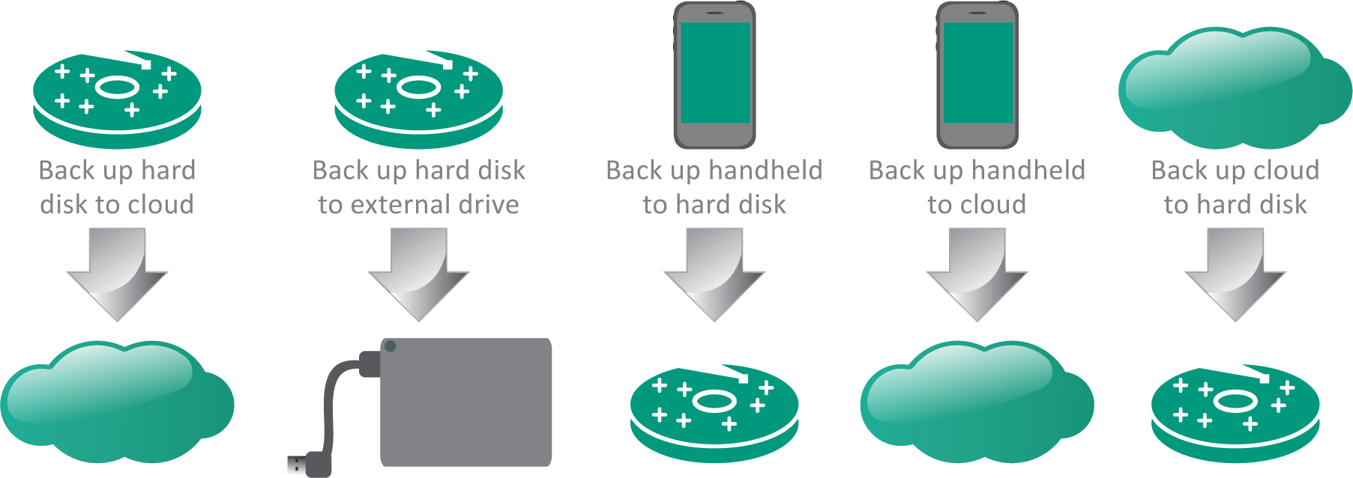
Backup
When deciding on what to back up, know what’s important and ensure that current versions exist on more than one storage device

Slide 79
Backup
Tools you’ll need for backups:
  Recovery drive (system repair disc) – contains parts of the OS necessary to boot your computer and diagnose system problems
  Copy command – allows you to make copies of essential files
  File History – allows for automated data backup and file synchronization to make copies of files from your Documents, Music, Picture, etc.
  System image – Windows includes a disk image option called System image; a bit-for-bit copy of the data from all sectors of a hard disk

Slide 80
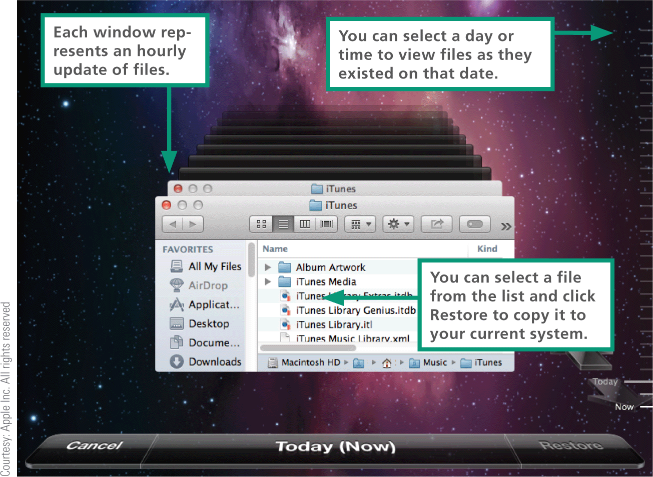
Backup
Macs with OS X offer a comprehensive file synchronization utility called Time Machine, which backs up the entire hard disk

Slide 81
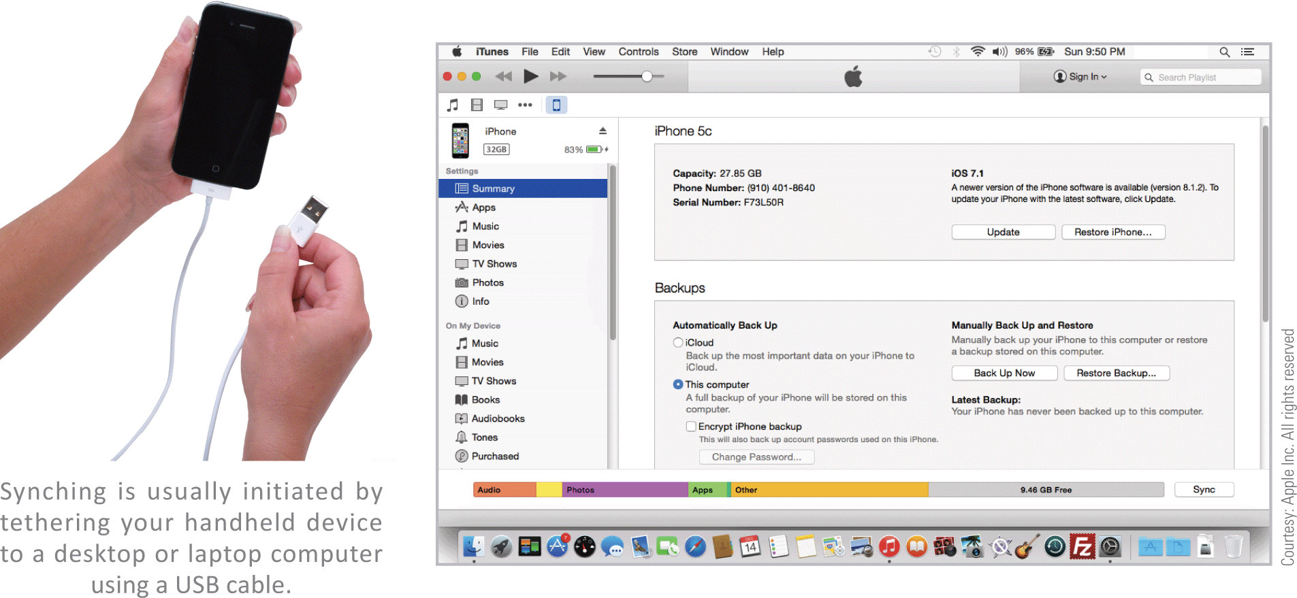
Backup
Owners of iOS devices can backup to a local computer using iTunes or to iCloud

Slide 82
Section E: Input and Output
Add-on Gadgets
Expansion Ports
Bluetooth
Display Devices
Printers
Things

Slide 83
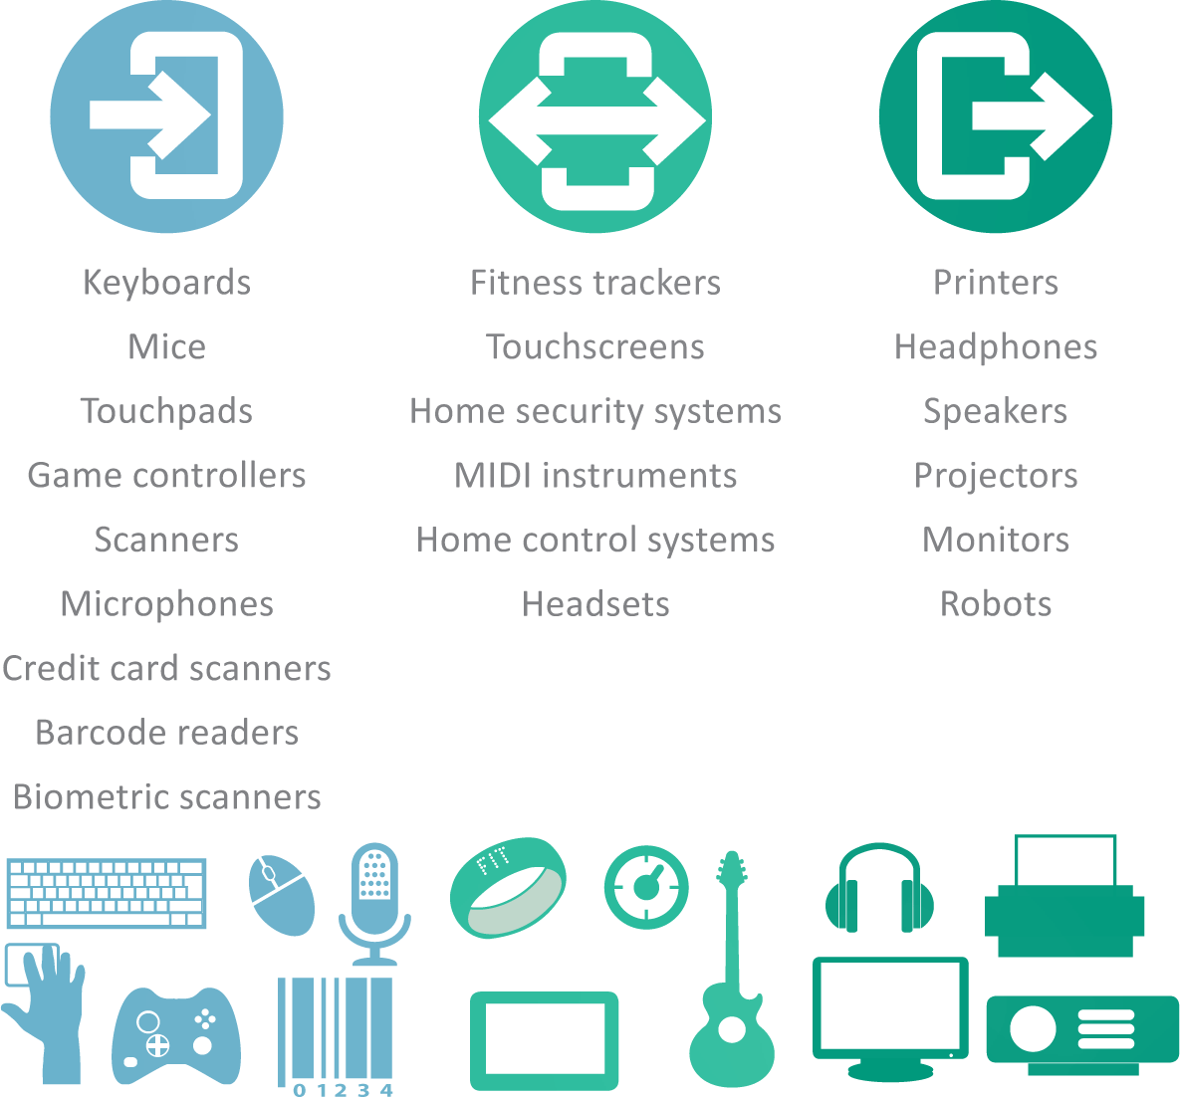
Add-on Gadgets
There are lots of options available for gadgets that accompany your digital devices

Slide 84
Expansion Ports
Many digital devices have ports in the system unit for connecting cables and various add-ons; these ports are called expansion ports because they expand the options for input, output, and storage
When you plug in a USB flash drive or insert a memory card, you are using an expansion port

Slide 85
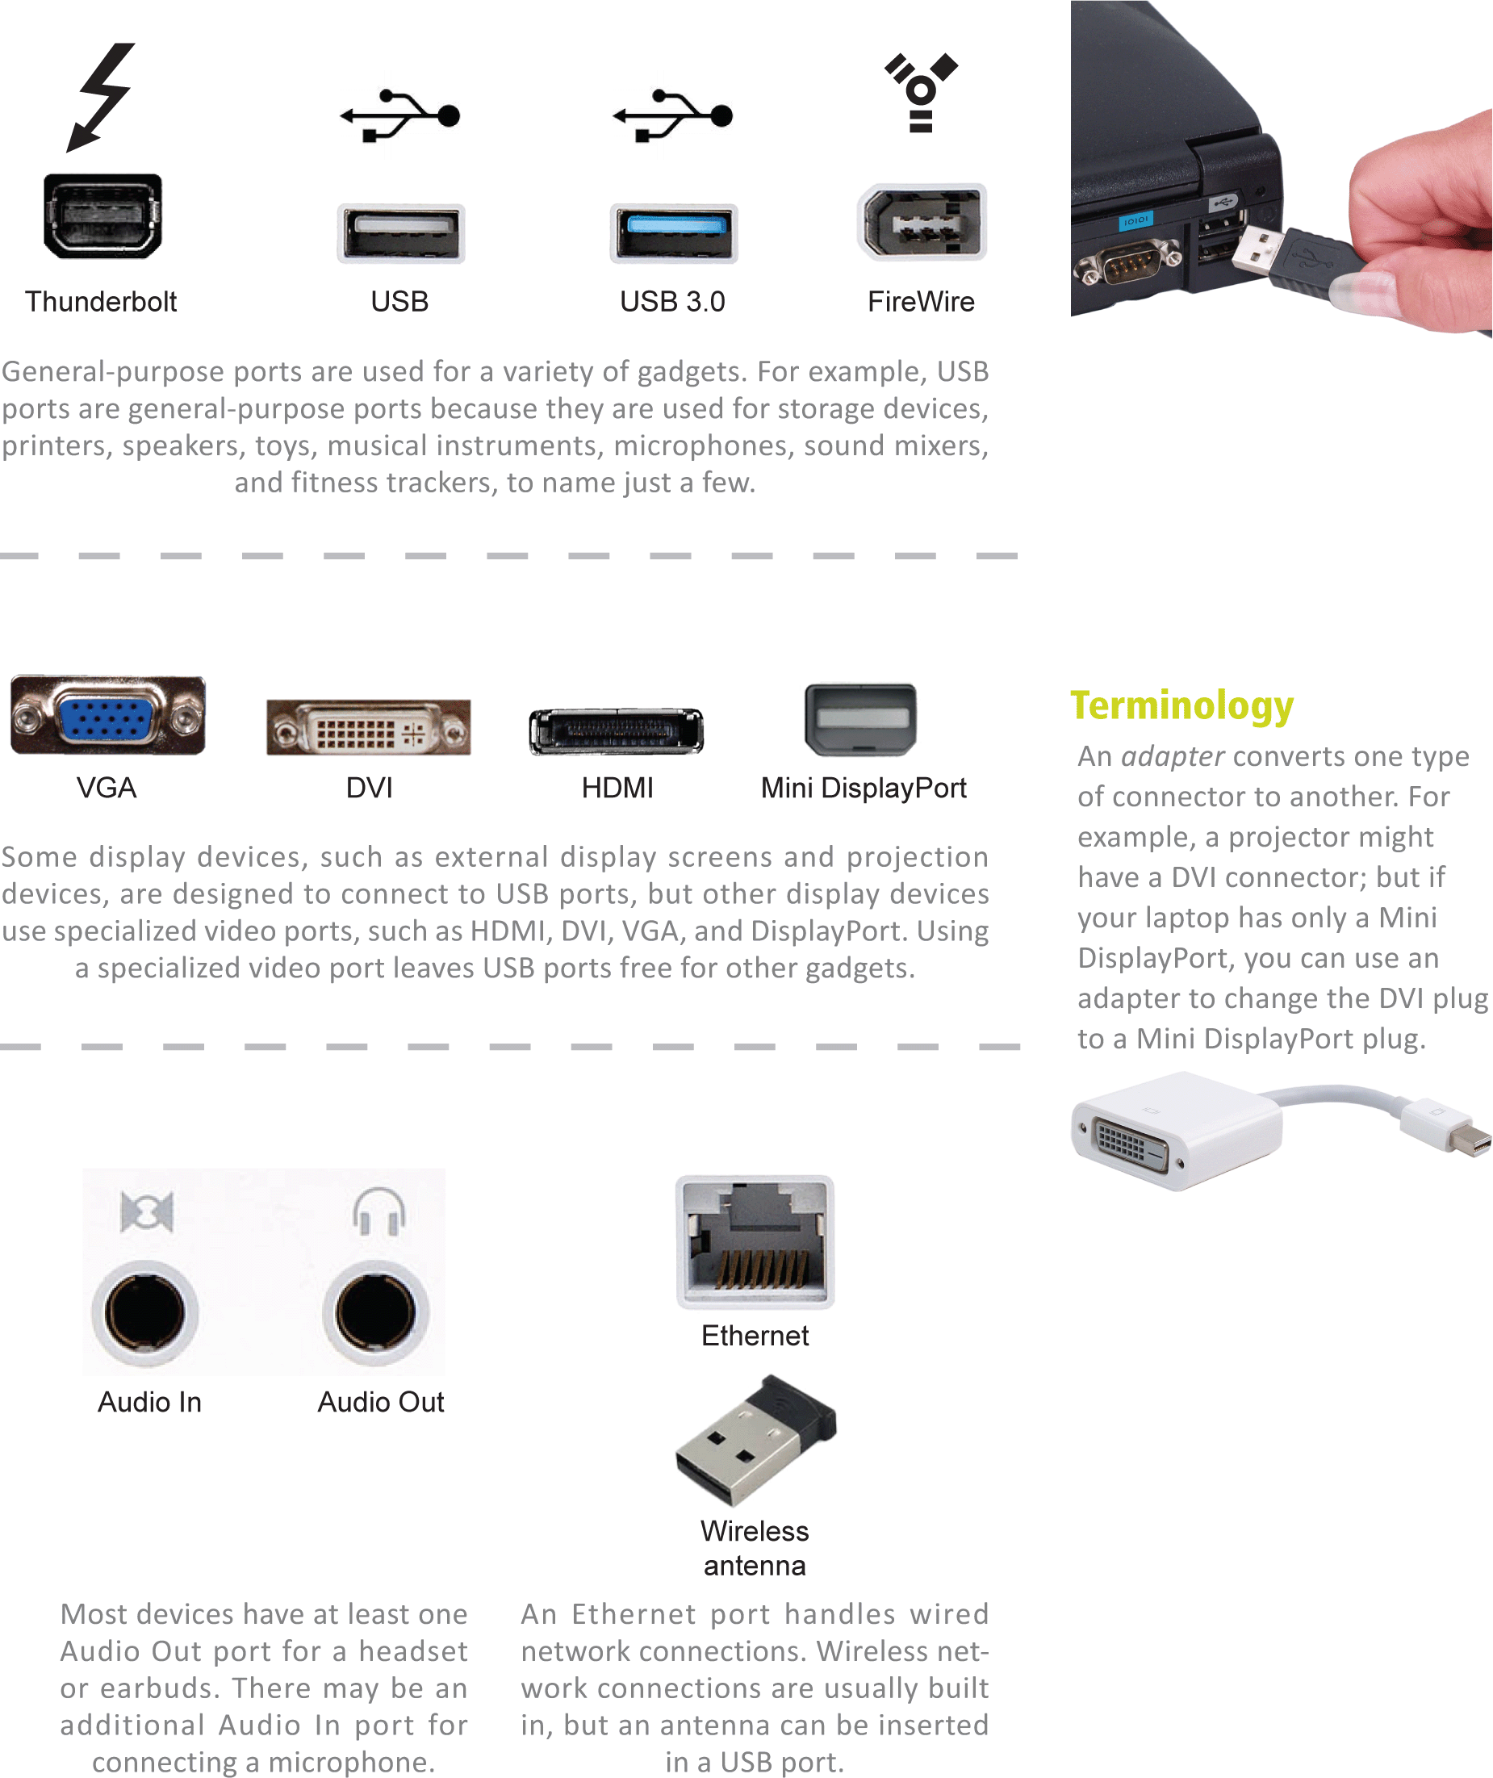
Expansion ports

Slide 86
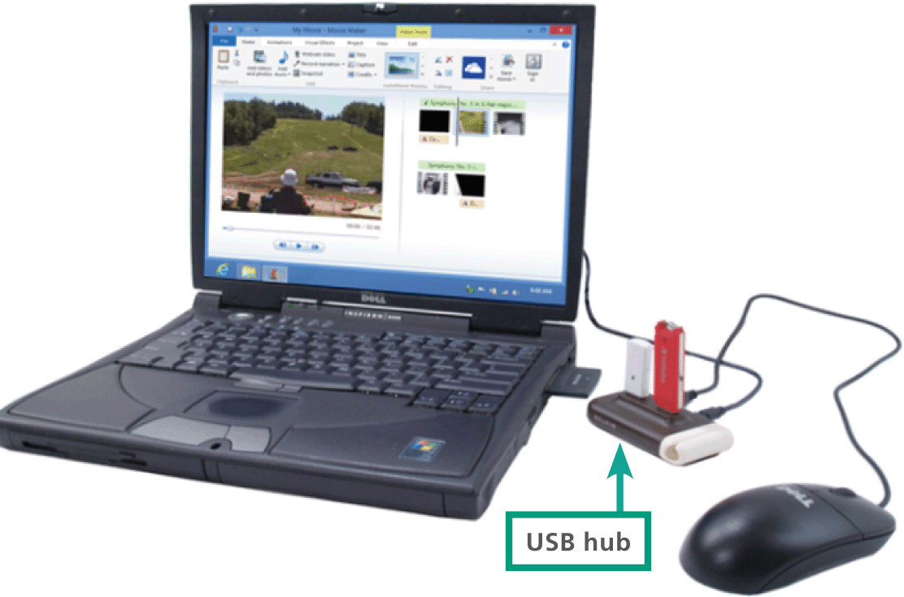
Expansion Ports
If you want to connect more devices than the available number of USB ports, you can use a USB hub

Slide 87
Bluetooth
A common wireless technology for connecting peripherals is Bluetooth
Bluetooth is a low-power technology, so it is ideal for mobile devices that don’t have big batteries
Bluetooth is used to connect wireless headsets to smartphones and is built into many smartphones, tablets, laptops, and desktops

Slide 88
Device Drivers and Apps
A device driver is software that helps a peripheral device establish communication with its host device
For example, the device driver for an HP printer sets up data streams from RAM to the printer and makes sure that the data is formatted in a way that the printer can work

Slide 89
Display Devices
A computer display device that simply displays text and images is classified as an output device
Touchscreens, however, can be classified as both input and output devices because they accept input and also display output
LCD (liquid crystal display) technology produces an image by filtering light through a layer of liquid crystal cells

Slide 90
Display Devices
Factors that affect image quality are:
  Screen size – the measurement in inches from one corner of the screen diagonally across to the opposite corner
  Response rate – the time it takes for one pixel to change from black to white then back to black
  Dot pitch (dp) – The LED’s that form an image on the screen are spaced in a grid; dp is the distance in millimeters between like-colored LEDs
  Screen resolution – The number of horizontal and vertical pixels that a device displays on the screen

Slide 91
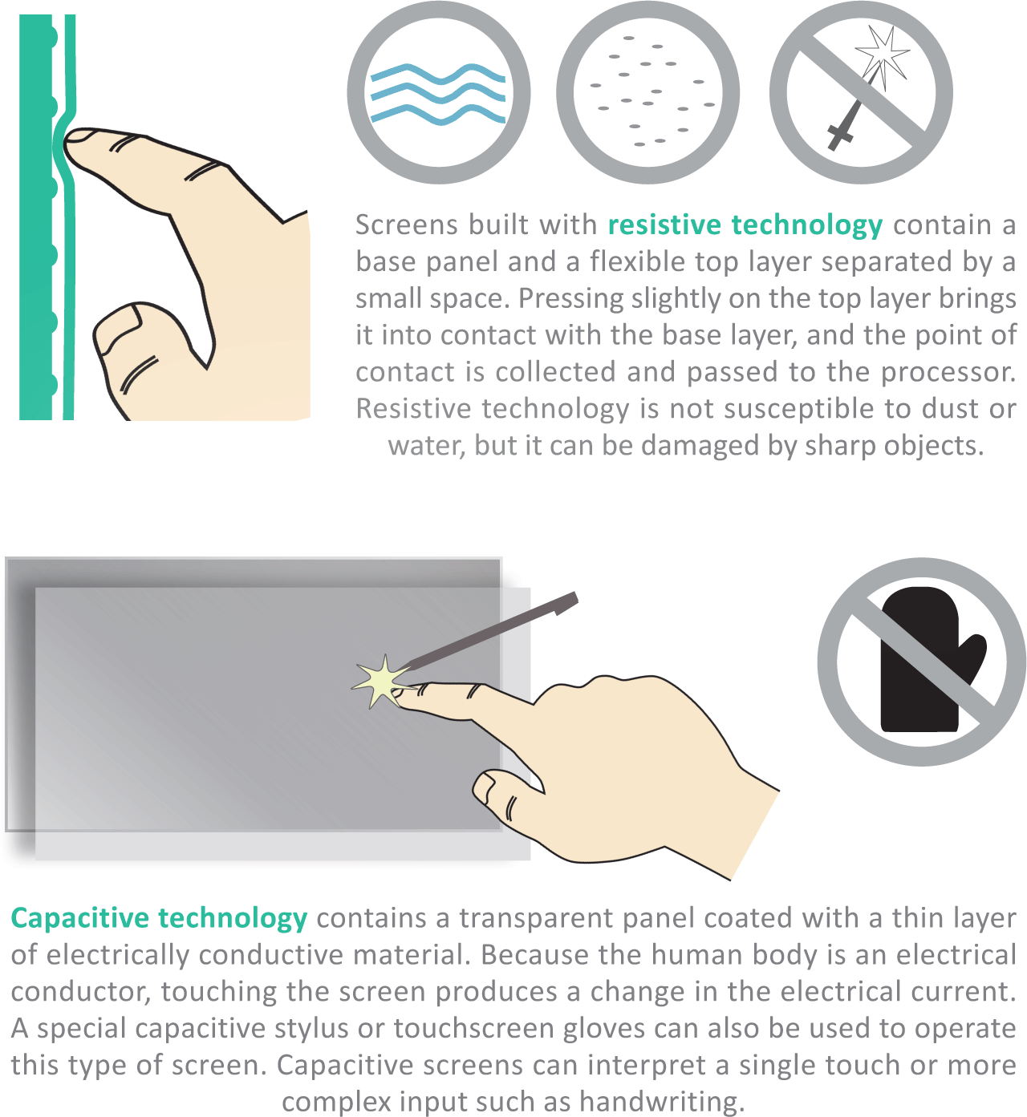
Display Devices
Tablet computers, handheld devices, retail store self-checkouts, and ATMs display output and collect input from a touchscreen
They can also display a virtual keyboard for devices that are not connected to a physical keyboard

Slide 92
Display Devices
Display devices require graphics circuitry to generate and transport the signals for displaying an image on the screen
One type of graphics circuitry, referred to as integrated graphics, is built into a computer’s system board

Slide 93

Display Devices
A second option, called dedicated graphics, is graphics circuitry mounted on a small circuit board called a graphics card (or video card)

Slide 94

Display Devices
A graphics card contains a graphics processing unit (GPU) and a special video memory, which stores screen images as they are processed but before they are displayed

Slide 95

Printers
Today’s best-selling multifunction printers use ink jet or laser technology and can also serve as scanners, copiers, and fax machines
An ink jet printer has a nozzle-like print head that sprays ink onto paper to form characters and graphics

Slide 96

Things
The utopian vision for the Internet of Things (IoT) is a busy hive of smart sensors that work behind the scenes to collect data and use it to improve just about anything

Slide 97
Unit 2 Complete

