Slide 1
Unit 1
Digital Content
ENHANCED EDITION

Slide 2
Unit Contents
Section A: Digital Basics
Section B: Digital Sound
Section C: Bitmap Graphics
Section D: Vector Graphics
Section E: Digital Video

Slide 3
Section A: Digital Basics
Data Representation Basics
Representing Numbers
Representing Text
Bits and Bytes
Compression

Slide 4
Data Representation Basics
Data refers to the symbols that represent people, events, things, and ideas. Data can be a name, a number, the colors in a photograph, or the notes in a musical composition
Data Representation refers to the form in which data is stored, processed, and transmitted
Devices such as smartphones, iPods, and computers store data in digital formats that can be handled by electronic circuitry

Slide 5
Data Representation Basics
Digitization is the process of converting text, numbers, sound, photos, and video into data that can be processed by digital devices
The digital revolution has evolved through four phases, beginning with big, expensive, standalone computers, and progressing to today’s digital world in which small, inexpensive digital devices are everywhere
Notes:
Figure 1-1

Slide 6
Data Representation Basics
The 0s and 1s used to represent digital data are referred to as binary digits – from this term we get the word bit which stands for binary digit
A bit is a 0 or 1 used in the digital representation of data
A digital file, usually referred to simply as a file, is a named collection of data that exits on a storage medium, such as a hard disk, CD, DVD, or flash drive

Slide 7
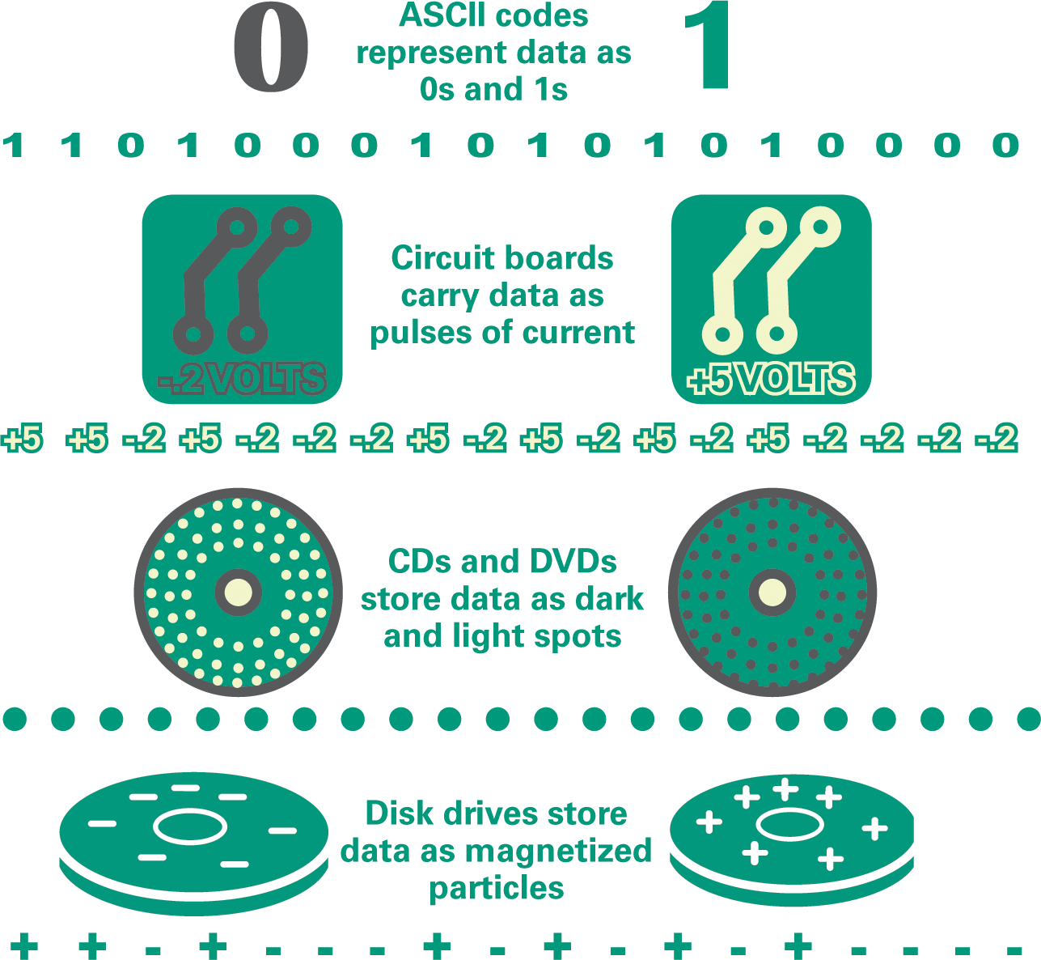
Data Representation Basics
Notes:
Figure 1-2

Slide 8
Representing Numbers
Numeric data consists of numbers that can be used in arithmetic operations
Digital devices represent numeric data using the binary number system, also called base 2
The binary number system only has two digits: 0 and 1
No numeral like 2 exists in the system, so the number “two” is represented in binary as 10 (pronounced “one zero”)

Slide 9
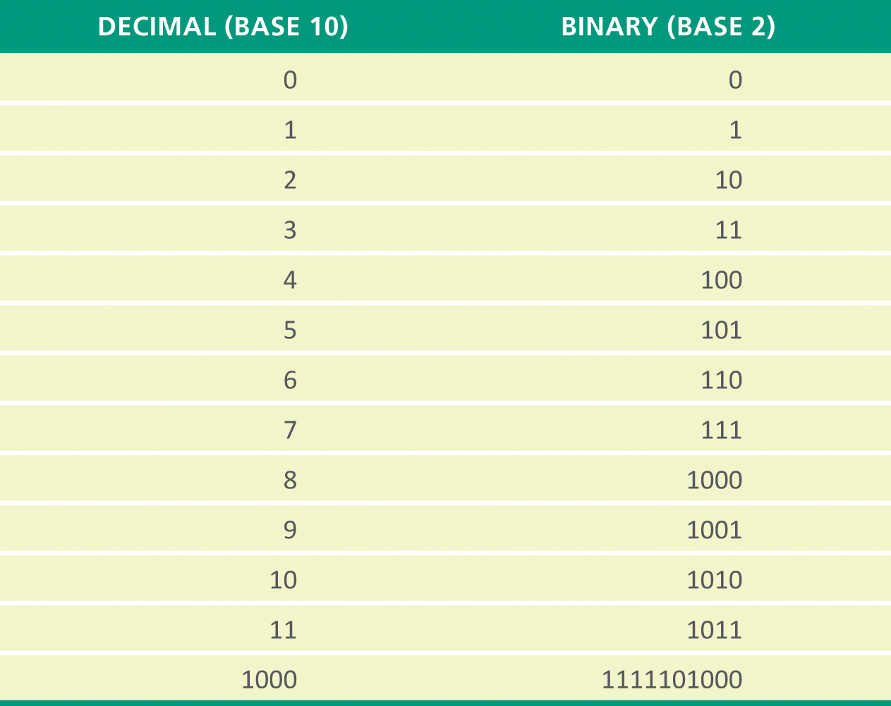
Representing Numbers
Notes:
Figure 1-4

Slide 10
Representing Text
Character data is composed of letters, symbols, and numerals that are not used in calculations
Examples of character data include your name, address, and hair color
Character data is commonly referred to as “text”

Slide 11
Representing Text
Digital devices employ several types of codes to represent character data, including ASCII, Unicode and their variants
ASCII (American Standard Code for Information Interchange, pronounced “ASK ee”) requires seven bits for each character
The ASCII code for an uppercase A is 1000001

Slide 12
Representing Text
Extended ASCII is a superset of ASCII that uses eight bits for each character
For example, Extended ASCII represents the uppercase letter A as 01000001
Using eight bits allows Extended ASCII to provide codes for 256 characters

Slide 13
Representing Text
Unicode (pronounced “YOU ni code”) uses sixteen bits and provides codes or 65,000 characters
This is a bonus for representing the alphabets of multiple languages

Slide 14
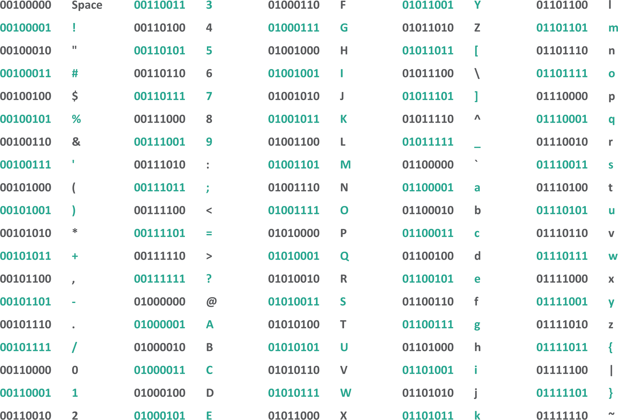
Representing Text
Notes:
Figure 1-5

Slide 15
Representing Text
ASCII codes are used for numerals, such as Social Security numbers and phone numbers
Plain, unformatted text is sometimes called ASCII text and is stored in a so-called “text file” with a name ending in .txt
On Apple devices these files are labeled “Plain Text”; in Windows, these files are labeled “Text Document”

Slide 16
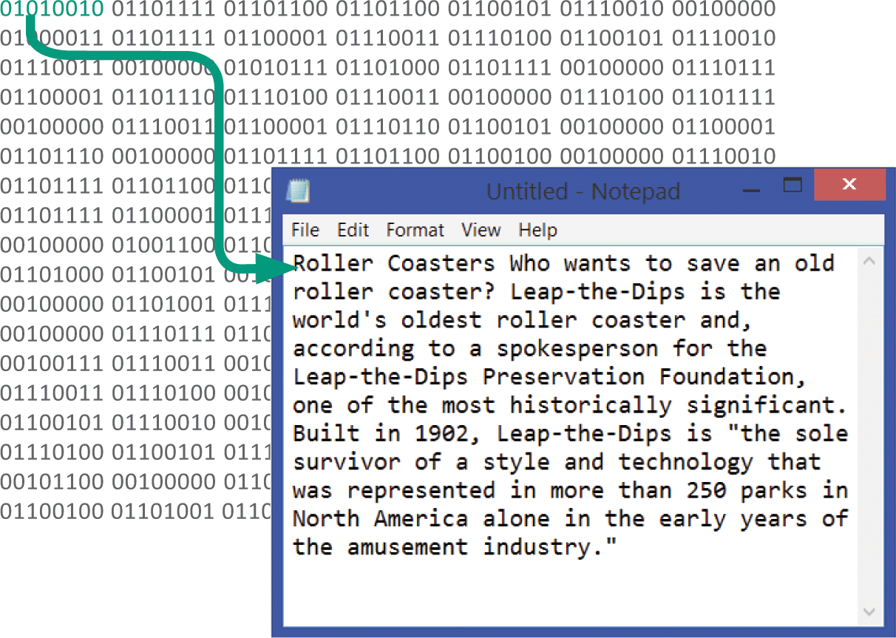
Representing Text
ASCII text files contain no formatting
To create documents with styles and formats, formatting codes have to be embedded in the text

Slide 17
Representing Text
Microsoft Word produces formatted text and creates documents in DOCX format
iWork Pages produces documents in PAGES format
Adobe Acrobat produces documents in PDF format
HTML markup language used for Web pages produces documents in HTML format

Slide 18
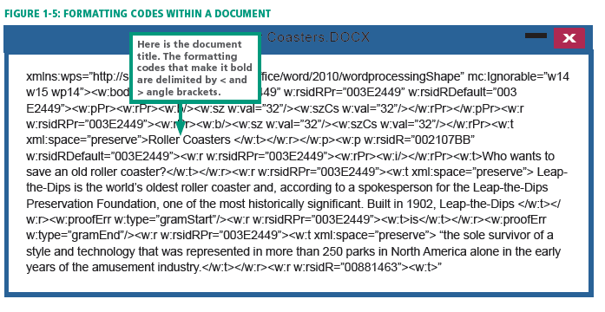
Representing Text
Notes:
Figure 1-7

Slide 19
Bits and Bytes
All of the data stored and transmitted by digital devices is encoded as bits
Terminology related to bits and bytes is extensively used to describe storage capacity and network access speed
The word bit, an abbreviation for binary digit, can be further abbreviated as a lowercase b
A group of eight bits is called a byte and is usually abbreviated as an uppercase B

Slide 20
Bits and Bytes
When reading about digital devices, you’ll frequently encounter references such as 50 kilobits per second, 1.44 megabytes, 2.8 gigahertz, and 2 terabytes.
Kilo, mega, giga, tera, and similar terms are used to quantify digital data

Slide 21
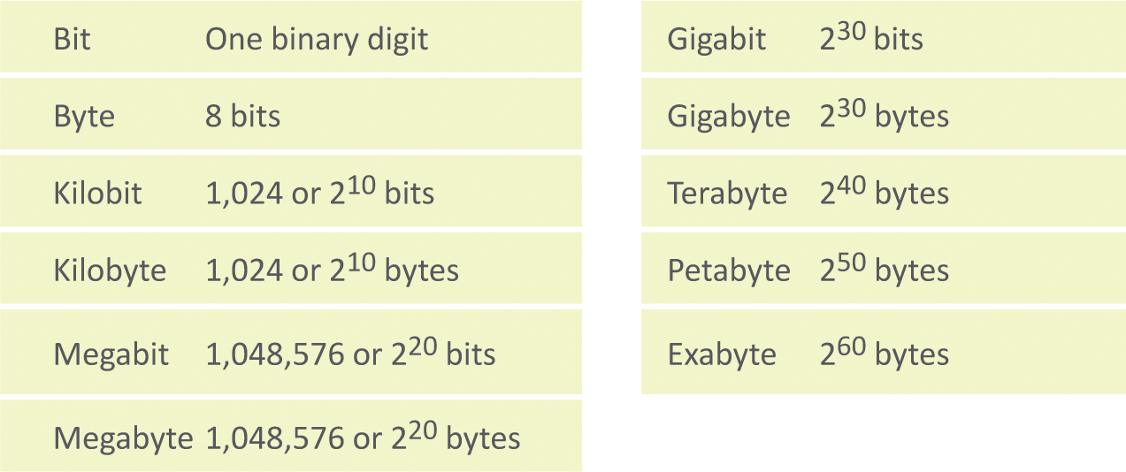
Bits and Bytes
Notes:
Figure 1-9

Slide 22
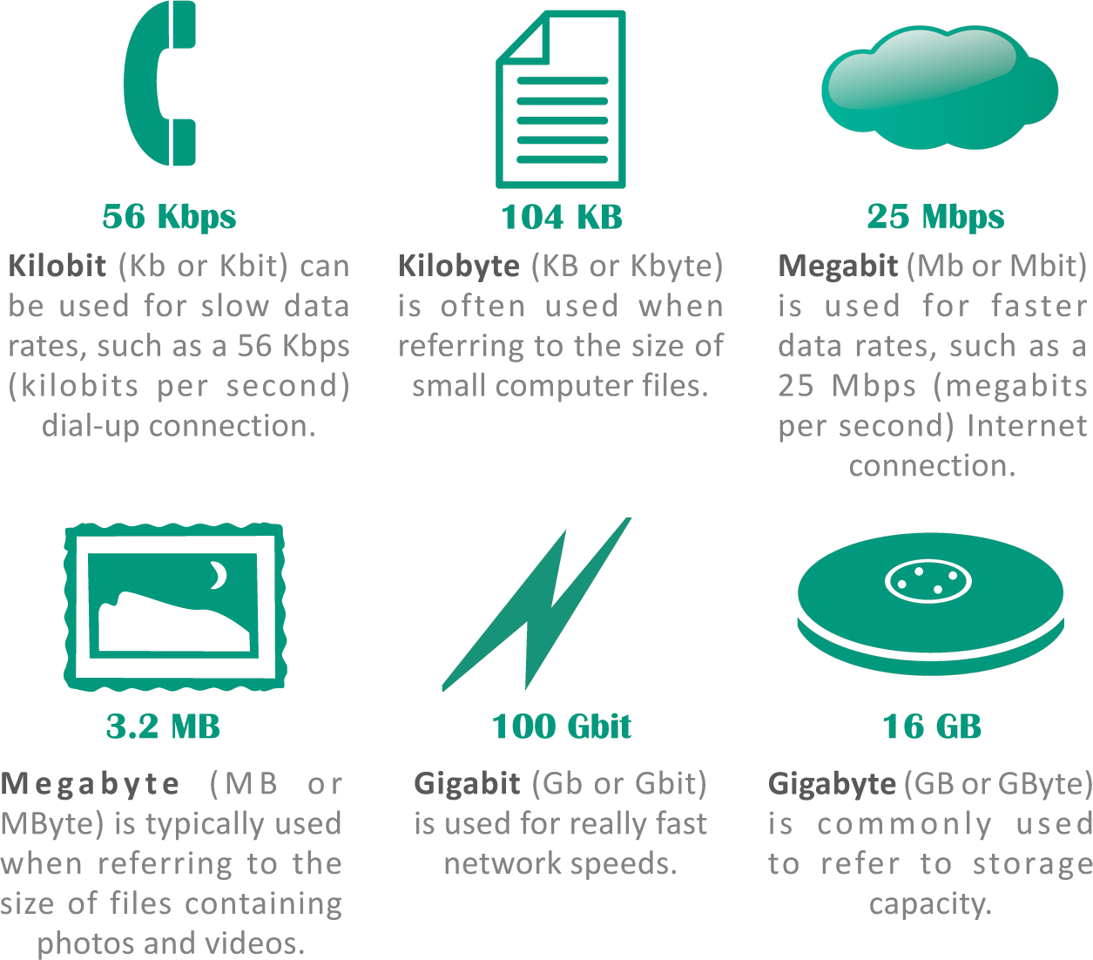
Bits and Bytes
Use bits for data rates, such as Internet connection speeds, and movie download speeds
Use bytes for file sizes and storage capacities

Slide 23
Compression
To reduce file size and transmission times, digital data can be compressed
Data compression refers to any technique that recodes the data in a file so that it contains fewer bits
Compression is commonly referred to as “zipping”

Slide 24
Compression
Compression techniques have two categories: lossless and lossy
Lossless compression provides a way to compress data and reconstitute it into its original state; uncompressed data stays exactly the same as the original data
Lossy compression throws away some of the original data during the compression process; uncompressed data is not exactly the same as the original

Slide 25
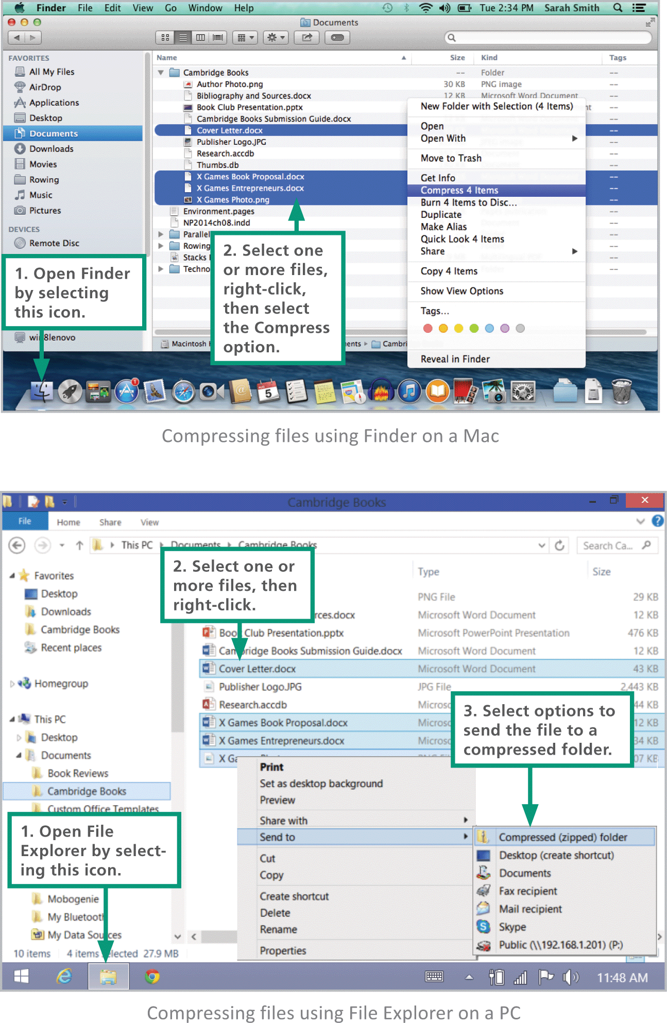
Compression
Software for compressing data is sometimes referred to as a compression utility or a zip tool
On laptops and desktop computers, the compression utility is accessed from the same screen used to manage files

Slide 26
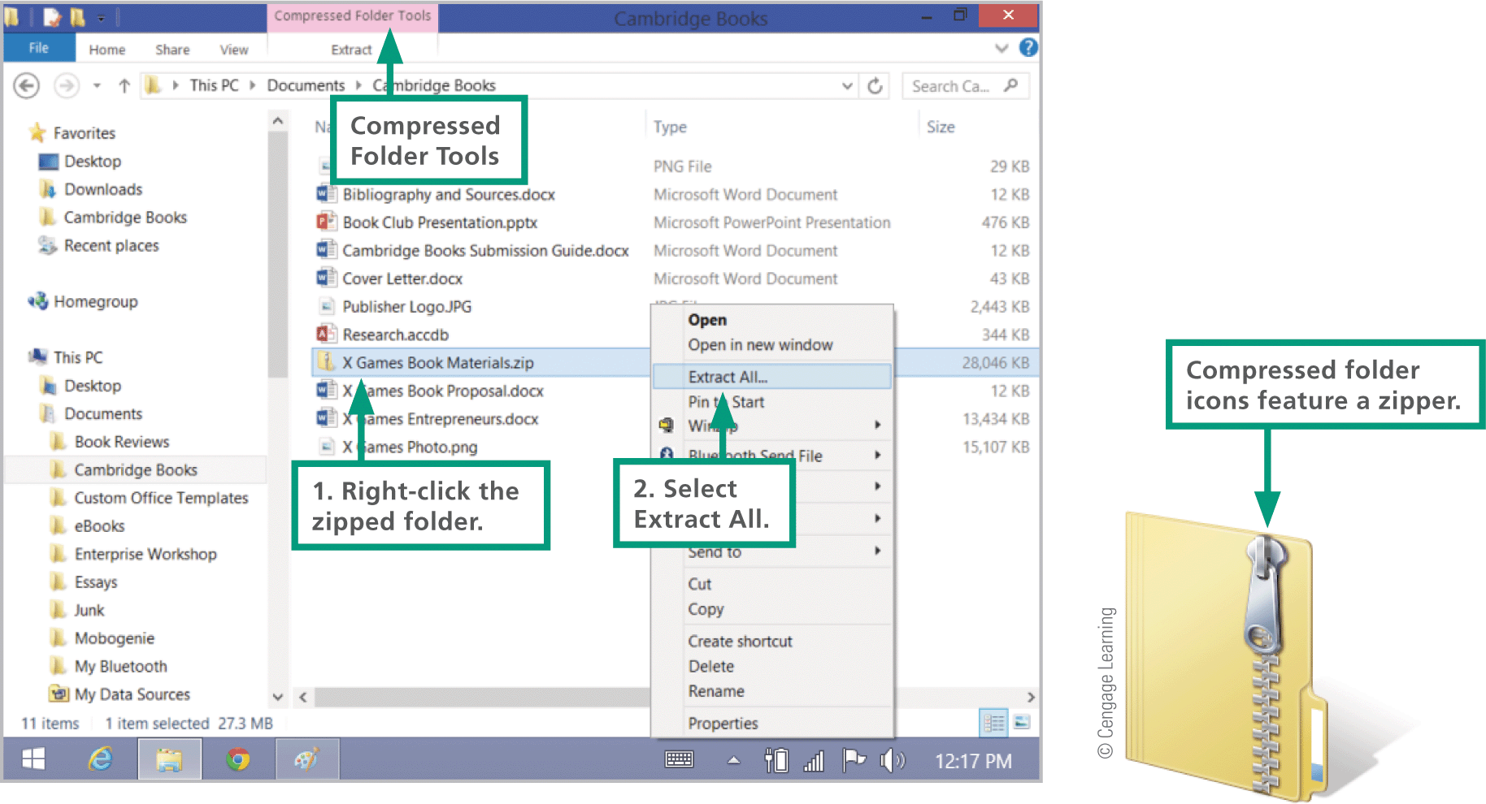
Compression
The process of reconstituting files is called extracting or unzipping
Compressed files may end with a .zip, .gz, .pkg, or.tar.gz

Slide 27
Section B: Digital Sound
Digital Audio Basics
Digital Audio File Formats
MIDI
Digitized Speech

Slide 28
Digital Audio Basics
Digital audio is music, speech, and other sounds represented in binary format for use in digital devices
Most digital devices have a built-in microphone and audio software, so recording external sounds is easy
To digitally record sound samples of a sound wave are collected at periodic intervals and stored as numeric data in an audio file
Sound waves are sampled many times per second by an analog-to-digital converter
A digital-to-analog converter transforms the digital bits into analog sound waves
Notes:
Figure 1-13

Slide 29
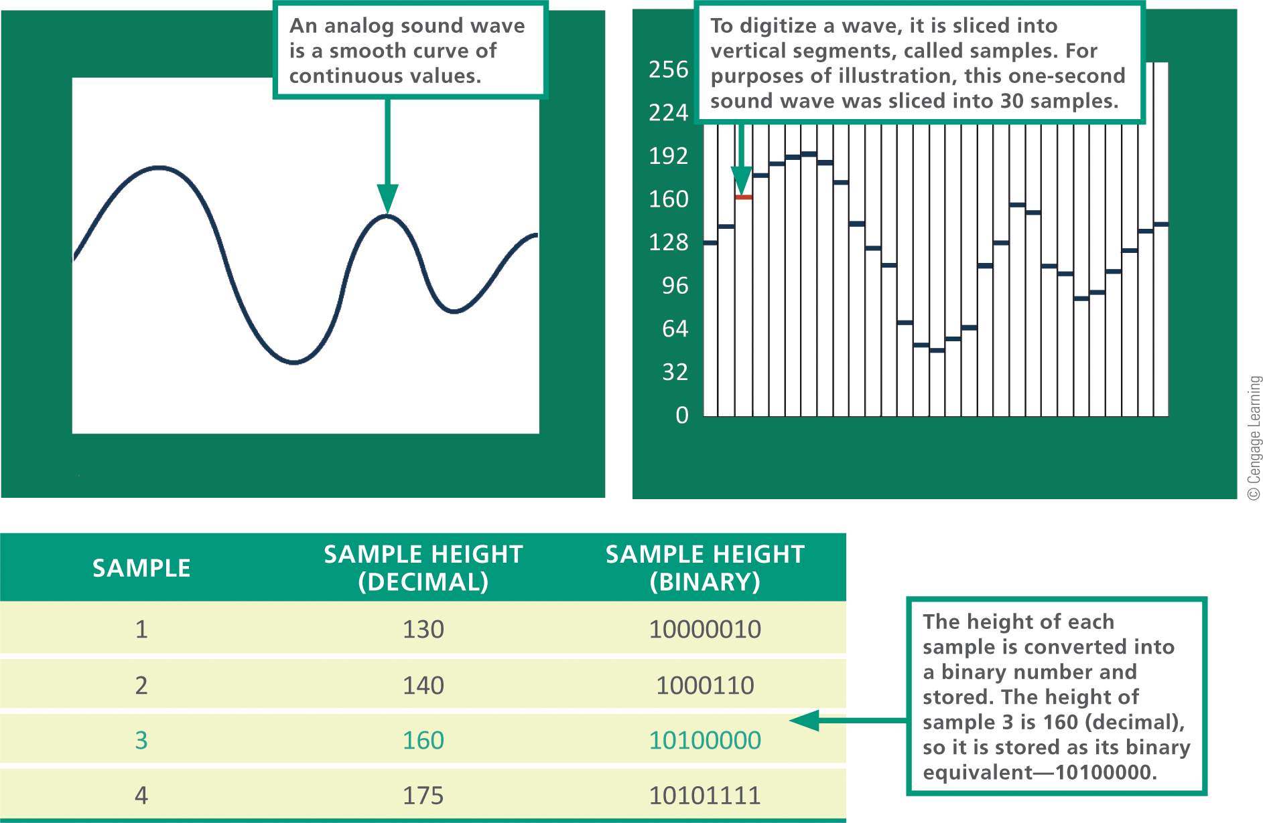
Digital Audio Basics

Slide 30
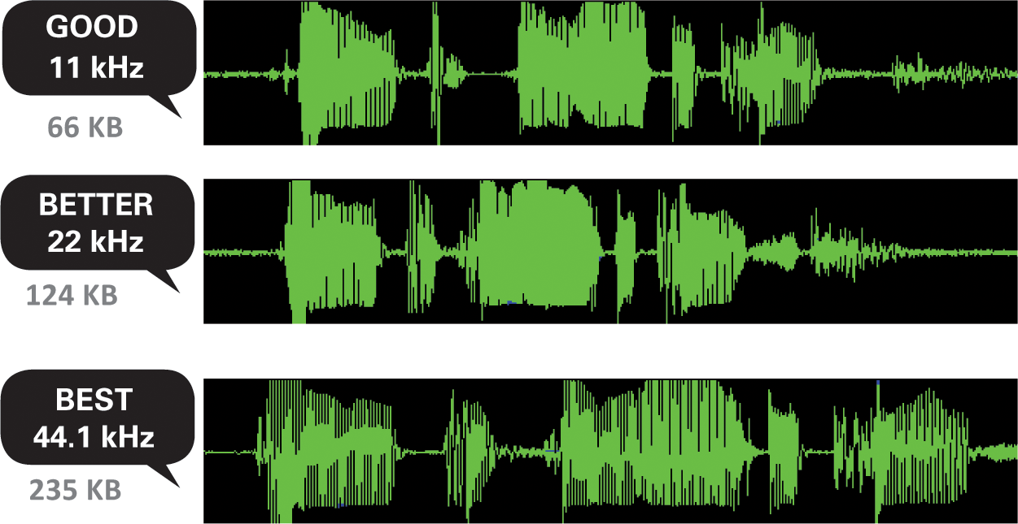
Digital Audio Basics
Sampling rate refers to the number of times per second that a sound is measured during the recording process
Higher sampling rates increase the quality of a sound recording but require more storage space
Notes:
Figure 1-14

Slide 31
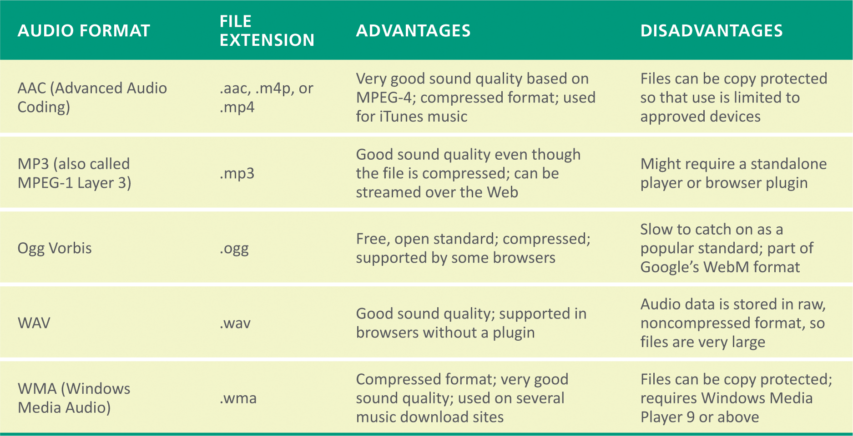
Digital Audio File Formats
A digital file can be identified by its type or its file extension, such as Thriller.mp3 (an audio file)
The most popular digital audio formats are: AAC, MP3, Ogg, Vorbis, WAV, and WMA

Slide 32
Digital Audio File Formats
To play a digital audio file, you must use some type of audio software, such as:
  Audio Software: General-purpose software and apps used for recording, playing, and modifying audio files, such as iTunes
  Audio Players: Small standalone software application or mobile app that offers tools for listening to digital audio and managing playlists, typically included with your computer’s OS (operating system)
  Audio Plugins: Software that works in conjunction with your computer’s browser to manage and play audio from a Web page

Slide 33
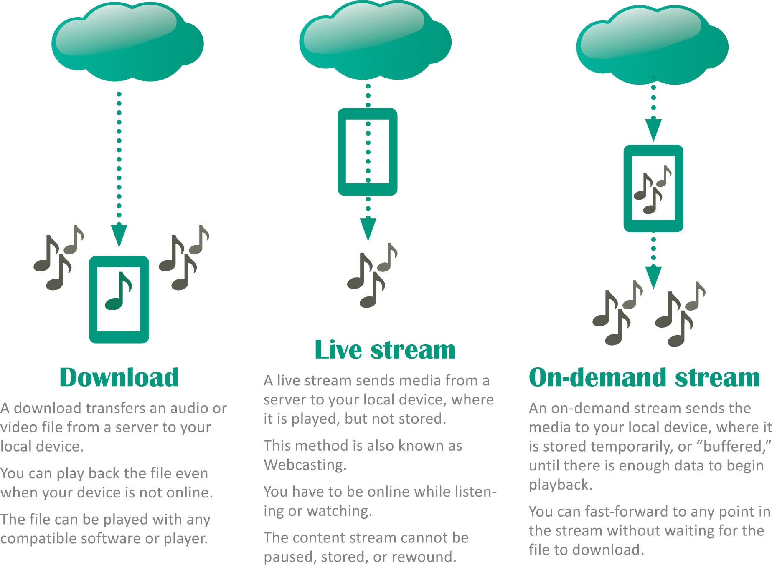
Digital Audio File Formats

Slide 34
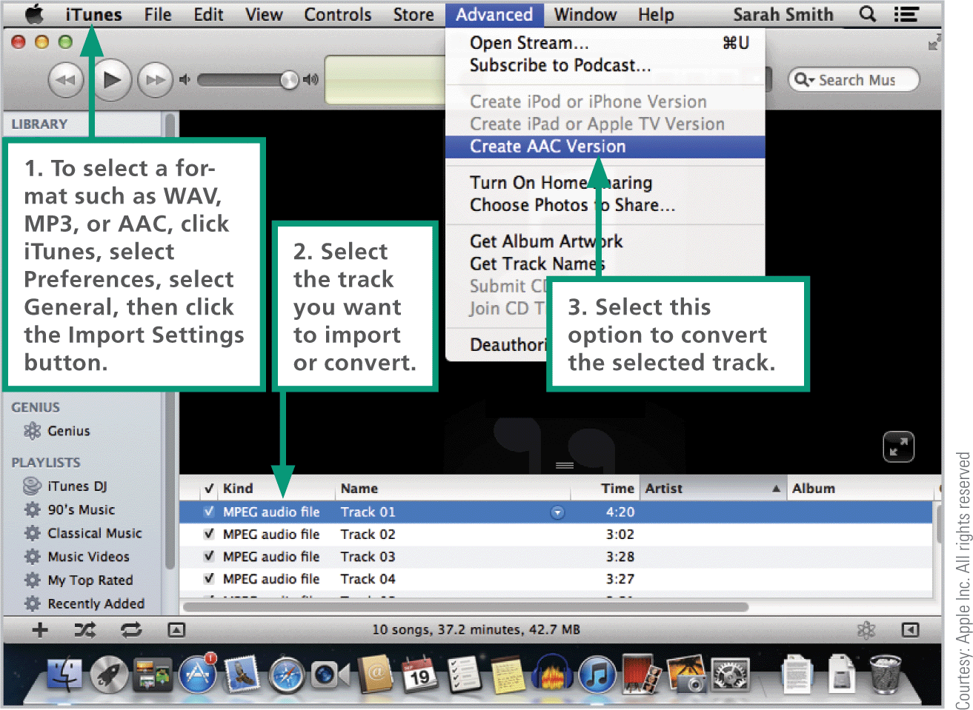
Digital Audio File Formats
Ripping is a slang term that refers to the process of importing tracks from a CD or DVD to your computer’s hard disk
The technical term for ripping music tracks is digital audio extraction
Notes:
Figure 1-15

Slide 35
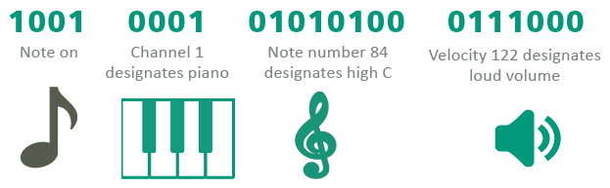
MIDI
MIDI (Musical Instrument Digital Interface) specifies a standard way to store music data for synthesizers, electronic MIDI instruments, and computers
MIDI messages are instructions that specify the pitch of a note, the point at which the note begins, the volume of the note, etc.
An MIDI message may look like this:
Notes:
Figure 1-16

Slide 36
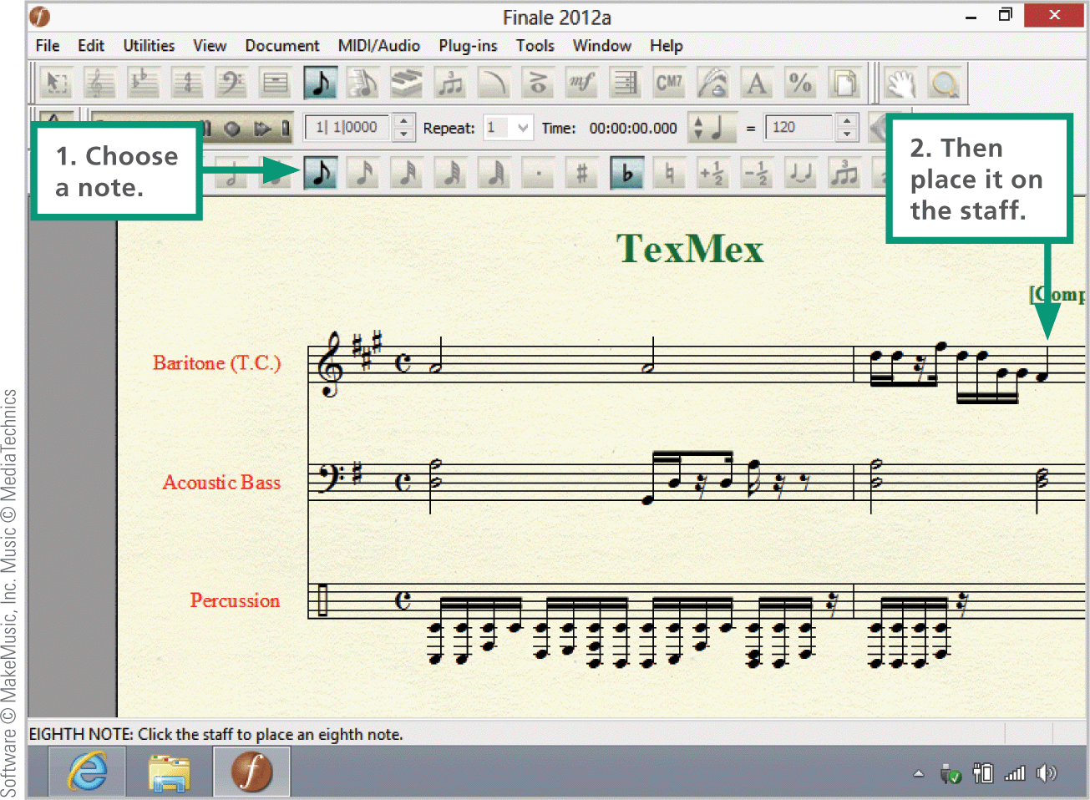
MIDI
Music composition software with MIDI support makes it easy to place notes on a screen-based music staff then play back the composition on a MIDI keyboard or through the speakers of a digital device
Notes:
Figure 1-17

Slide 37
Digitized Speech
Speech synthesis is the process by which machines produce sound that resembles spoken words
Speech recognition (or voice recognition) refers to the ability of a machine to understand spoken words
Notes:
Figure 1-18

Slide 38
Digitized Speech
Speech recognition software analyzes the sounds of your voice and converts each word into groups of phonemes (basic sound units)
The software then compares the groups to the words in a digital dictionary to find a match
When a match is found, the software can display the word on the screen or use it to carry out a command

Slide 39
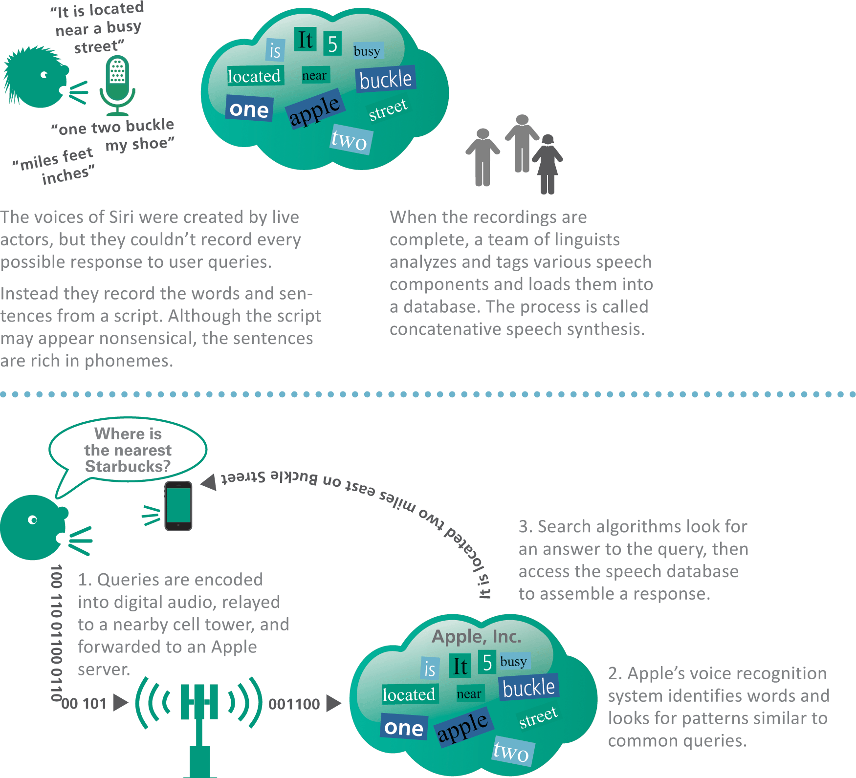
Digitized Speech

Slide 40
Section C: Bitmap Graphics
Bitmap Basics
Bitmap Data Representation
Bitmap Resolution
Image Compression
Modifying Bitmap Images

Slide 41
Bitmap Basics
As digital devices gained the ability to display images, two types of computer graphics evolved: bitmap & vector
A bitmap graphic is composed of a grid of tiny rectangular cells
Each cell is a picture element, commonly called a pixel
Each pixel is assigned a color, which is stored as a binary number
Notes:
Figure 1-24

Slide 42
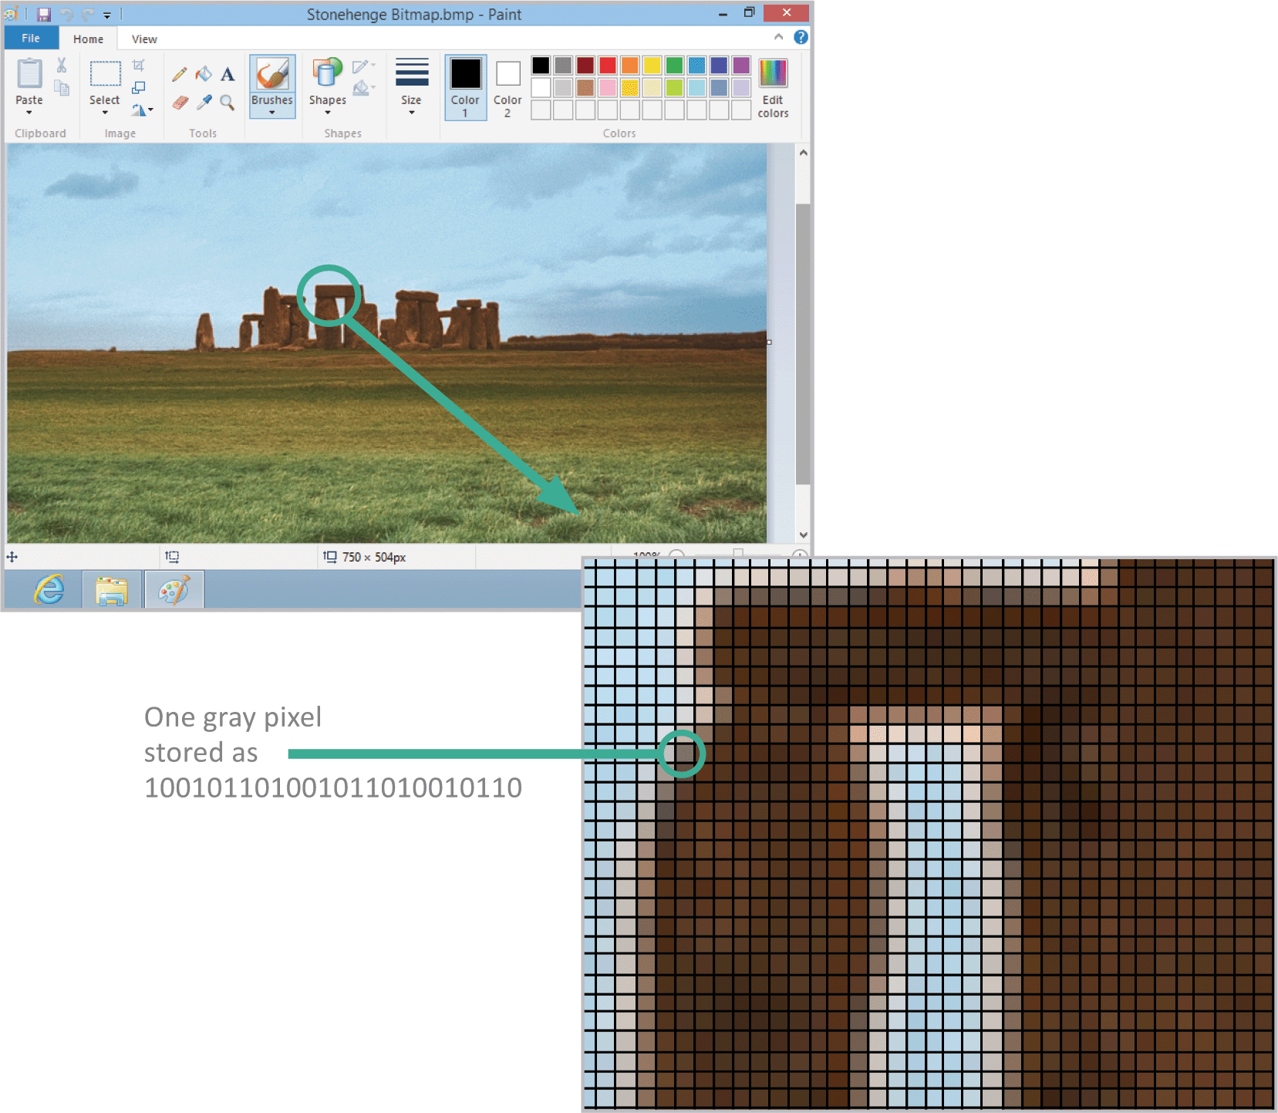
Bitmap Basics
Notes:
Figure 1-25

Slide 43
Bitmap Basics
You can create a bitmap graphic from scratch using the tools provided by graphics software – specifically a category of graphics software referred to as paint software
Examples of paint software are, Adobe photoshop, iPhoto, and Microsoft Paint
Notes:
Figure 1-26

Slide 44
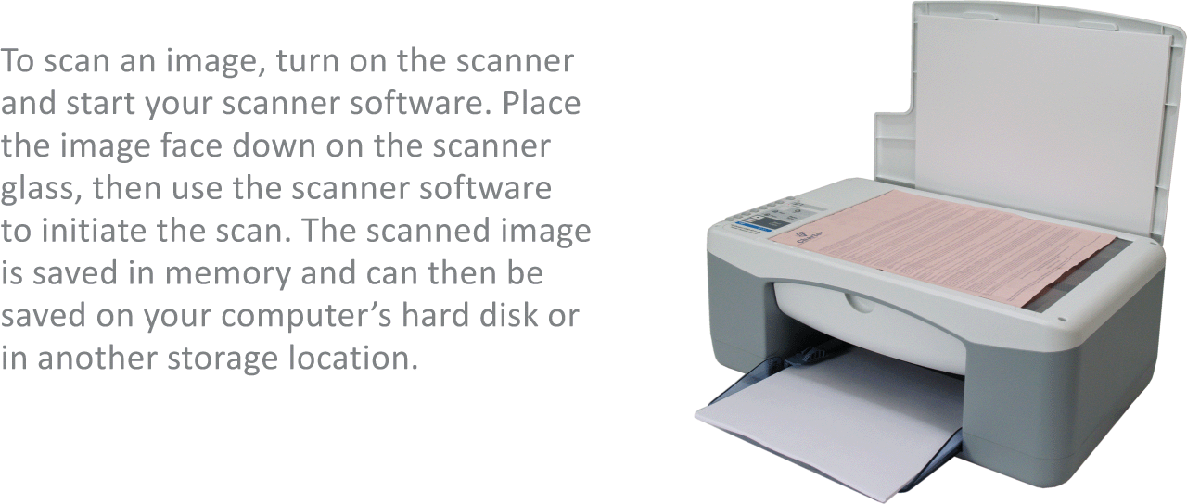
Bitmap Basics
You can use a scanner to convert a printed image into a bitmap graphic
A scanner divides an image into a fine grid of cells and assigns a digital value for the color of each cell
As a scan progresses the values are transferred to a digital device and stored as a bitmap graphics file
Notes:
Figure 1-29

Slide 45
Bitmap Basics
In a digital camera, the lens focuses light from the image onto a small image sensor called a CCD (charge-coupled device)
A CCD contains a grid of tiny light sensitive diodes called photosites
Photosites correspond to pixels; the more pixels used to capture an image, the higher its resolution
Cameras, scanners, and graphics software offer a choice of bitmap formats, such as BMP, RAW, TIFF, JPEG, GIF, and PNG
Notes:
Figure 1-30 – 1-31

Slide 46
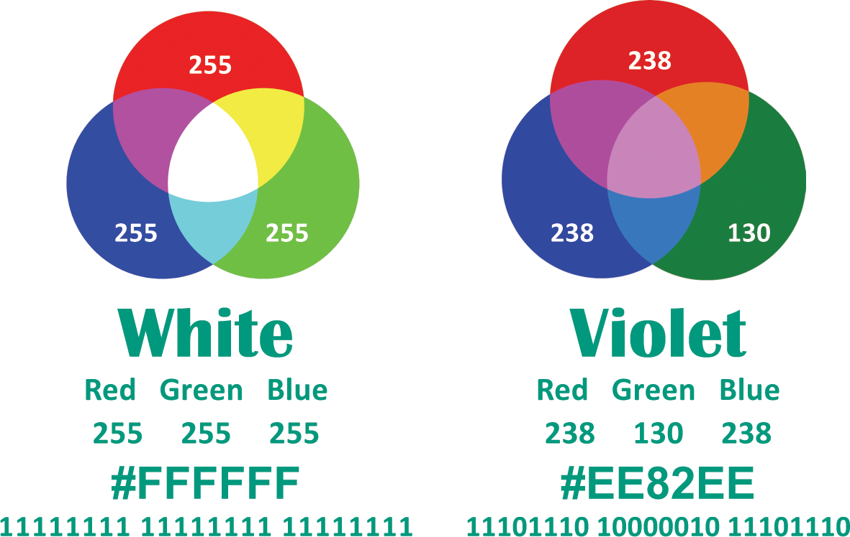
Bitmap Data Representation
Color and resolution are key elements in bitmap data representation
Today’s color display devices represent color using the RGB color model

Slide 47
Bitmap Data Representation
Color values can be specified in decimal (base 10), hexadecimal (base 16), or binary (base 2)
With eight bits used to represent each color value, one pixel requires 24 bits
The number of colors available in a graphic is referred to as color depth

Slide 48
Bitmap Resolution
The dimensions of the grid that forms a bitmap graphic are referred to as image resolution
High-resolution graphics contain more data than low-resolution graphics; more data makes it possible to display and print high-quality images that are sharper and clearer

Slide 49
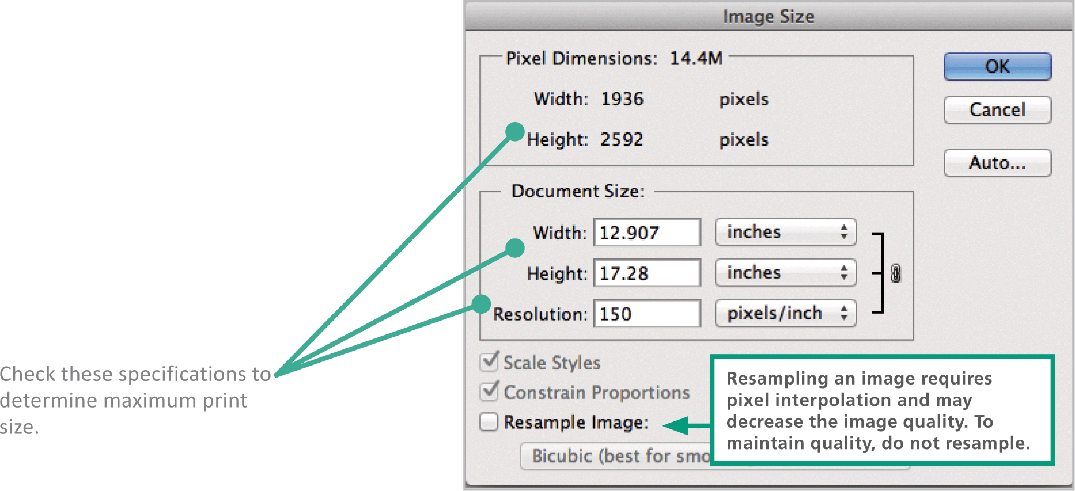
Bitmap Resolution
Graphics software, such as Adobe Photoshop, can help you gauge how large an image can be printed before the quality begins deteriorate

Slide 50
Image Compression
Image compression refers to any technique that recodes the data in an image file so that it contains fewer bits
Run-length encoding (RLE) is a type of lossless compression that replaces a series of similarly colored pixels with a binary code that indicates the number of pixels and their colors

Slide 51
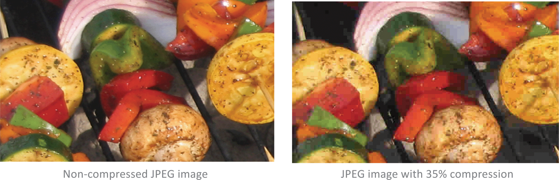
Image Compression
Lossy compression techniques discard some data from an image to shrink its file size
For many images, lossy compression results in only a minor reduction in the sharpness of the images

Slide 52
Modifying Bitmap Images
Photoshop software and a host of local and online apps make it easy to modify digital images
Photoediting software includes sophisticated tools based on graphics algorithms that produce amazing transformations of digital images

Slide 53
Modifying Bitmap Images
Characteristics of bitmap that can be modified:
  Noise reduction – “noise” refers to spots, dust, and scratches left on old photos after they are scanned
  Image enhancement – improves brightness, color saturation, and focus
  Selective color change – algorithms are used to colorize black and white photos
  Correcting image distortion – reconstructing perspective with photoediting
  Cloning – employs algorithms pulling pixels from one area and moving them to another
  Inpainting – reconstructing lost or unwanted areas in a photo
  Digital compositing – assembling more than one image into one by using clipping paths and alpha bending

Slide 54
Section D: Vector Graphics
Vector Graphics Basics
Vector Tools
3-D Graphics

Slide 55
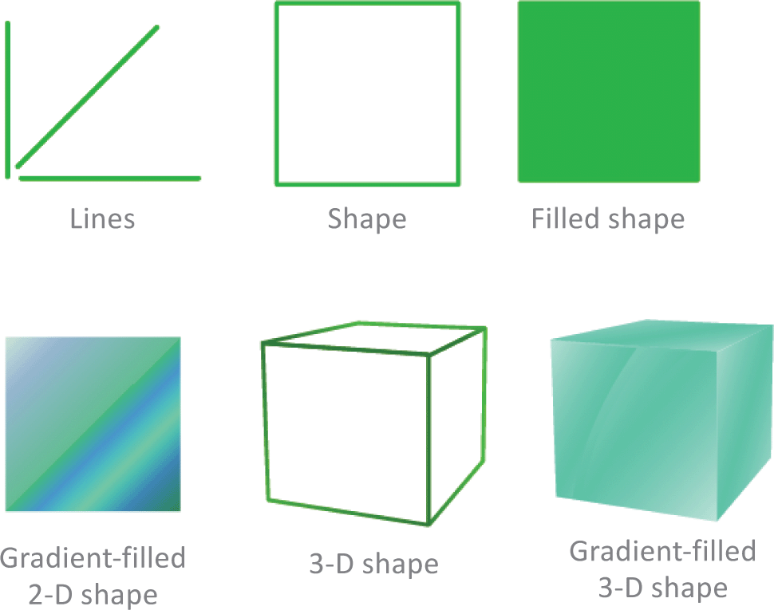
Vector Graphics Basics
The first graphics that appeared on computer screens were not photos, but simple shapes consisting of lines and curves, each referred to as a vector

Slide 56
Vector Graphics Basics
A vector graphic consists of a set of instructions for creating a picture
Vector graphics include standard shapes such as circles and rectangles

Slide 57
Vector Graphics Basics
Vector Graphics vs. Bitmap Graphics
  Resize better than bitmaps
  Require less storage space
  Not as realistic as bitmap images
  Editing an object is easier than in bitmap
Notes:
Figure 1-36

Slide 58
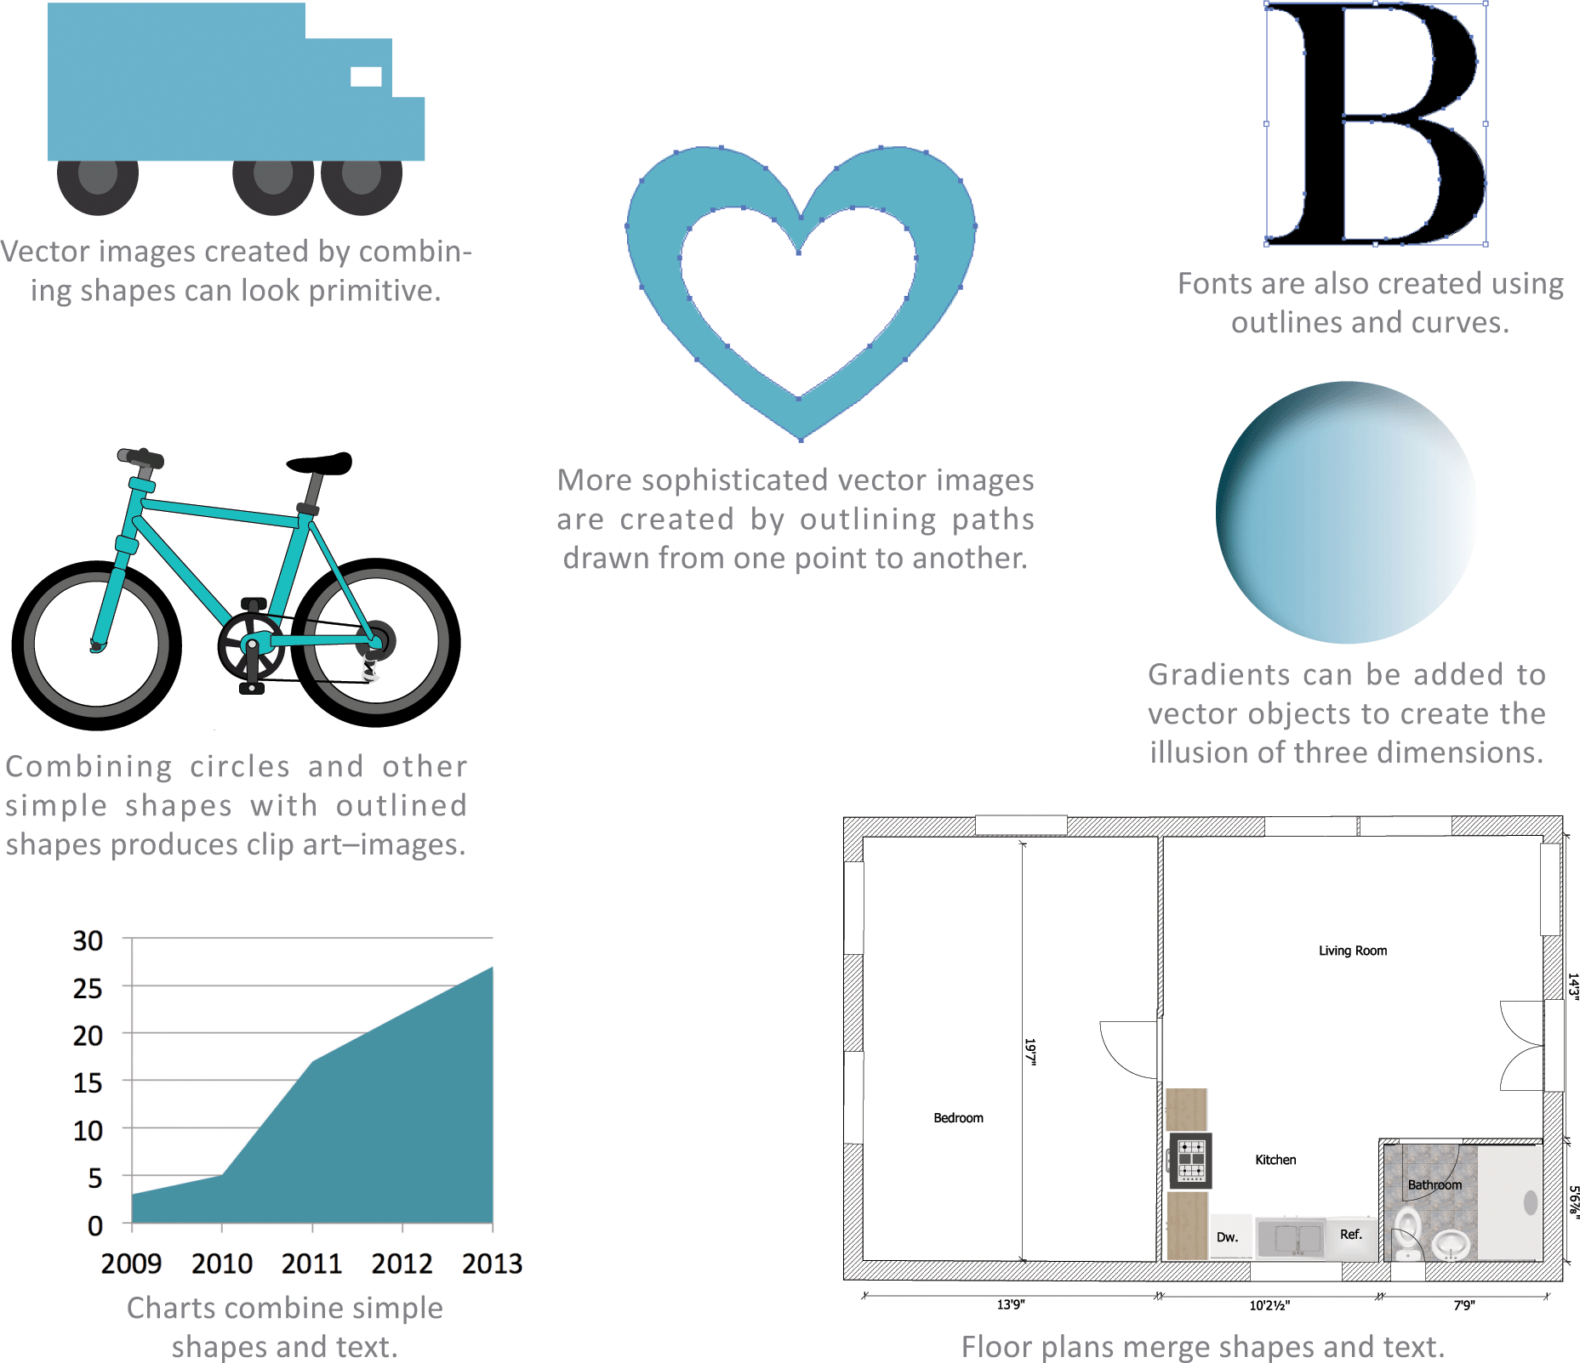
Vector Graphics Basics
Vector graphics are used for line art, logos, simple illustrations, infographic elements, and diagrams

Slide 59
Vector Tools
Vector graphics are created from scratch using drawing software such as:
  Adobe Illustrator
  LibreOffice Draw
  Open source Inkscape
  Various vector drawing apps
Notes:
Figure 1-39

Slide 60
3-D Graphics
3-D Graphics are based on vectors stored as a set of instructions describing the coordinates for lines and shapes in a three-dimensional space
Vectors form a wireframe that works like the framework for a tent
The process of covering the wireframe surface with color and texture is called rendering
The technique for adding light and shadows to a 3-D image is called ray tracing

Slide 61
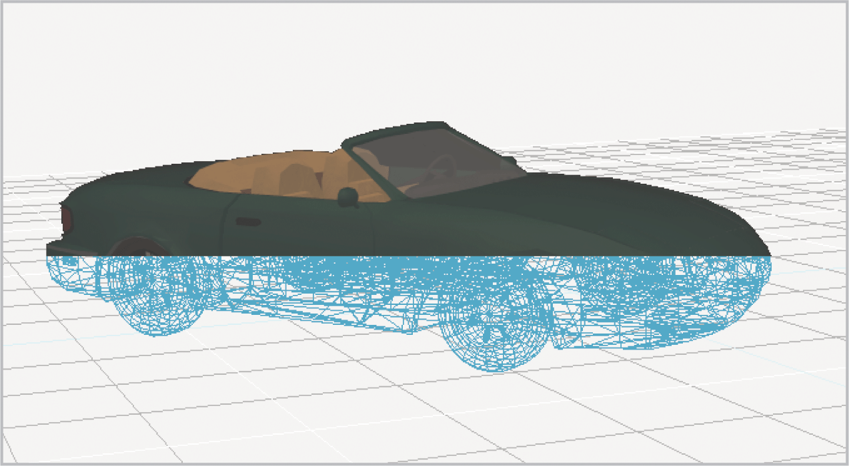
3-D Graphics

Slide 62
3-D Graphics
3-D graphics can be animated to produce special effects for movies or to create interactive, animated characters and environments for 3-D computer games
An enormous amount of processing power is needed to create 3-D computer animation
The classic computer game Doom presented in 24-bit color requires 34,560,000 bits for each frame of animation

Slide 63
Section E: Digital Video
Digital Video Basics
Video Compression
Video File Formats

Slide 64
Digital Video Basics
Digital video uses bits to store color and brightness data for each video frame, a process similar to storing the data for a series of bitmap images in which the color of each pixel is represented by a binary number
Footage from home movies, VHS tapes, and other older sources can be digitized using video capture equipment
You can shoot footage for digital video with:
  A consumer-quality camcorder
  A Webcam
  A Cell phone camera

Slide 65
Digital Video Basics
Digital cinematography is used in the motion picture industry; it captures moving images as bits, rather than on film
Digital video is a core technology for digital television, videoconferencing systems, and video messaging.
Notes:
Figure 1-41

Slide 66
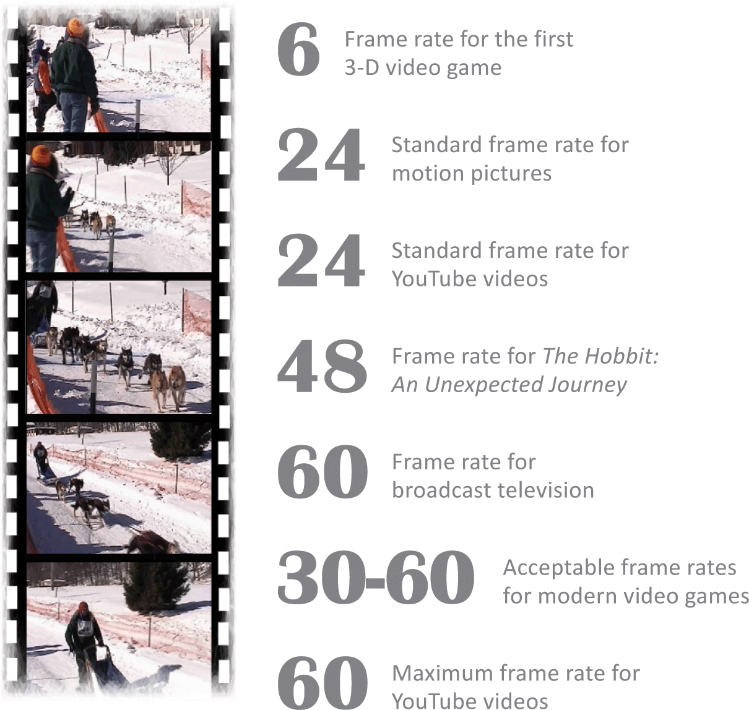
Digital Video Basics
Digital video displays bitmap images in rapid succession
Each bitmap image is referred to as a frame
The number of frames that are displayed per second is the frame rate (fps)

Slide 67
Digital Video Basics
Video resolutions can be expressed as width x height, as the horizontal resolution, or as the vertical resolution
Cameras used for digital cinematography capture video with a resolution of 2040 x 1536
This resolution is referred to as 2K because the horizontal resolution is about 2,000 pixels

Slide 68
Digital Video Basics
Vertical resolutions are expressed with a “p” for progressive scan, in which the frame is drawn line by line in sequence from top to bottom
An interlaced scan is a contrasting scanning technique that produces an image by drawing every other line, then going back and filling in the in-between lines
Digital video for computers typically uses progressive scanning; digital television uses interlaced scanning

Slide 69
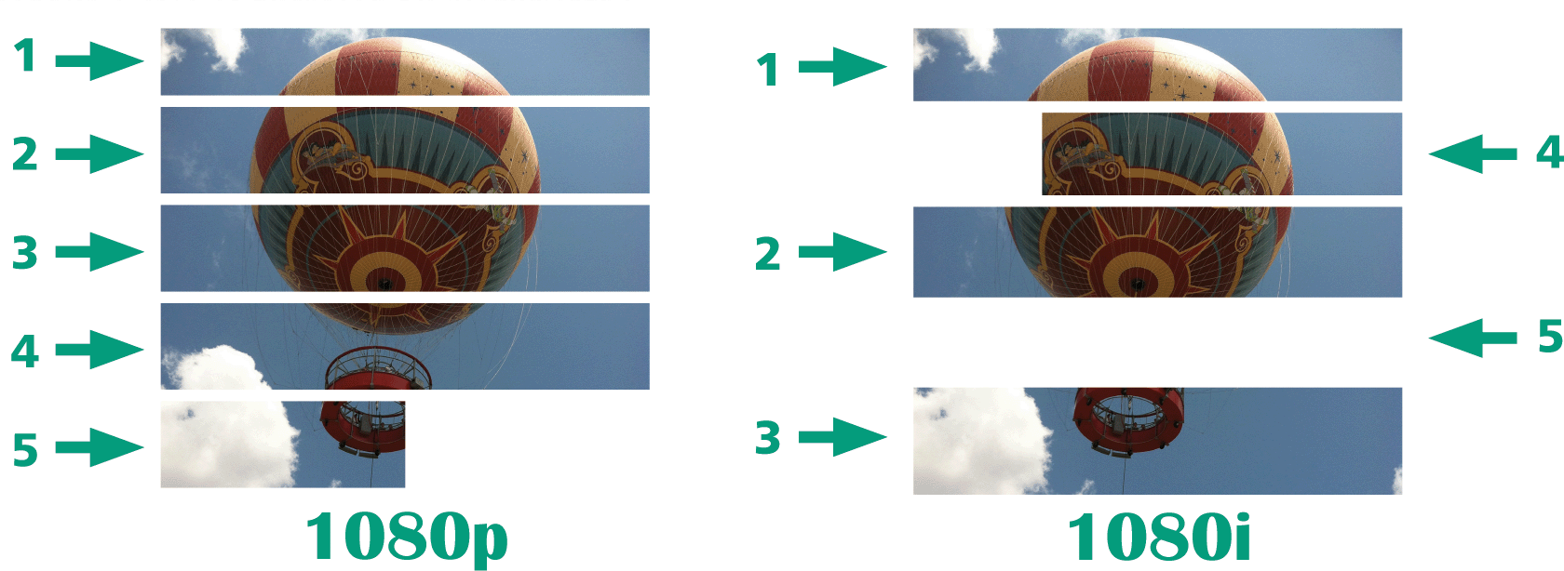
Digital Video Basics

Slide 70
Digital Video Basics
Aspect ratio is the proportional relation between the width and height of an image or video frame
  iPads use a 4:3 aspect ratio
  Widescreen devices, such as Laptops and Smartphones, use a 16:9 aspect ratio
Notes:
Figure 1-45

Slide 71
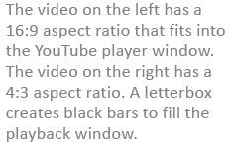
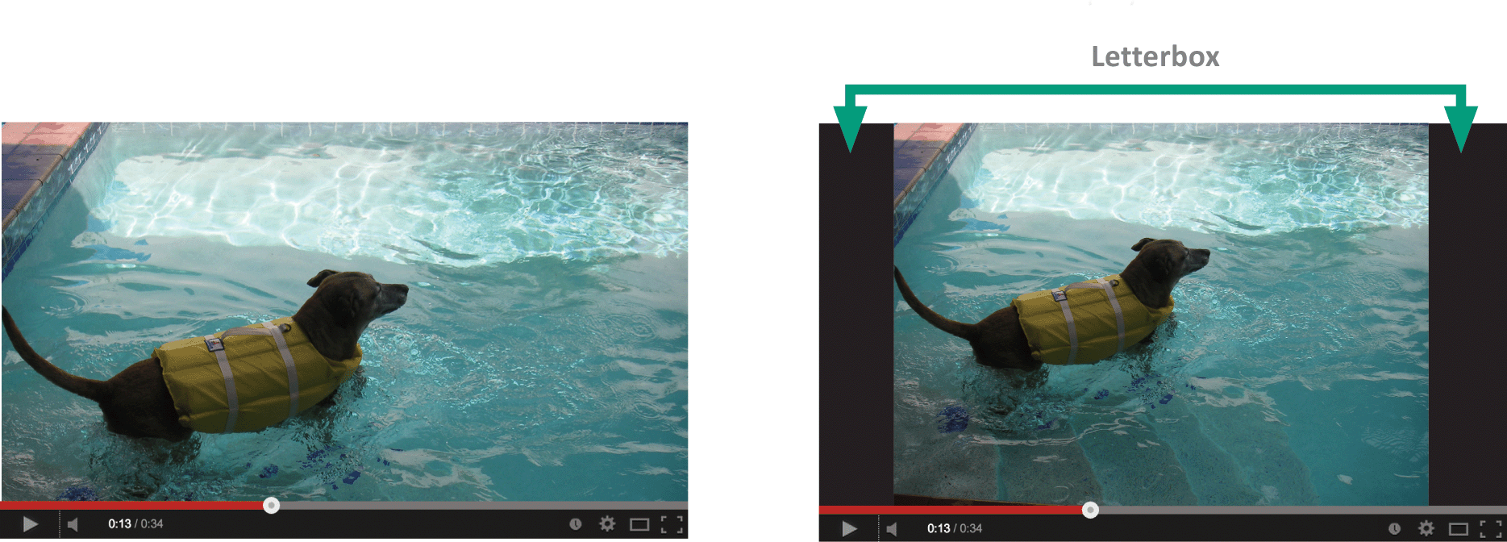
Digital Video Basics
When 4:3 videos are displayed on a widescreen player, they are bordered by the black bars of a letterbox

Slide 72
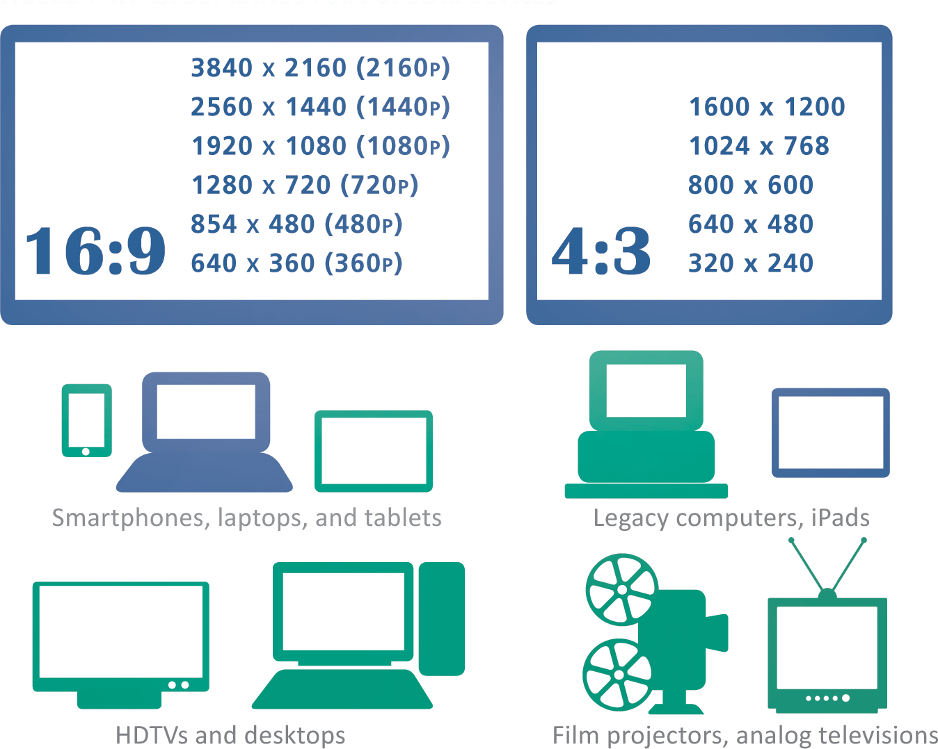
Digital Video Basics
Notes:
Figures 1-47 – 1-48

Slide 73
Digital Video Basics
1,194,393,600 bits are needed for one second of digital video
A feature-length video requires an astounding 8,599,633,920,000 bits! More than one trillion bytes!
A Bit rate is the number of bits that are processed during a specific unit of time, usually during one second
Bit rate can be expressed as bits per second (b/sec or bps) & kilobits per second (Kbit/s or Kbps)

Slide 74
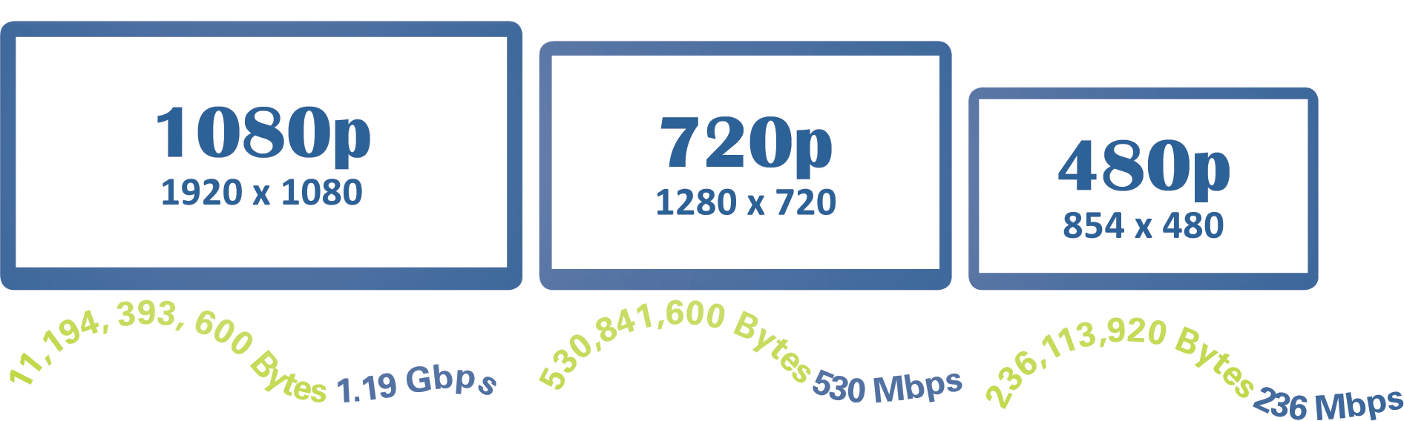
Video Compression
Choosing a lower resolution when saving a video reduces the bit rate

Slide 75
Video Compression
Compression removes some of the data (bits) through the following techniques:
Compressor/decompressor software
  Image compression – frames of a video are compressed using lossy and lossless compression
  Interframe compression – stores only the pixels that change color from one frame to the next

Slide 76
Video Compression
A codec (compressor/decompressor) is the software that compresses a video stream when a video is stored, and decompresses the file when the video is played
Each codec uses a unique algorithm to shrink the size of a video file, so they are not interchangeable
Popular codecs include: MPEG, VP8, DivX, H.264, Theora, and Windows Media Video

Slide 77
Video File Formats
Video files are stored in container formats that hold the compressed video stream and an audio stream
MP4 , AVI, MOV, MPEG, WebM, ASF, VOB, and Ogg Theora are popular container formats

Slide 78
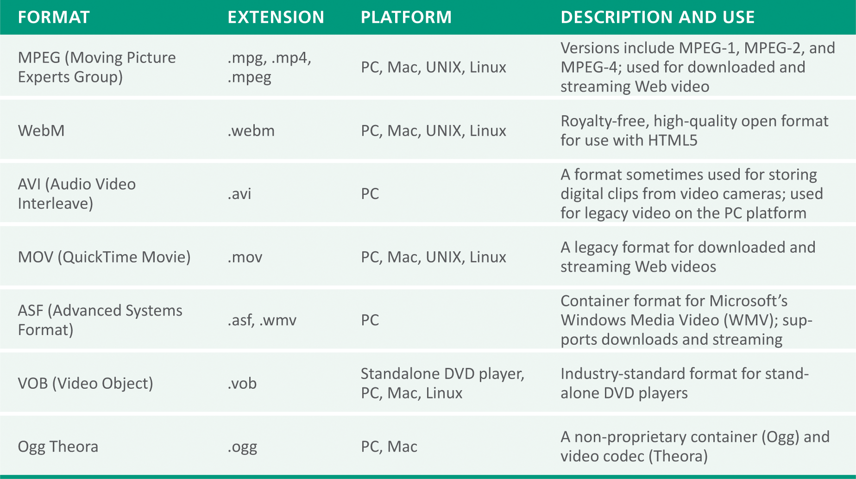
Video File Formats

Slide 79
Video File Formats
Browsers support several video formats and Web developers sometimes have to provide a video in multiple formats
Digital videos can be converted from one format to another through a process called transcoding
Basic video editing tools are used to arrange video clips, add a soundtrack, insert captions and choose output format

Slide 80
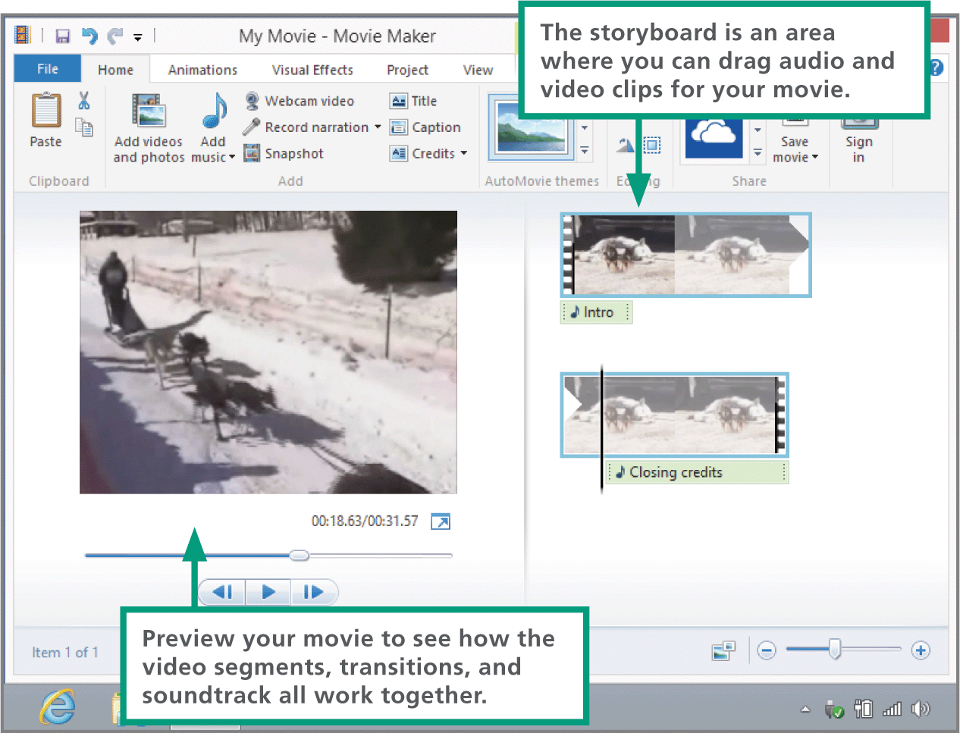
Video File Formats

Slide 81
Unit 1 Complete

