Slide 1
Unit E
Step-by-Step:
Programming with Python
ENHANCED EDITION

Slide 2
Unit Contents
Section A: “Hello World!”–Python Style
Section B: The Wacky Word Game
Section C: Build Your Own Calculator
Section D: Ask The Fortune Teller
Section E: Dogs and Cats

Slide 3
Section A: “Hello World!–Python Style
Programming Basics
Introduction to Python
Let’s Start Coding
Working with Strings
Using Python Keywords

Slide 4
Programming Basics
A computer program is a set of step-by-step instructions that tells the computer what to do.
Computer programming, otherwise known as programming, is the process of writing the instructions, referred to as code, that tell the computer what to do.
Instruction code for a computer program is based on an algorithm, which is a sequence of steps for solving a problem or performing a task.

Slide 5
Introduction to Python
Python is a programming language used to communicate with a computer.
Other types of programming languages include:
  C
  C++
  Java
  JavaScript

Slide 6
Introduction to Python
Python is excellent for beginners, yet outstanding for experts.
To work in Python you’ll need the following:
  A Code Editor – a place to enter source code for a program.
  A Debugger – a computer program used to find errors.
  An Interpreter – a program that translates code into machine language.
  A Compiler – a program that translates code to a machine language before sending it to the computer; these can be Web apps.

Slide 7
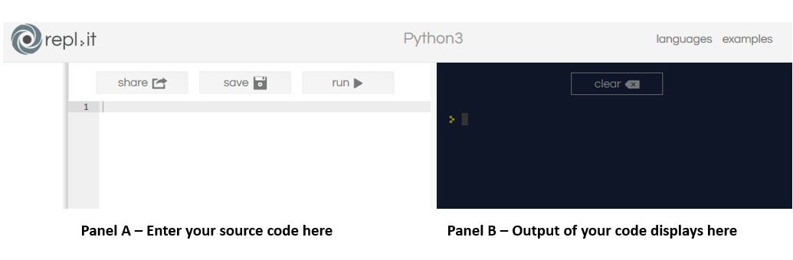
Introduction to Python
An IDE (integrated development environment) provides an editor, debugger, and interpreter.
The programs in Unit E use the online IDE repl.it.

Slide 8
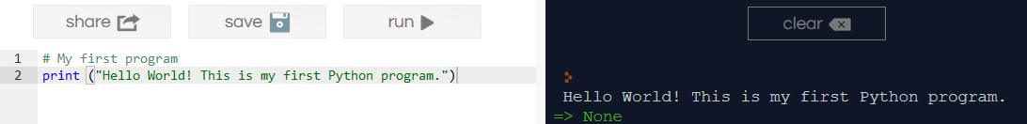
Let’s Start Coding
The most famous program in the world is a single line of code that prints “Hello World!” on the screen.
After entering and running the “Hello World!” program, your program and output should look like Figure E-2.

Slide 9
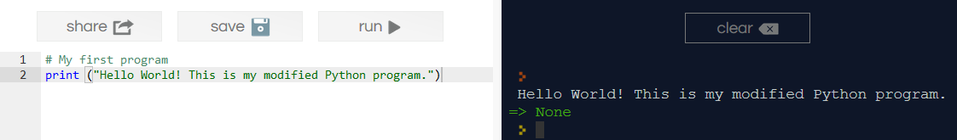
Let’s Start Coding
  You can modify your program using the code editor. Figure E-3 shows the modified “Hello World!” program.

Slide 10
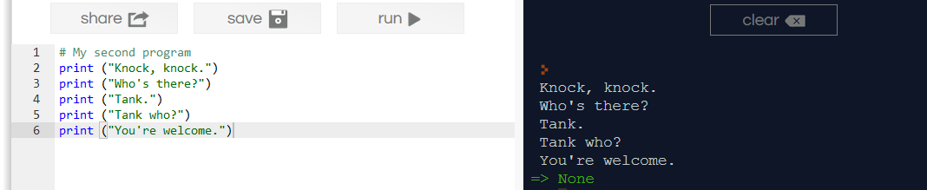
Let’s Start Coding
Most programs contain more than one line of code. The example below in Figure E-4, demonstrates how to write a multiline“Knock Knock” joke in Python.

Slide 11
Let’s Start Coding
The Python programming language has its own syntax, which is a set of rules that defines how it can be written.
A comment in Python is used by programmers to explain what the code does–it does not show up when the program runs.
An important rule to remember is that a comment must begin with the # character and end on the physical line on which the # character has been typed.

Slide 12

Working with Strings
When you write a sentence, you create a sequence of words that your reader will understand. Similarly, in programming you create a sequence of characters called a string, which can be made up of words, letters, punctuation marks, and numerals.
For example, in your first program, line 2 contains this string:

Slide 13
Working with Strings
The term concatenation is used by programmers any time two or more characters are connected.
Several strings can be connected using a symbol, such as the + symbol, as a concatenation operator. The example below uses the + symbol to concatenate two strings:

Slide 14
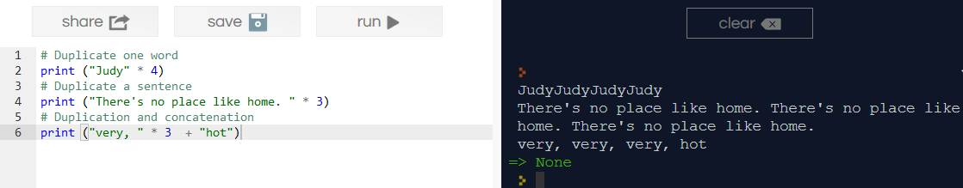
Working with Strings
Python gives programmers a shortcut for working with repeated strings. To print the same word more than once, just use the * symbol and the number of times you want it duplicated. Figure E-5 shows what your output should look like.

Slide 15
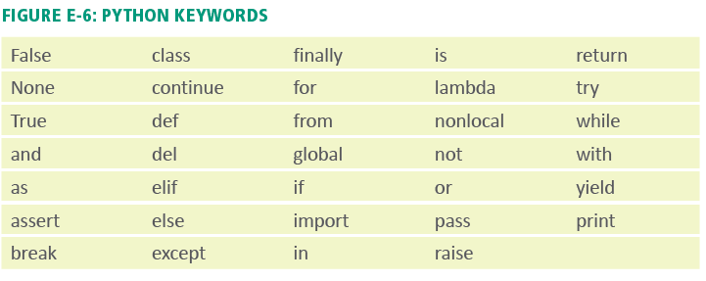
Using Python Keywords
All programming languages have their own vocabulary, which is based on a set of keywords. Python has a small vocabulary of only 33 keywords, of which only about 10 are frequently used.

Slide 16
Debugging
Programs must be tested to see if they work correctly. A programming error is called a bug.
The process for tracking down bugs and correcting them is called debugging.
Syntax errors and logic errors are the two most frequently encountered.

Slide 17
Debugging
A syntax error occurs when an instruction does not follow the rules of the programming language.
Some Python syntax rules are:
  Comments always start with a #.
  Python is case sensitive.
  Strings are delineated by quotation marks.
  Keywords can only be used for their intended purpose.

Slide 18
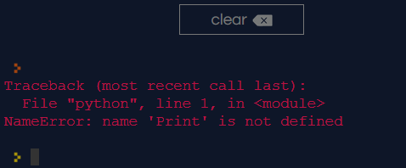
Debugging
If you receive an error message you can check the line of code where the error resides.
Figure E-7 shows an error message generated in Python. Read the message carefully to identify your error.

Slide 19
Section B: The Wacky Word Game
Using Variables
Objects and Classes
Input
Wacky Word Game
Sharing Your Programs

Slide 20
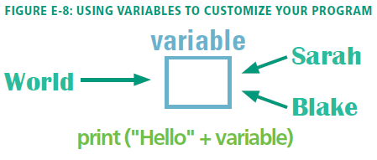
Using Variables
Technically, a variable is a named memory location that holds data specified by a programmer or entered by an end user.
Programmers think of variables as empty boxes where data can be temporarily stored and used by a computer program.

Slide 21
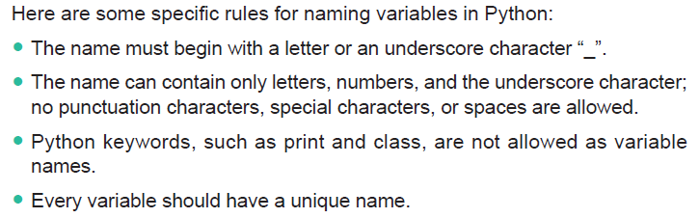
Using Variables
A variable name should describe the information the variable is designed to store. For example, a good name for a variable that will contain a first name might be “firstname” or “first_name.”

Slide 22
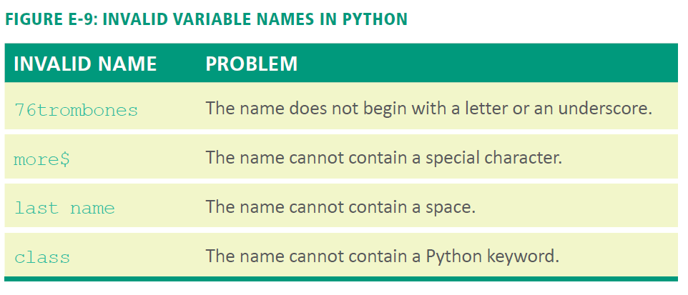
Using Variables

Slide 23
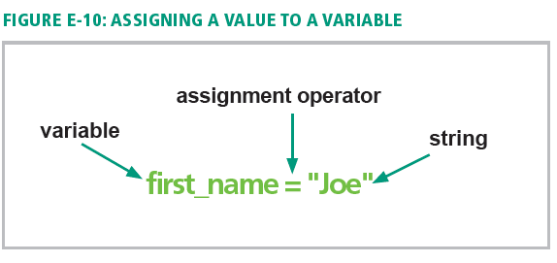
Using Variables
The process of creating a variable is sometimes referred to as declaring a variable.
Putting data in a variable is referred to as assigning a value to it.

Slide 24
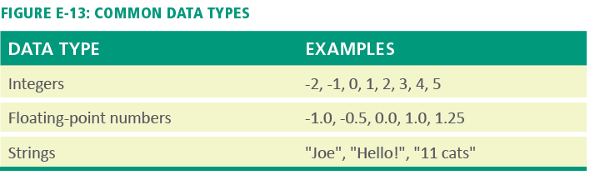
Using Variables
The type of data that a variable can hold is referred to as its data type.

Slide 25
Objects and Classes
Python is an object-oriented programming language, which is a language that enables the programmer to use objects to accomplish a program’s goals.
The object-oriented paradigm is based on objects and classes that can be defined and manipulated by program code.
Object-oriented programming (OOP) is a style of programming that focuses on using objects to design and build applications.

Slide 26
Objects and Classes
An object is anything that can be seen, touched, or used; it can be a person, a place, or a thing.
Every object in an OOP is crated from a class, which is a description or template that the computer uses to create the object.
A class attribute defines the characteristics of a set of objects.
An object created from a class is called an instance of a class and is said to be instantiated (created) from the class.

Slide 27
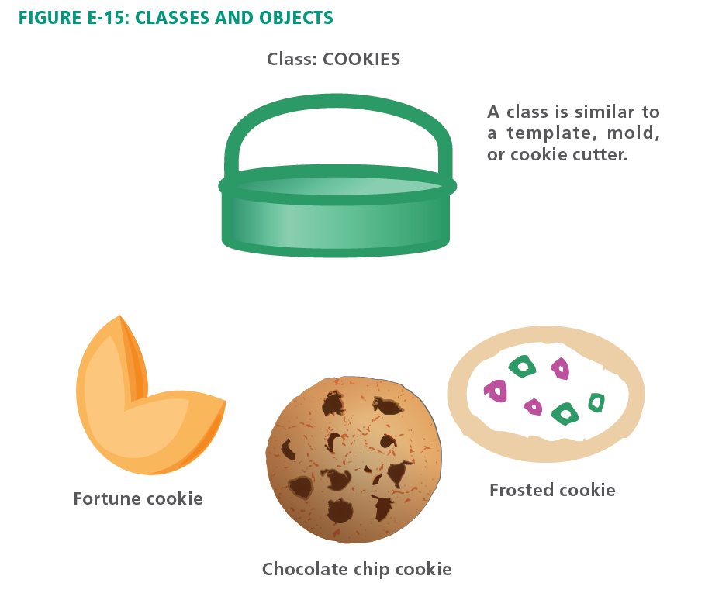
Objects and Classes

Slide 28
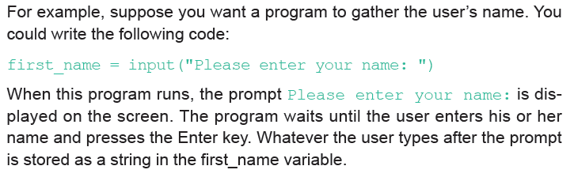
Input
Python uses the input command to get user input.
The input command allows the program to display a message on the screen that asks a user to enter information; this message is called a prompt.
For example, suppose you want a program to gather a user’s name. You could write the following code:

Slide 29
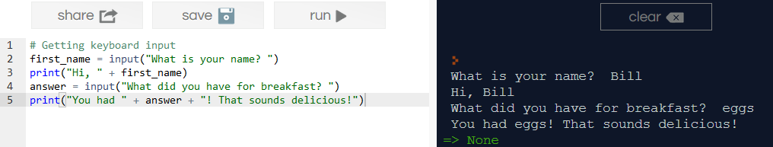
Input
Writing prompts using the input command is a great way to relay instructions to your program’s user. Figure E-17 demonstrates how to use the input command in your code.

Slide 30
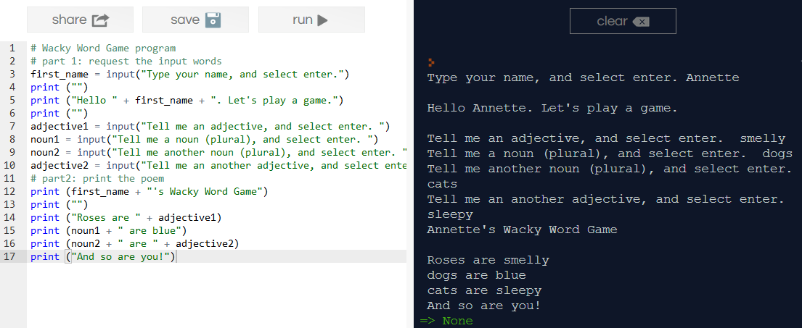
Wacky Word Game
The Wacky Word Game uses variables, strings, and input. This program produces a game that prompts a player for a list of words and then asks the player to use them in a story or a poem. The output generates a nonsensical or comical story.

Slide 31
Sharing Your Programs
You may want to share your program code with your friends, instructors, etc.
To do so, you can use repl.it’s Share option.
You can also make a screenshot of the program and share it as a file.

Slide 32
Section C: Build Your Own Calculator
Calculations
Selection Structures
Comparison and Logical Operators
Comparing Strings

Slide 33
Calculations
When a computer calculates an arithmetic operation it is called computation.
To instruct the computer to perform a calculation, programmers use an arithmetic expression, which contains values (such as 2 and 3) and arithmetic operators (such as + and -).
Figure E-19, on the next slide, illustrates a simple arithmetic expression and the symbols Python uses for arithmetic operators.

Slide 34
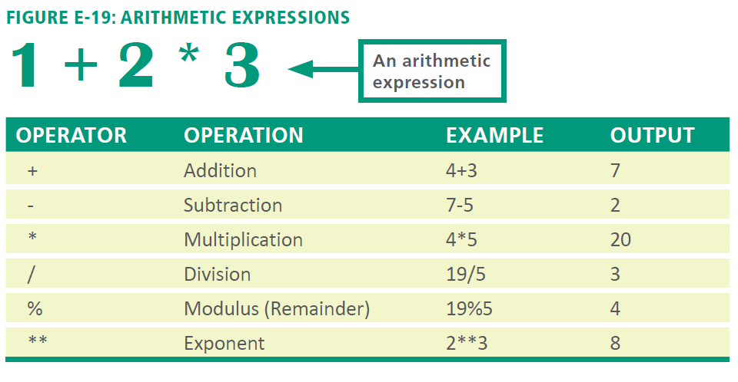
Calculations

Slide 35
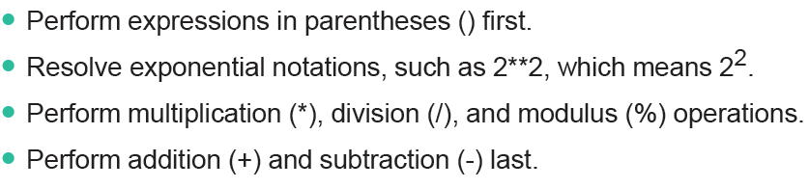
Calculations
The result of an arithmetic expression depends on the order in which Python performs the math.
In mathematics, the order of operations is a collection of rules that dictate which procedures to perform first when calculating an arithmetic expression.
In Python, the order of operations follows these rules:

Slide 36
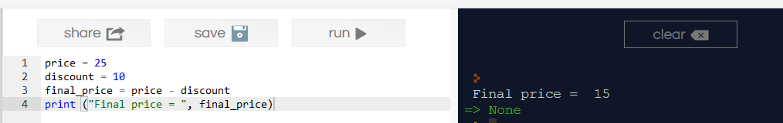
Calculations
Programmers frequently set up calculations by loading values into variables and then writing formulas using variables instead of numbers.
This technique makes it easy to modify the numbers used in a calculation or get the numbers as input when a program runs.
Figure E-20 shows a program with the variables “price” and “discount.”

Slide 37
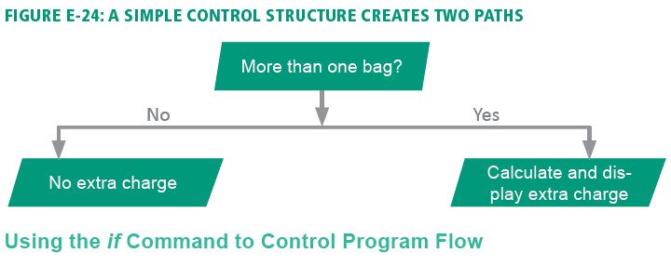
Selection Structures
A selection control structure tells a computer what to do based on whether a condition is true or false.
You can think of a selection control as one or more paths in a program.
Figure E-24 illustrates a simple branch using a checked bags example.

Slide 38
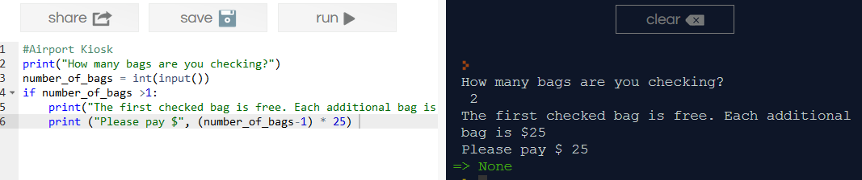
Selection Structures
An example of a selection control structure is the if command.
Figure E-25 illustrates how an if statement works in a program using the airport kiosk checked bag example from Figure E-24.

Slide 39
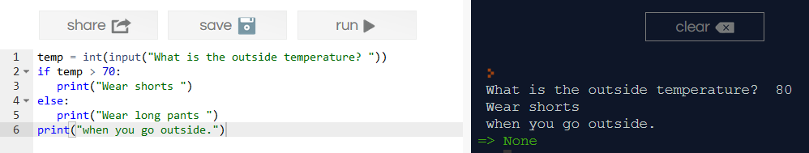
Selection Structures
Frequently, programmers want one thing to happen when a condition is true and something else to happen when it is false.
To accomplish this, they use the if…else statement.
Figure E-26 illustrates how to program an if…else statement about weather conditions and clothing.

Slide 40
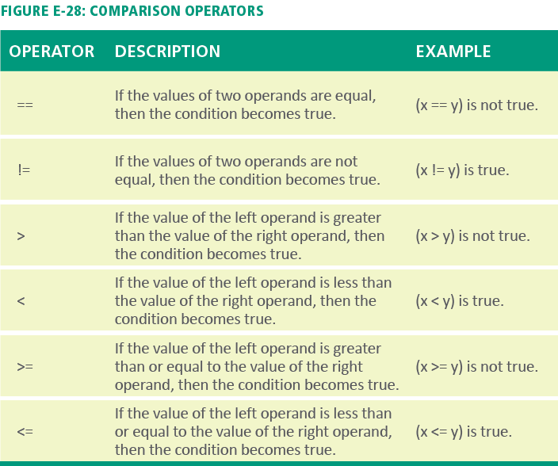
Comparison and Logical Operators
A comparison operator is used in an expression to compare two values.
The most commonly used comparison operators are >, < and ==.

Slide 41
Comparison and Logical Operators
The == operator is the equality operator; it is used for comparisons.
The = symbol is the assignment operator; it is used to store values and strings in variables.
Two rules come in handy when using comparison operators:
  First rule: If an expression contains more than one comparison operator, the operators are evaluated from left to right in the expression.
  Second rule: Comparison operators are evaluated after any arithmetic operators in an expression. For example, in 3 + 6 < 16 / 2, the two arithmetic operators will be evaluated first, and then the two resulting numbers will be compared.

Slide 42
Comparison and Logical Operators
If…else statements can also contain logical operators.
Python has three logical operators: AND, OR, and NOT.
Python evaluates logical expressions as true or false, so they can be the basis for control structures that use if statements.

Slide 43
Comparing Strings
When a program collects string input, such as a user’s name, it can be used in expressions that become part of control structures.
For example, a program might ask users if they know how to swim in order to enroll them in the appropriate swim class.
Strings in Python are case sensitive, which means the string “Yes” is not the same as either the string “YES” or the string “yes”.
To avoid problems with case, you can use the upper() and lower() methods to convert string input to a known case.

Slide 44
Section D: Ask The Fortune Teller
Repetition Control Structures
Lists

Slide 45
Repetition Control Structures
A repetition control structure allows programmers to write code that can repeatedly execute a statement or a series of statements.
The section of code that repeats is referred to as a loop or an iteration.
Python has two types of loops: the for-loop and the while-loop.
For-loops make it easy to specify the number of repetitions in a loop.

Slide 46
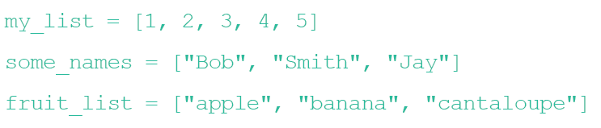
Lists
A list in Python is an ordered group of items that can be numbers or strings that are modifiable.
The following are some examples of lists:

Slide 47
Lists
Lists are tools that programmers use to make certain programming tasks straightforward when combined with repetition.
Lists can be used for mathematical operations, such as totaling the items in a list and placing the result in an accumulator.
An accumulator is a numeric variable in which values are repetitively added.

Slide 48
Section E: Dogs and Cats
Functions
Methods

Slide 49
Functions
In this Unit, you have used several of Python’s built-in functions, such as print(), input(), and str().
A programmer-defined function is typically a block of code that is part of a program but is not included in the main execution path.
Figure E-42, on the next slide, illustrates how a programmer would visualize the structure of a program containing the treasure_chest() function.

Slide 50
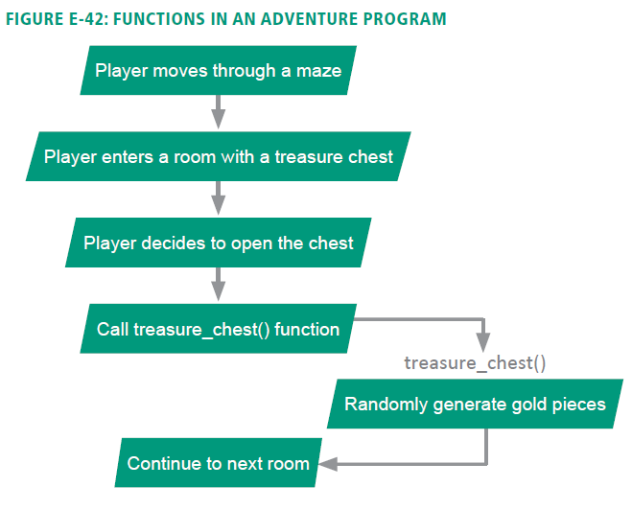
Functions

Slide 51
Functions
When using functions, keep the following in mind:
  Function blocks begin with the keyword def followed by the function name and parentheses ().
  The parentheses can hold parameters. Make sure that the function call and the function definition have the same number of parameters.
  The code block within every function starts with a colon (:) and is indented.
  The function terminates with the last indented line of code.
  The return statement passes data from the function to the main program.

Slide 52
Methods
A method is a segment of code that defines an action belonging to a class.
In Python, methods are essentially functions, but they are defined slightly differently; a method must always have an argument called self within the parentheses.
When Python calls a method, it passes the current object to that method as the first parameter.
Figure E-48, on the next slide, illustrates how this works.

Slide 53
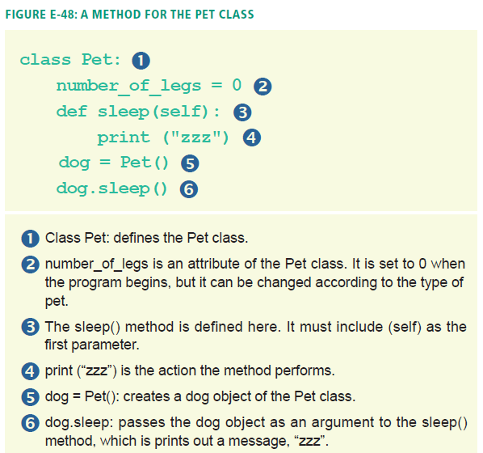
Methods

Slide 54
Methods
In object-oriented jargon, inheritance refers to passing certain characteristics from one class to other classes.
A superclass is the class from where attributes and methods can be in inherited.
A subclass inherits attributes and methods from a superclass.
Polymorphism, sometimes called overloading, is the ability to redefine a method in a subclass. It enables programmers to create a single, more generic name for a method that behaves in unique ways for different classes.

Slide 55
Unit E Complete
ENHANCED EDITION

